Slide 1
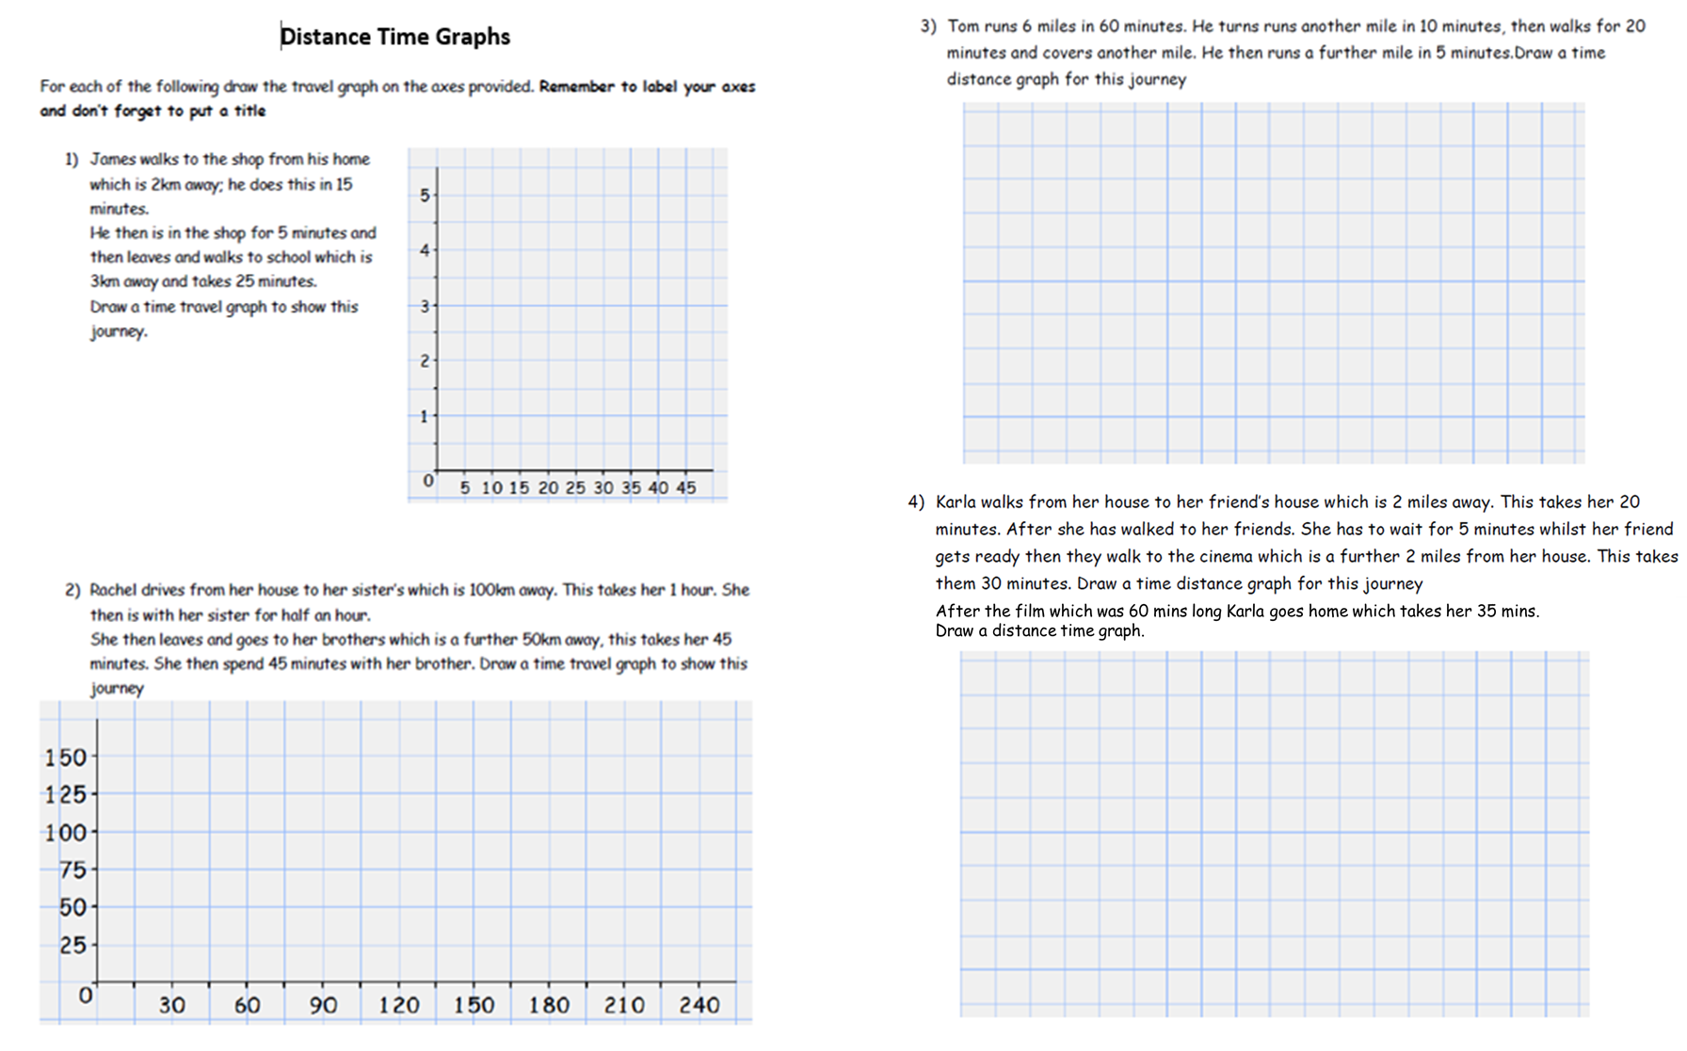

Slide 2
ANSWERS

Slide 3
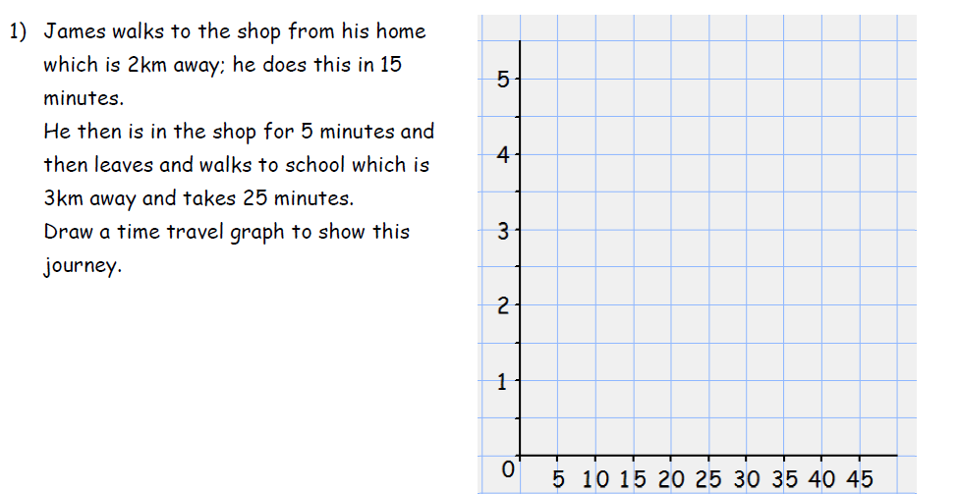
(45, 5)
(15, 2)
(20, 2)

Slide 4
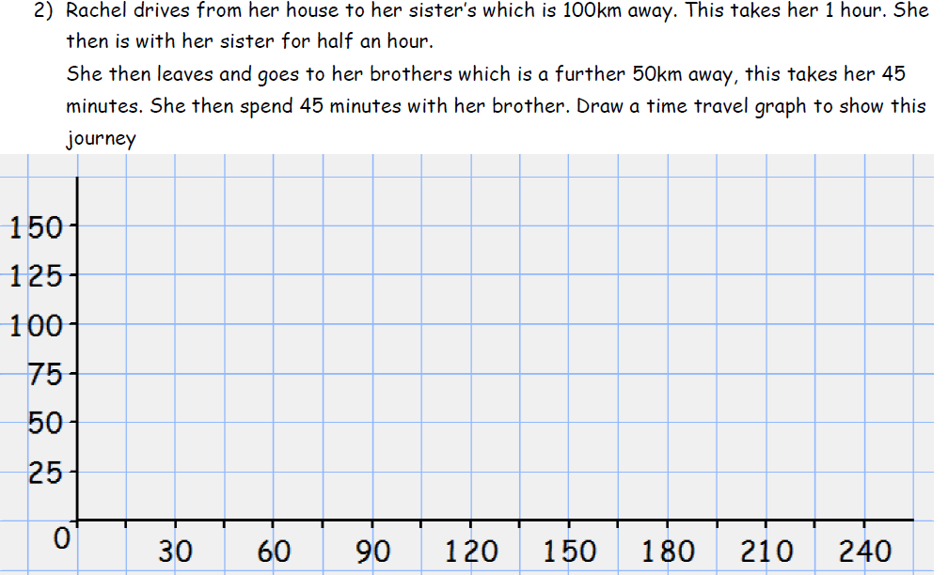
(150, 135)
(180, 150)
(60, 100)
(90, 100)

Slide 5
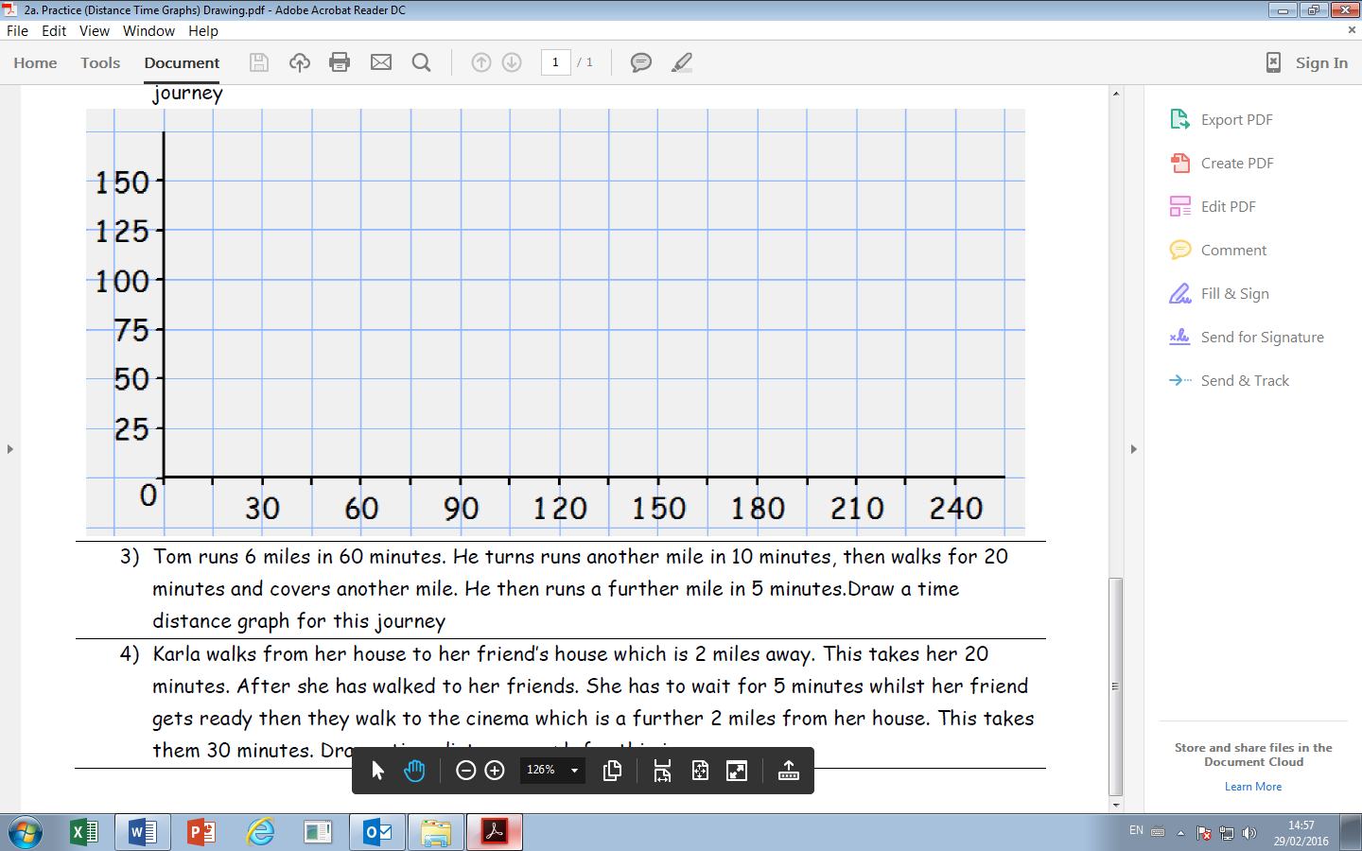
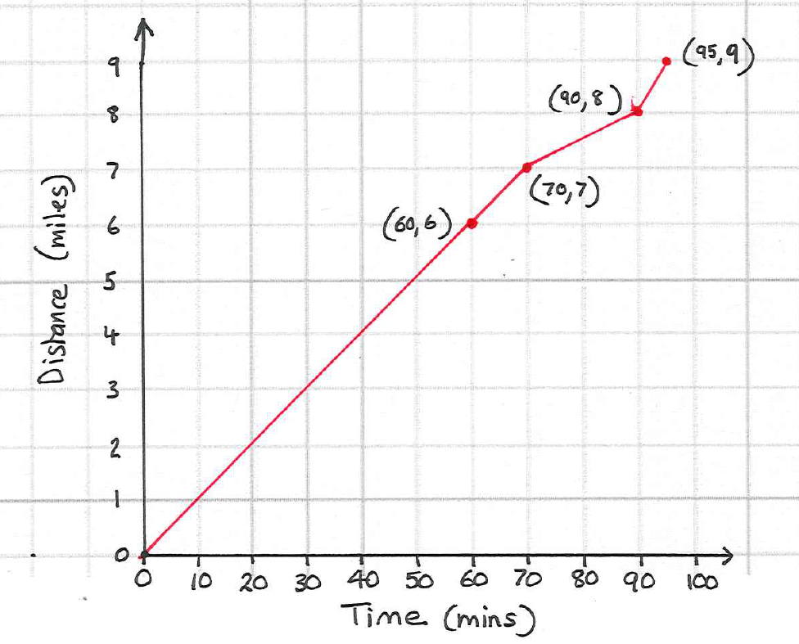

Slide 6
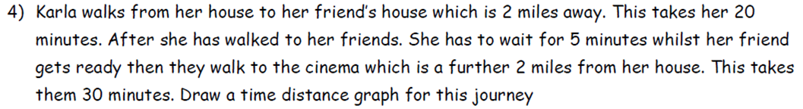
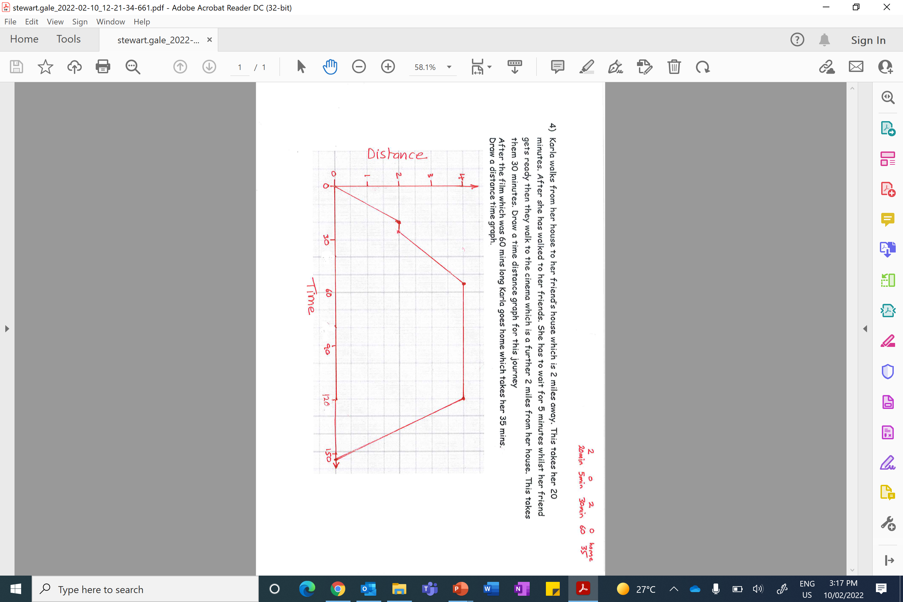
After the film which was 60 mins long Karla goes home which takes her 35 mins.
Draw a distance time graph.

