Slide 1
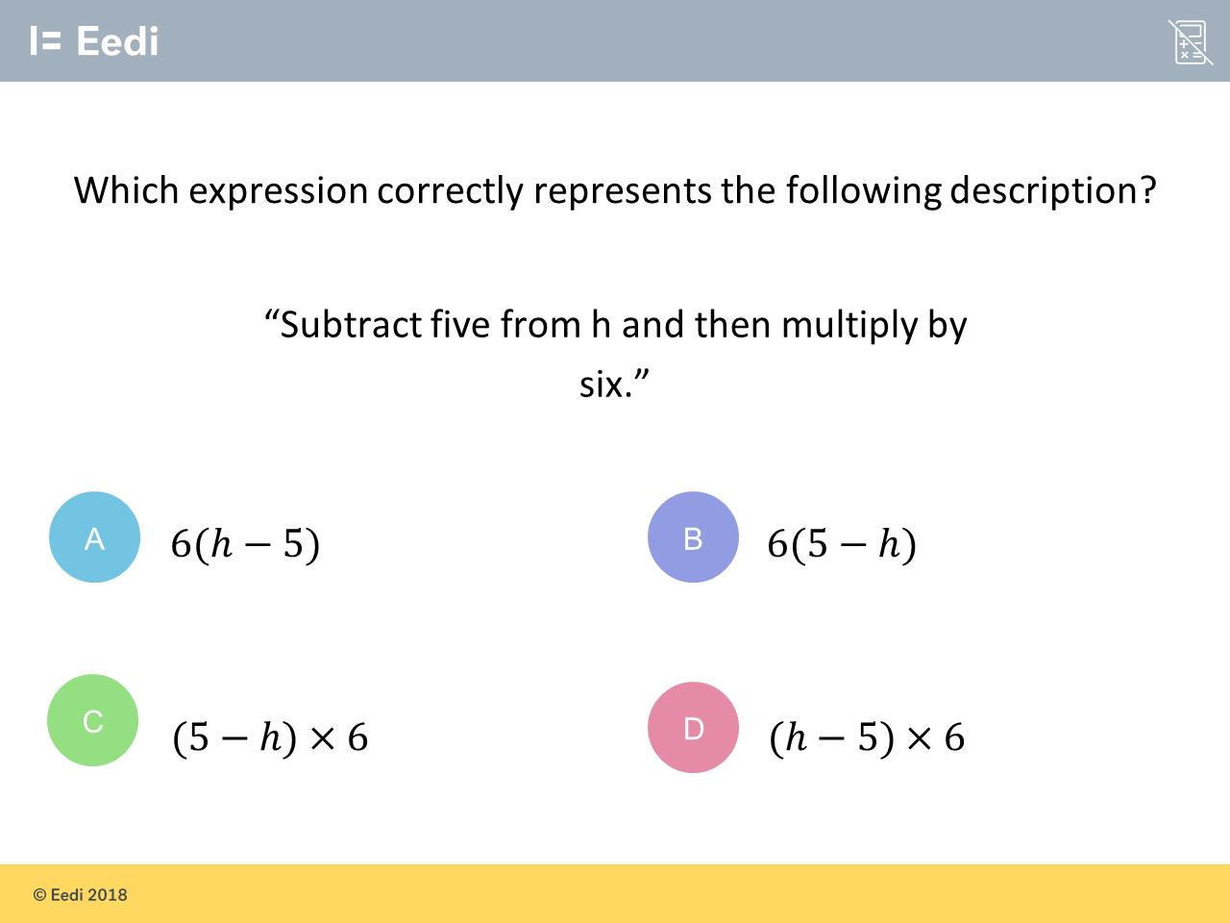
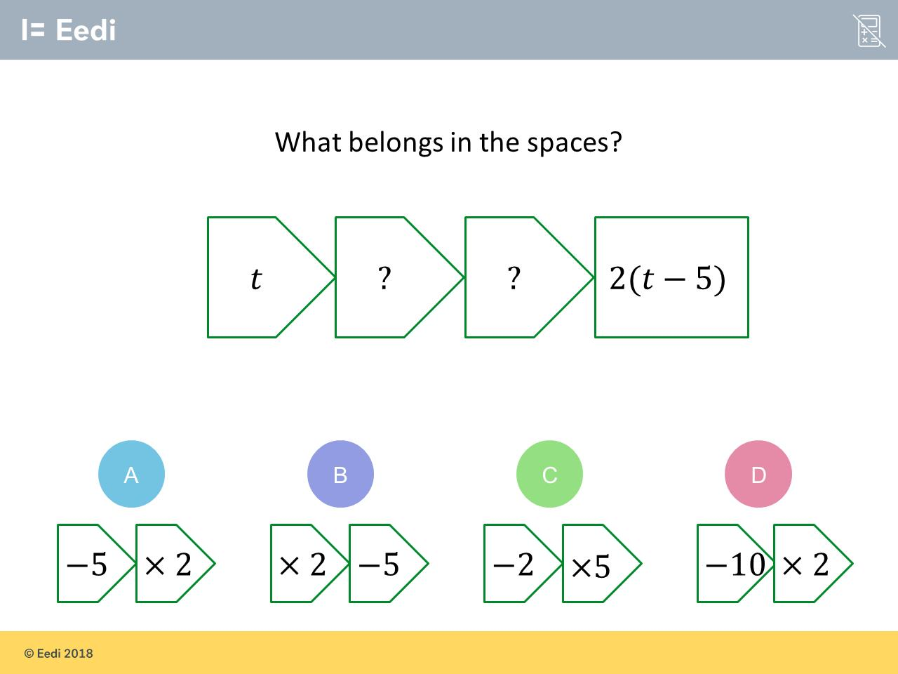
Worst answered question?
Most common wrong answer?

Slide 2
ANSWERS

Slide 3
Worst answered question?

Slide 4
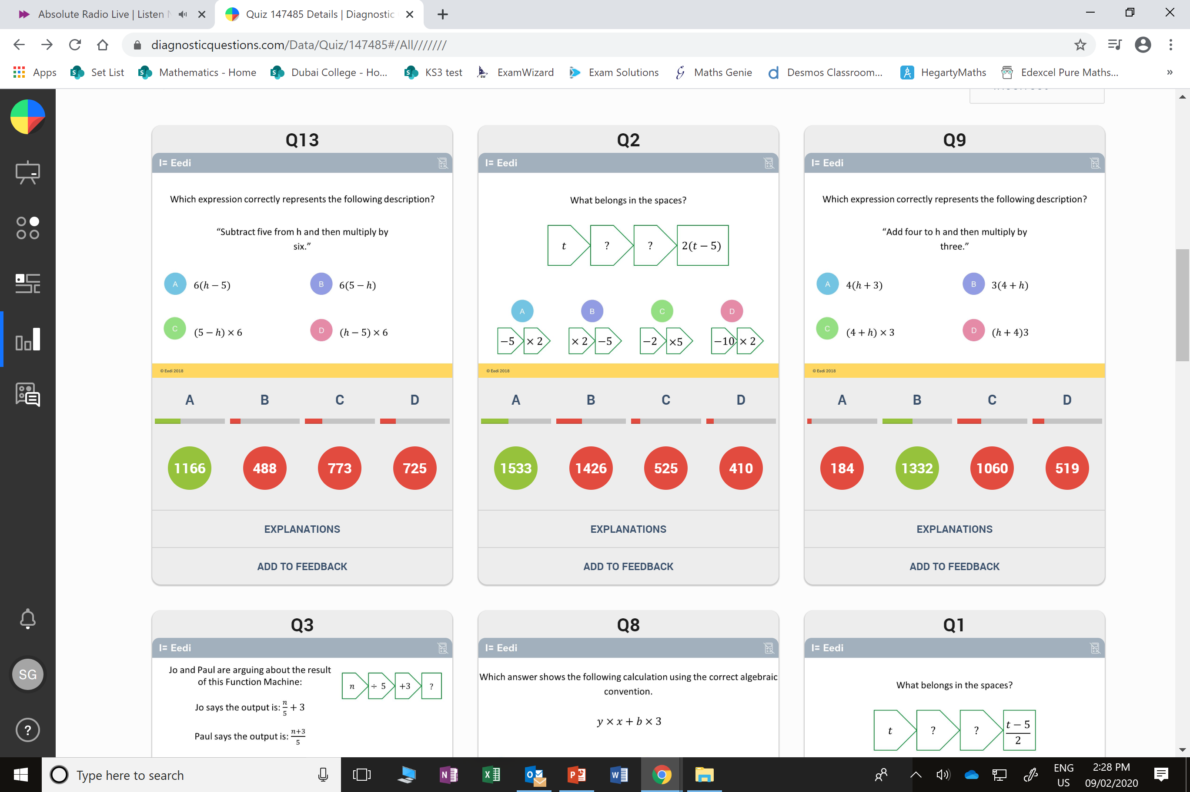
C
They did
5 subtract h.

Slide 5
B
They did
2t - 5

