Slide 1
Exponentials and Logs
Natural Logs
Chapter 14
(Part 6 of 9)

Slide 2


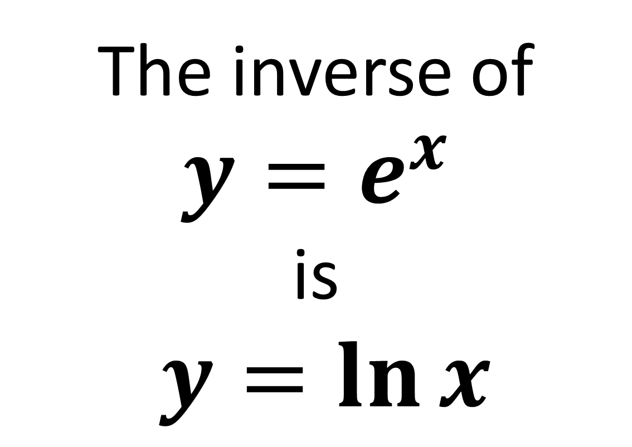
Natural Logarithms
The inverse of
$y=e^{x}$
is
$y=\ln{x}$
$ln$ of $x$

Slide 3
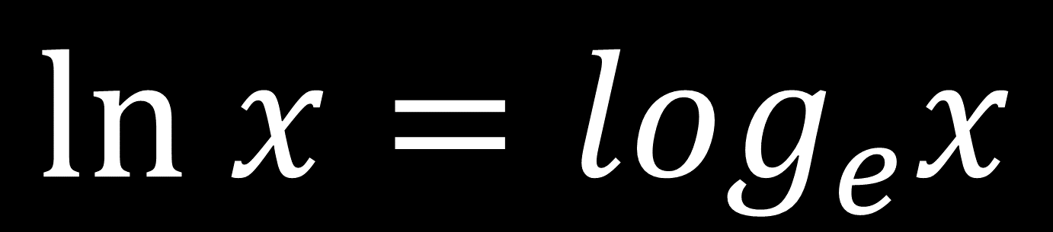
𝑙𝑛 is the “natural log of 𝒙” meaning “log to the base 𝑒”
$$ln x=\log_{e}x$$

Slide 4
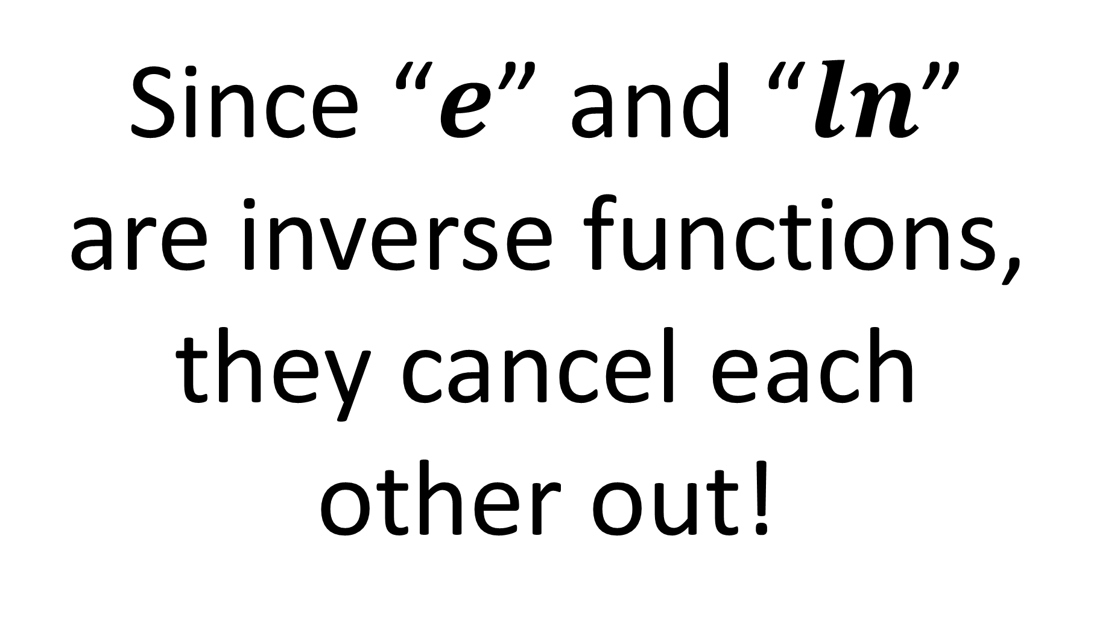
Since “$e$” and “$ln$”
are inverse functions,
they cancel each
other out!

Slide 5
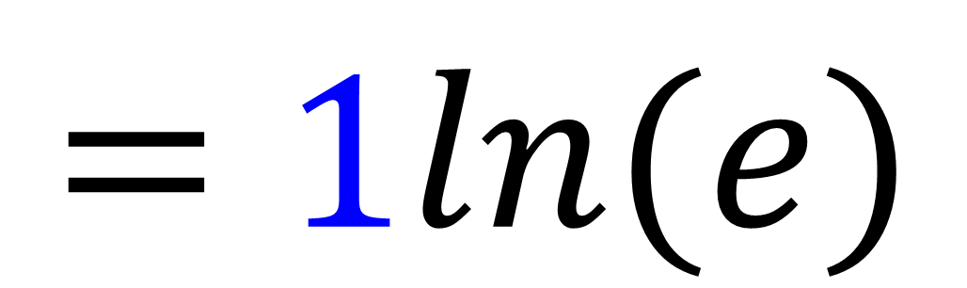

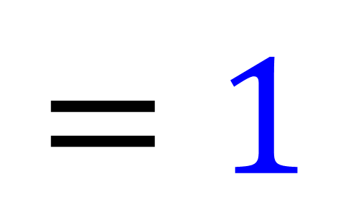
$$ln⁡(e^{1})$$
$$=1ln⁡(e)$$
$$=1$$

Slide 6
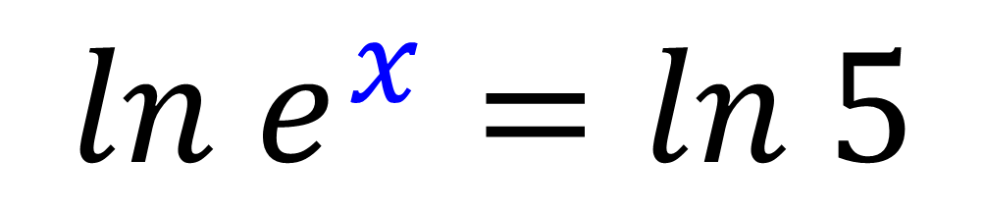
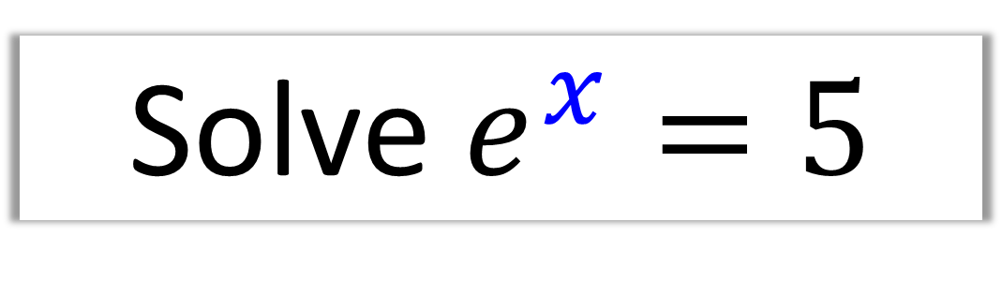
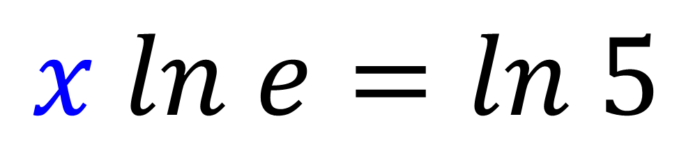
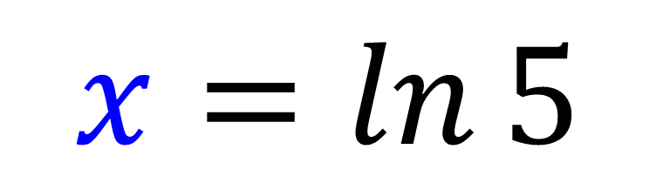
Solve $e^{x}=5$
$ln$ $e^{x}=ln 5$
$x ln$ $e=ln 5$
$$x=\ln{5}$$

Slide 7
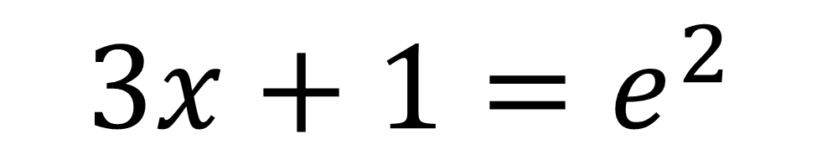
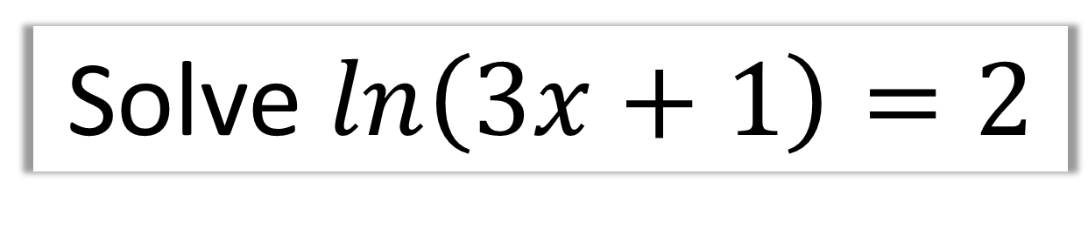
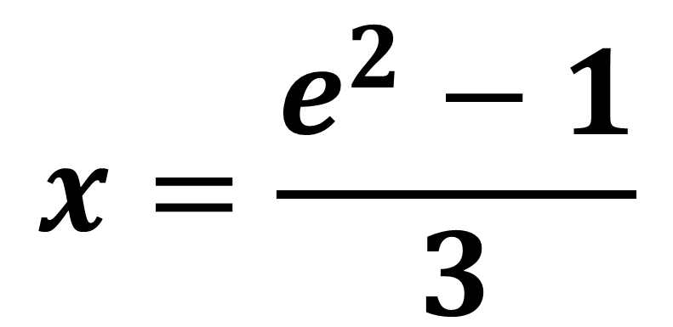
Solve $\ln\left(3x+1\right)=2$
$$3x+1=e^{2}$$
$$x=\frac{e^{2}−1}{3}$$

Slide 8
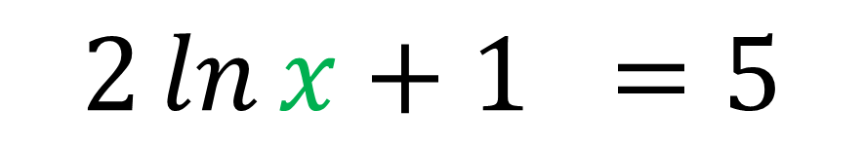
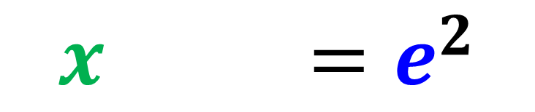
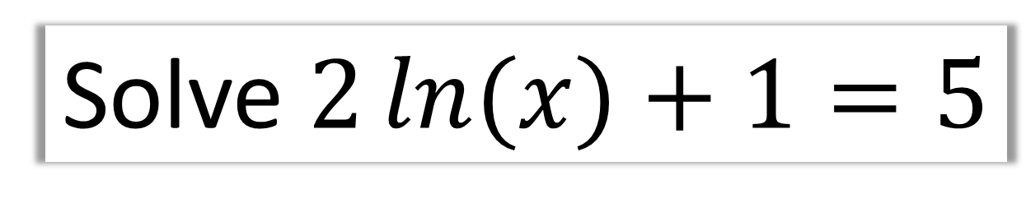
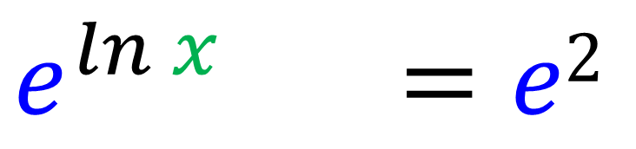
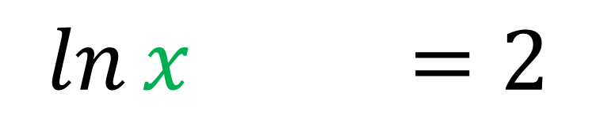
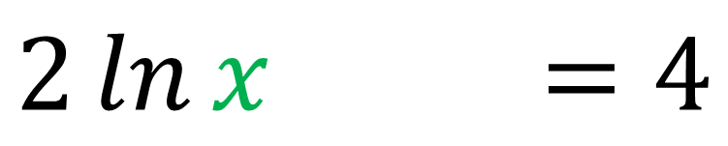
Solve $2\ln{(x)}+1=5$
$$2\ln{x}+1 =5$$
$$2\ln{x}+1 =4$$
$$\ln{x)}+1=2$$
$$e^{ln x} =e2$$
$$x =e^{2}$$

Slide 9
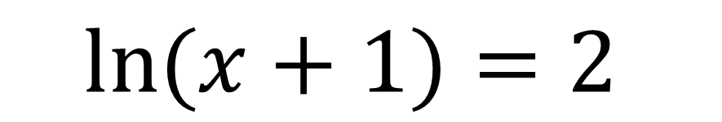
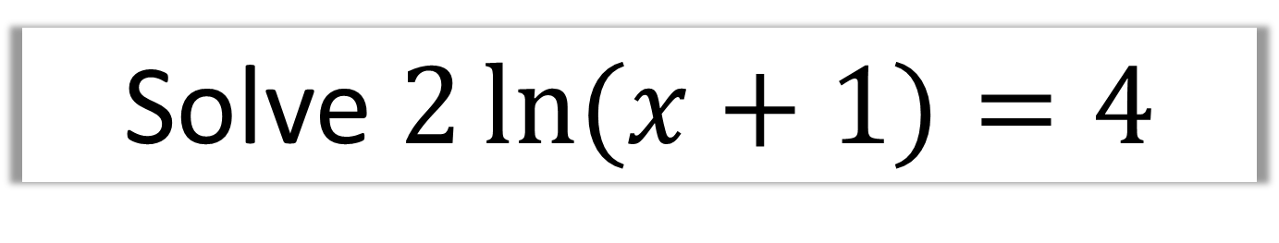
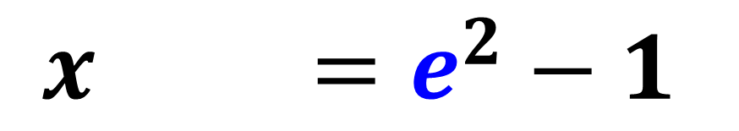
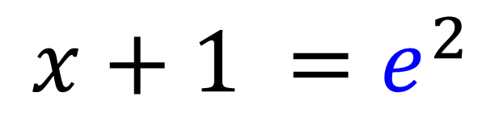
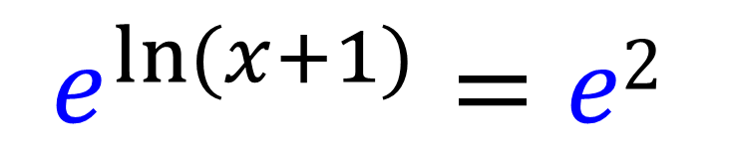
Solve $2\ln{(x}+1)=4$
$$\ln{(x}+1)=2$$
$$e^{\ln{(x+1)}}=e2$$
$$x+1 =e^{2}$$
$$x =e^{2}−1$$

Slide 10

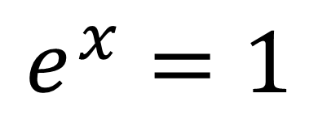
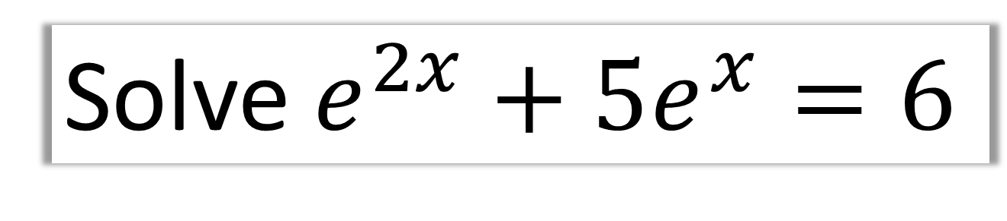
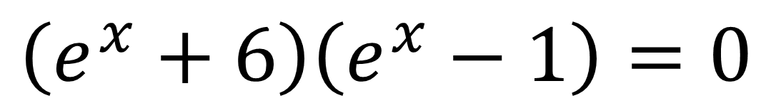
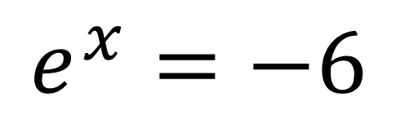
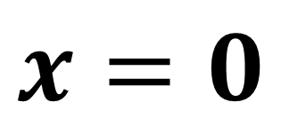
Solve $e^{2x}+5e^{x}=6$
$$e^{2x}+5e^{x}−6=0$$
$$\left(e^{x}+6\right)\left(e^{x}−1\right)=0$$
$$e^{x}=−6$$
$$e^{x}=1$$
No Solutions
$$x=0$$

Slide 11
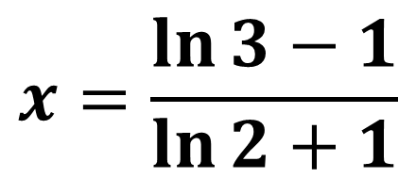
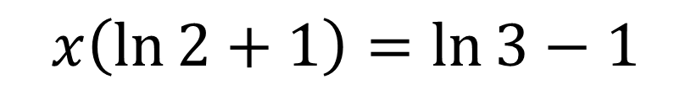
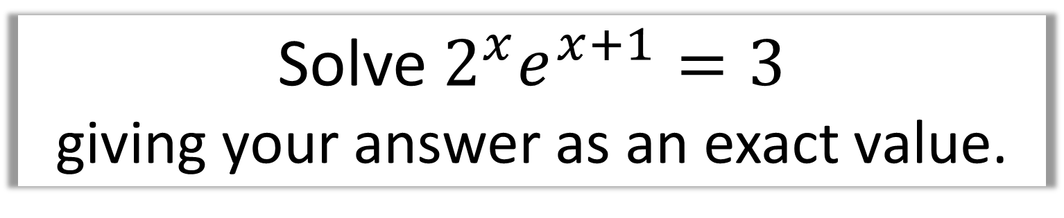
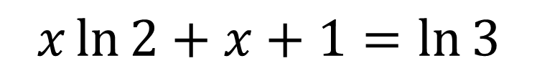
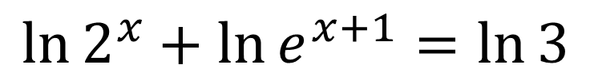
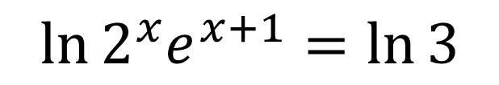
Solve $2^{x}e^{x+1}=3$
giving your answer as an exact value.
$$\ln{2^{x}e^{x+1}}=\ln{3}$$
$$\ln{2^{x}}+\ln{e^{x+1}=\ln{3}}$$
$$x\ln{2}+x+1=\ln{3}$$
$$x\left(\ln{2}+1\right)=\ln{3}−1$$
$$x=\frac{\ln{3}−1}{\ln{2}+1}$$

