Slide 1
LO: Writing and Solving Quadratic Equations

Slide 2
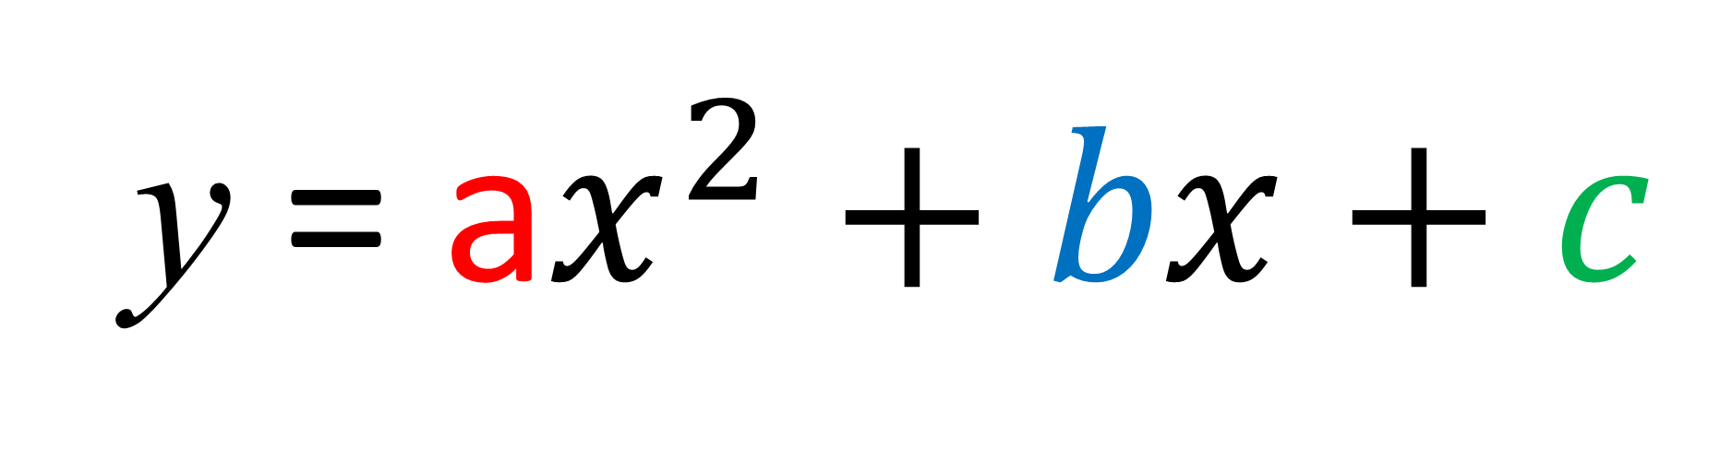
What name would you give
to this equation?
y = a$x^{2}+bx+c$

Slide 3
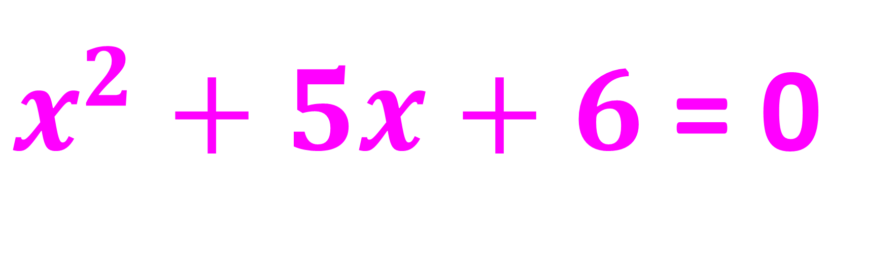
Quadratic Equation or Not?
$x^{2}+5x+6$ = 0
Yes

Slide 4
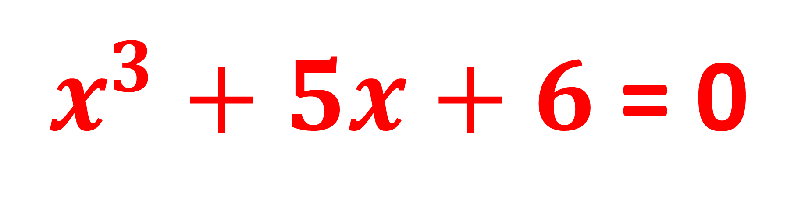
Quadratic Equation or Not?
$x^{3}+5x+6$ = 0
No

Slide 5
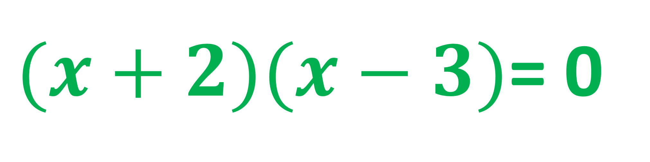
Quadratic Equation or Not?
$(x+2)(x−3)$= 0
Yes

Slide 6
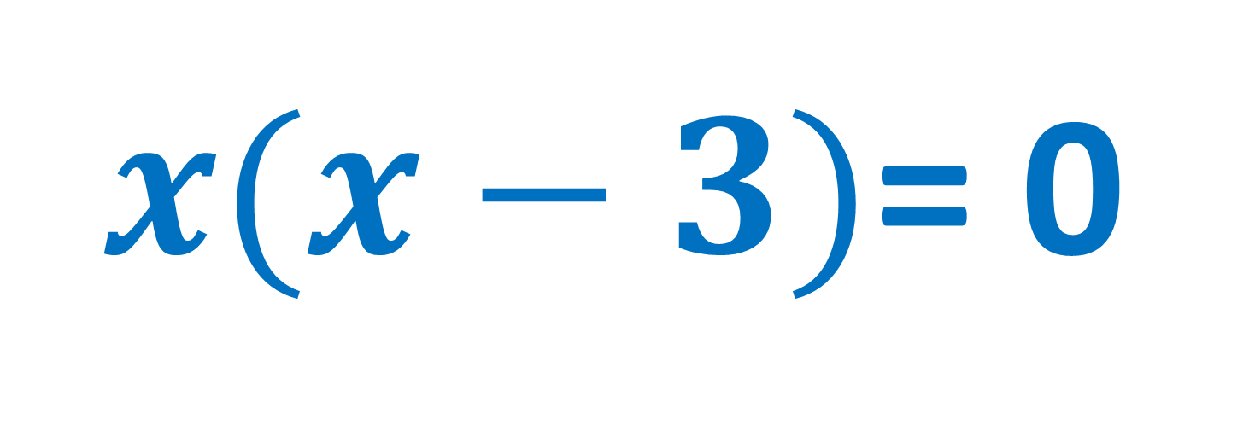
Quadratic Equation or Not?
$x(x−3)$= 0
Yes

Slide 7
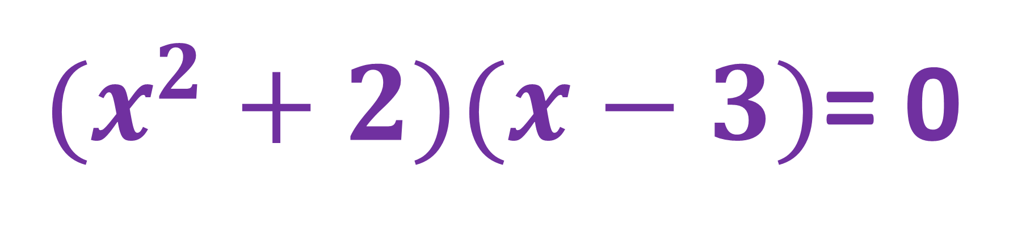
Quadratic Equation or Not?
$(x^{2}+2)(x−3)$= 0
No

Slide 8
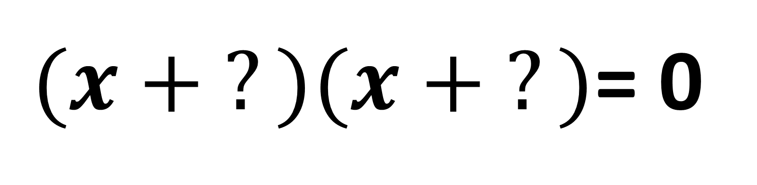
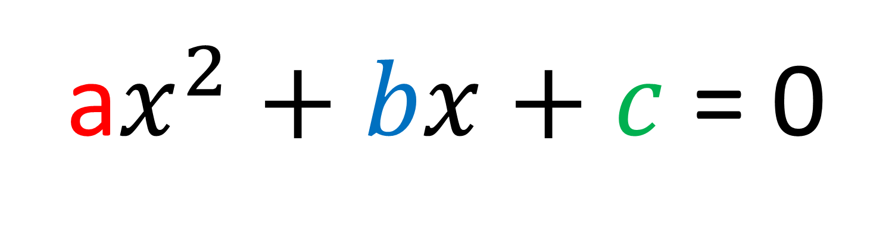
What is the best way to try to solve a quadratic equation (without a calculator)?
a$x^{2}+bx+c$ = 0
Factorise
$(x + ?)(x + ?)$= 0

Slide 9
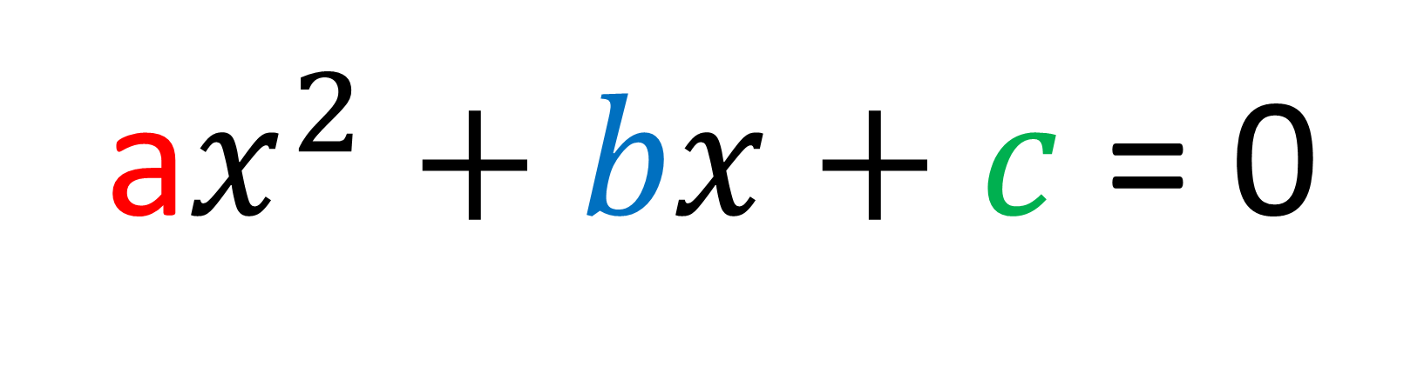
How many solutions could you have for a quadratic equation?
a$x^{2}+bx+c$ = 0
None, One or Two.

Slide 10
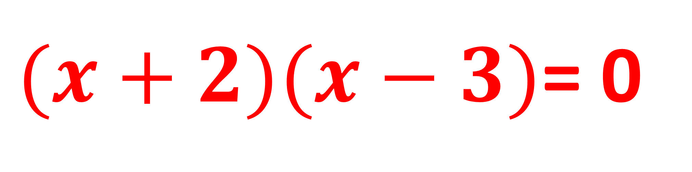
What are the solutions?
$(x+2)(x−3)$= 0
x = -2
x = 3

Slide 11
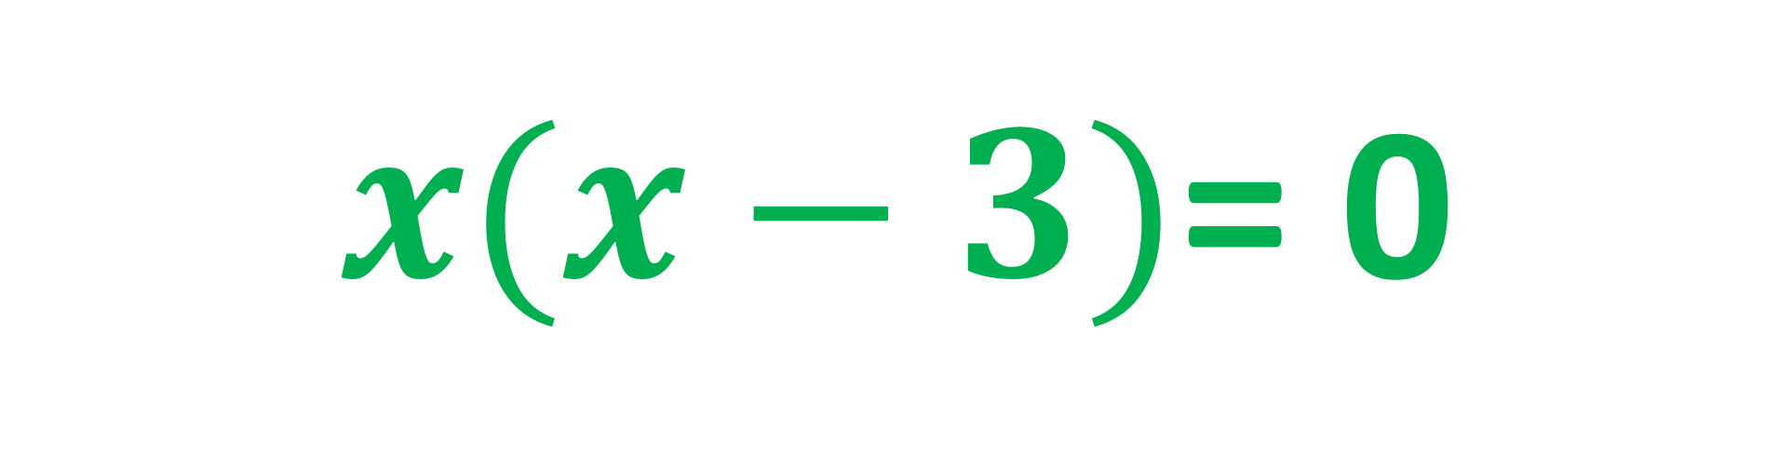
What are the solutions?
$x(x−3)$= 0
x = 0
x = 3

Slide 12
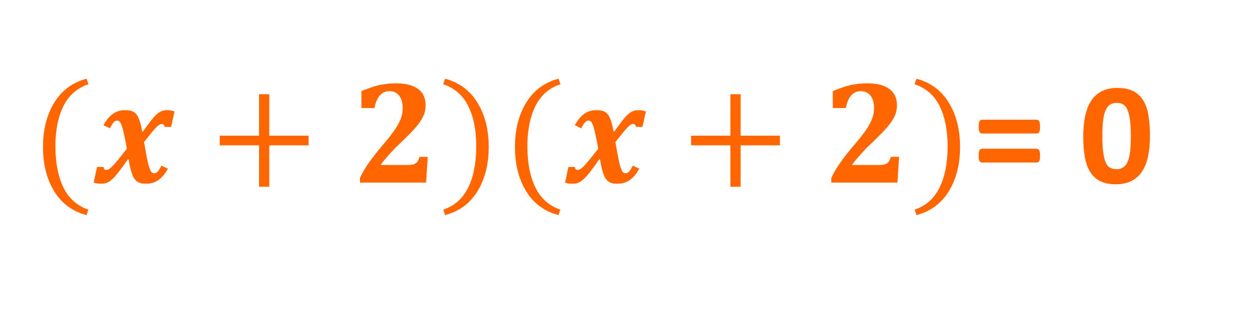
What are the solutions?
$(x+2)(x+2)$= 0
x = -2

Slide 13
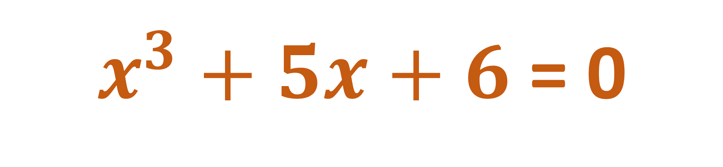
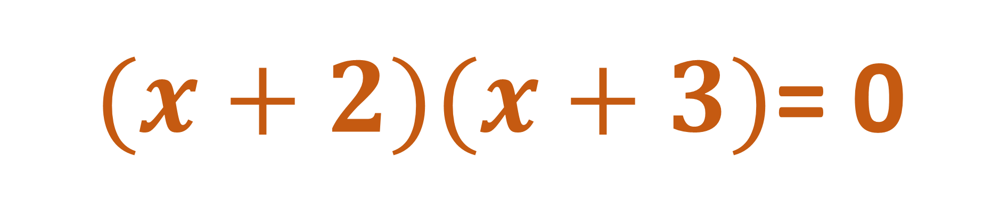
What are the solutions?
$x^{3}+5x+6$ = 0
$(x+2)(x+3)$= 0
x = -2
x = -3

Slide 14
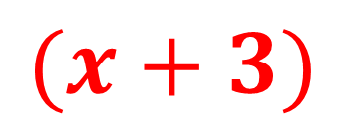
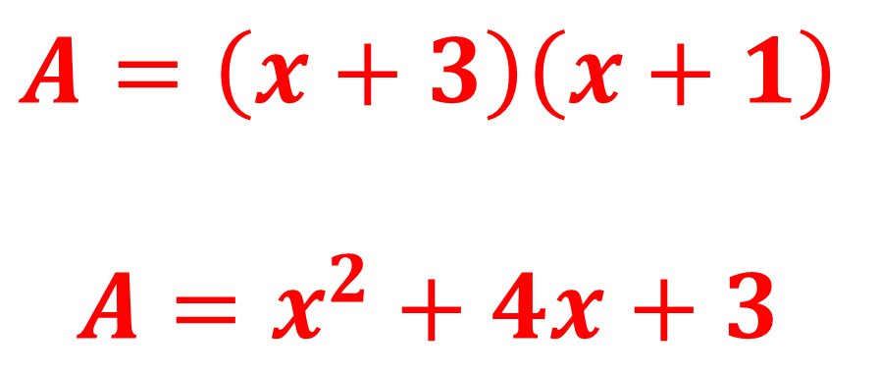
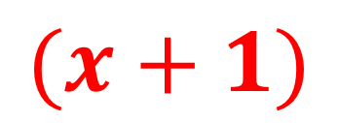
$$(x+3)$$
$$(x+1)$$
Find an equation for the area (A) of the rectangle.
$$A=\left(x+3\right)\left(x+1\right)$$
$$A=x^{2}+4x+3$$

Slide 15
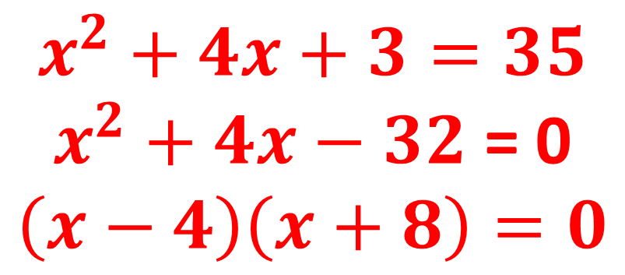
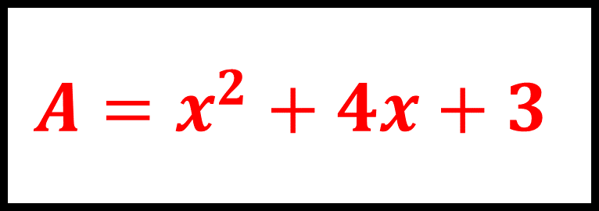
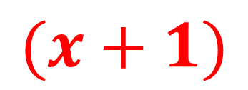
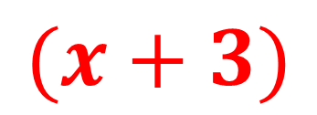
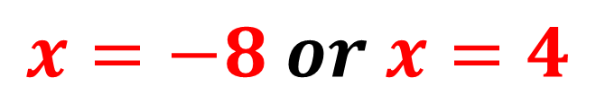
$$(x+3)$$
$$A=x^{2}+4x+3$$
$$(x+1)$$
The area of this shape is 35cm².
Find the length and width of the rectangle.
$$x^{2}+4x+3=35$$
$x^{2}+4x−32$ = 0
$$\left(x−4\right)\left(x+8\right)=0$$
$$x=−8 or x=4$$
Length = (4 + 3) = 7
Width = (4 + 1) = 5

Slide 16
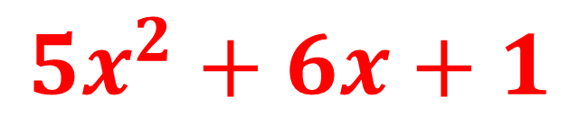
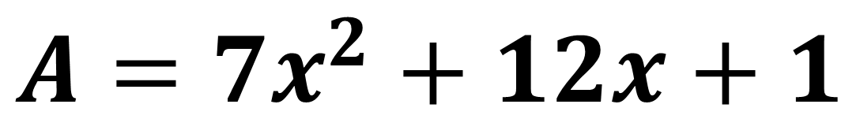
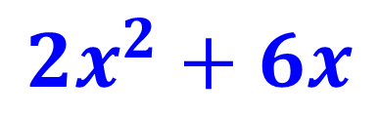
Write an equation for the area of the shape below.
2x
x + 3
$$2x^{2}+6x$$
x + 1
$$5x^{2}+6x+1$$
5x + 1
$$A=7x^{2}+12x+1$$

