Slide 1
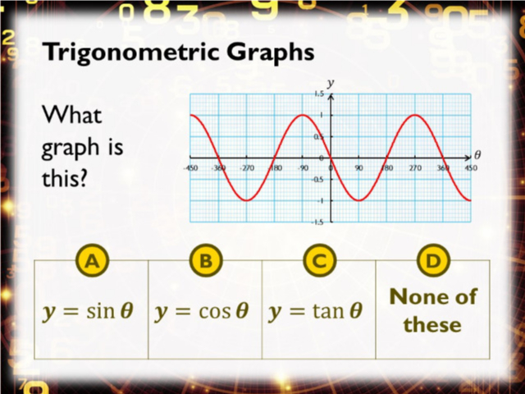
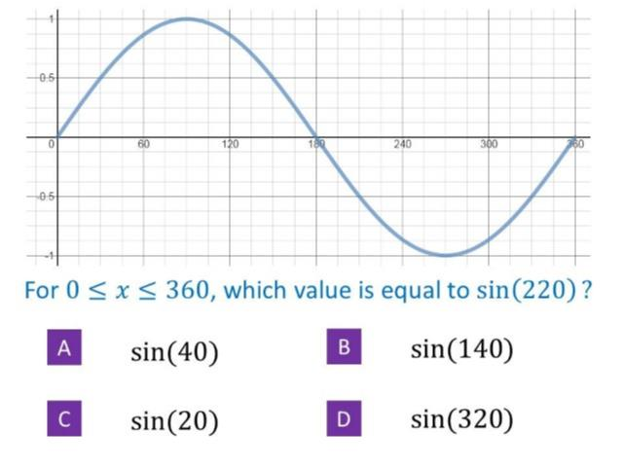
Worst answered question?
Most common wrong answer?

Slide 2
ANSWERS

Slide 3
Worst answered question?

Slide 4
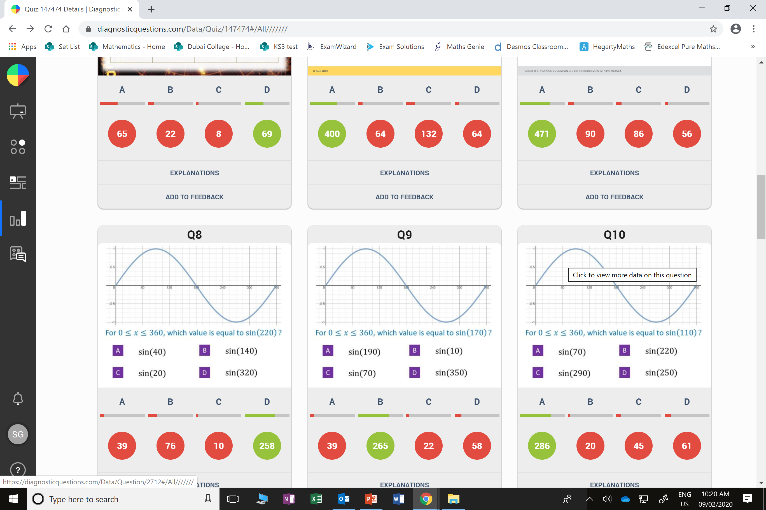
A
They did not look to see if it started at (0,0) or (0,1).

Slide 5
B
They found the positive version of sin 220.

