Slide 1
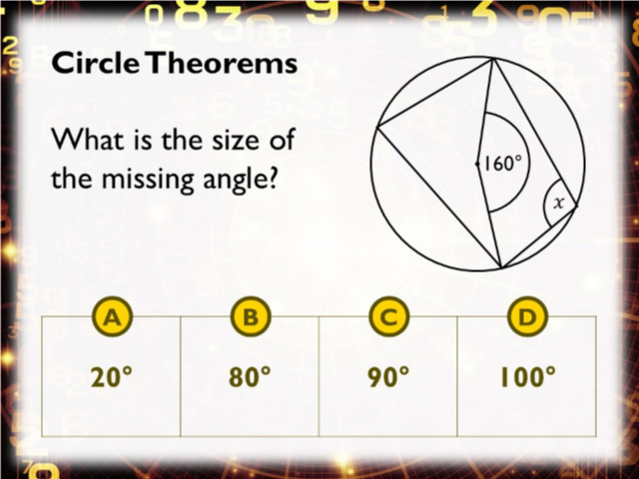
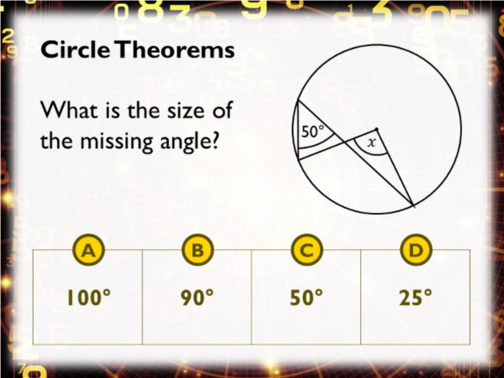
Worst answered question?
Most common wrong answer?

Slide 2
ANSWERS

Slide 3
Worst answered question?

Slide 4
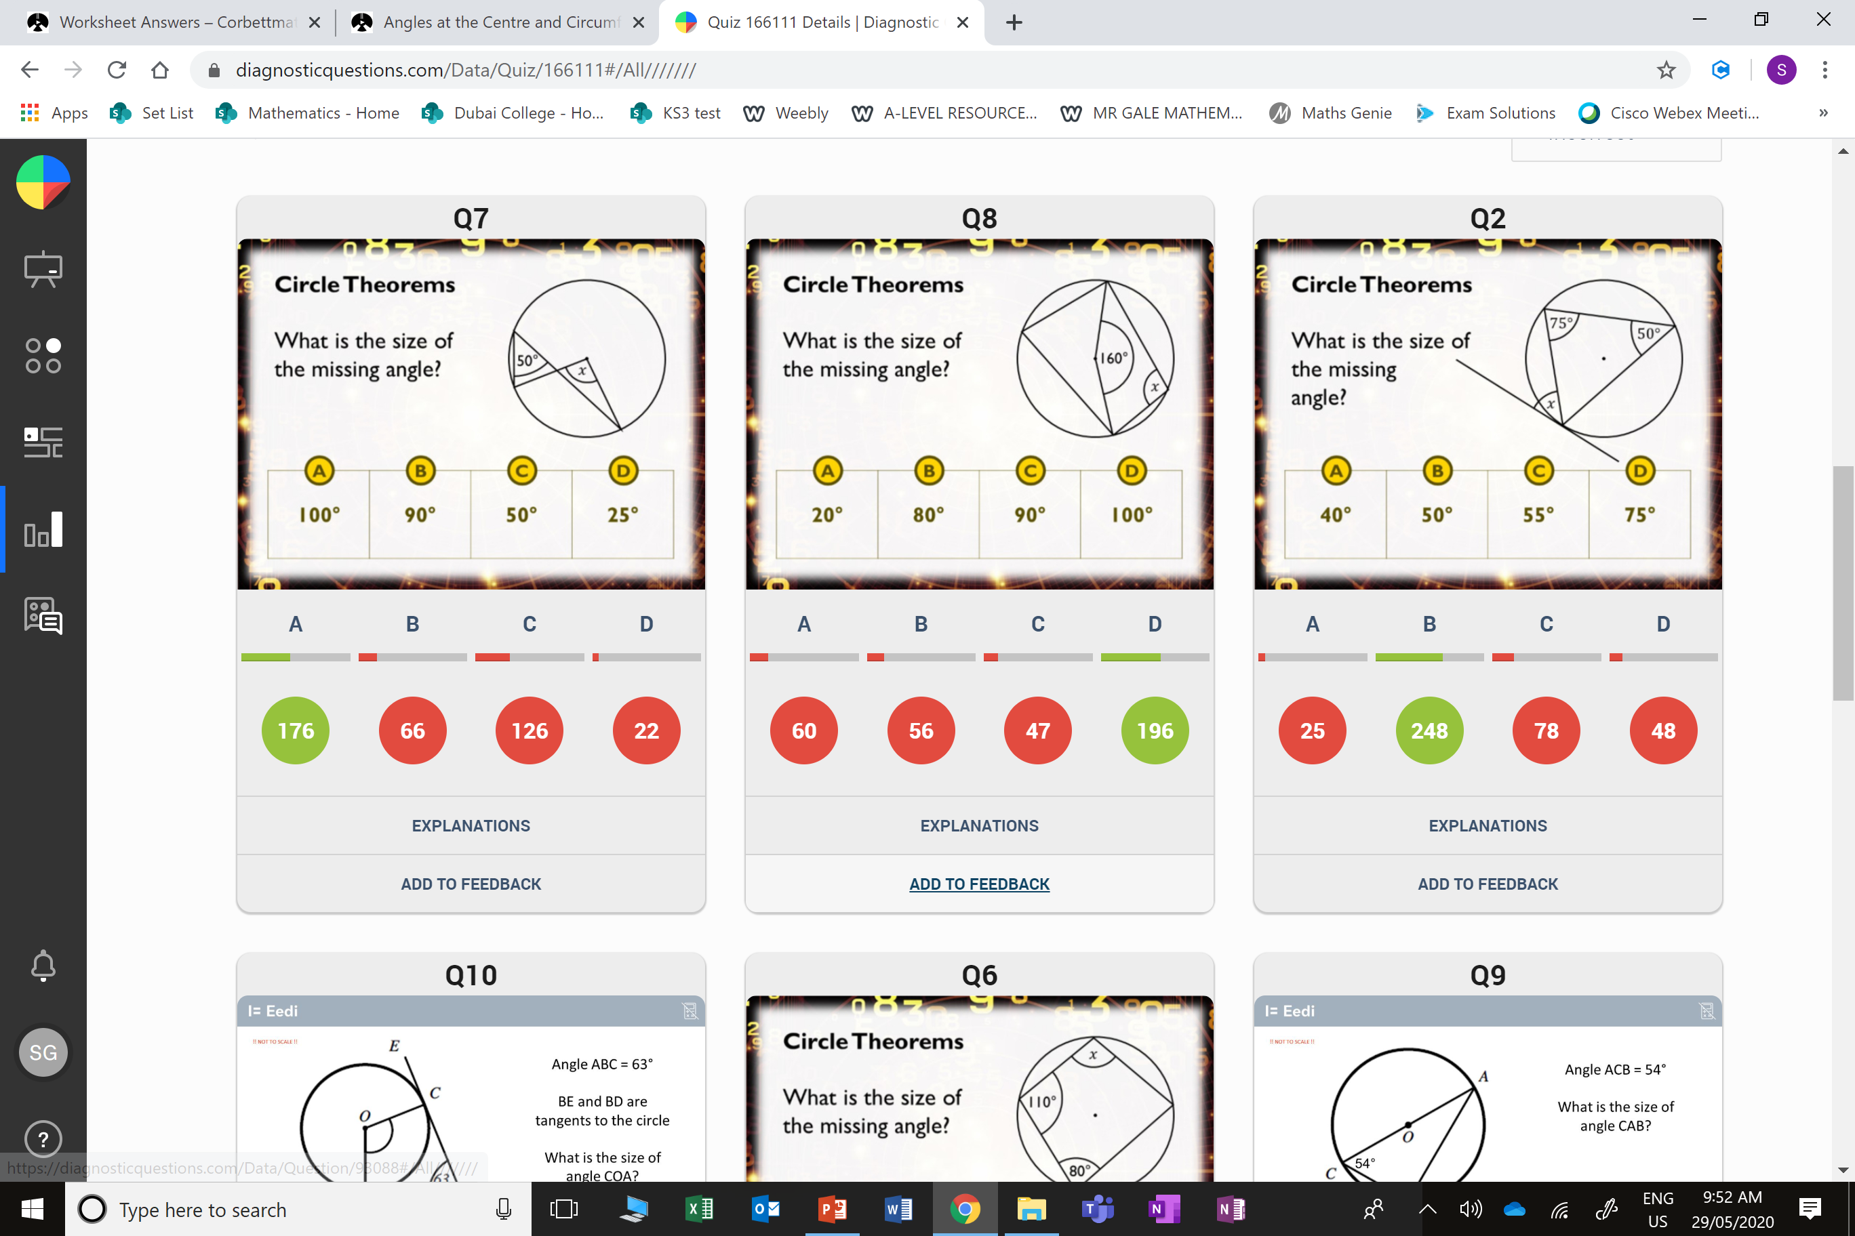
C
The student thought it was same angles from a chord.

Slide 5
A
They thought opposite angles add up to 180˚.

