Slide 1
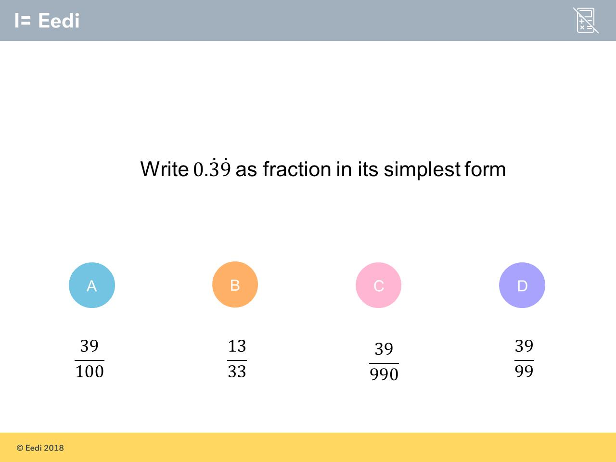
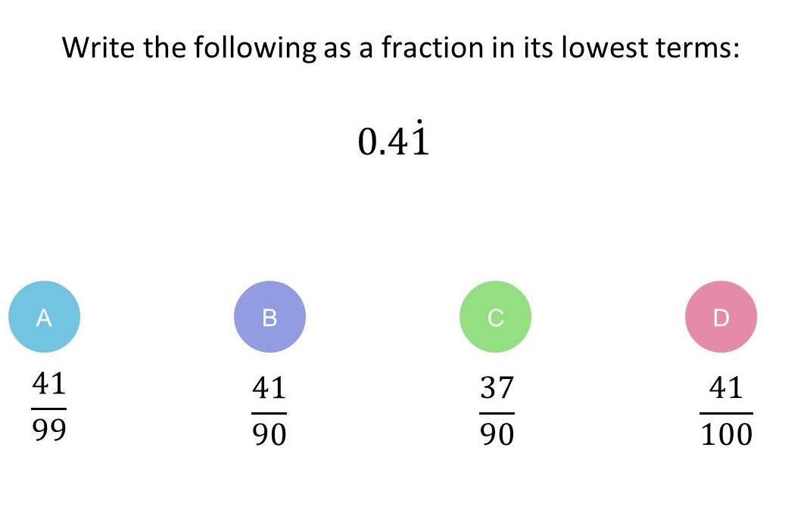
Worst answered question?
Most common wrong answer?

Slide 2
ANSWERS

Slide 3
Worst answered question?

Slide 4
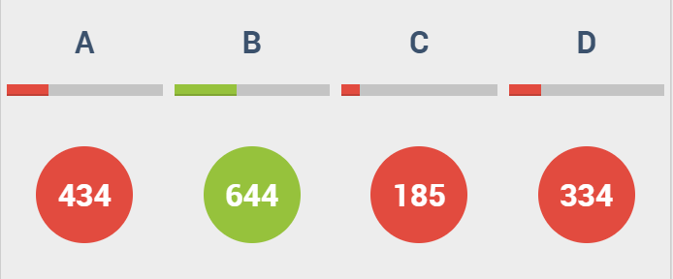
A
The students did not notice it was a recurring decimal.

Slide 5
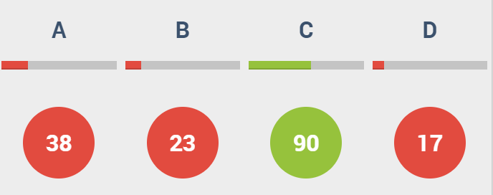
A
They tried to subtract
x from 100x.

