Slide 1
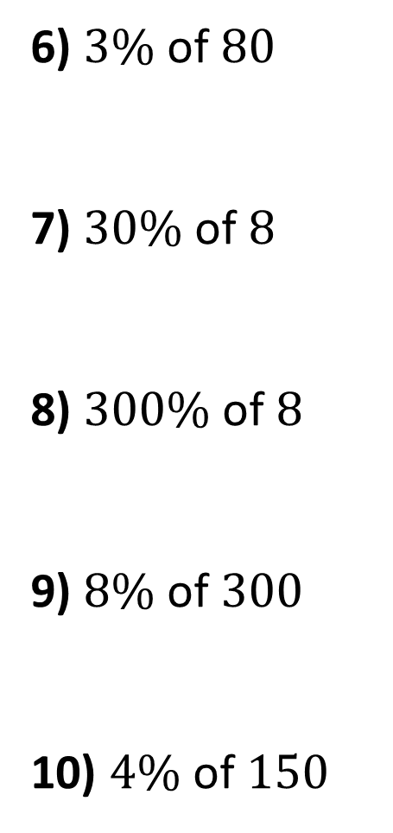
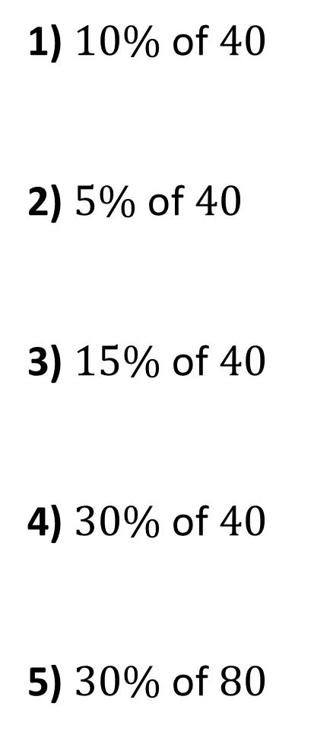
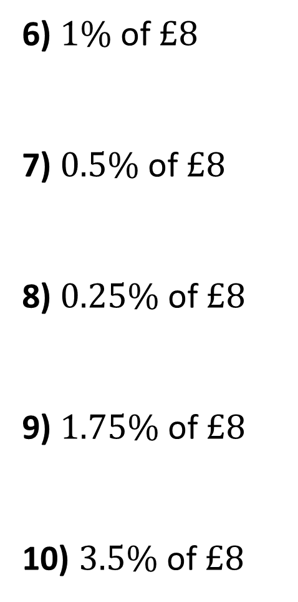
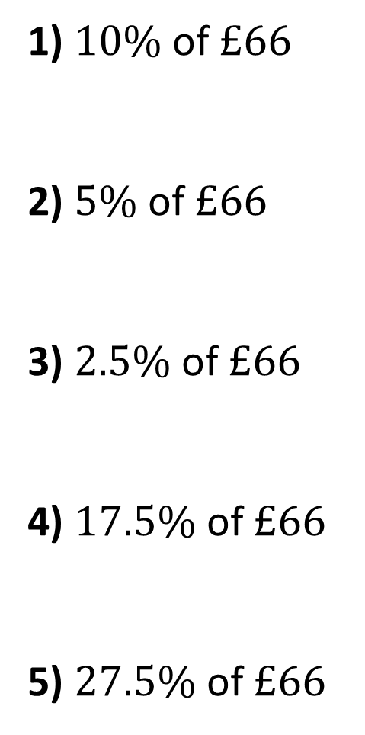
1) $10\%$ of $40$
2) $5\% \text{of} 40$
3) $15\% \text{of} 40$
4) $30\% \text{of} 40$
5) $30\% \text{of} 80$
6) $3\% \text{of} 80$
7) $30\% \text{of} 8$
8) $300\% \text{of} 8$
9) $8\% \text{of} 300$
10) $4\% \text{of} 150$
1) $10\%$ of $£66$
2) $5\% \text{of} £66$
3) $2.5\% \text{of} £66$
4) $17.5\% \text{of} £66$
5) $27.5\% \text{of} £66$
6) $1\% \text{of} £8$
7) $0.5\% \text{of} £8$
8) $0.25\% \text{of} £8$
9) $1.75\% \text{of} £8$
10) $3.5\% \text{of} £8$

Slide 2
ANSWERS

Slide 3
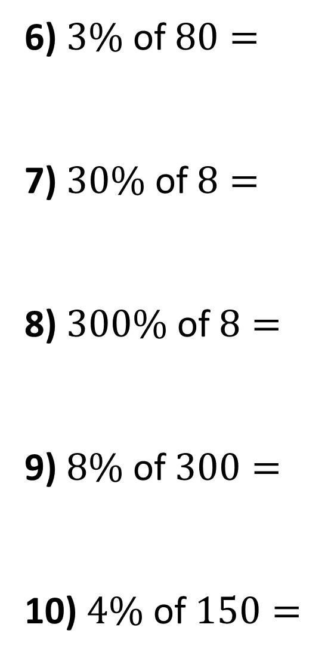
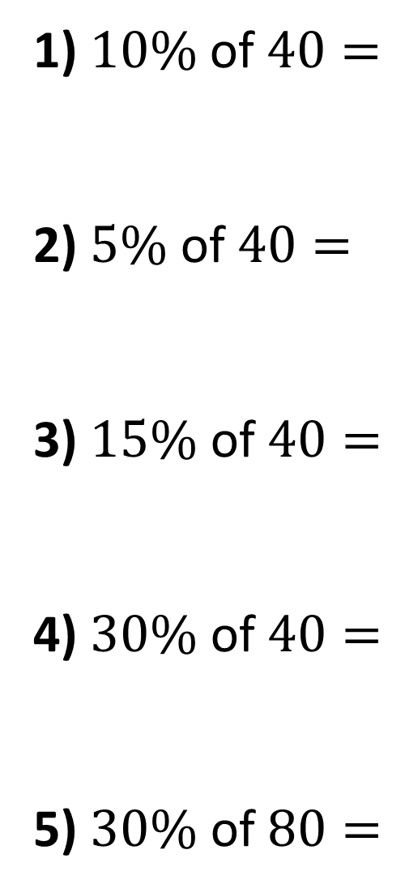
1) $10\%$ of $40=$
2) $5\% \text{of} 40=$
3) $15\% \text{of} 40=$
4) $30\% \text{of} 40=$
5) $30\% \text{of} 80=$
4
6) $3\% \text{of} 80=$
7) $30\% \text{of} 8=$
8) $300\% \text{of} 8=$
9) $8\% \text{of} 300=$
10) $4\% \text{of} 150=$
2.4
2
2.4
6
24
12
24
24
6

Slide 4
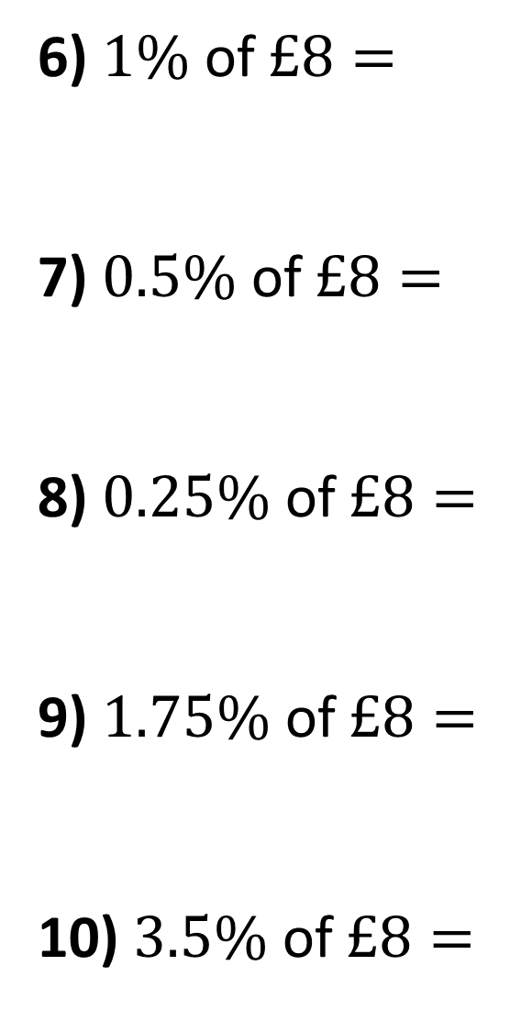
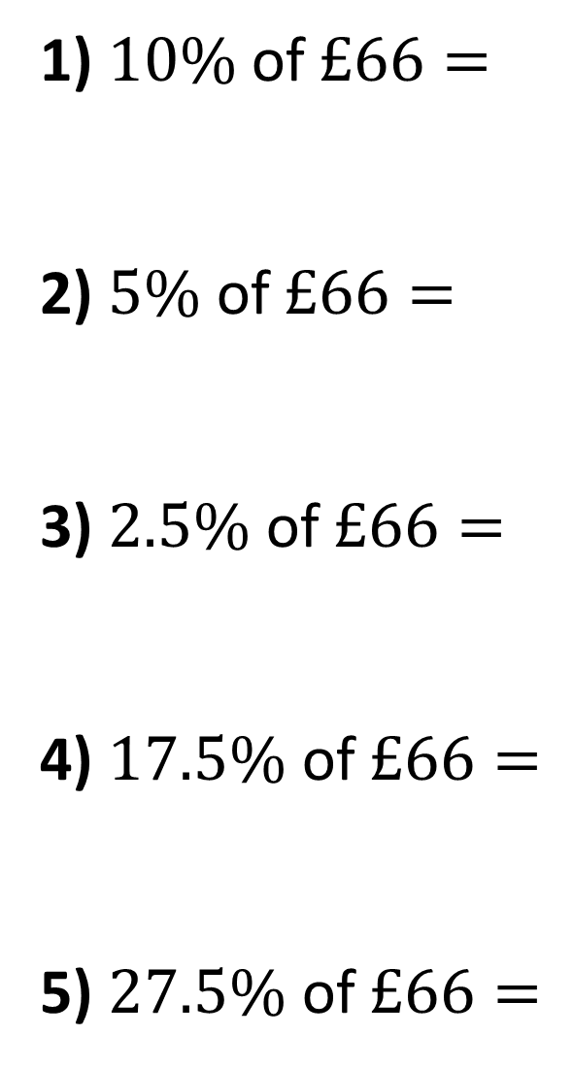
£6.60
6) $1\% \text{of} £8=$
7) $0.5\% \text{of} £8=$
8) $0.25\% \text{of} £8=$
9) $1.75\% \text{of} £8=$
10) $3.5\% \text{of} £8=$
1) $10\%$ of $£66=$
2) $5\% \text{of} £66=$
3) $2.5\% \text{of} £66=$
4) $17.5\% \text{of} £66=$
5) $27.5\% \text{of} £66=$
£0.08
£3.30
£0.04
£1.65
£0.02
£11.55
£0.14
£18.15
£0.28

