Slide 1
Elastic, Strings and Springs
Elastic Energy
Chapter 3
(Part 5 of 5)

Slide 2
Springs and Strings
Problem Solving Considerations
Approach 1: Hooke’s Law and F=ma
  Most equilibrium problems
  Problems linked to acceleration and forces
Approach 2: Energy
  Most problems linked to distance travelled and velocity

Slide 3
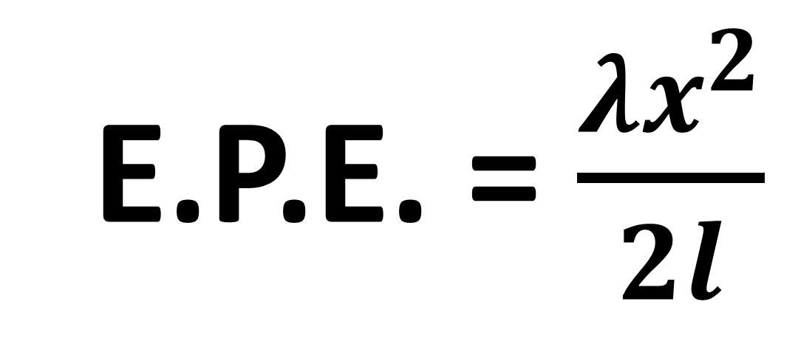
The Elastic Potential Energy
stored in a spring or string
is equal to the work done
in stretching /compressing it.
E.P.E. = $\frac{λx^{2}}{2l}$

Slide 4
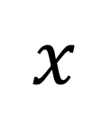
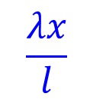
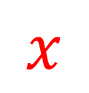

Tension in the spring is linear to the extension of the spring.
$$T$$
$$\frac{λx}{l}$$
Tension in the Spring
$$x$$
$$x$$
Extension Length of the String
The area under the graph is equal to work done and therefore
the Energy in the String.

Slide 5
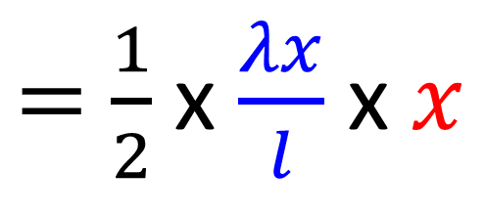
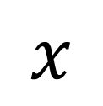
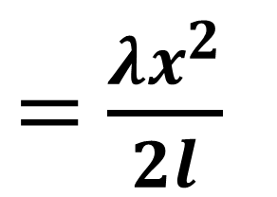
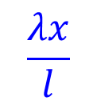
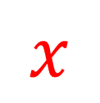
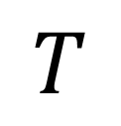
Find the Area Under a Graph
$$T$$
Area Under the Graph
$$\frac{λx}{l}$$
$=$ $\frac{1}{2}$ x $\frac{λx}{l}$ x$x$
Tension in the Spring
Elastic Potential Energy
$$x$$
$=$ $\frac{λx^{2}}{2l}$
$$x$$
Extension Length of the String

Slide 6
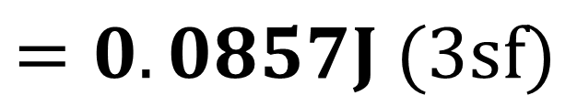
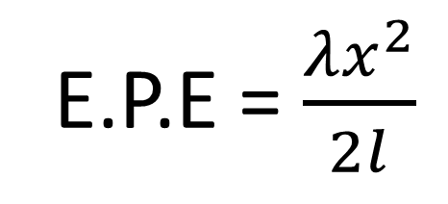

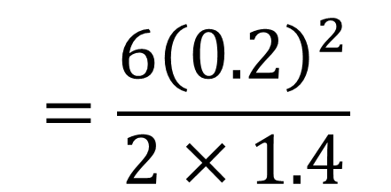
An elastic string has natural length 1.4m and
modulus of elasticity 6N.
Find the energy stored in the string when its length is 1.6m
E.P.E = $\frac{λx^{2}}{2l}$
E.P.E = $\frac{λx^{2}}{2l}$
$$=\frac{6{\left(0.2\right)}^{2}}{2×1.4}$$
$$=0.0857J (3sf)$$

Slide 7

The law of Conservation of Energy
 | Start | Finish
Work | IN | OUT
KE | Initial | Final
GPE | Initial | Final
EPE | Initial | Final
Total Initial Energy $=$ Total Final Energy

Slide 8
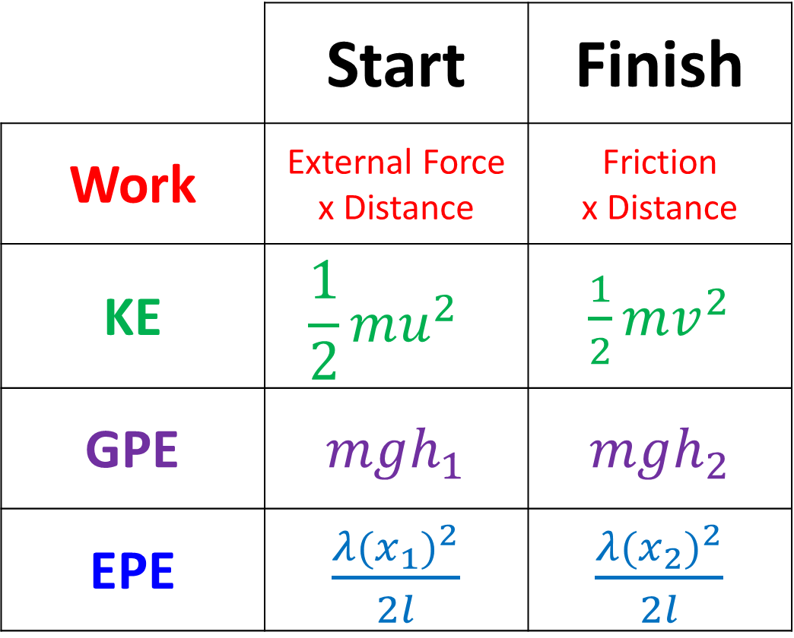
The law of Conservation of Energy
 | Start | Finish
Work | External Force x Distance | Friction x Distance
KE | $$\frac{1}{2}mu^{2}$$ | $\frac{1}{2}mv^{2}$
GPE | $mgh_{1}$ | $mgh_{2}$
EPE | $\frac{λ{(x_{1})}^{2}}{2l}$ | $\frac{λ{(x_{2})}^{2}}{2l}$

Slide 9
Example A: Horizontal
A particle of mass 0.5kg is attached to one end of an elastic string, of natural length 2m and modulus of elasticity 19.6N.
The other end of the elastic string is attached to a point O.
The particle is released from the point O.
Find the greatest distance it will reach below O.

Slide 10
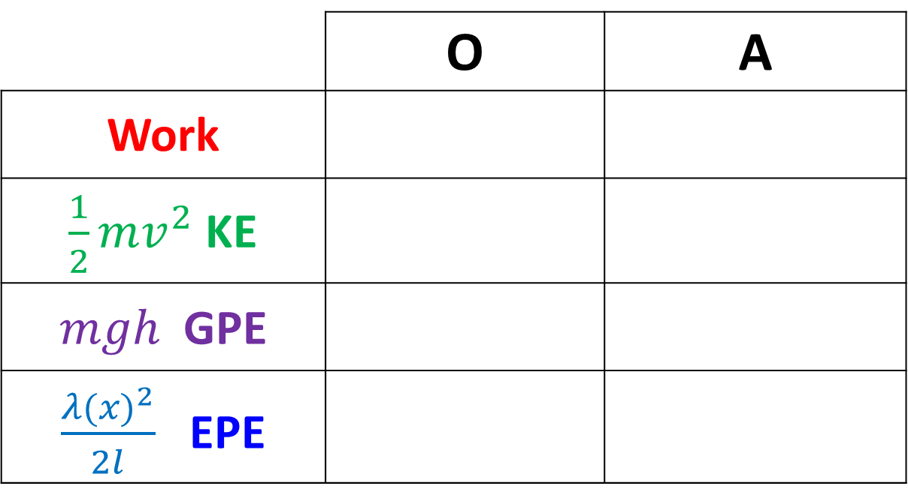
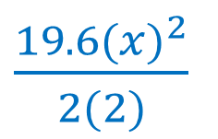
A particle of mass 0.5kg is attached to one end of an elastic string, of natural length 2m and modulus of elasticity 19.6N.
The other end of the elastic string is attached to a point O.
The particle is released from the point O.
Find the greatest distance it will reach below O.
O
 | O | A
Work
$\frac{1}{2}mv^{2}$ KE
$mgh$ GPE
$\frac{λ{(x)}^{2}}{2l}$ EPE
0.5
0
0
2
0
0
x
(0.5)(9.8)(2+x)
0
A
0.5
$\frac{19.6{(x)}^{2}}{2(2)}$
0

Slide 11

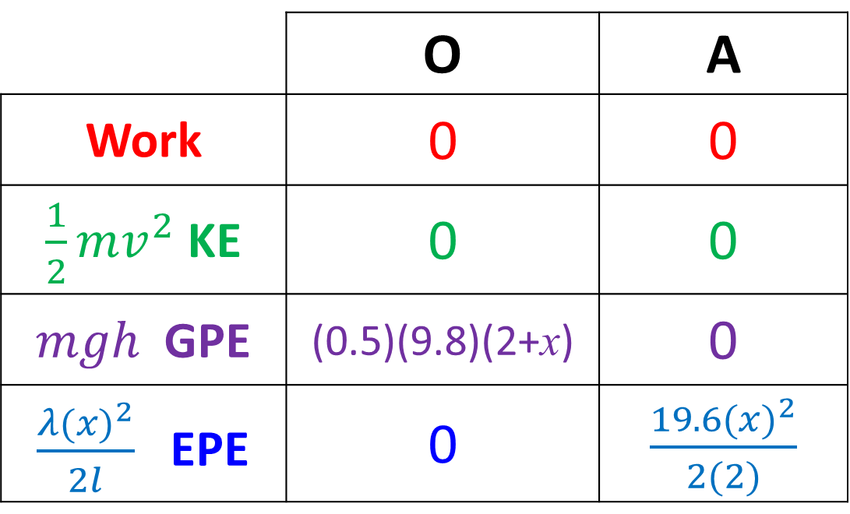


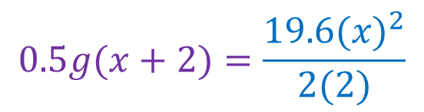

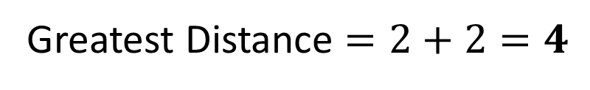
A particle of mass 0.5kg is attached to one end of an elastic string, of natural length 2m and modulus of elasticity 19.6N.
The other end of the elastic string is attached to a point O.
The particle is released from the point O.
Find the greatest distance it will reach below O.
 | O | A
Work | 0 | 0
$\frac{1}{2}mv^{2}$ KE | 0 | 0
$mgh$ GPE | (0.5)(9.8)(2+x) | 0
$\frac{λ{(x)}^{2}}{2l}$ EPE | 0 | $\frac{19.6{(x)}^{2}}{2(2)}$
Initial Energy $=$ Final Energy
$$0.5g(x+2)=\frac{19.6{(x)}^{2}}{2(2)}$$
$$4.9x+9.8= {19.6x}^{2}$$
$0= {19.6x}^{2}$ $− 4.9x−9.8$
$$x=2 or x=−1$$
Greatest Distance $=2+2=4$

Slide 12
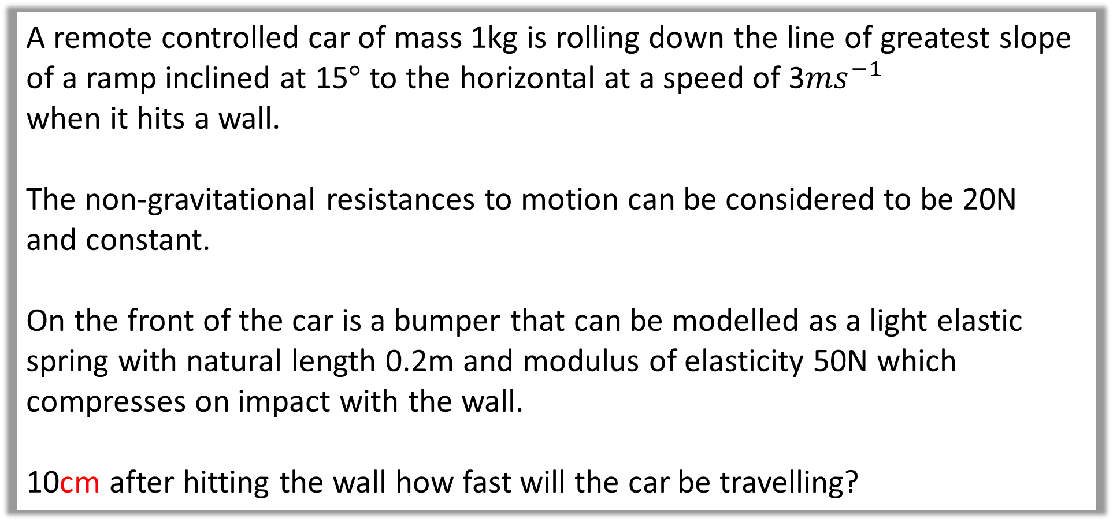
Example B: Slope
A remote controlled car of mass 1kg is rolling down the line of greatest slope of a ramp inclined at 15$°$ to the horizontal at a speed of 3$ms^{−1}$
when it hits a wall.
The non-gravitational resistances to motion can be considered to be 20N
and constant.
On the front of the car is a bumper that can be modelled as a light elastic spring with natural length 0.2m and modulus of elasticity 50N which compresses on impact with the wall.
10cm after hitting the wall how fast will the car be travelling?

Slide 13
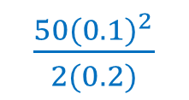

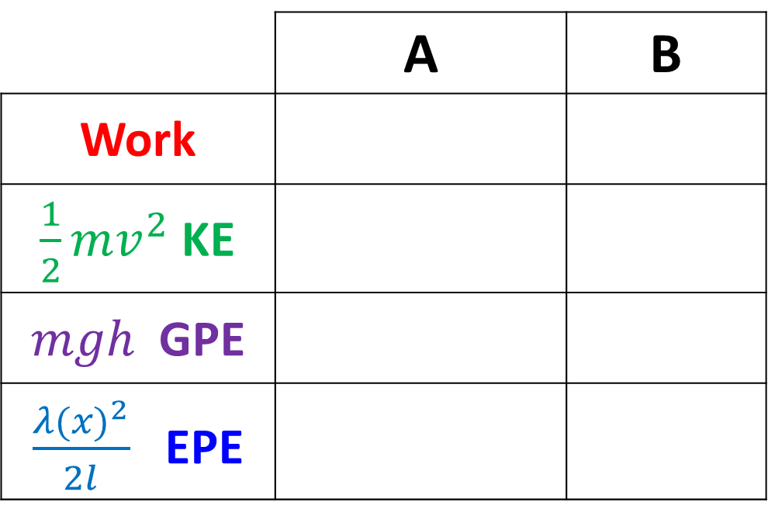
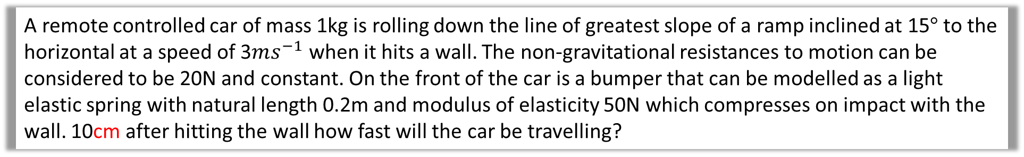
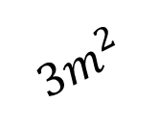

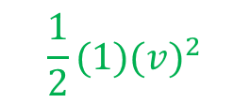

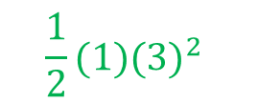
A remote controlled car of mass 1kg is rolling down the line of greatest slope of a ramp inclined at 15$°$ to the horizontal at a speed of 3$ms^{−1}$ when it hits a wall. The non-gravitational resistances to motion can be considered to be 20N and constant. On the front of the car is a bumper that can be modelled as a light elastic spring with natural length 0.2m and modulus of elasticity 50N which compresses on impact with the wall. 10cm after hitting the wall how fast will the car be travelling?
A
$$20N$$
 | A | B
Work
$\frac{1}{2}mv^{2}$ KE
$mgh$ GPE
$\frac{λ{(x)}^{2}}{2l}$ EPE
$$3m^{2}$$
B
1
20(0.1)
0
0.1m
0.1 sin 15
$$\frac{1}{2}(1)(3)^{2}$$
$$\frac{1}{2}(1)(v)^{2}$$
1
$$\left(1\right)\left(9.8\right)(0.1\sin{15)}$$
0
$$15°$$
$\frac{50{(0.1)}^{2}}{2(0.2)}$
0

Slide 14
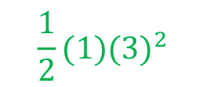


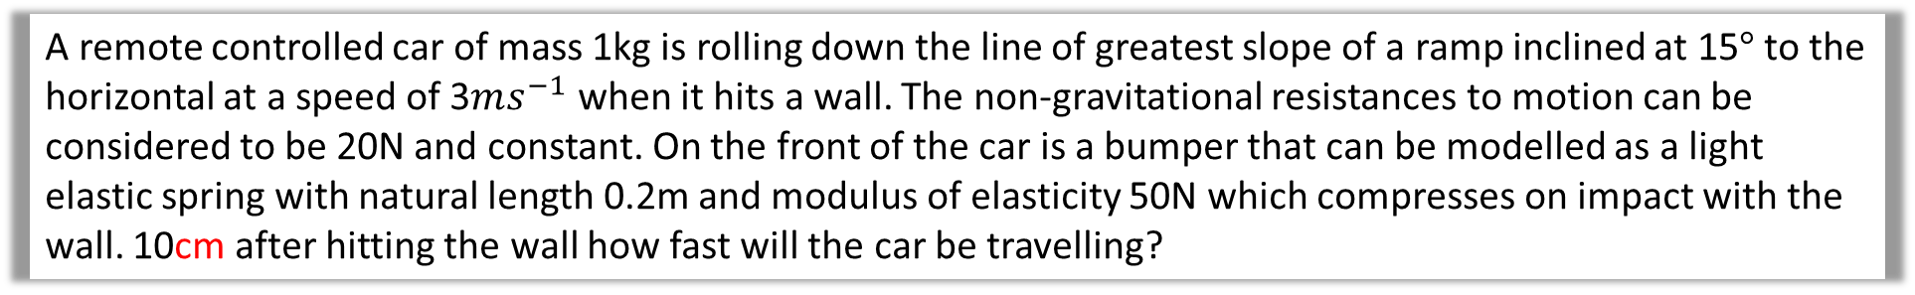
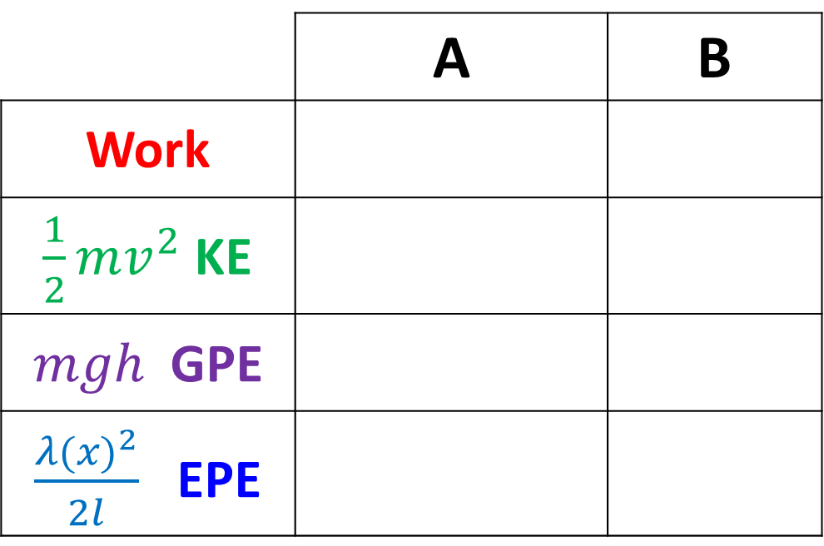

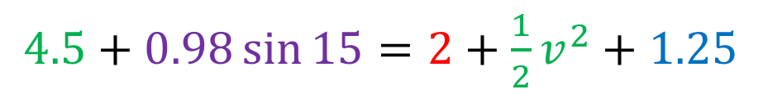
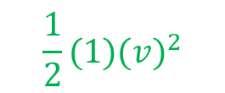
A remote controlled car of mass 1kg is rolling down the line of greatest slope of a ramp inclined at 15$°$ to the horizontal at a speed of 3$ms^{−1}$ when it hits a wall. The non-gravitational resistances to motion can be considered to be 20N and constant. On the front of the car is a bumper that can be modelled as a light elastic spring with natural length 0.2m and modulus of elasticity 50N which compresses on impact with the wall. 10cm after hitting the wall how fast will the car be travelling?
 | A | B
Work
$\frac{1}{2}mv^{2}$ KE
$mgh$ GPE
$\frac{λ{(x)}^{2}}{2l}$ EPE
Initial Energy = Final Energy
20(0.1)
0
$4.5+0.98\sin{15=2+\frac{1}{2}v^{2}+1.25}$
$$\frac{1}{2}(1)(3)^{2}$$
$$\frac{1}{2}(1)(v)^{2}$$
$v=1.73ms^{−1}$
$$\left(1\right)\left(9.8\right)(0.1\sin{15)}$$
0
$\frac{50{(0.1)}^{2}}{2(0.2)}$
0

