Slide 1
Match up the graphs with the equations.
y = -x
y = -x²
y = x
y = -x³
y = x³
y = x²
B
D
C
A
E
F

Slide 2
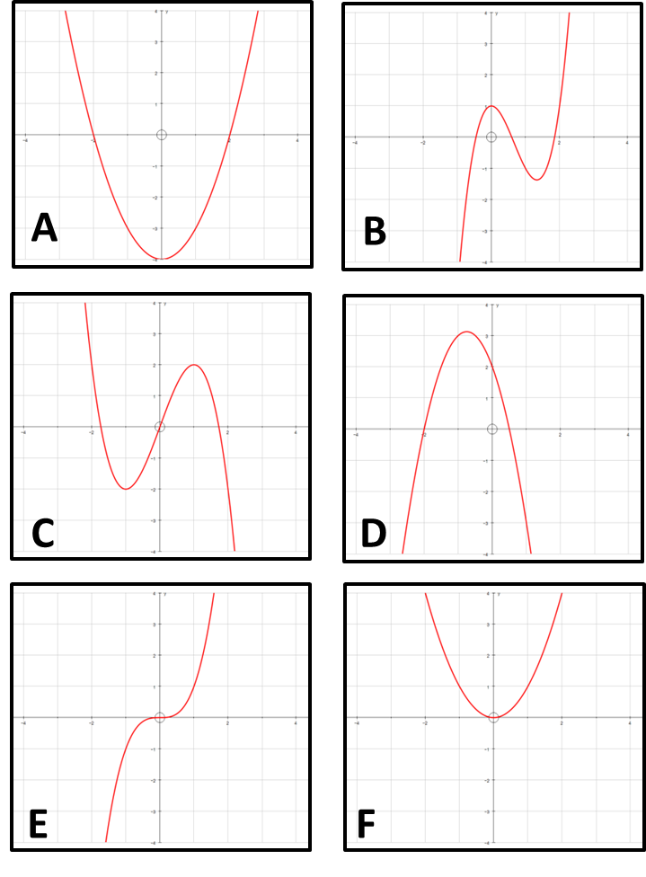
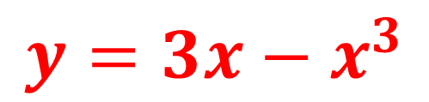
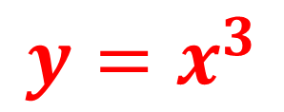
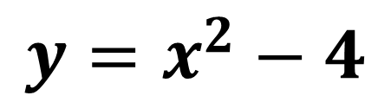
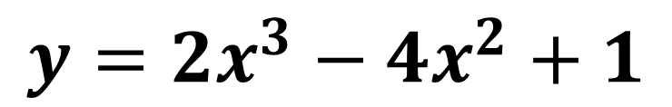
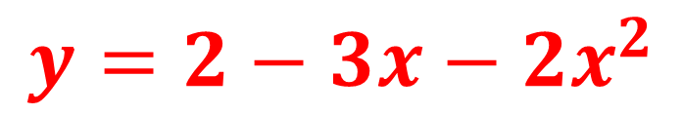
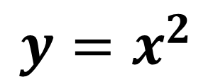
Match up the graphs
with the equations.
$$y={2−3x−2x}^{2}$$
$$y=2x^{3}−4x^{2}+1$$
$$y=x^{3}$$
$$y=x^{2}−4$$
$$y=3x−x^{3}$$
$$y=x^{2}$$

Slide 3
ANSWERS

Slide 4
Match up the graphs with the equations.
y = -x
y = -x²
y = x
E
B
D
F
A
y = -x³
y = x³
y = x²
C
B
D
C
A
E
F

Slide 5
Match up the graphs
with the equations.
$$y={2−3x−2x}^{2}$$
D
$$y=2x^{3}−4x^{2}+1$$
B
$$y=x^{3}$$
E
$$y=x^{2}−4$$
A
$$y=3x−x^{3}$$
C
$$y=x^{2}$$
F

