Slide 1
Integration
By substitution
Chapter 11
(Part 4 of 12)

Slide 2
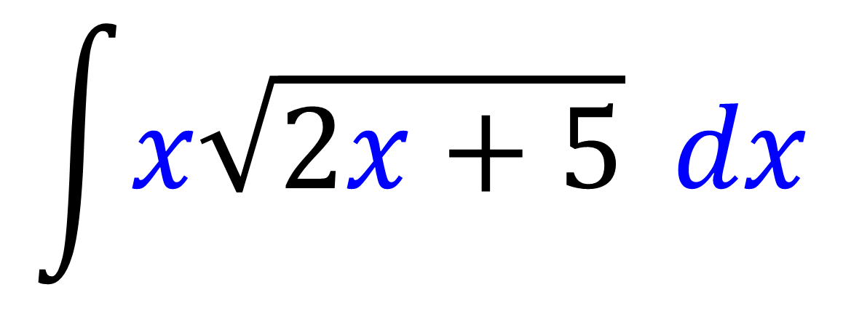
Can you do this integration by using
the reverse chain rule?
$$\int{x\sqrt{2x+5}} dx$$
No

Slide 3
Integration by Substitution
For complicated expressions,
you can do substitution
to turn it into an equivalent
integration that is simpler.

Slide 4
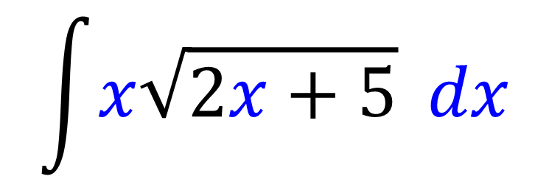
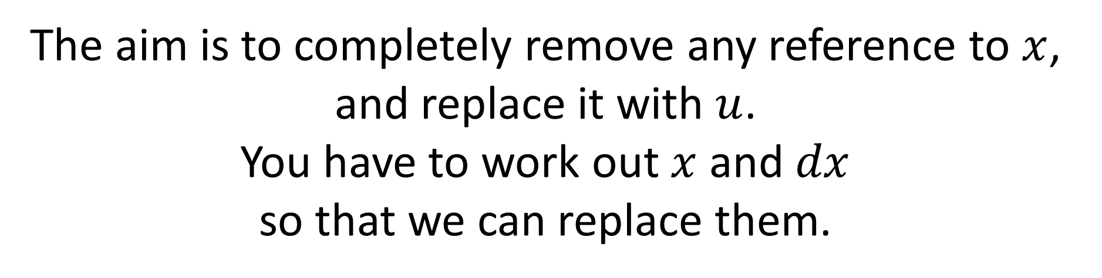
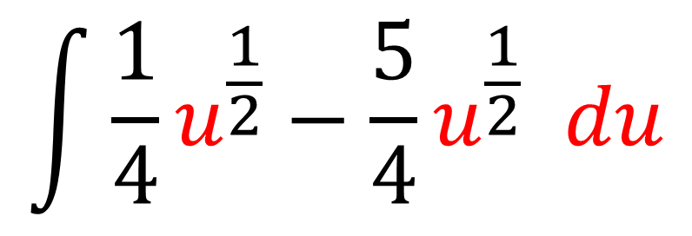
$$\int{x\sqrt{2x+5}} dx$$
The aim is to completely remove any reference to $x$, and replace it with $u$.
You have to work out $x$ and $dx$
so that we can replace them.
$$\int{{\frac{1}{4}u}^{\frac{1}{2}}−\frac{5}{4}u^{\frac{1}{2}} du}$$

Slide 5




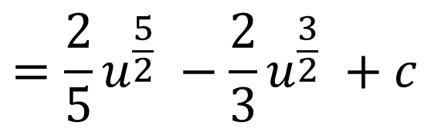
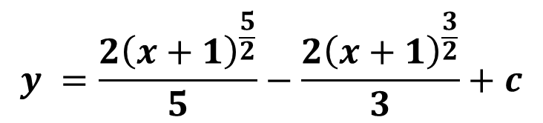
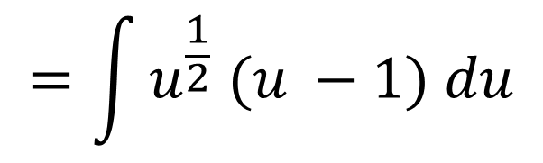


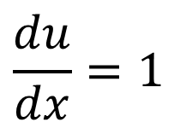
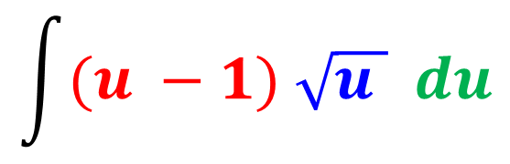
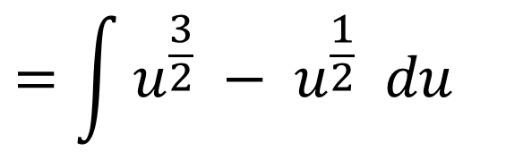
Use the substitution $u=x+1$ to find $\int{x \sqrt{x+1}} dx$
STEP 1: Work out $x$
STEP 3: Substitute these into original expression.
STEP 4: Integrate simplified expression.
$$u=x+1$$
$$\int{(u −1) \sqrt{u } du}$$
$$=\frac{2}{5}u^{\frac{5}{2}} −\frac{2}{3}u^{\frac{3}{2}} +c$$
$$x=u −1$$
STEP 2: Work out $dx$
$$=\int{u^{\frac{1}{2}} (u −1) du}$$
STEP 5: Write answer in terms of $x$.
$$\frac{du}{dx}=1$$
$$=\int{u^{\frac{3}{2}} −{ u}^{\frac{1}{2}} du}$$
$$y =\frac{{2\left(x+1\right)}^{\frac{5}{2}}}{5}−\frac{2{\left(x+1\right)}^{\frac{3}{2}}}{3}+c$$
$$dx=du$$

Slide 6
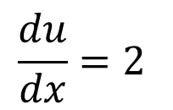
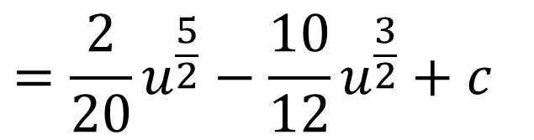
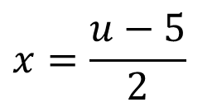
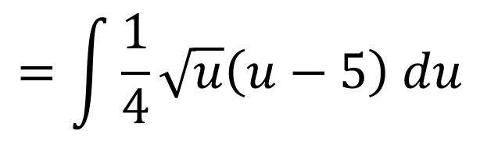
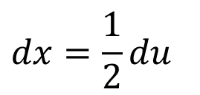
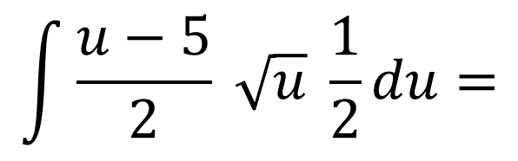

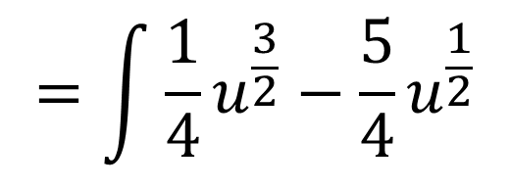

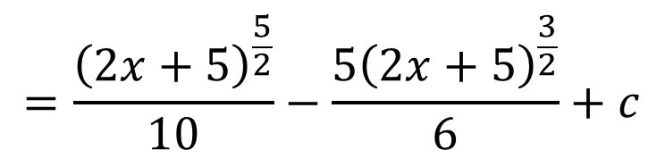
$u=2x+5$ to find $\int{x\sqrt{2x+5}} dx$
STEP 1: Work out $x$
STEP 3: Substitute these into original expression.
STEP 4: Integrate simplified expression.
$u=2x+5$
$$x=\frac{u−5}{2}$$
$$\int{\frac{u−5}{2} \sqrt{u} \frac{1}{2}du}=$$
$$=\frac{2}{20}u^{\frac{5}{2}}−\frac{10}{12}u^{\frac{3}{2}}+c$$
STEP 2: Work out $dx$
$$=\int{\frac{1}{4}\sqrt{u}\left(u−5\right) du}$$
STEP 5: Write answer in terms of $x$.
$$\frac{du}{dx}=2$$
$$=\frac{{\left(2x+5\right)}^{\frac{5}{2}}}{10}−\frac{5{\left(2x+5\right)}^{\frac{3}{2}}}{6}+c$$
$$dx=\frac{1}{2}du$$
$$=\int{\frac{1}{4}u^{\frac{3}{2}}−\frac{5}{4}u^{\frac{1}{2}}}$$

Slide 7
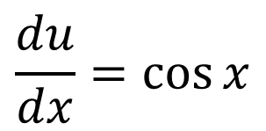
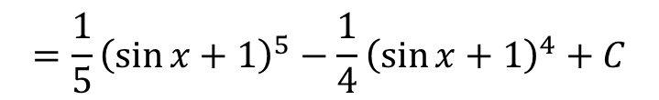

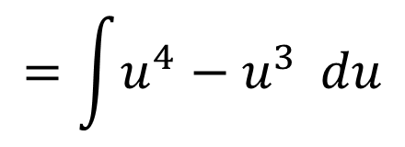

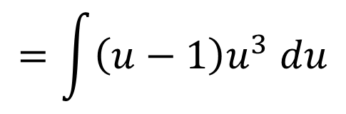

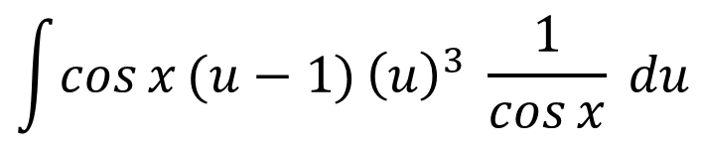

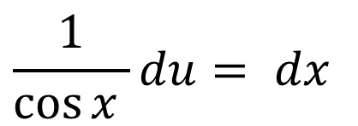
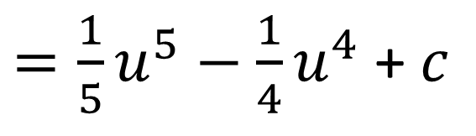
Use the substitution $u=\sin{x}+1$ to find $\int{\cos{x}\sin{x}{\left(1+\sin{x}\right)}^{3}}dx$
STEP 1: Work out $x$
STEP 3: Substitute
STEP 4: Integrate
$$u=\sin{x}+1$$
$={\frac{1}{5}u}^{5}−{\frac{1}{4}u}^{4}$ + $c$
$$\int{\cos{x}(u−1{)}{\left(u\right)}^{3} }\frac{1}{\cos{x}} du$$
$$\sin{x}=u−1$$
STEP 2: Work out $dx$
$$=\int{\left(u−1\right)u^{3} du}$$
STEP 5: Write in terms of $x$
$$\frac{du}{dx}=\cos{x}$$
$$=\frac{1}{5}{\left(\sin{x}+1\right)}^{5}−\frac{1}{4}{\left(\sin{x}+1\right)}^{4}+C$$
$$=\int{u^{4}−u^{3}} du$$
$$\frac{1}{\cos{x} }du= dx$$

Slide 8
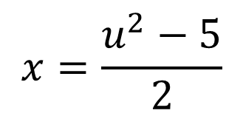
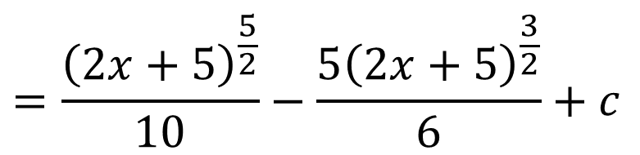
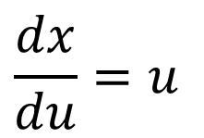
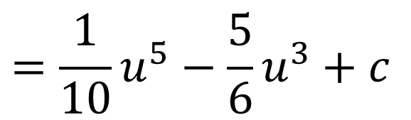

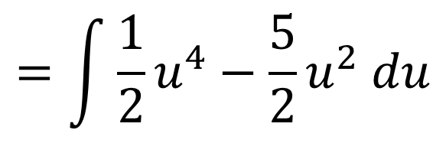

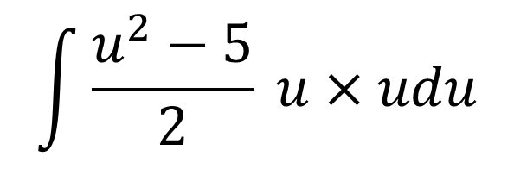


Use the substitution $u^{2}=2x+5$ to find $\int{x\sqrt{2x+5}} dx$
STEP 1: Work out $x$
STEP 3: Substitute
STEP 4: Integrate
$$u=\sqrt{2x+5}$$
$$=\frac{1}{10}u^{5}−\frac{5}{6}u^{3}+c$$
$$x=\frac{u^{2}−5}{2}$$
$$\int{\frac{u^{2}−5}{2} u×udu}$$
STEP 2: Work out $dx$
$$=\int{\frac{1}{2}u^{4}−\frac{5}{2}u^{2} du}$$
STEP 5: Write in terms of $x$
$$\frac{dx}{du}=u$$
$$=\frac{{\left(2x+5\right)}^{\frac{5}{2}}}{10}−\frac{5{\left(2x+5\right)}^{\frac{3}{2}}}{6}+c$$
$$dx=u du$$

Slide 9
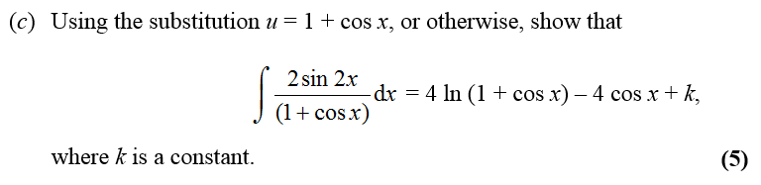
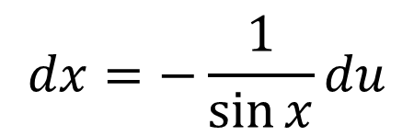


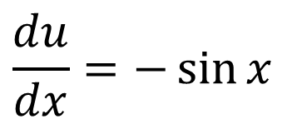
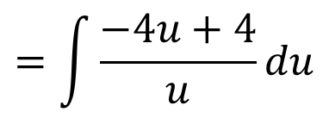

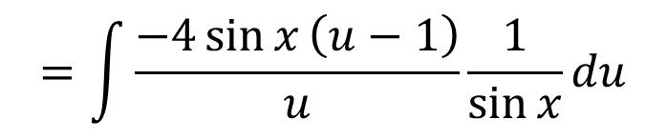
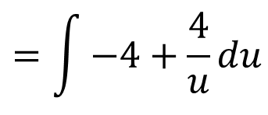
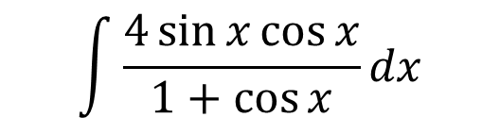



STEP 1: Work out $x$
STEP 3: Substitute
STEP 4: Integrate
$$\cos{x}=u−1$$
$$\int{\frac{4\sin{x}\cos{x}}{1+\cos{x}}dx}$$
$$=−4u+4\ln\left|u\right|+c$$
STEP 2: Work out $dx$
$$=\int{\frac{−4\sin{x}\left(u−1\right)}{u}}\frac{1}{\sin{x}}du$$
$$\frac{du}{dx}=−\sin{x}$$
STEP 5: Write in terms of $x$
$$=\int{\frac{−4u+4}{u}du}$$
$$dx=−\frac{1}{\sin{x}}du$$
$$=−4(\cos{x+1)}−\ln\left|\cos{x}+1\right|+c$$
$$=\int{−4+\frac{4}{u}}du$$

Slide 10

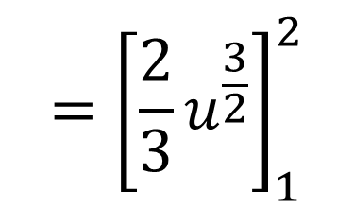

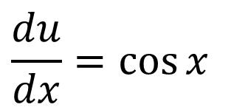
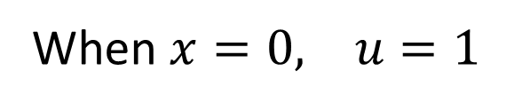


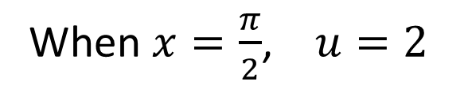

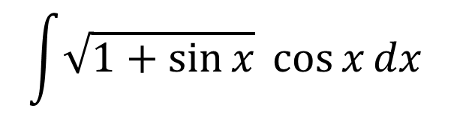

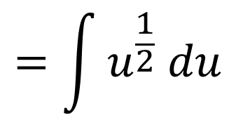
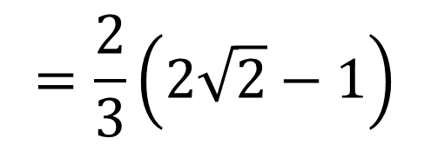
Calculate $\int_{0}^{\frac{π}{2}}{\cos{x}\sqrt{1+\sin{x}}} dx$
STEP 1: Work out $x$
STEP 3: Substitute
STEP 5: Integrate
$u=1+\sin{x}$
$$\int{\sqrt{1+\sin{x}}}\cos{x}dx$$
$$={\left[\frac{2}{3}u^{\frac{3}{2}}\right]}_{1}^{2}$$
$$\sin{x}=u−1$$
$$=\int{u^{\frac{1}{2}} du}$$
STEP 2: Work out $dx$
STEP 6: Substitute limits.
$$\frac{du}{dx}=\cos{x}$$
STEP 4: Change limits
$$=\frac{2}{3}\left(2\sqrt{2}−1\right)$$
When $x=\frac{π}{2}$, $u=2$
$$du=\cos{x} dx$$
When $x=0, u=1$

Slide 11
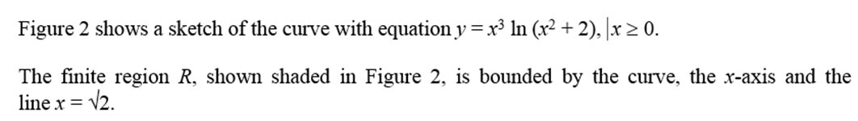

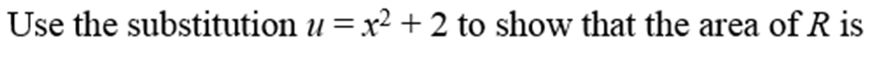
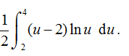
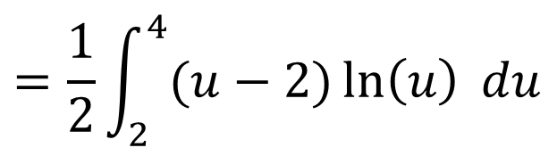
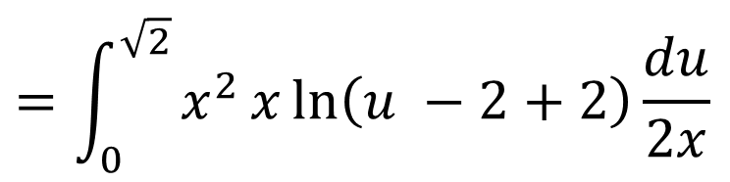







STEP 1: Work out $x$
STEP 3: Substitute
STEP 4: Change limits
$$x^{2}=u−2$$
$$=\int_{0}^{\sqrt{2}}{x^{2 }x\ln\left(u −2+2\right)\frac{du}{2x}}$$
When $x=\sqrt{2}$, $u=4$
When $x=0, u=2$
STEP 2: Work out $dx$
$$=\int_{0}^{\sqrt{2}}{\frac{1}{2}(u−2)\ln\left(u\right) du}$$
$$=\frac{1}{2}\int_{2}^{4}{(u−2)\ln\left(u\right) du}$$
$$du=2x dx$$

