Slide 1
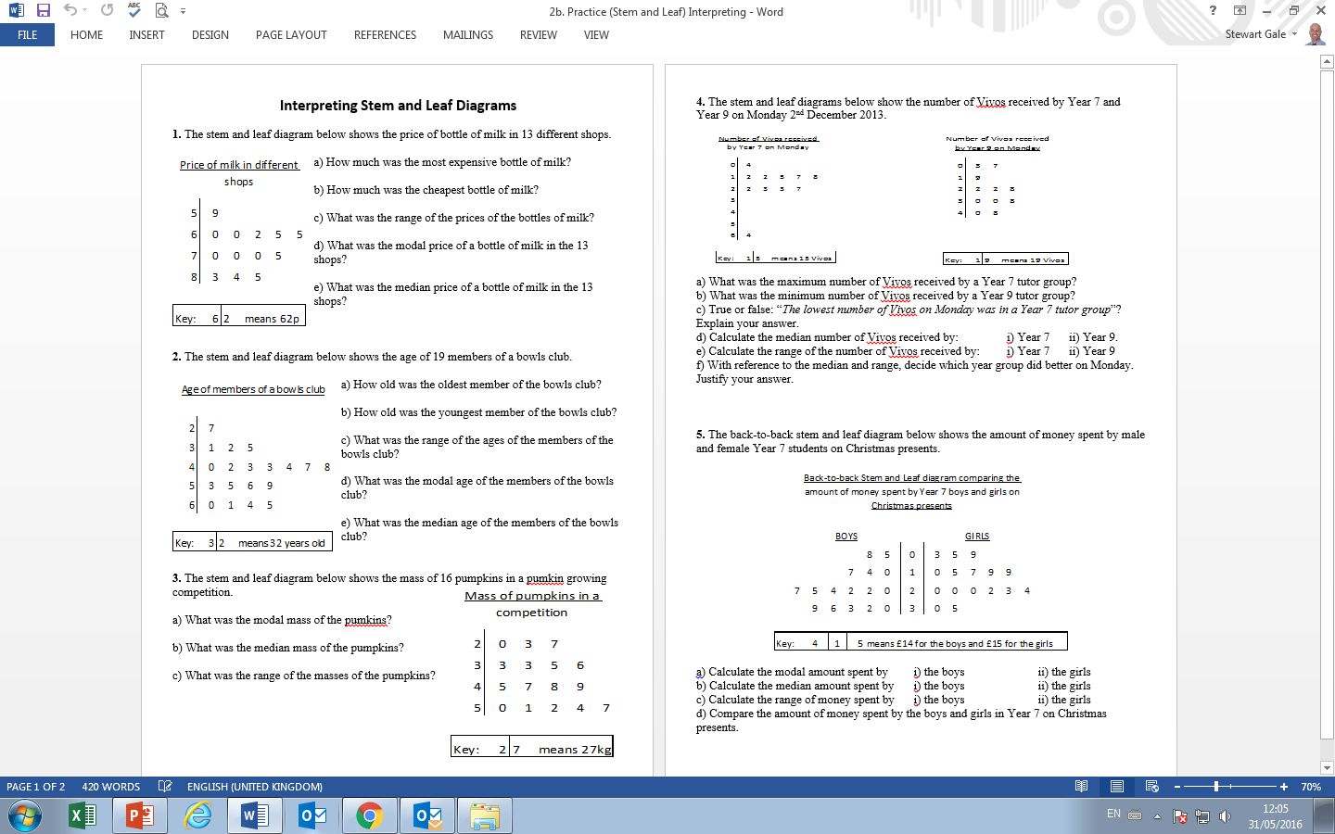

Slide 2
ANSWERS

Slide 3
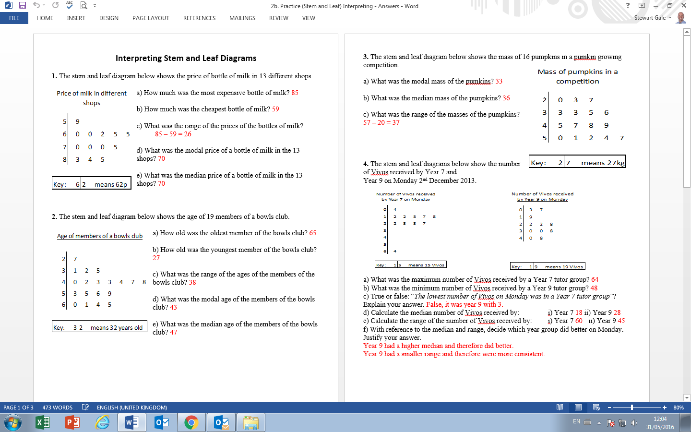

Slide 5
46

Slide 6
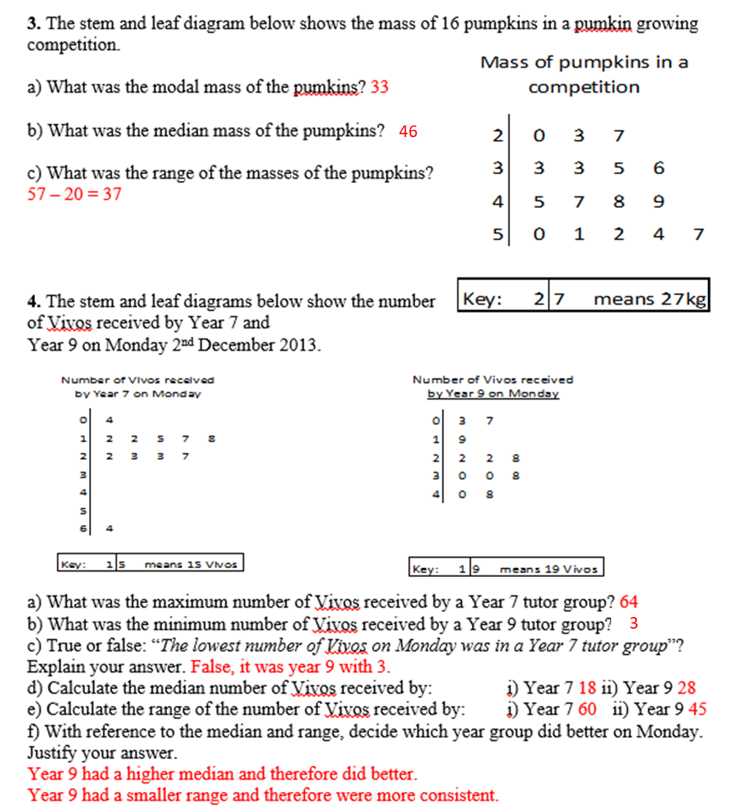

Slide 7
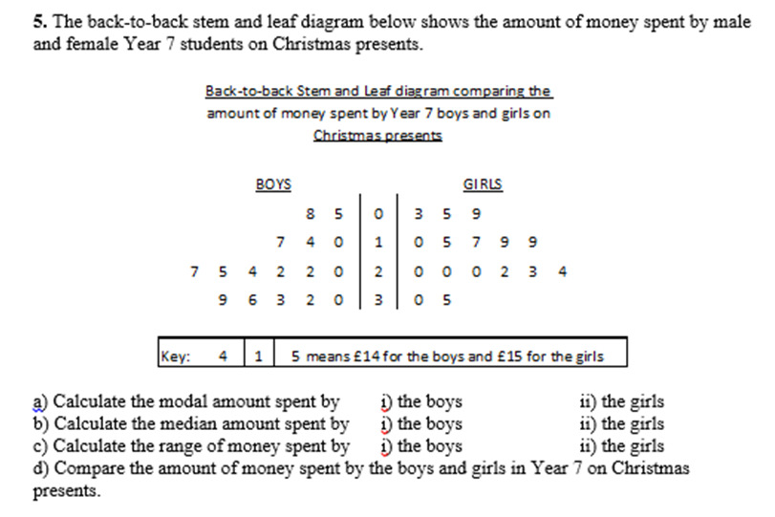
364
291
23
19.5
34
32
The boys had a higher median than the girls.
The boys had a bigger range than the girls.

