Slide 1
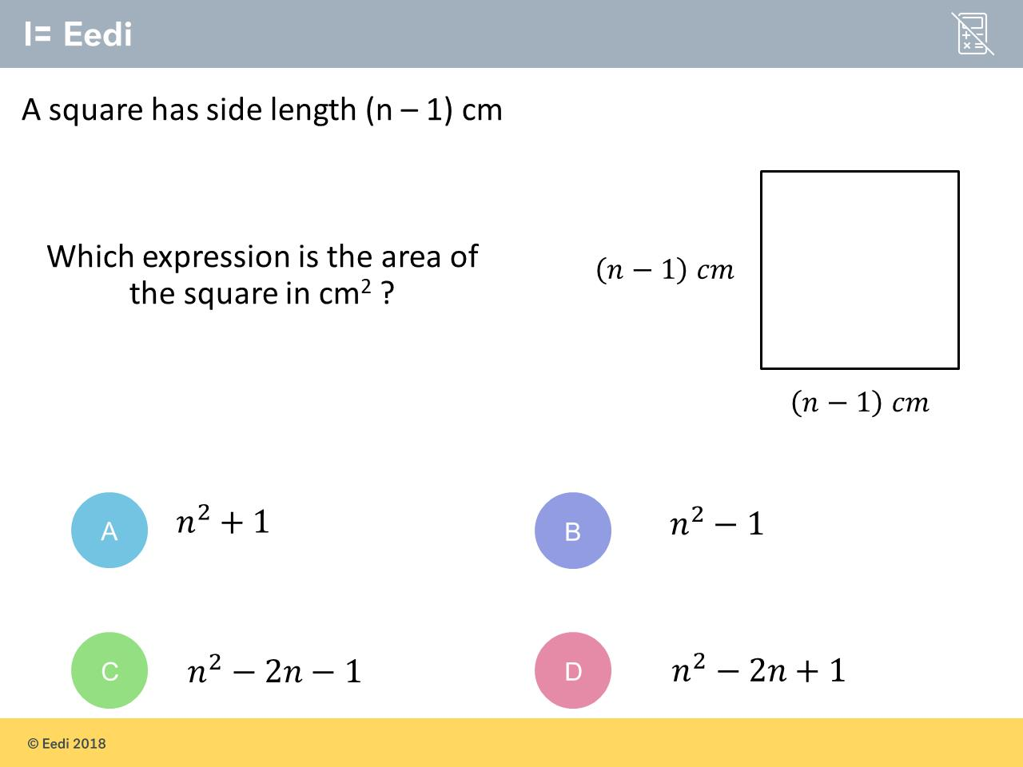
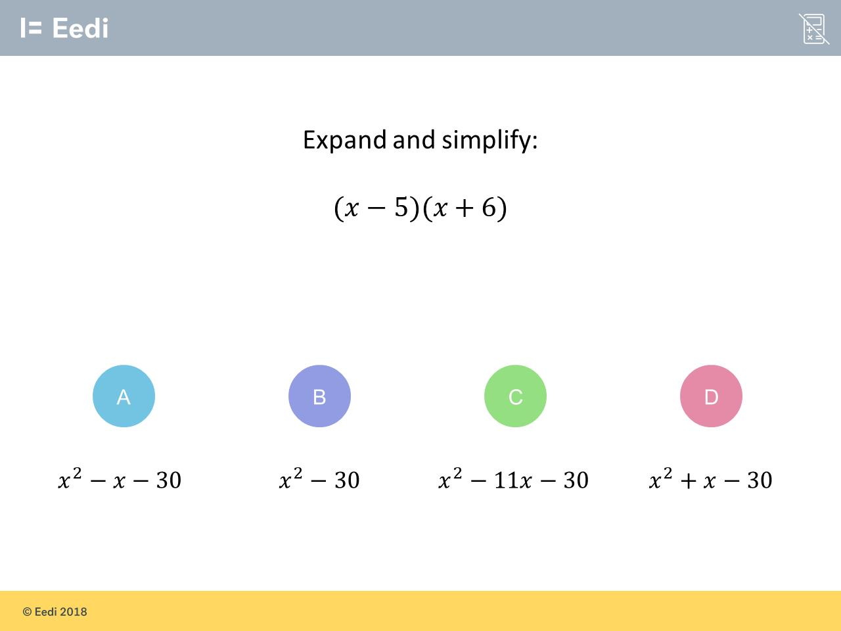
Worst answered question?
Most common wrong answer?

Slide 2
ANSWERS

Slide 3
Worst answered question?

Slide 4
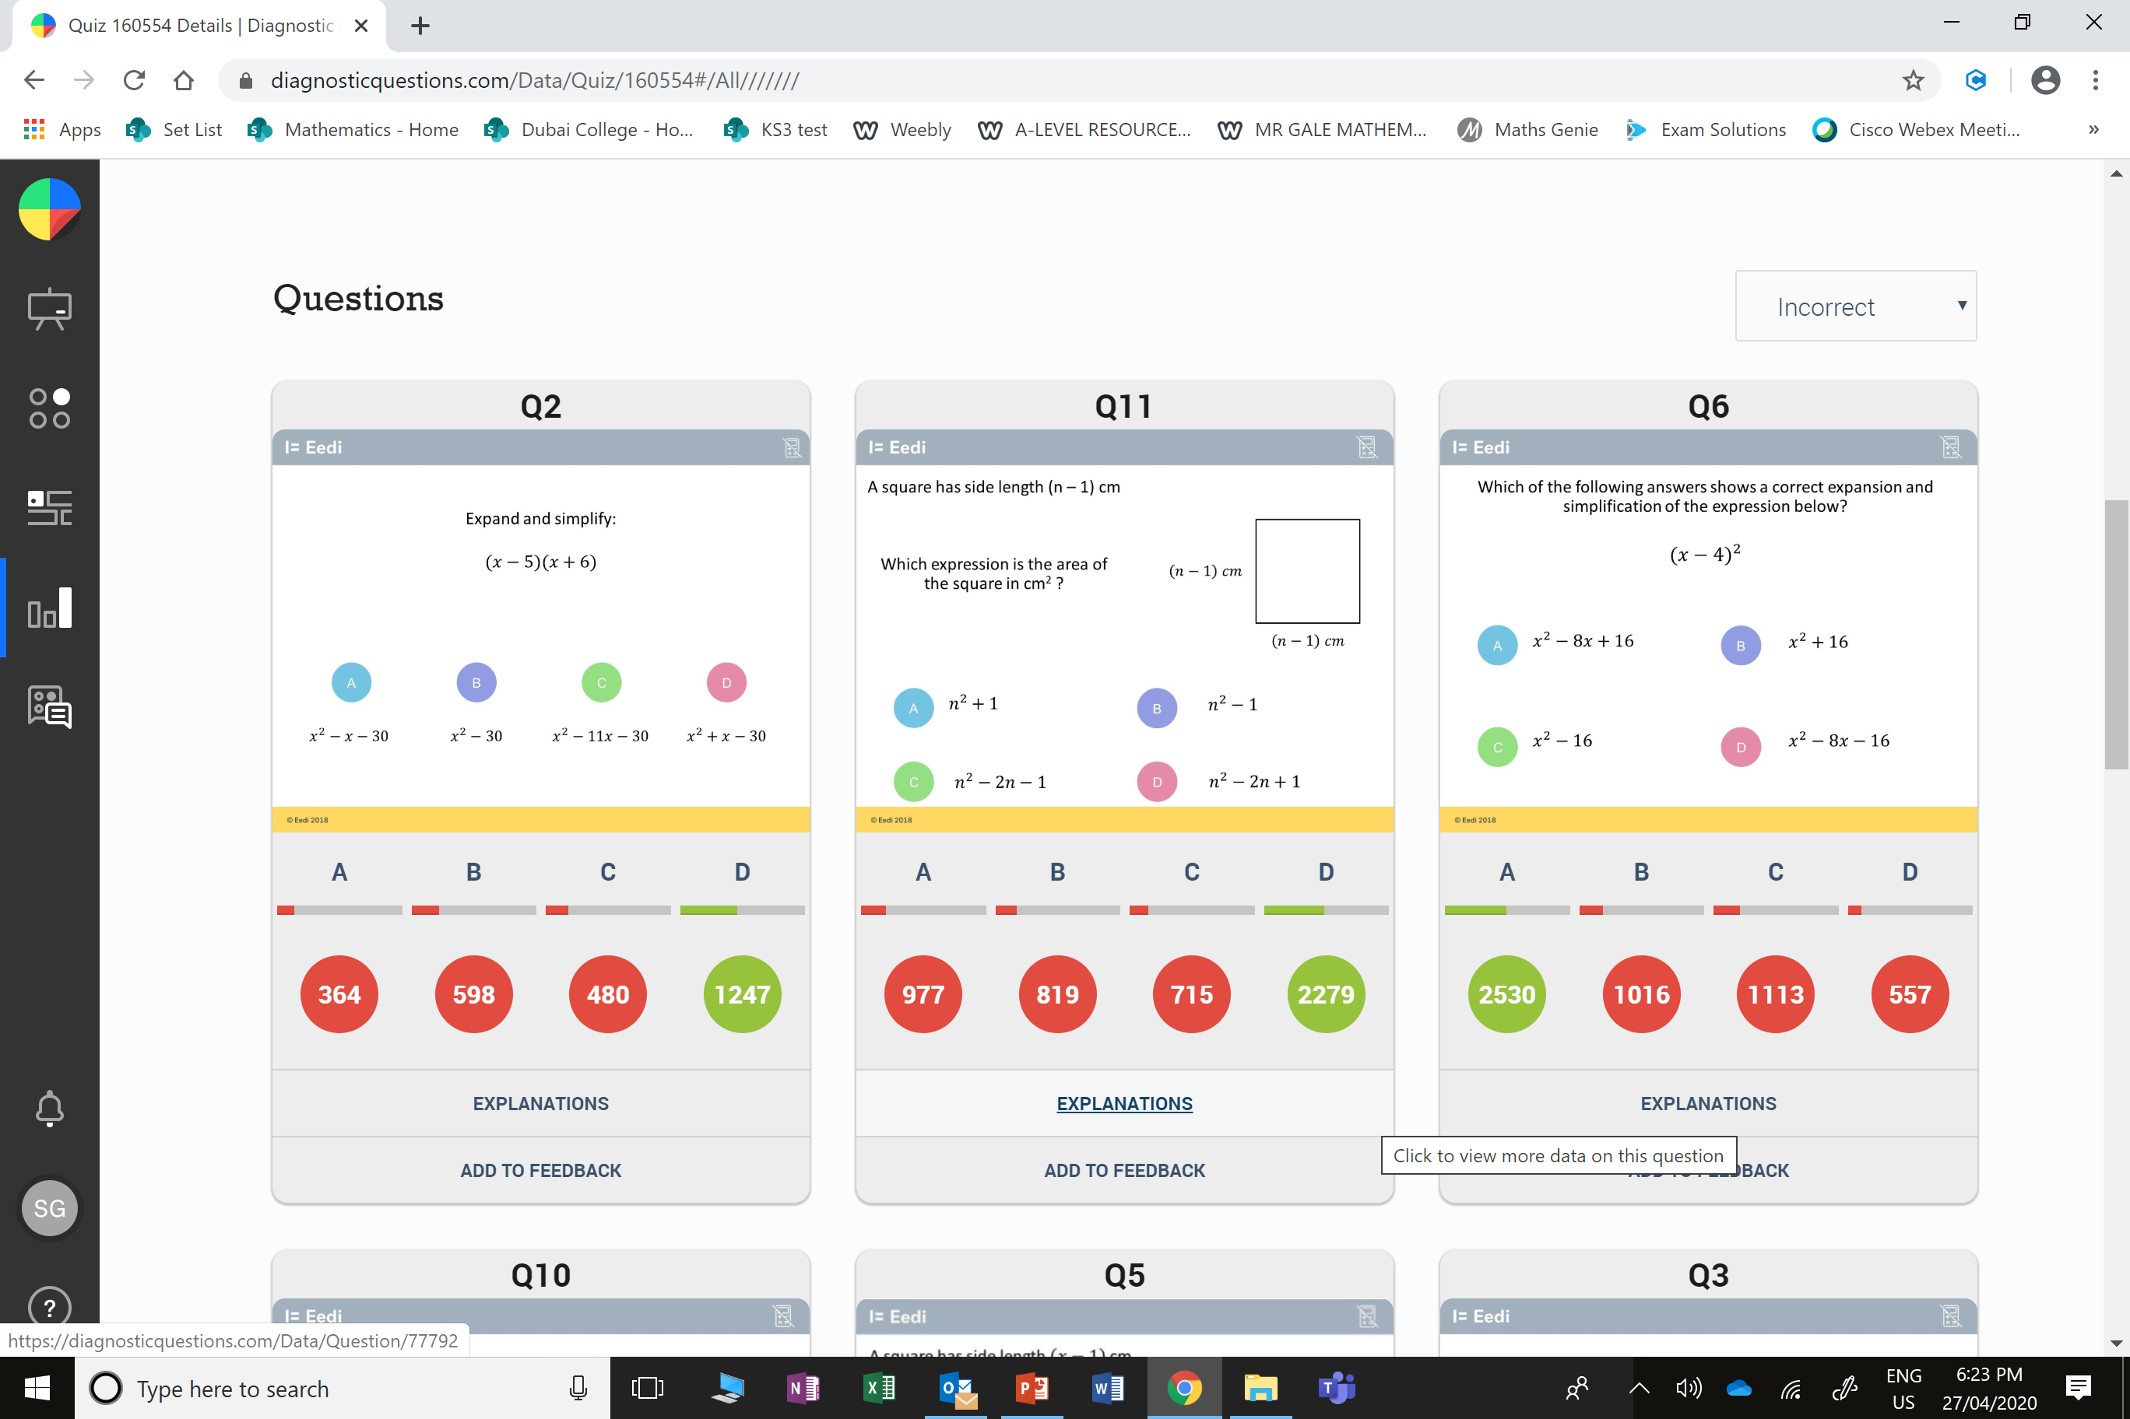
B
The student has multiplied the first terms and the second terms only.

Slide 5
A
The student has just squared the first and second terms.

