Slide 1
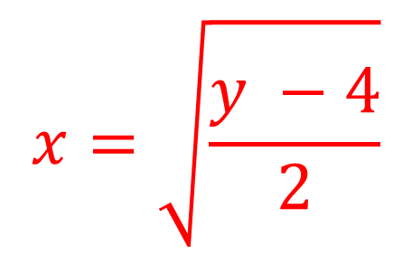
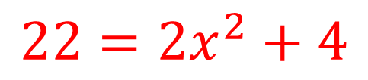
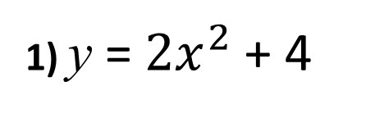
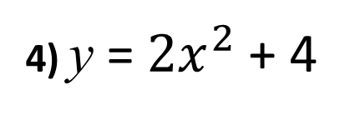
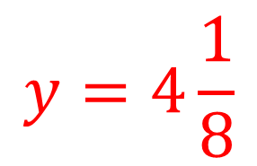


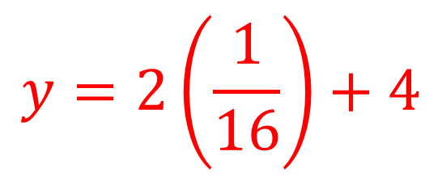
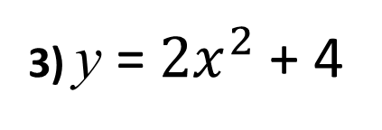
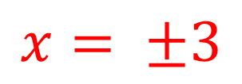
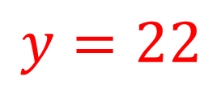
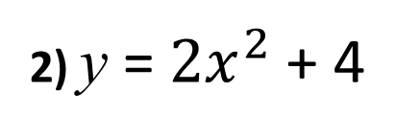
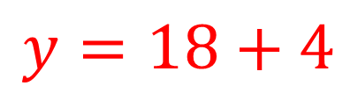
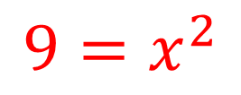
1) y = $2x^{2}$ + 4
2) y = $2x^{2}$ + 4
Make x the subject of the formula.
Calculate the value for y when x = -3
$$x=\sqrt{\frac{y −4}{2}}$$
$$y=18+4$$
$$y=22$$
3) y = $2x^{2}$ + 4
4) y = $2x^{2}$ + 4
Calculate the value for y when x = $\frac{1}{4}$
Calculate the value for x when y = $22$
$$y=2\left(\frac{1}{16}\right)+4$$
$$22=2x^{2}+4$$
$$9=x^{2}$$
$$y=4\frac{1}{8}$$
$$x= ±3$$

Slide 2
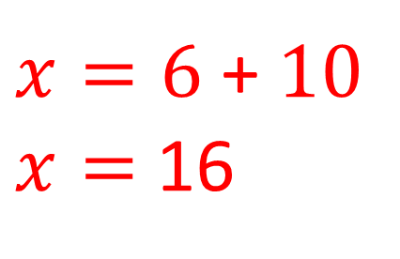
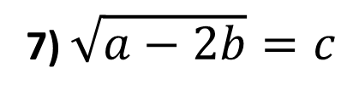
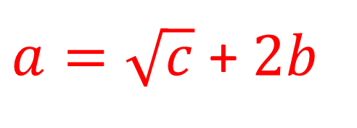
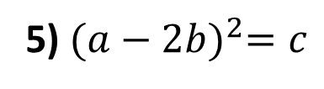
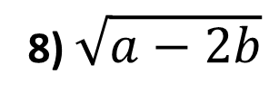
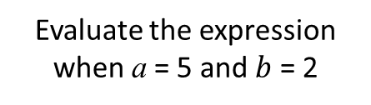
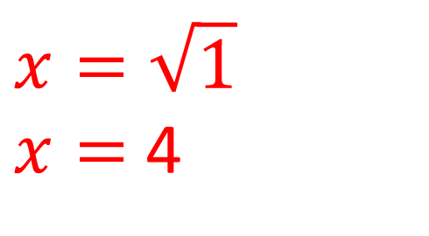
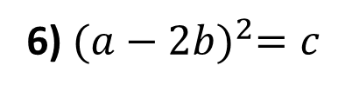
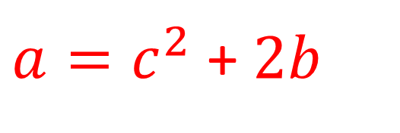
5) ${(a−2b)}^{2}=c$
6) ${(a−2b)}^{2}=c$
Make a the subject of the formula.
Calculate the value for a
when b = 5 and c = 36
$a=\sqrt{c}$ + $2b$
$x=6$ + $10$
$x=$ 16
7) $\sqrt{a−2b}=c$
8) $\sqrt{a−2b}$
Make a the subject of the formula.
Evaluate the expression
when a = 5 and $b$ = 2
$a=c^{2}$ + $2b$
$$x=\sqrt{1}$$
$x=$ 4

