Slide 1
Algebraic Methods
Improper Fractions
Chapter 1
(Part 4 of 4)

Slide 2
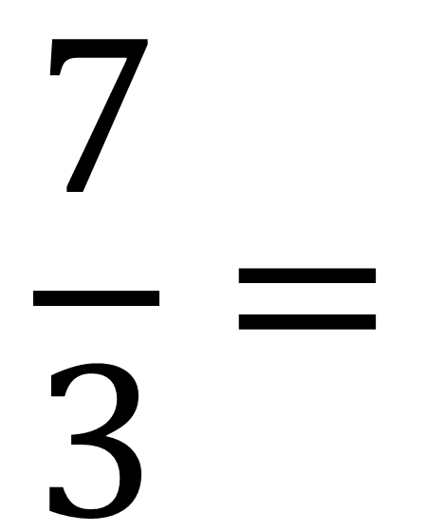
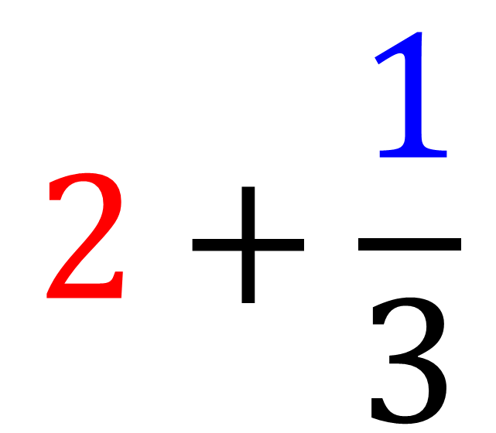
Improper Fractions – Whole Number and Remainder
Remainder
$$\frac{7}{3}=$$
$$2+\frac{1}{3}$$
Whole Number

Slide 3
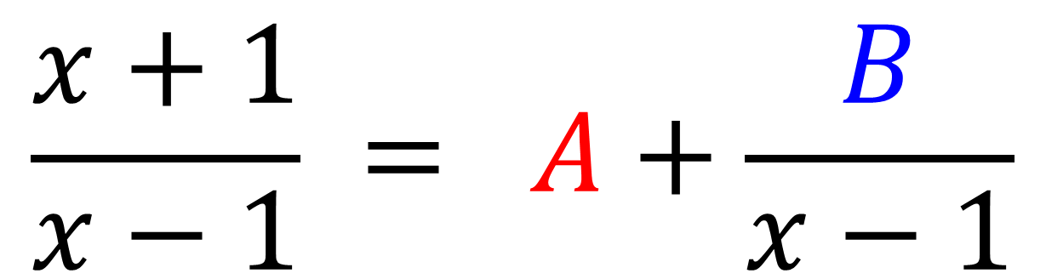
Improper Fractions – Whole Number and Remainder
Remainder
Whole Number
$$\frac{x+1}{x−1} = A+\frac{B}{x−1}$$

Slide 4
Improper Fractions
An algebraic fraction is improper
If the power of the numerator is
equal to or more than
the power of the denominator.

Slide 5
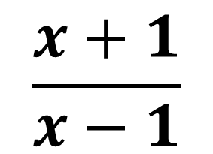
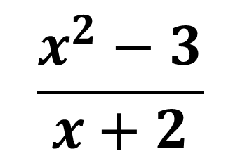
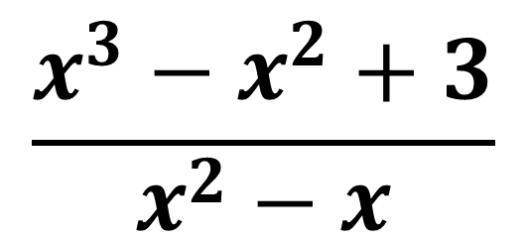
An algebraic fraction is improper if the power of the numerator
is equal to or more than the power of the denominator.
$$\frac{x^{2}−3}{x+2}$$
$$\frac{x^{3}−x^{2}+3}{x^{2}−x}$$
$$\frac{x+1}{x−1}$$

Slide 6




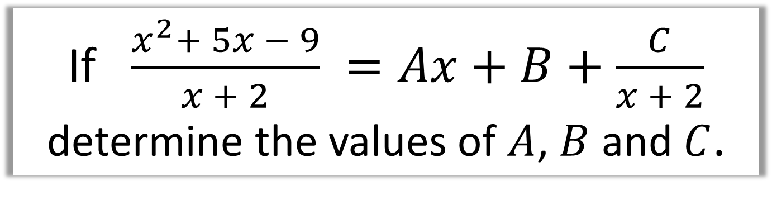




If $\frac{x^{2}+ 5x − 9}{x + 2} =Ax+B+\frac{C}{x + 2}$
determine the values of $A$, $B$ and $C$.
$$x^{2}+ 5x − 9≡Ax\left(x+2\right)+B\left(x+2\right)+C$$
Let $x=−2$
Let $x=0$
Let x = 1
$$C=−15$$
$$−9=2B+C$$
$$−3 =3A+3B+C$$
$$B=3$$
$$A=1$$
$$\frac{x^{2}+ 5x − 9}{x + 2}≡\left(x+3\right)−\frac{15}{x+2}$$

Slide 7
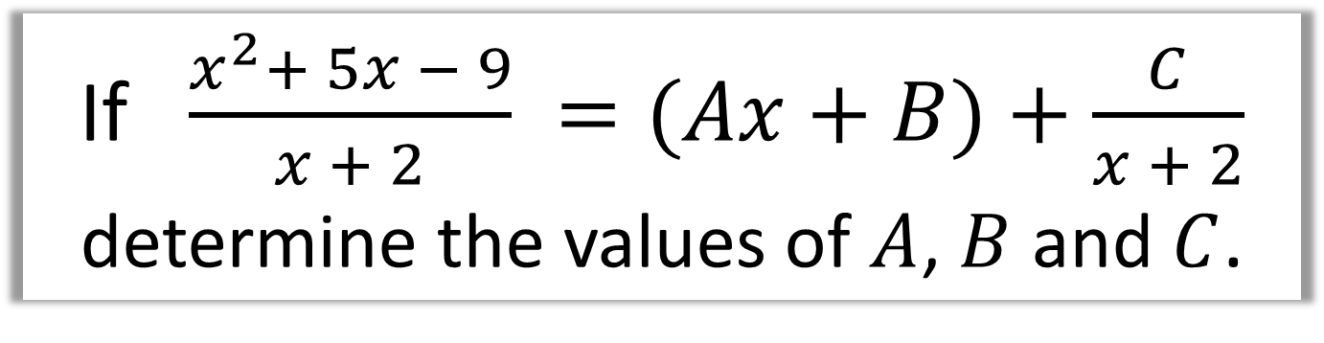
If $\frac{x^{2}+ 5x − 9}{x + 2} =(Ax+B)+\frac{C}{x + 2}$
determine the values of $A$, $B$ and $C$.
Another way to answer improper partial fraction question is to do algebraic long division.

Slide 8

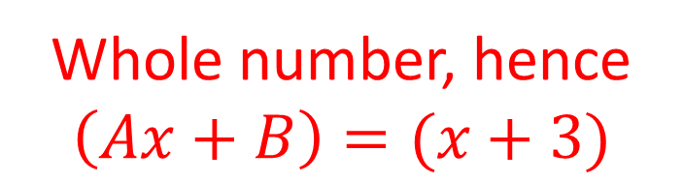


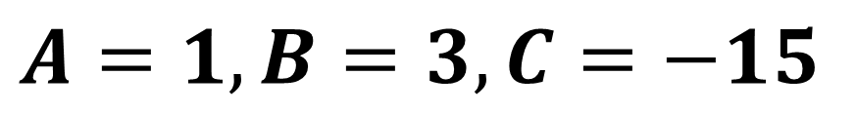
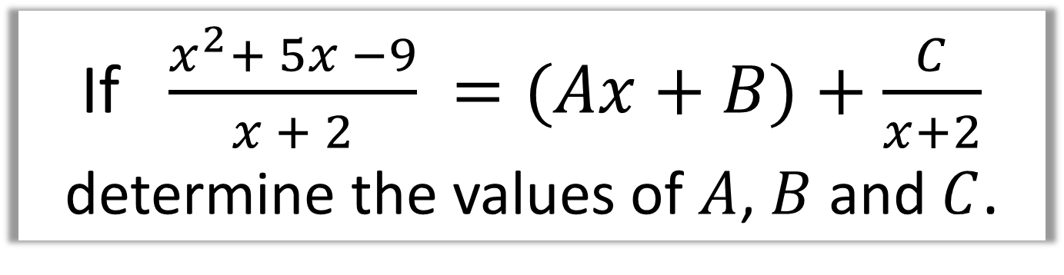



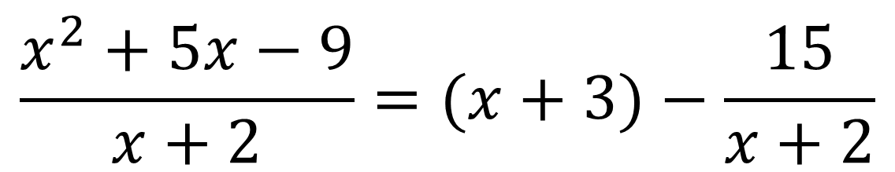


If $\frac{x^{2}+ 5x −9}{x + 2} =(Ax+B)+\frac{C}{x+2}$
determine the values of $A$, $B$ and $C$.
Whole number, hence
$$\left(Ax+B\right)=(x+3)$$
$$x + 3$$
$$x+2$$
$$x^{2}+5x−9$$
$$x^{2}+2x$$
$$\frac{x^{2}+5x−9}{x+2}=(x+3)−\frac{15}{x+2}$$
$$3x−9$$
$$3x+6$$
$$−15$$
$$A=1, B=3, C=−15$$
Remainder, hence $C$ = $−$15

Slide 9
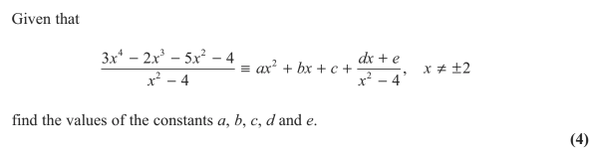
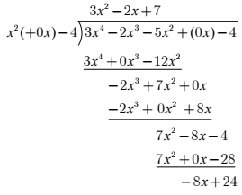
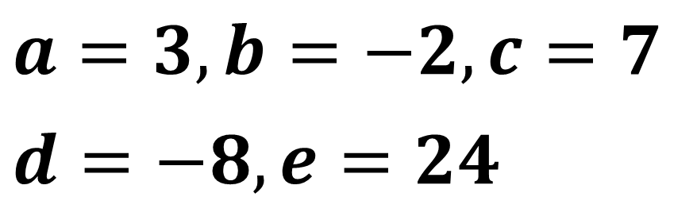
$$a=3, b=−2, c=7$$
$$d=−8, e=24$$

