Slide 1
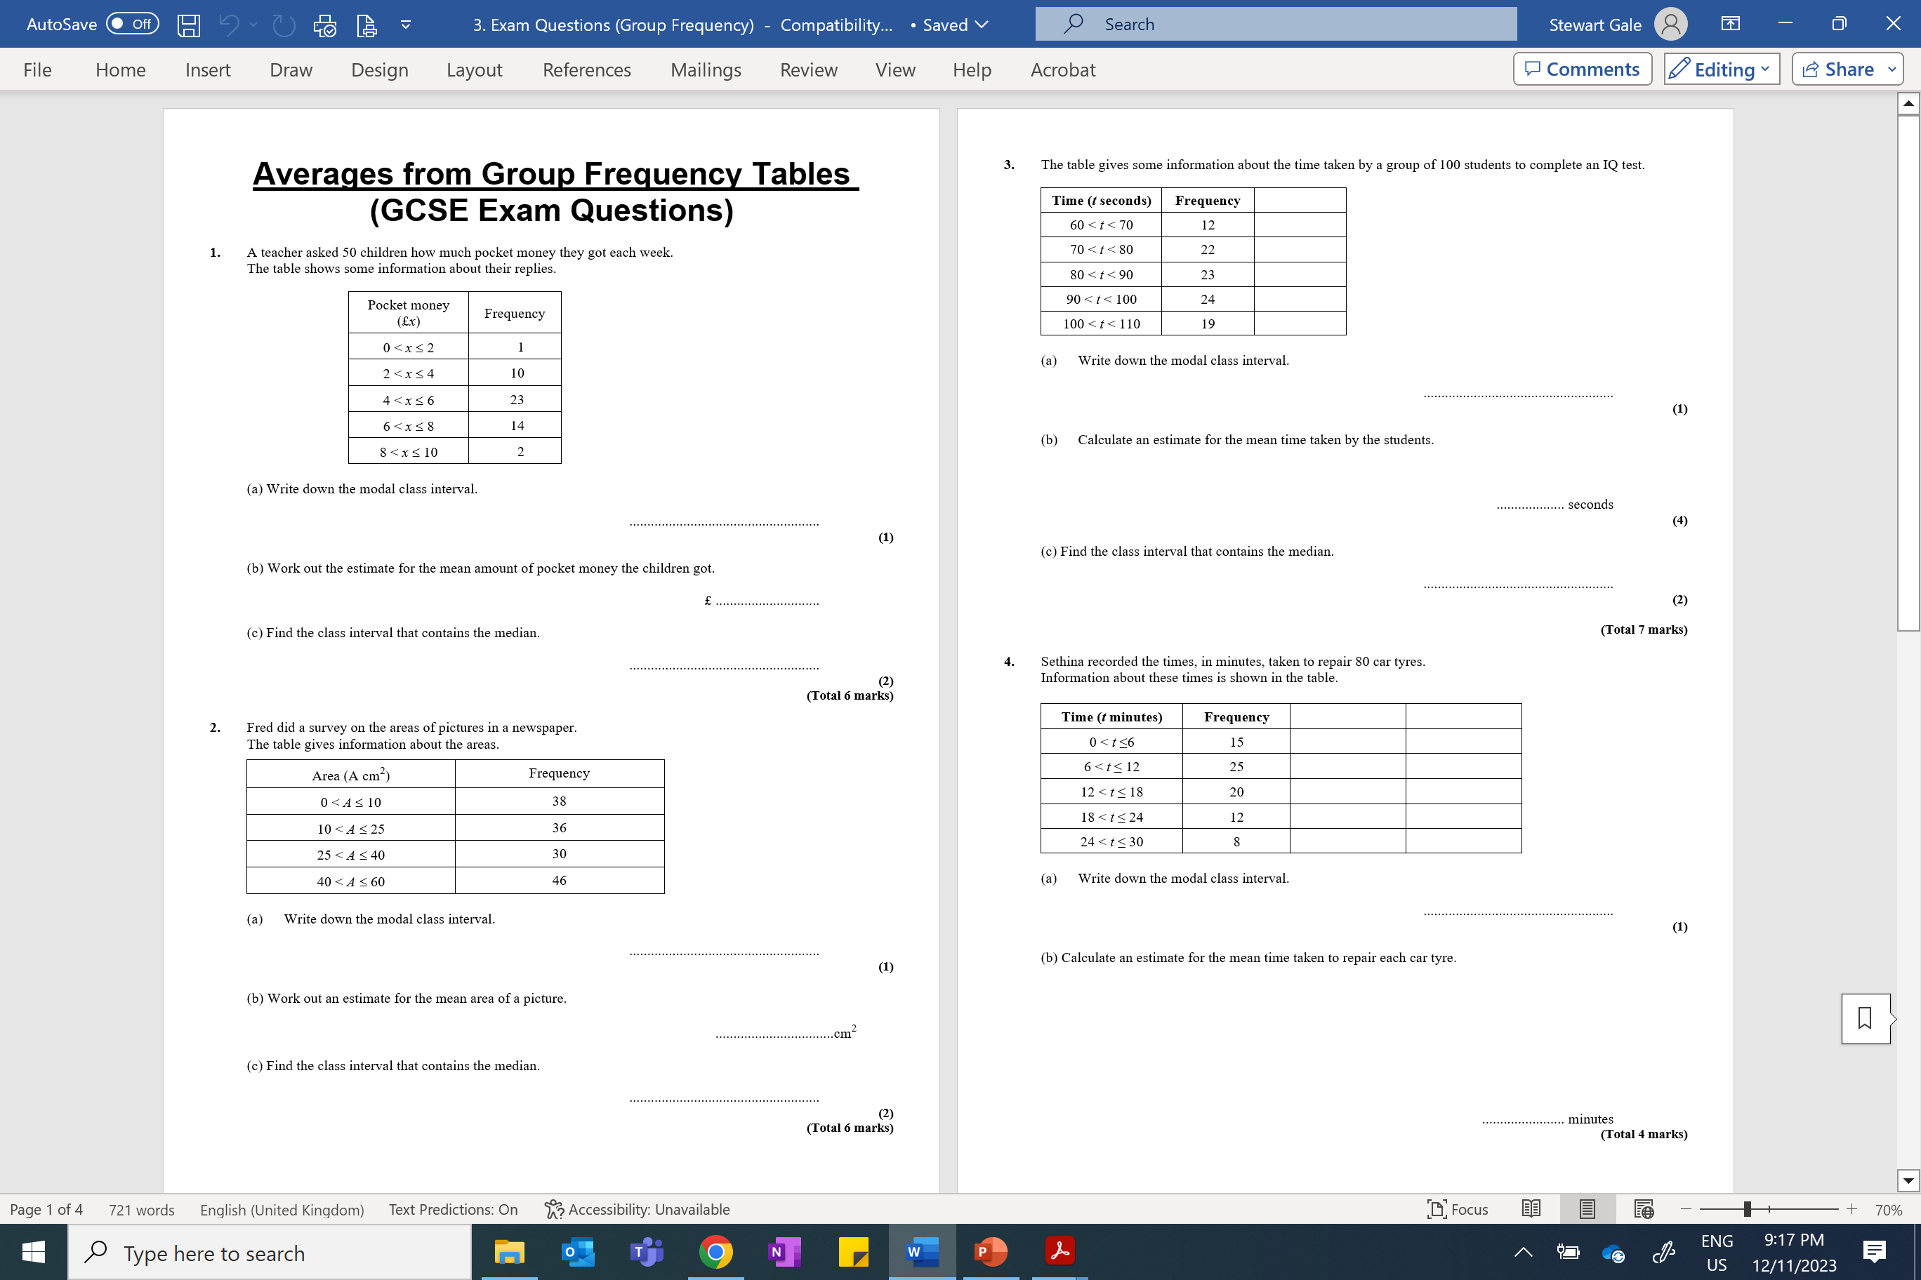

Slide 2
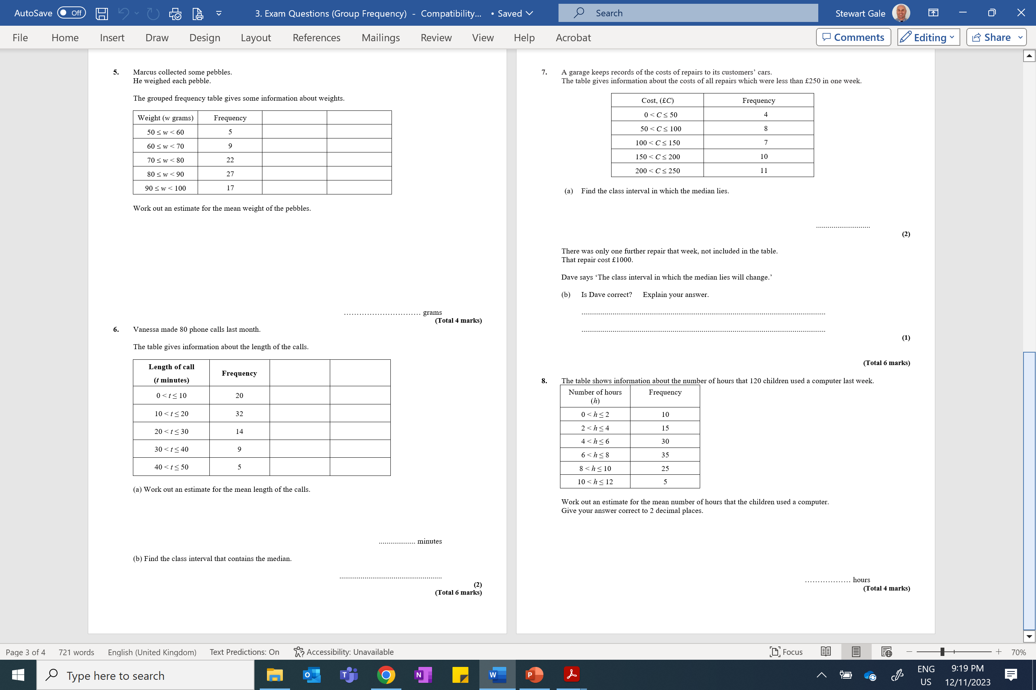

Slide 3
ANSWERS

Slide 4
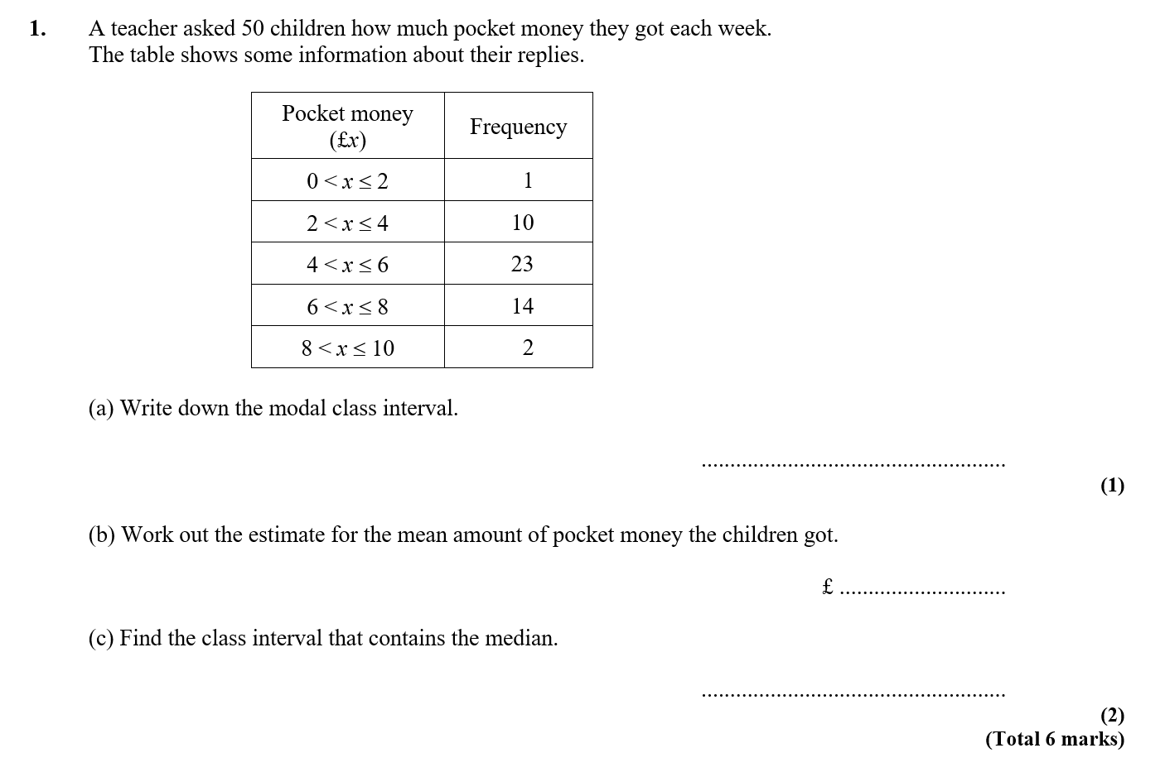
4 < x < 6
262 ÷ 50 = 5.24
(1 × 1) + (3 × 10) + (5 × 23) + (7 × 14) + (9 × 2) = 262
4 < x < 6

Slide 5
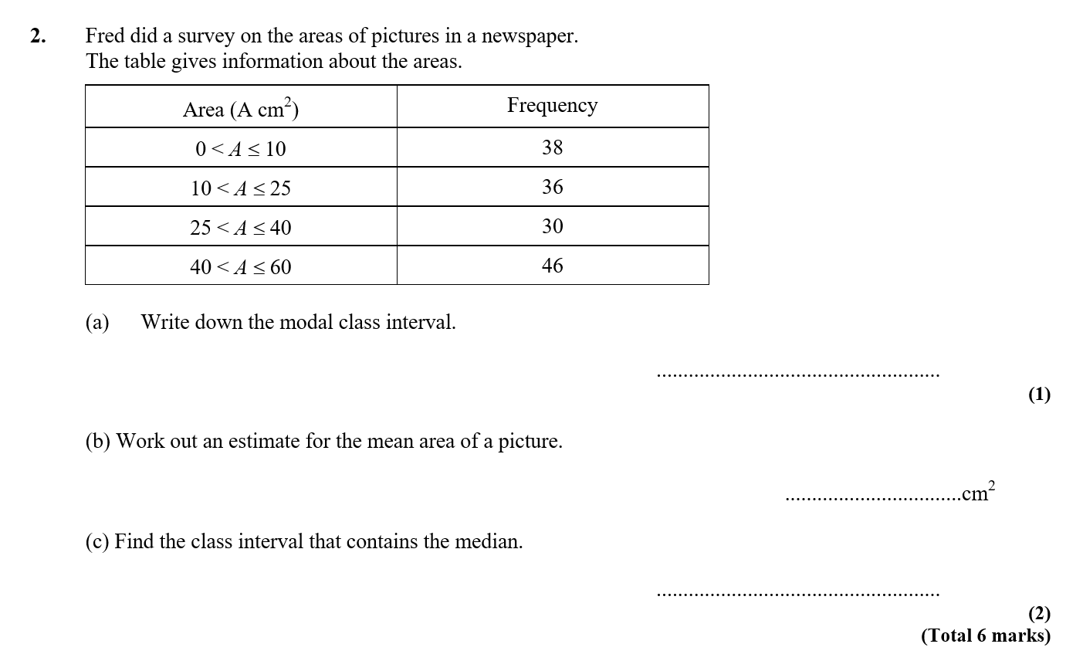
40 < A < 60
4095 ÷ 150 = 27.3
38 × 5 + 36 × 17.5 + 30 × 32.5 + 46 × 50
= 190 + 630 + 975 + 2300 = 4095
25 < x < 40

Slide 6
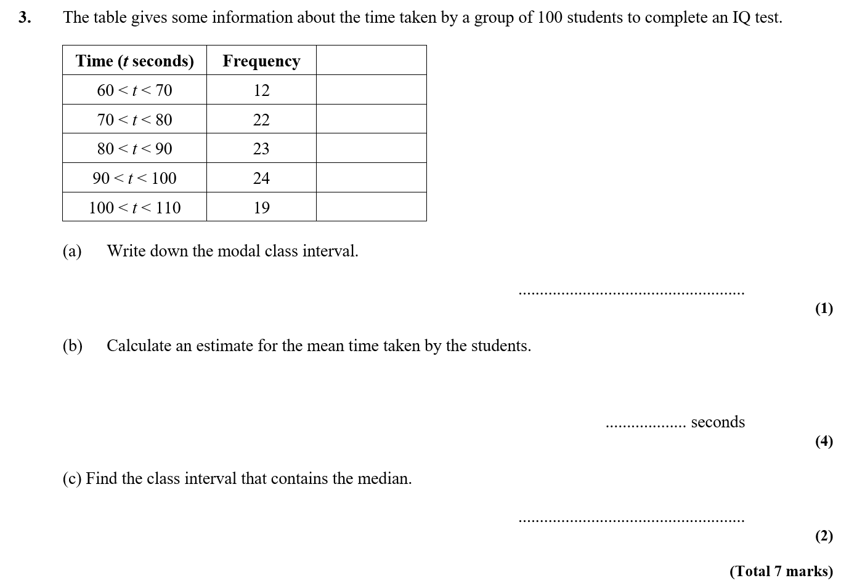
90 < t ≤ 100
65 × 12 = 780
75 × 22 = 1650
85 × 23 = 1955
95 × 24 = 2280
105 × 19 = 1995
8660/100 = 86.6
80 < t ≤ 90

Slide 7
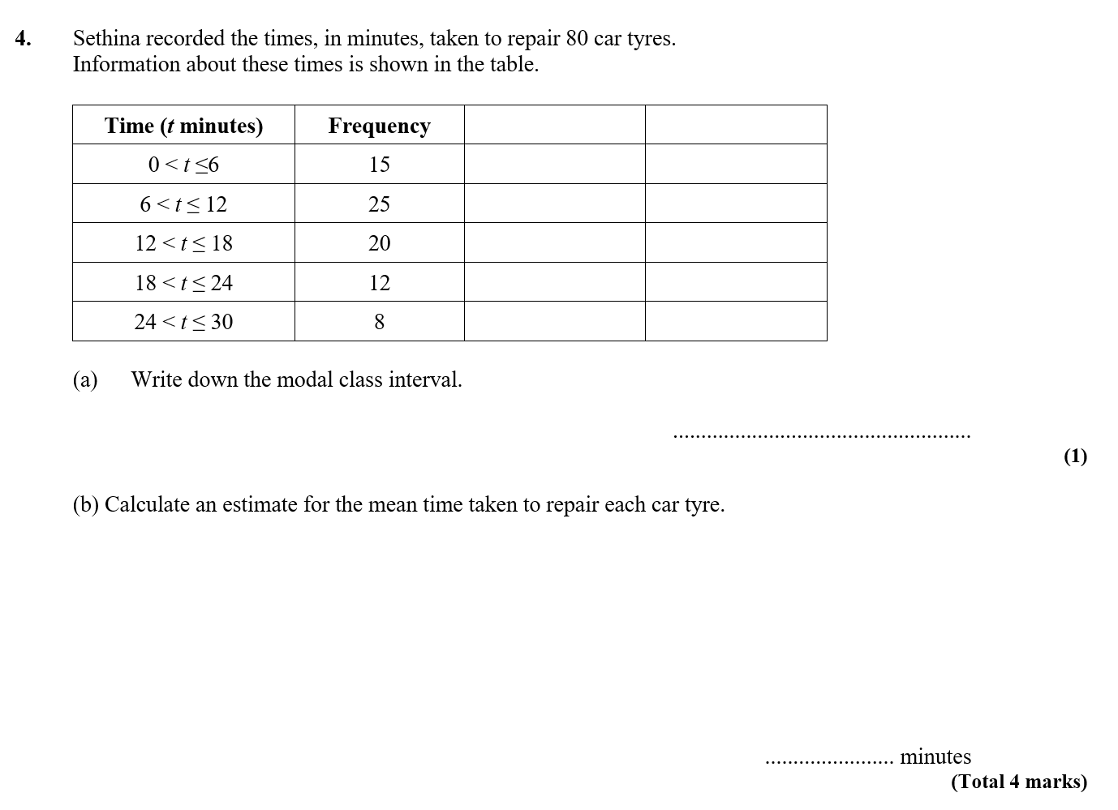
6 < t ≤ 12
15 × 3 = 45
25 × 9 = 225
20 × 15 = 300
12 × 21 = 252
8 × 27 = 216
1038 ÷ 80 = 12.975

Slide 8

55 x 5 + 65 x 9 + 75 x 22 + 85 x 27 + 95 x 17 = 6420
6420 ÷ 80 = 80.25

Slide 9
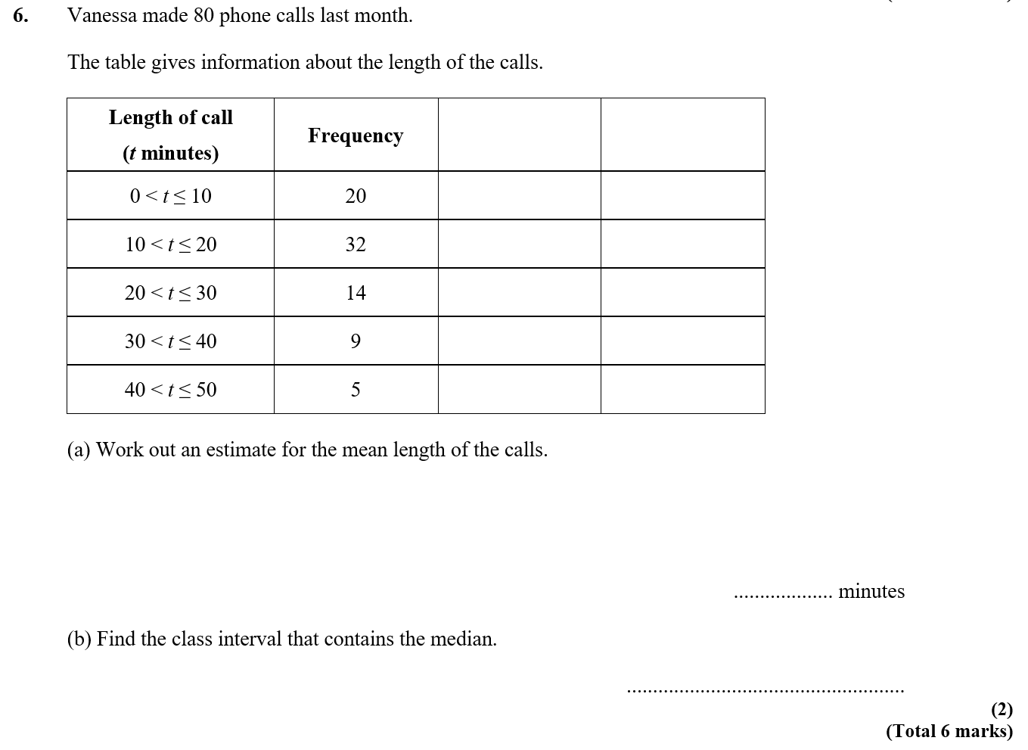
(20 × 5) + (32 × 15) + (14 × 25) + (9 × 35) + (5 × 45)
= 100 + 480 + 350 + 315 + 225
1470 ÷ 80 = 18.375
10 < t ≤ 20

Slide 10
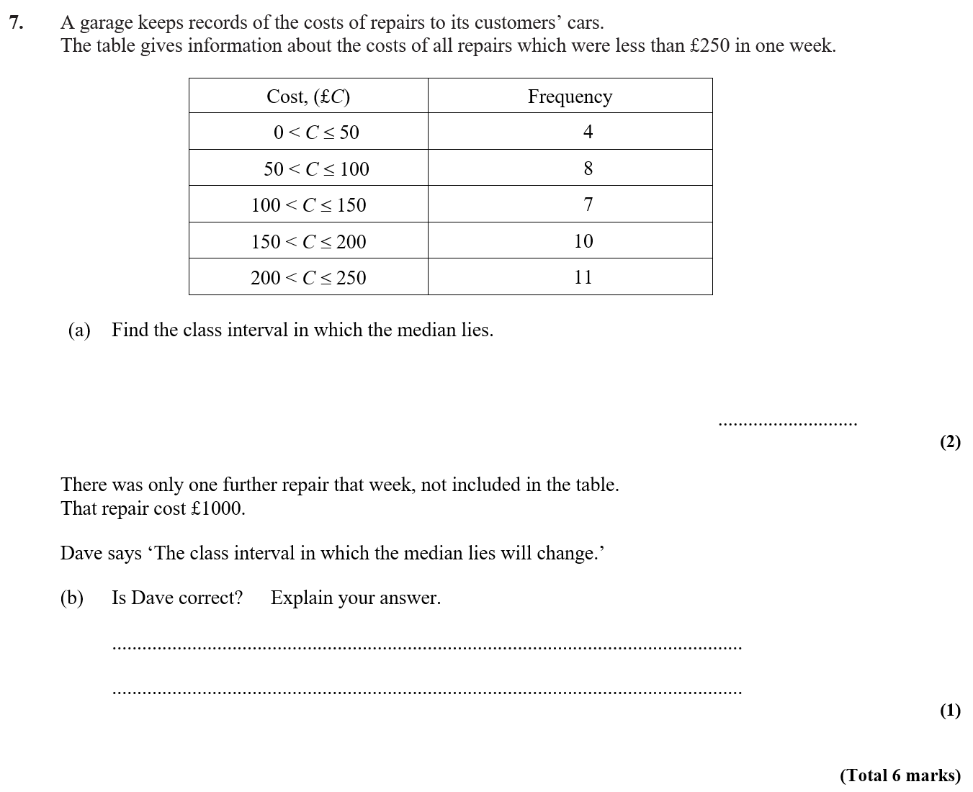
150 < C ≤ 200
No, because the 21st value is in the same interval

Slide 11
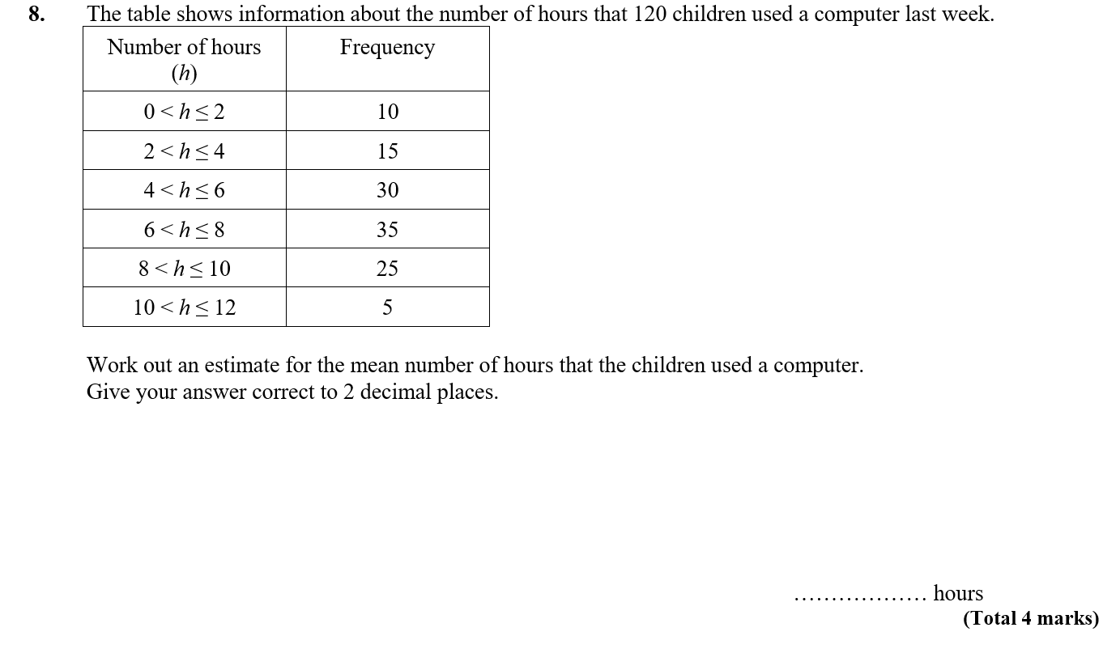
(1 × 10) + (3 × 15)+ (5 × 30) + (7 × 35) + (9 × 25) + (11 × 5) = 730
730 ÷ 120 = 6.08333

