Slide 1
Circles
Equation of a Circle
Chapter 6
(Part 2 of 4)

Slide 2
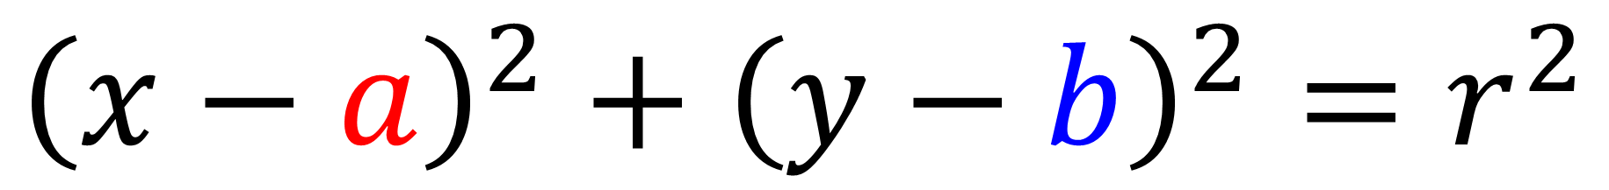
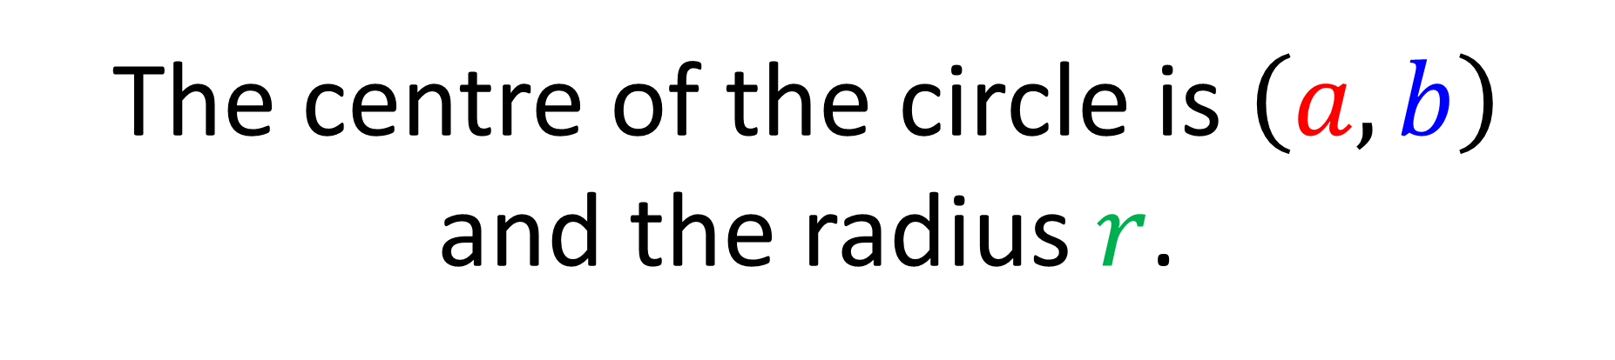
Equation of a Circle
$${\left(x−a\right)}^{2}+{\left(y−b\right)}^{2}=r^{2}$$
The centre of the circle is $\left(a,b\right)$
and the radius $r$.

Slide 3
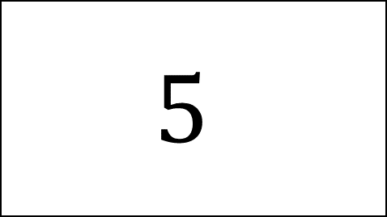
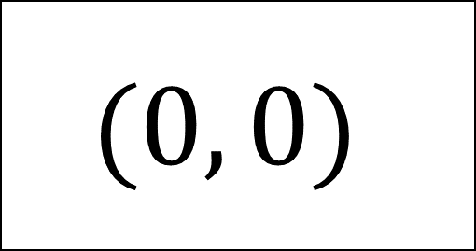
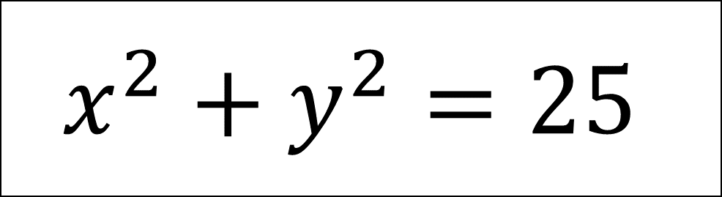
Centre
Radius
$$(0, 0)$$
$$5$$
Equation
$$x^{2}+y^{2}=25$$

Slide 4
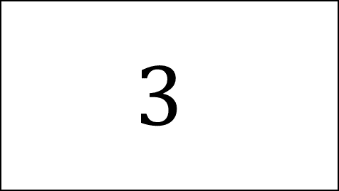
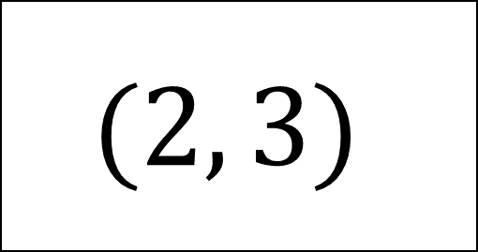
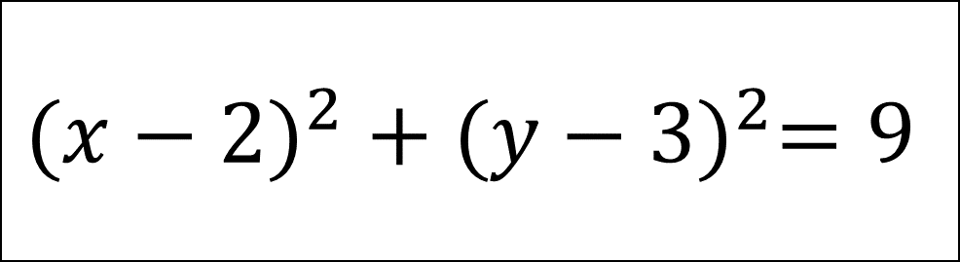
Centre
Radius
$$(2, 3)$$
$$3$$
Equation
$${(x−2)}^{2} + {(y−3)}^{2}=9$$

Slide 5
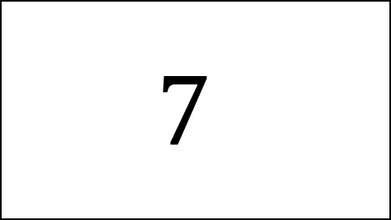
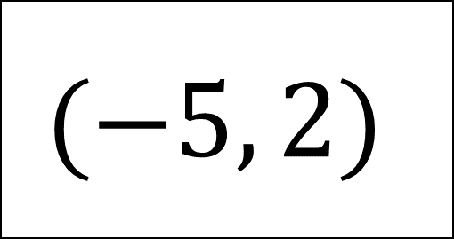
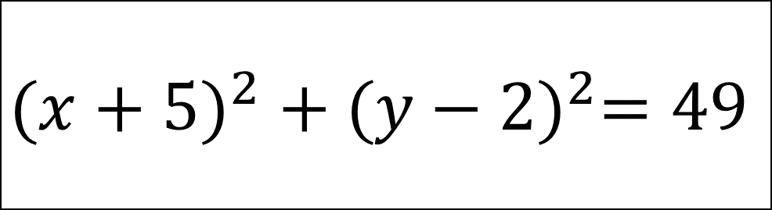
Centre
Radius
$$(−5, 2)$$
$$7$$
Equation
$${(x+5)}^{2} +{ (y−2)}^{2}=49$$

Slide 6
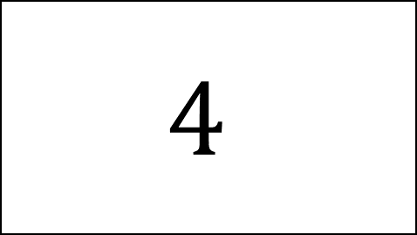
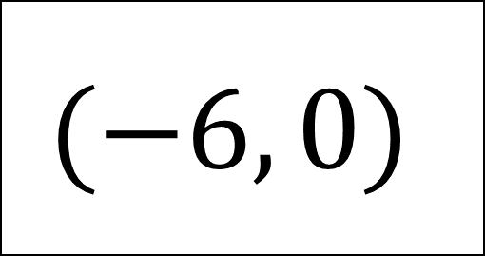
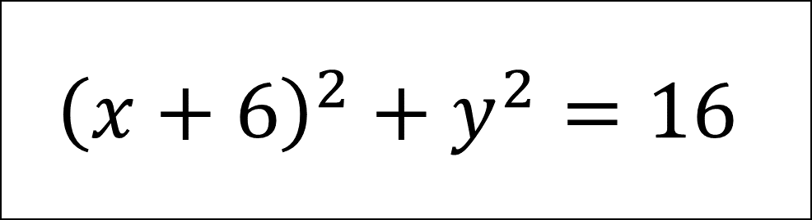
Equation
$${\left(x+6\right)}^{2}+y^{2}=16$$
Centre
Radius
$$(−6, 0)$$
$$4$$

Slide 7
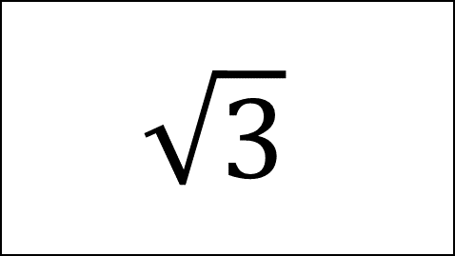
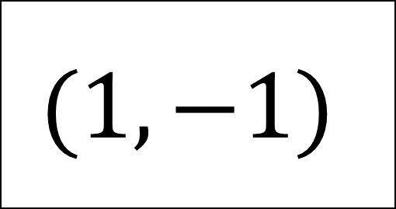
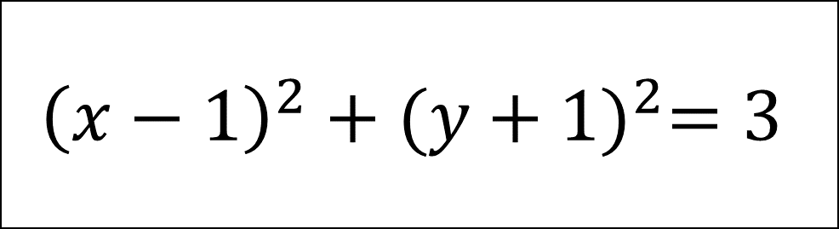
Equation
$${\left(x−1\right)}^{2}+{(y+1)}^{2}=3$$
Centre
Radius
$$(1, −1)$$
$$\sqrt{3}$$

Slide 8
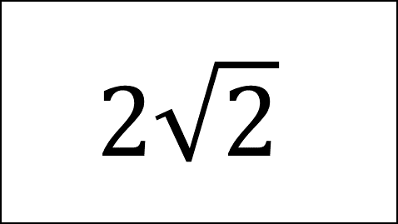
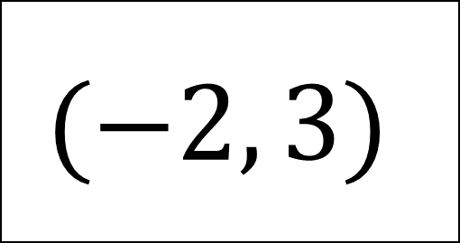
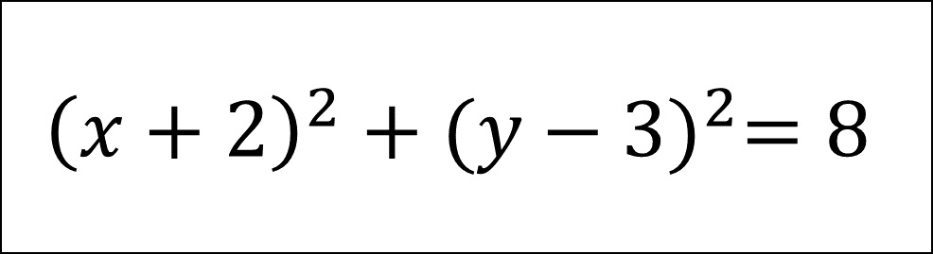
Equation
$${\left(x+2\right)}^{2}+{(y−3)}^{2}=8$$
Centre
Radius
$$(−2, 3)$$
$$2\sqrt{2}$$

Slide 9
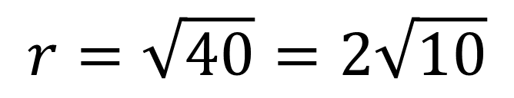

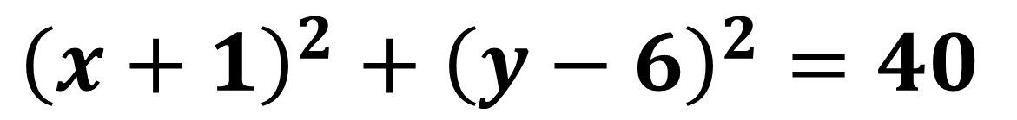

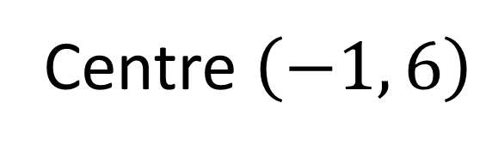
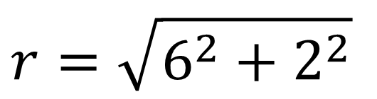
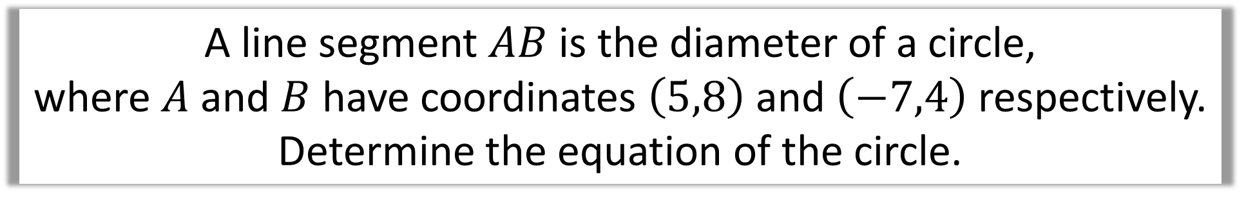
A line segment $AB$ is the diameter of a circle,
where $A$ and $B$ have coordinates $\left(5,8\right)$ and $\left(−7,4\right)$ respectively.
Determine the equation of the circle.
Centre $\left(−1, 6\right)$
$$A\left(5,8\right)$$
$$r=\sqrt{6^{2}+2^{2}}$$
$$B\left(−7,4\right)$$
$$r=\sqrt{40}=2\sqrt{10}$$
$${\left(x+1\right)}^{2}+{\left(y−6\right)}^{2}=40$$

Slide 10
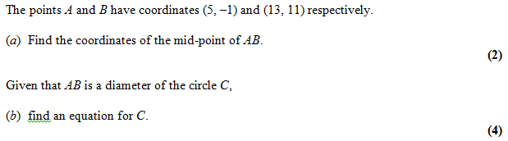
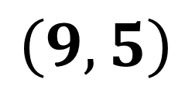
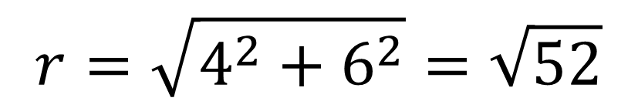
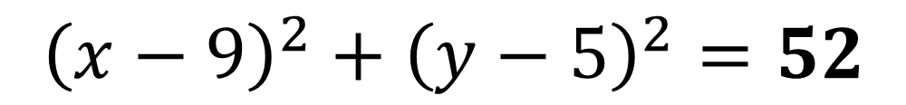
a)
$$\left(9, 5\right)$$
$$r=\sqrt{4^{2}+6^{2}}=\sqrt{52}$$
b)
$${\left(x−9\right)}^{2}+{\left(y−5\right)}^{2}=52$$

Slide 11
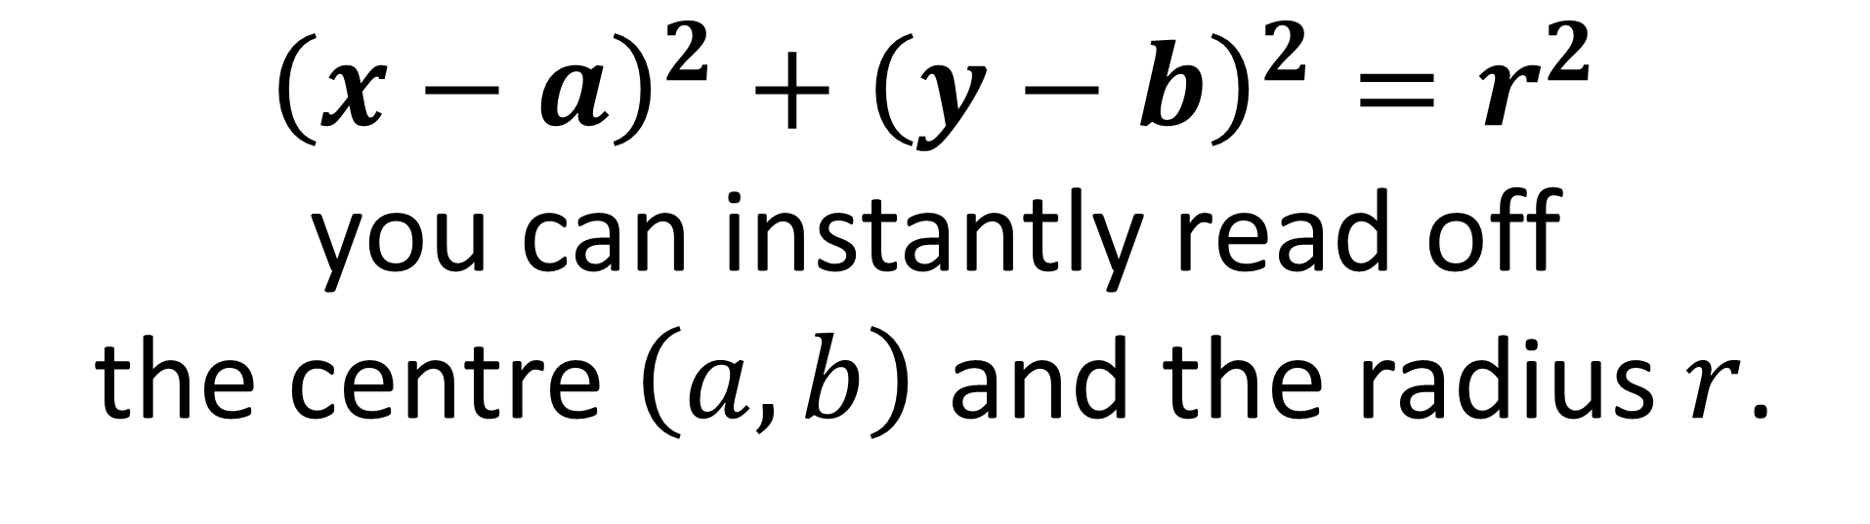
${\left(x−a\right)}^{2}+{\left(y−b\right)}^{2}=r^{2}$
you can instantly read off
the centre $\left(a,b\right)$ and the radius $r$.
But what if the equation
wasn’t in this form?

Slide 12
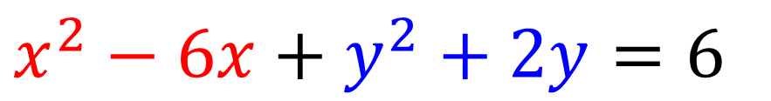
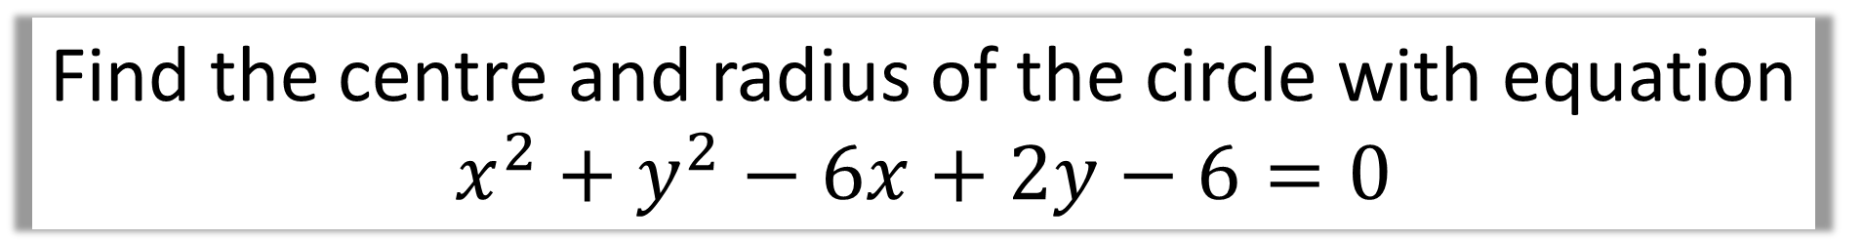
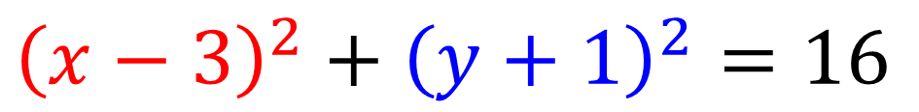
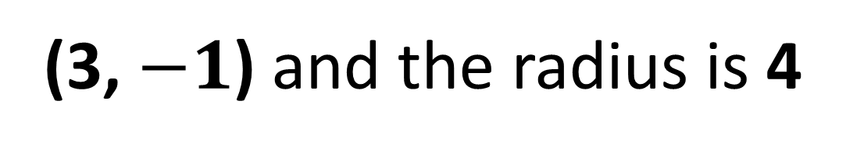
Find the centre and radius of the circle with equation
$$x^{2}+y^{2}−6x+2y−6=0$$
$$x^{2}−6x+y^{2}+2y=6$$
Rearrange
Complete the Square
$${\left(x−3\right)}^{2}−9+{\left(y+1\right)}^{2}−1=6$$
$${\left(x−3\right)}^{2}+{\left(y+1\right)}^{2}=16$$
Move Constants
(3, $−1$) and the radius is 4

Slide 13
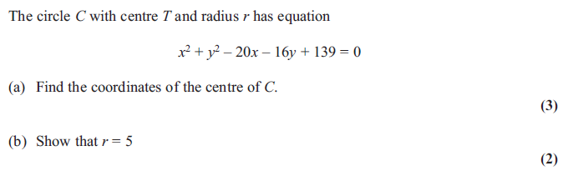
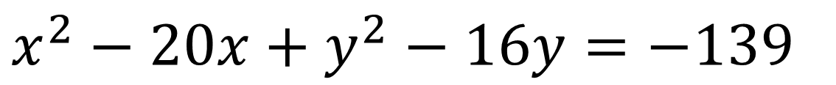
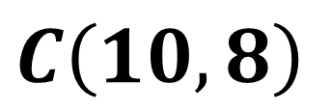
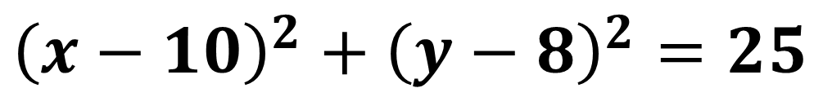
a)
$$x^{2}−20x+y^{2}−16y=−139$$
$${\left(x−10\right)}^{2}−100+{\left(y−8\right)}^{2}−64+139=0$$
$$C\left(10,8\right)$$
$${\left(x−10\right)}^{2}+{\left(y−8\right)}^{2}=25$$

Slide 14
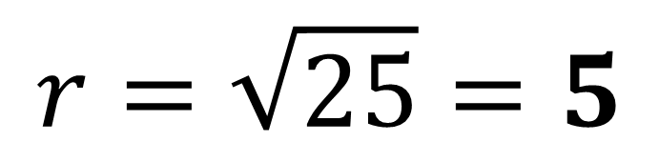
b)
$$r=\sqrt{25}=5$$

