Slide 1
Binomial Expansion
Validity
Chapter 4
(Part 4 of 4)

Slide 2
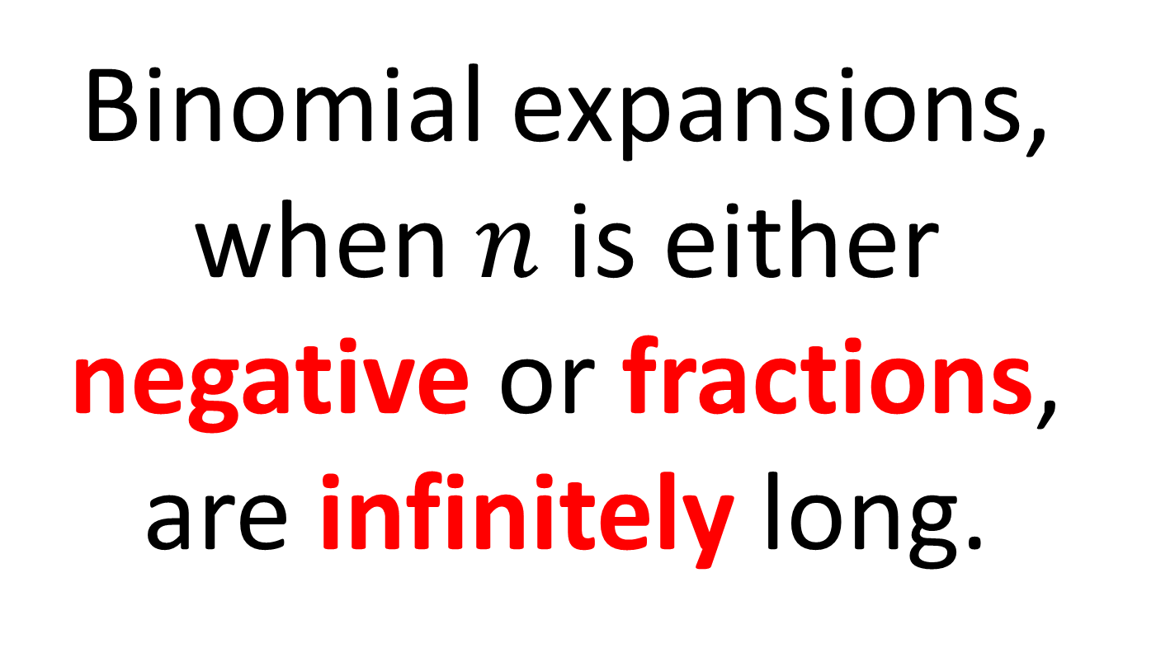
Infinite Expansions
Binomial expansions,
when $n$ is either
negative or fractions,
are infinitely long.

Slide 3
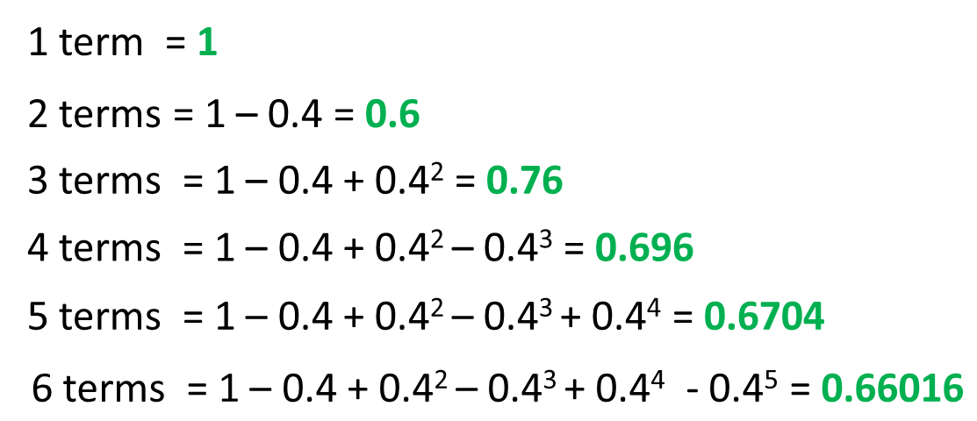
$$=1−x+x^{2}−x^{3}+x^{4}−x^{5}+x^{6}…$$
Let x = 0.4

Slide 4
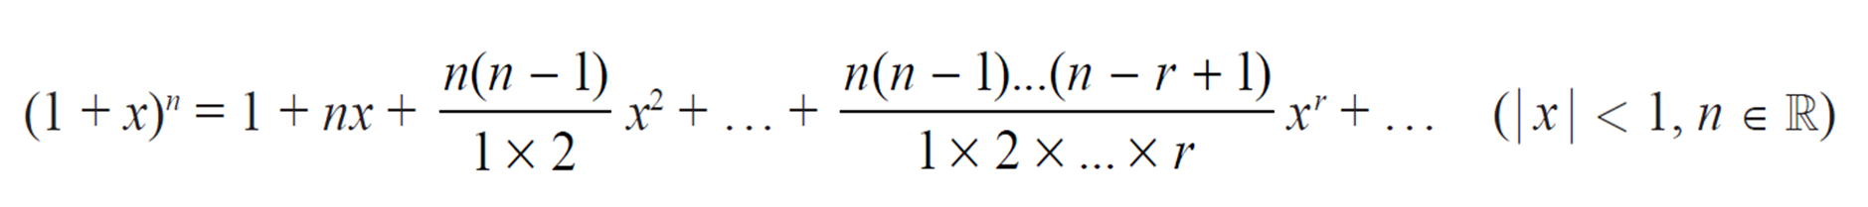
For an expansion to be valid
it needs to converge
on a number.

Slide 5

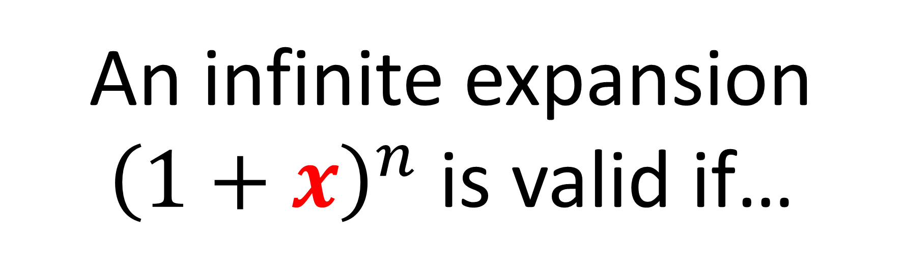
An infinite expansion ${\left(1+x\right)}^{n}$ is valid if…
$−$1 < 𝒙 < 1

Slide 6

$−$1 < 𝒙 < 1
which is the same as saying…
|𝒙|< 𝟏

Slide 7
$$=1−x+x^{2}−x^{3}+x^{4}−x^{5}+x^{6}…$$
Let x = 0.4
1 term = 1
2 terms = 1 – 0.4 = 0.6
Converges on a single value.
3 terms = 1 – 0.4 + 0.4² = 0.76
4 terms = 1 – 0.4 + 0.4² – 0.4³ = 0.696
5 terms = 1 – 0.4 + 0.4² – 0.4³ + 0.4⁴ = 0.6704
6 terms = 1 – 0.4 + 0.4² – 0.4³ + 0.4⁴ - 0.4⁵ = 0.66016
This converges, so expansion is valid.

Slide 8
$$=1−x+x^{2}−x^{3}+x^{4}−x^{5}+x^{6}…$$
Let x = 1
1 term = 1
2 terms = 1 – 0 = 0
NOT converging on a single value.
3 terms = 1 – 0 + 1² = 1
4 terms = 1 – 0 + 1² – 1³ = 0
5 terms = 1 – 0 + 1² – 1³ + 1⁴ = 1
6 terms = 1 – 0 + 1² – 1³ + 1⁴ - 1⁵ = 0
This does not converge so expansion is not valid.

Slide 9
$$=1−x+x^{2}−x^{3}+x^{4}−x^{5}+x^{6}…$$
Let x = 2
1 term = 1
2 terms = 1 – 2 = –1
3 terms = 1 – 2 + 2² = 3
The results is diverging.
4 terms = 1 – 2 + 2² – 2³ = –5
5 terms = 1 – 2 + 2² – 2³ + 2⁴ = 11
6 terms = 1 – 2 + 2² – 2³ + 2⁴ – 2⁵ = –21
This diverges, so expansion is not valid.

Slide 10
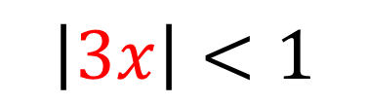
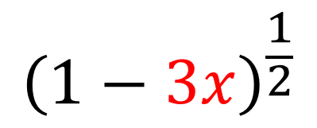
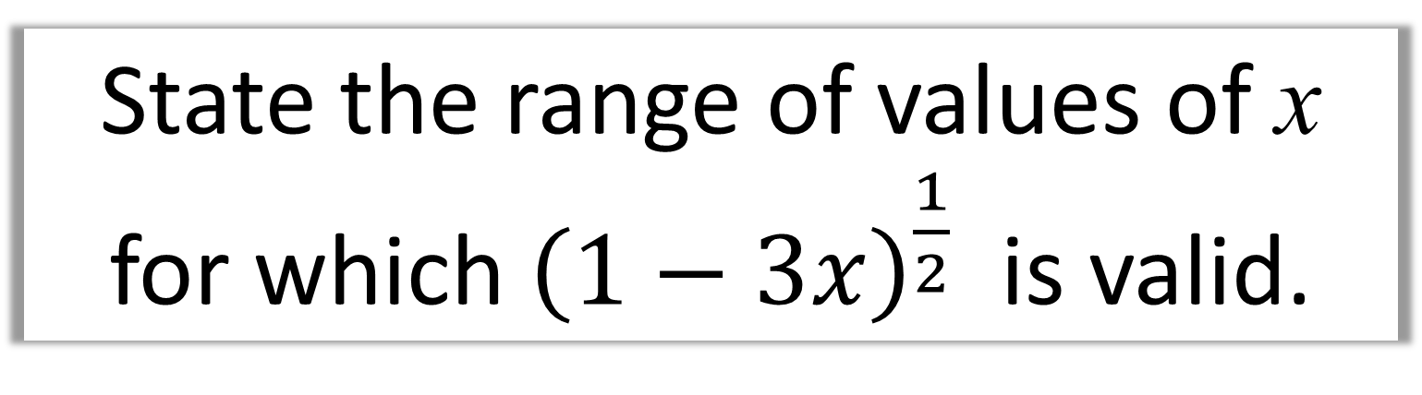
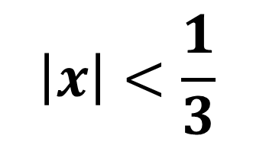
State the range of values of x for which ${\left(1−3x\right)}^{\frac{1}{2}}$ is valid.
$${\left(1−3x\right)}^{\frac{1}{2}}$$
$$\left|3x\right|<1$$
$$\left|x\right|<\frac{1}{3}$$

Slide 11
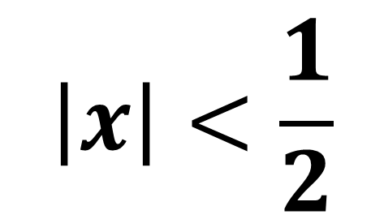
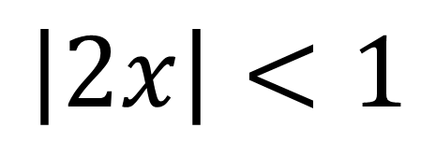
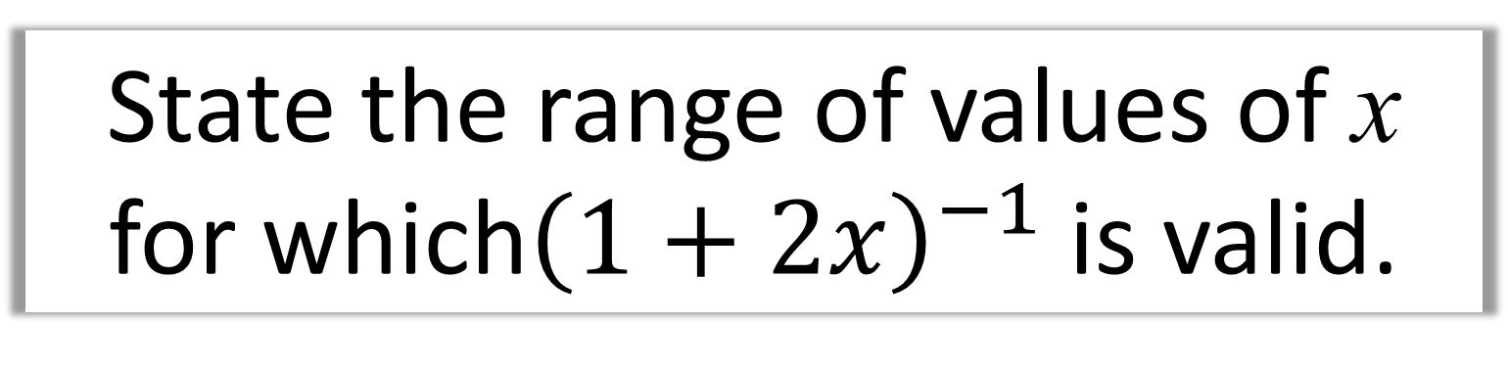
State the range of values of x for which${\left(1+2x\right)}^{−1}$ is valid.
$$\left|2x\right|<1$$
$$\left|x\right|<\frac{1}{2}$$

Slide 12
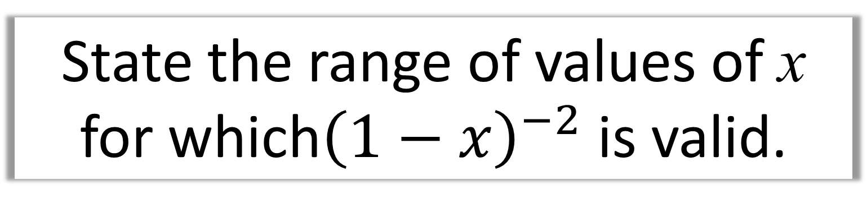
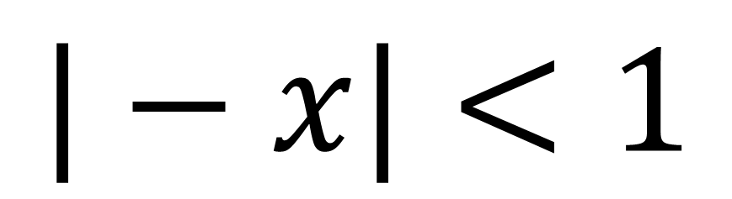
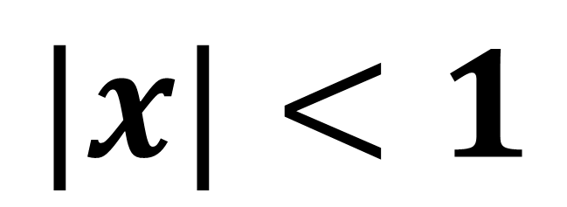
State the range of values of x for which${\left(1−x\right)}^{−2}$ is valid.
$$|−x|<1$$
$$|x|<1$$

Slide 13
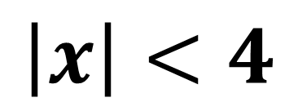
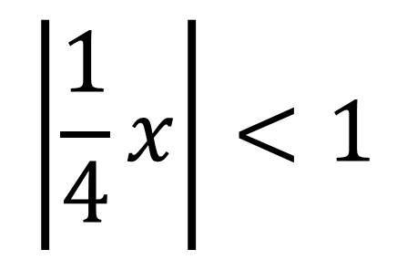
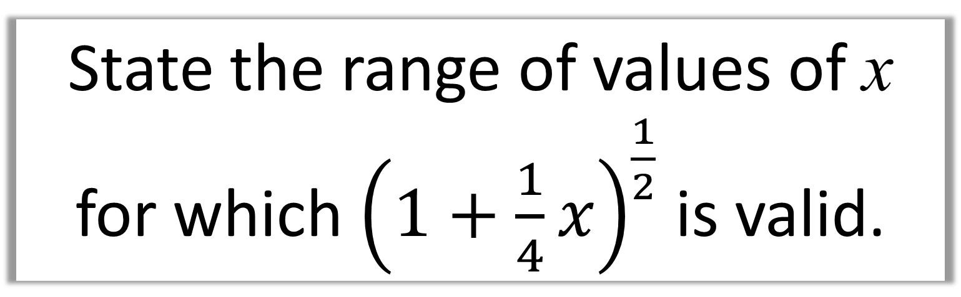
State the range of values of x for which ${\left(1+\frac{1}{4}x\right)}^{\frac{1}{2}}$ is valid.
$$\left|\frac{1}{4}x\right|<1$$
$$\left|x\right|<4$$

Slide 14
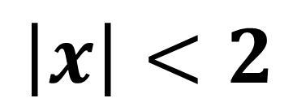
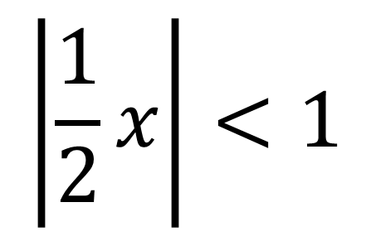
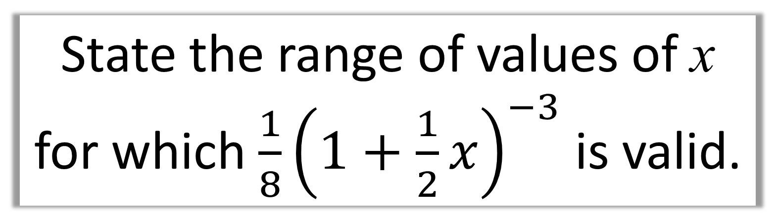
State the range of values of x for which $\frac{1}{8}{\left(1+\frac{1}{2}x\right)}^{−3}$is valid.
$$\left|\frac{1}{2}x\right|<1$$
$$\left|x\right|<2$$

Slide 15
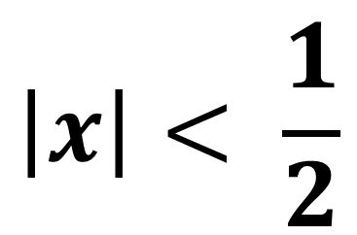
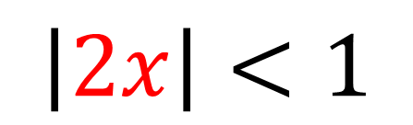
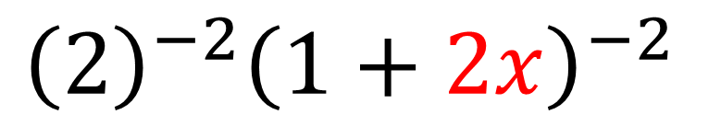
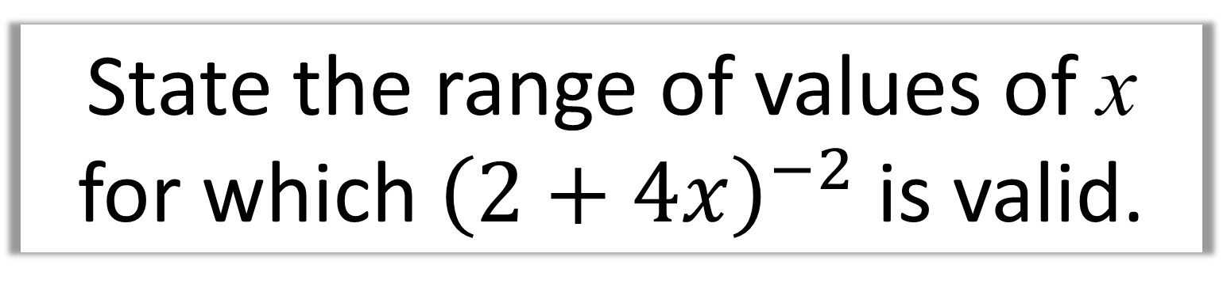
State the range of values of x for which ${\left(2+4x\right)}^{−2}$is valid.
$${{\left(2\right)}^{−2}\left(1+2x\right)}^{−2}$$
$$\left|2x\right|<1$$
$$\left|x\right|< \frac{1}{2}$$

