Slide 1
Numerical Methods
Modelling
Chapter 10
(Part 4 of 4)

Slide 2
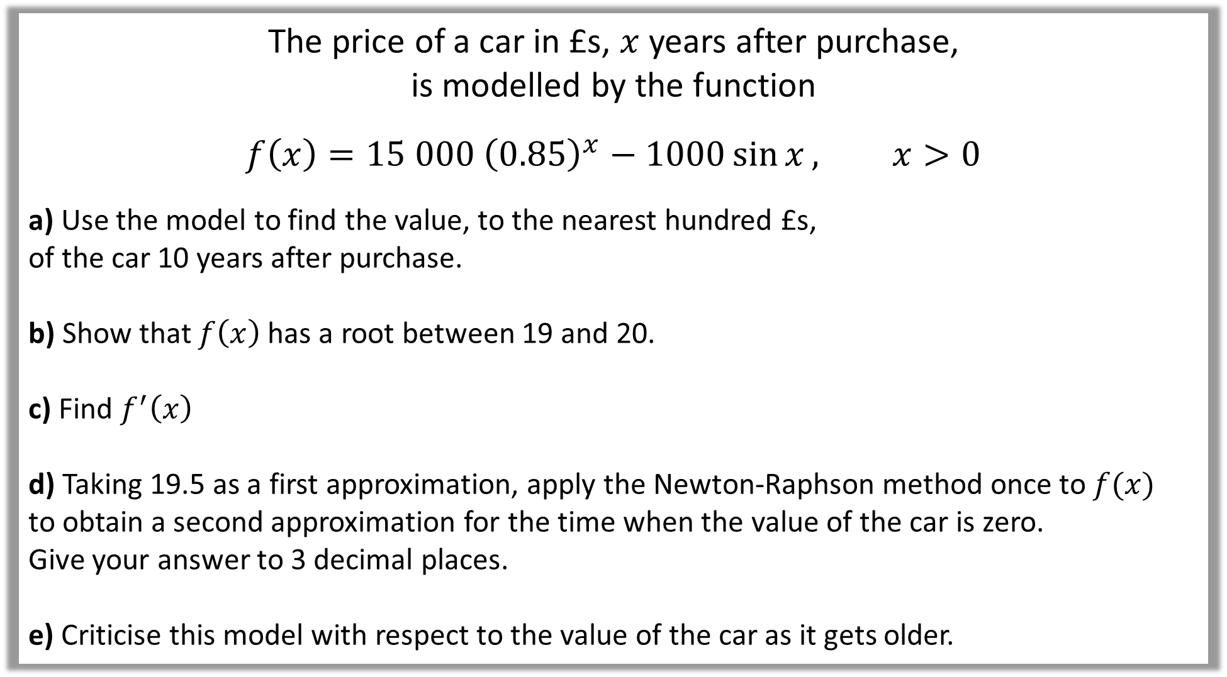
The price of a car in £s, $x$ years after purchase,
is modelled by the function
$$f\left(x\right)=15 000 {\left(0.85\right)}^{x}−1000\sin{x}, x>0$$
a) Use the model to find the value, to the nearest hundred £s,
of the car 10 years after purchase.
b) Show that $f\left(x\right)$ has a root between 19 and 20.
c) Find $f^{′}\left(x\right)$
d) Taking 19.5 as a first approximation, apply the Newton-Raphson method once to $f(x)$
to obtain a second approximation for the time when the value of the car is zero.
Give your answer to 3 decimal places.
e) Criticise this model with respect to the value of the car as it gets older.

Slide 3
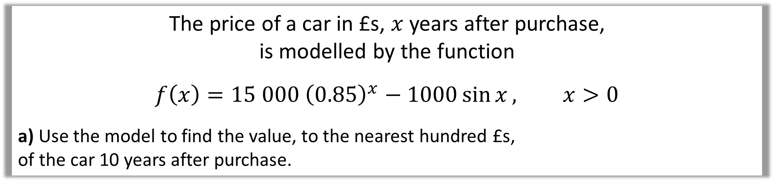
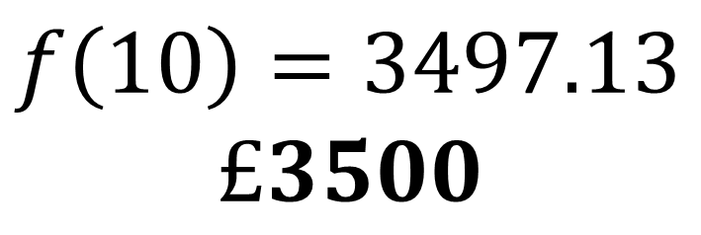
The price of a car in £s, $x$ years after purchase,
is modelled by the function
$$f\left(x\right)=15 000 {\left(0.85\right)}^{x}−1000\sin{x}, x>0$$
a) Use the model to find the value, to the nearest hundred £s,
of the car 10 years after purchase.
a)
$$f\left(10\right)=3497.13$$
$$£3500$$

Slide 4
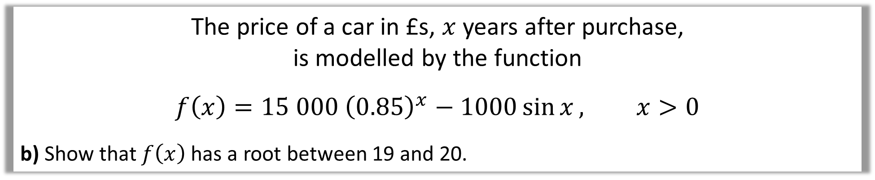

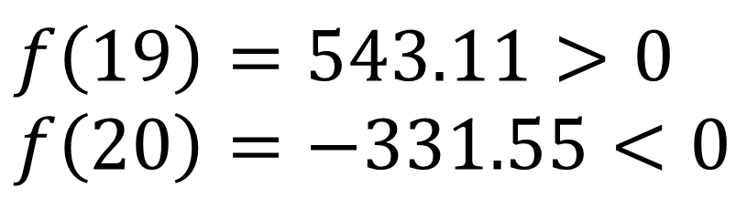
The price of a car in £s, $x$ years after purchase,
is modelled by the function
$$f\left(x\right)=15 000 {\left(0.85\right)}^{x}−1000\sin{x}, x>0$$
b) Show that $f\left(x\right)$ has a root between 19 and 20.
$$f\left(19\right)=543.11>0 \\ f\left(20\right)=−331.55<0$$
b)
Change of sign between 19 and 20
Root in the interval $19<x<20$

Slide 5
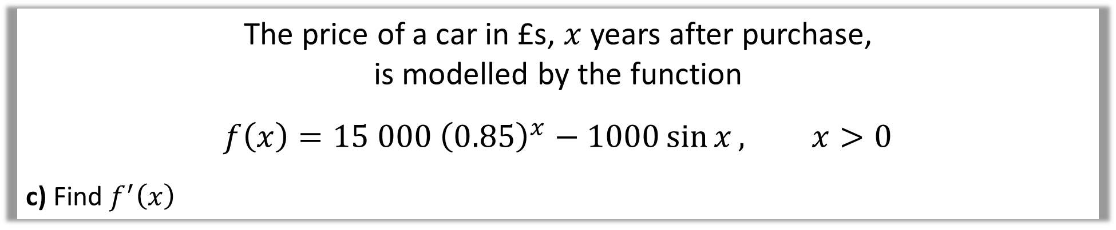
The price of a car in £s, $x$ years after purchase,
is modelled by the function
$$f\left(x\right)=15 000 {\left(0.85\right)}^{x}−1000\sin{x}, x>0$$
c) Find $f^{′}\left(x\right)$
c)
$$f^{′}\left(x\right)=\left(15 000\right){\left(0.85\right)}^{x}\left(\ln{0.85}\right)−1000\cos{x}$$

Slide 6
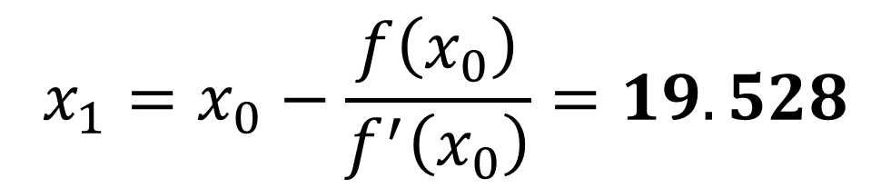
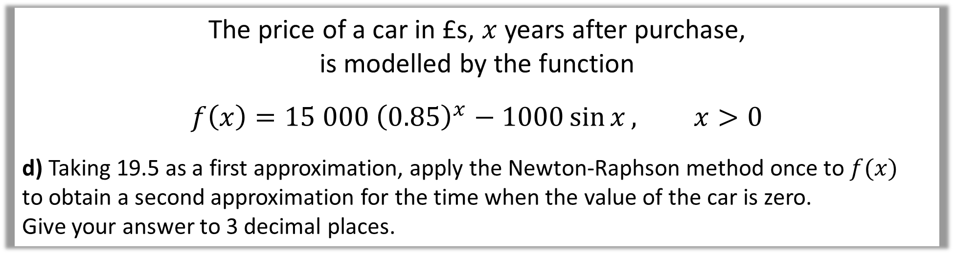

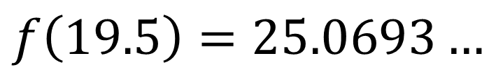
The price of a car in £s, $x$ years after purchase,
is modelled by the function
$$f\left(x\right)=15 000 {\left(0.85\right)}^{x}−1000\sin{x}, x>0$$
d) Taking 19.5 as a first approximation, apply the Newton-Raphson method once to $f(x)$
to obtain a second approximation for the time when the value of the car is zero.
Give your answer to 3 decimal places.
c)
$$f^{′}\left(x\right)=\left(15 000\right){\left(0.85\right)}^{x}\left(\ln{0.85}\right)−1000\cos{x}$$
$$f\left(19.5\right)=25.0693…$$
$$f^{′}\left(19.5\right)=−898.3009…$$
$$x_{1}=x_{0}−\frac{f\left(x_{0}\right)}{f^{′}\left(x_{0}\right)}=19.528$$

Slide 7

The price of a car in £s, $x$ years after purchase,
is modelled by the function
$$f\left(x\right)=15 000 {\left(0.85\right)}^{x}−1000\sin{x}, x>0$$
e) Criticise this model with respect to the value of the car as it gets older.
e)
In reality, the car can never have a negative value
so this model is not reasonable for cars that are approximately 20 or more years old.

