Slide 1
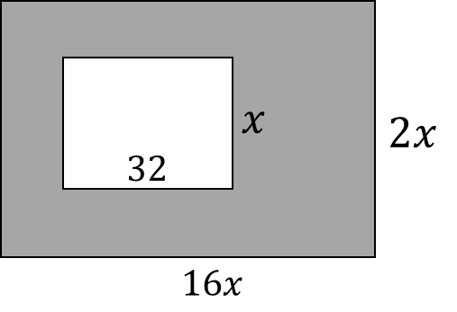
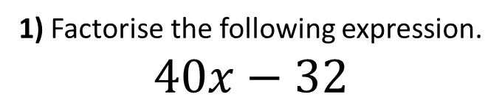
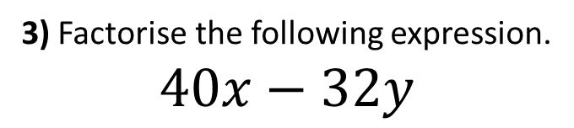
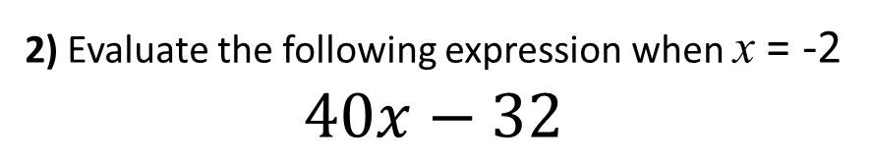
1) Factorise the following expression.
$$40x−32$$
2) Evaluate the following expression when x = -2
$$40x−32$$
3) Factorise the following expression.
$$40x−32y$$
4) Write an expression for the area of the shaded part of the shape.
40
40
40

Slide 2
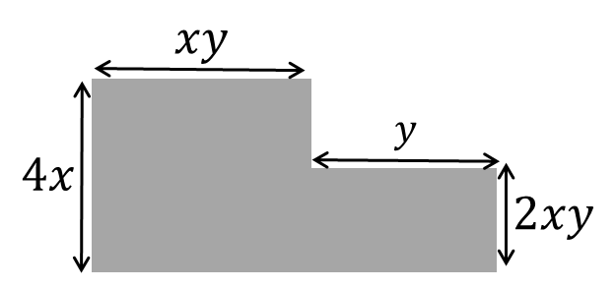

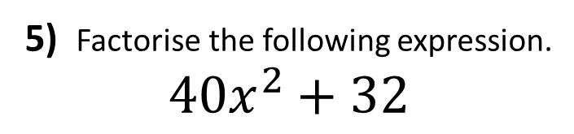
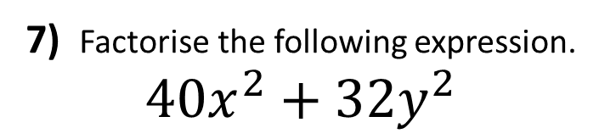


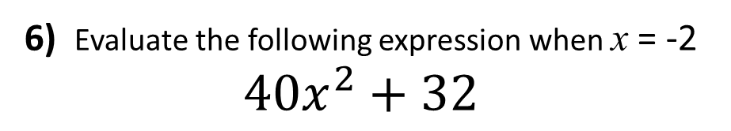
5) Factorise the following expression.
$$40x^{2}+32$$
6) Evaluate the following expression when x = -2
$$40x^{2}+32$$
7) Factorise the following expression.
$$40x^{2}+32y^{2}$$
$$x^{2}$$
8) Write an expression for the area of the shaded part of the shape.
$$y^{2}$$
40
$$32$$

Slide 3
ANSWERS

Slide 4
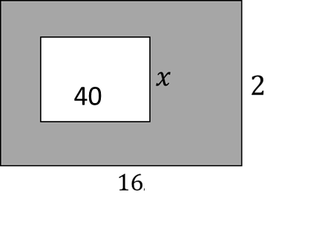
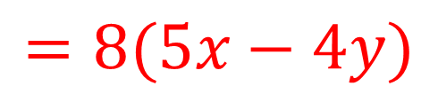
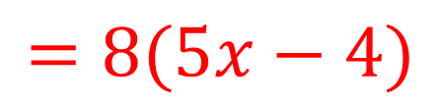
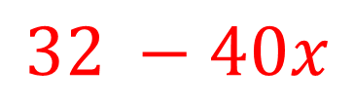
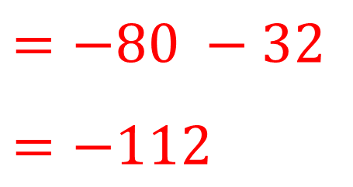
1) Factorise the following expression.
$$40x−32$$
2) Evaluate the following expression when x = -2
$$40x−32$$
$$=−80 −32$$
$$=−112$$
$$=8(5x−4)$$
3) Factorise the following expression.
$$40x−32y$$
4) Write an expression for the area of the shaded part of the shape.
40
$$=8(5x−4y)$$
40
$$32 −40x$$

Slide 5
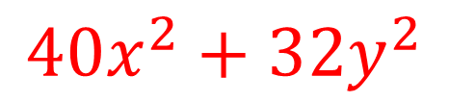
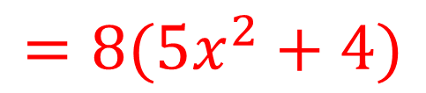
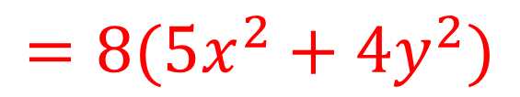
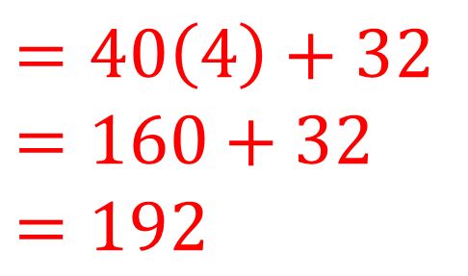
5) Factorise the following expression.
$$40x^{2}+32$$
6) Evaluate the following expression when x = -2
$$40x^{2}+32$$
$$=40\left(4\right)+32$$
$$=160+32$$
$$=192$$
$$=8(5x^{2}+4)$$
7) Factorise the following expression.
$$40x^{2}+32y^{2}$$
$$x^{2}$$
8) Write an expression for the area of the shaded part of the shape.
$$y^{2}$$
40
$$32$$
$$=8(5x^{2}+4y^{2})$$
$$40x^{2}+32y^{2}$$

