Slide 1

Junior Challenge 3
GOLD

Slide 2
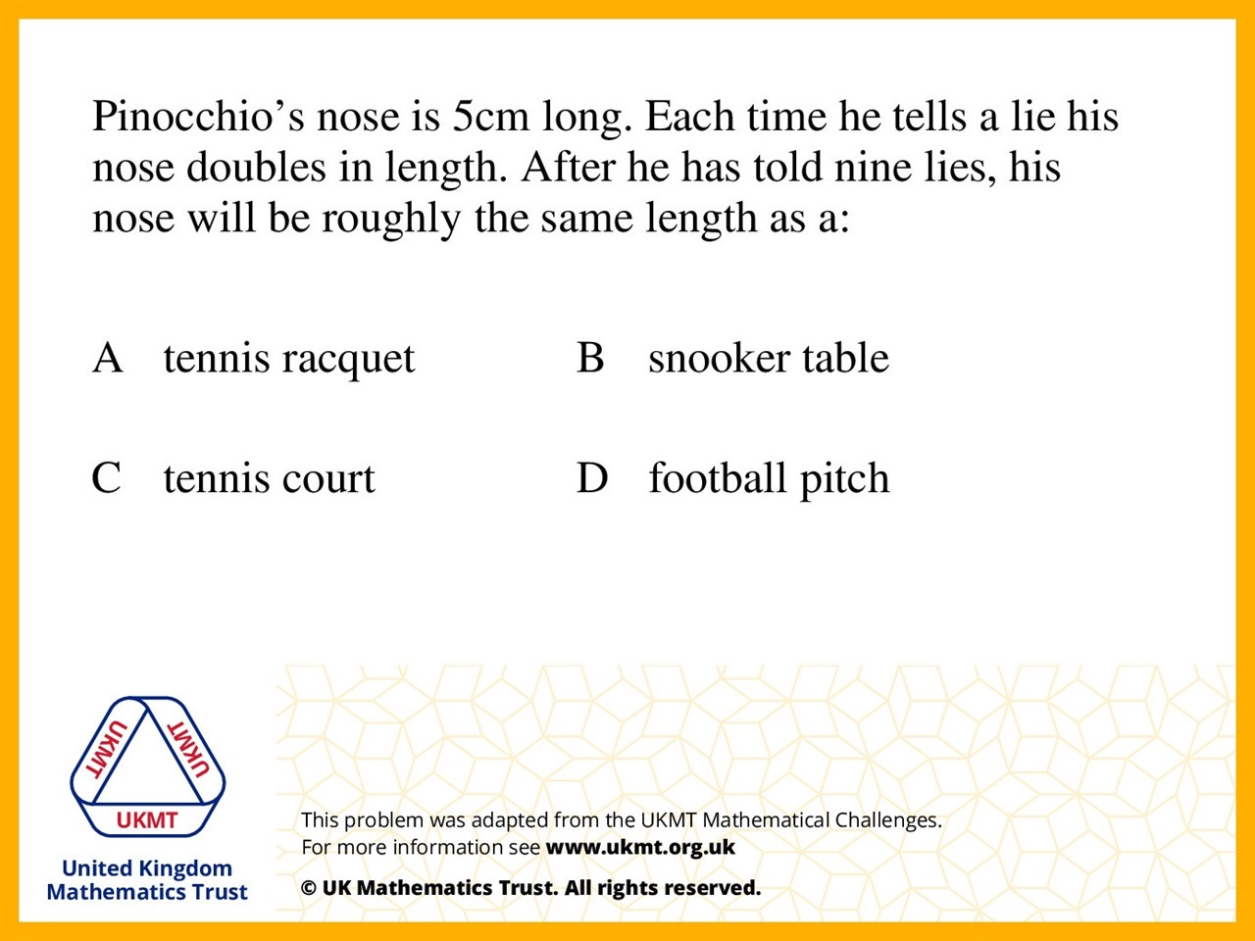
Q1.
5cm doubled 9 times is 25.60 metres,
near to a tennis court length

Slide 3
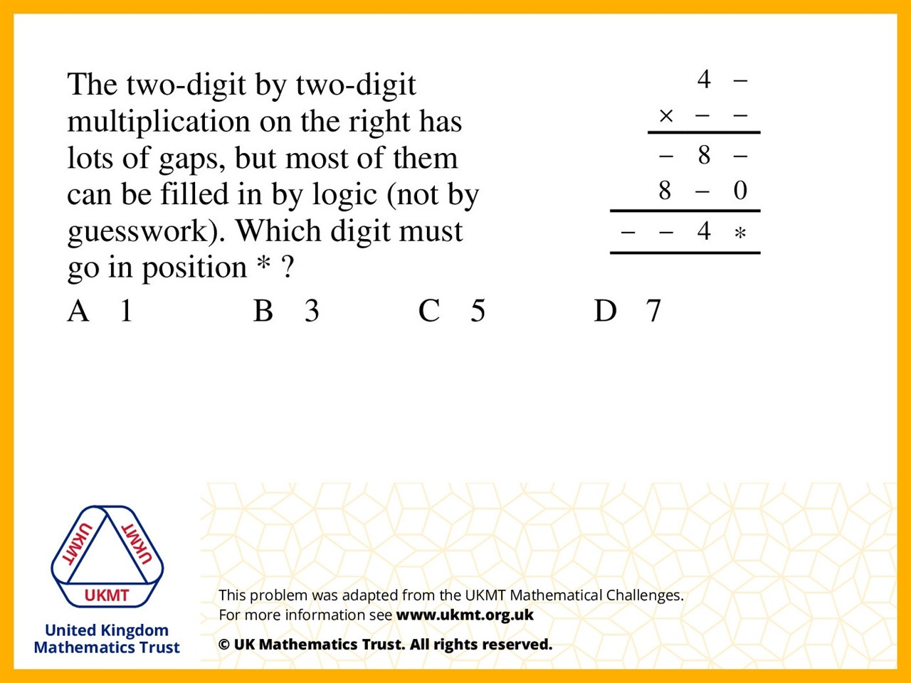
Q2.
7 x 41 = 287
20 x 41 = 820
287 + 820 = 1107

Slide 4
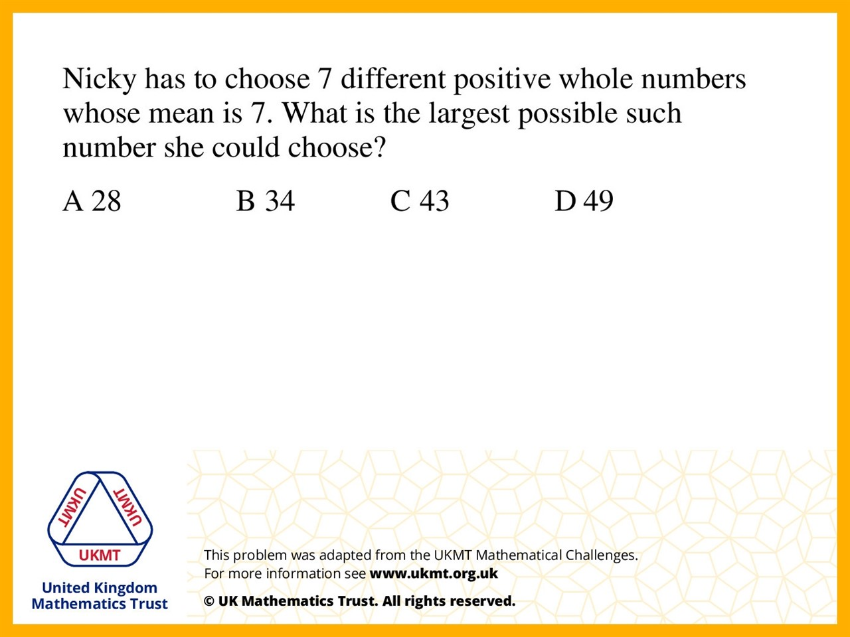
Q3.
7 numbers have a mean of 7 so the total of all 7 numbers is 49. The smallest possible total of 6 different numbers is 21 (1+2+3+4+5+6) so the largest the 7th can be is 49 – 21 = 28.

Slide 5
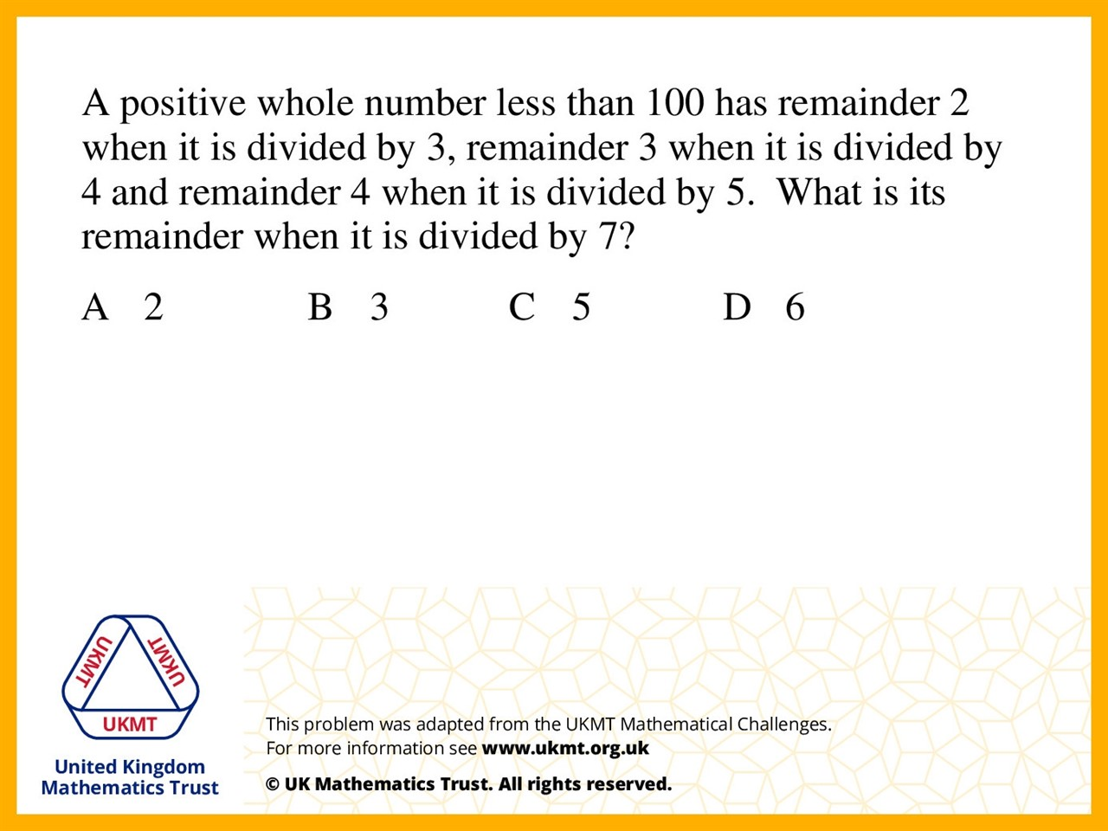
Q4.
You know it is 1 less than a number in the
3, 4 and 5 times table. The only number that fits for this is 60 so the number is 59. Then divided it by each number unitl you get the right remainders. 59 ÷ 7=8 r 3.

Slide 6
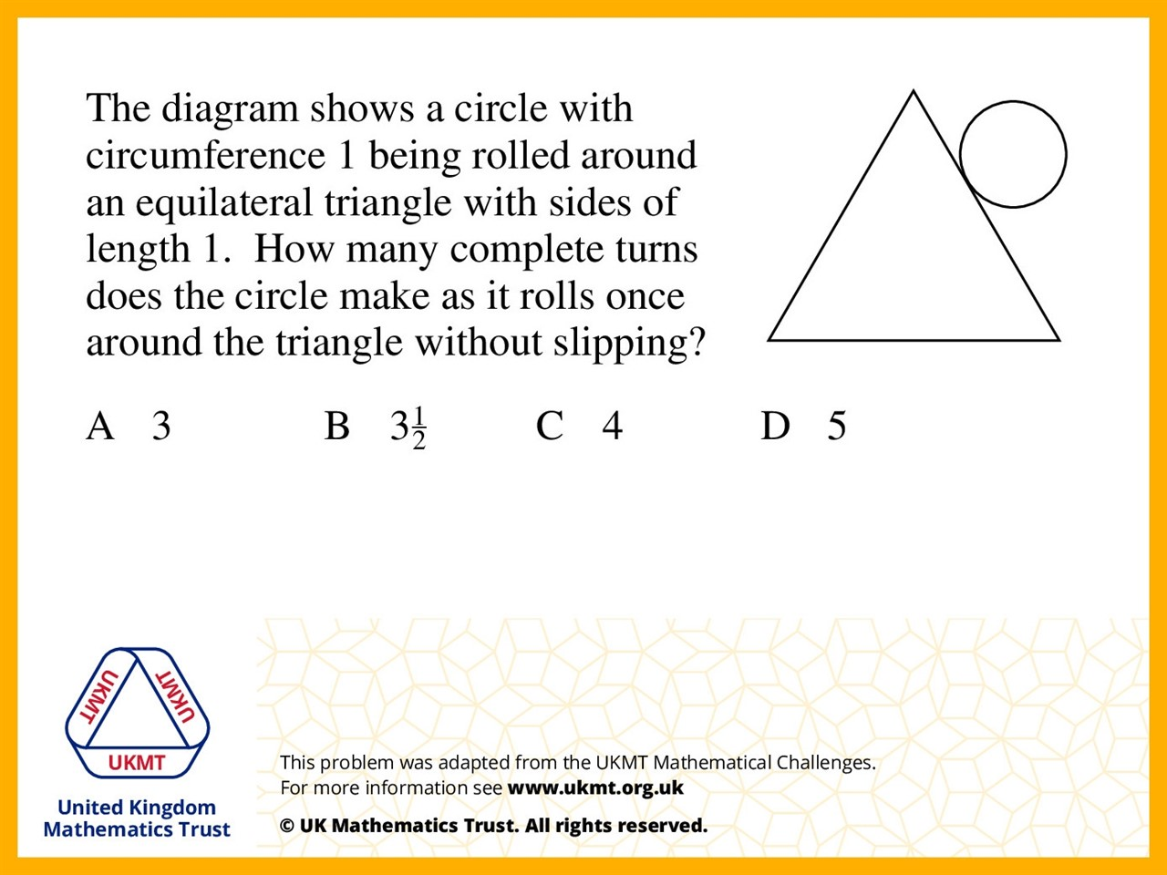
Q5.
Both lengths are the same therefore there is one turn per side but the there is also a third of a side per corner so 3x1= 3 and 3x1/3 = 1 so 3+1 = 4

