Slide 1
LO: Bisecting
Lines and Angles

Slide 2
What does the word bisect mean?
Cut in half.

Slide 3
Given the two lines bisect each other, what can you say about AC and CB?
A
C
B
AC = CB

Slide 4
Given that the angle ABC has been bisect by BD what can you say about ABD and CBD?
A
D
ABD = CBD
B
C

Slide 5
There are 3 types constructions
that you need to be able to do.
- Perpendicular bisector
- Construct a perpendicular line from a point on a line
- Construct a perpendicular line from a point above a line

Slide 6
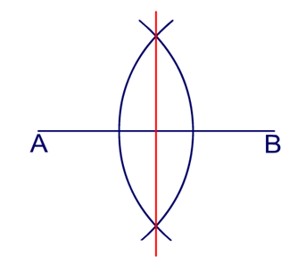

- Perpendicular bisector

Slide 7
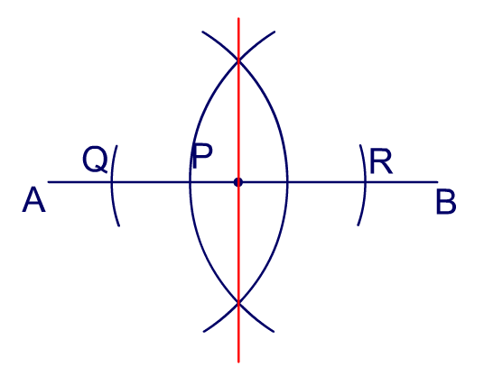
- Construct a perpendicular line from a point on a line

Slide 8
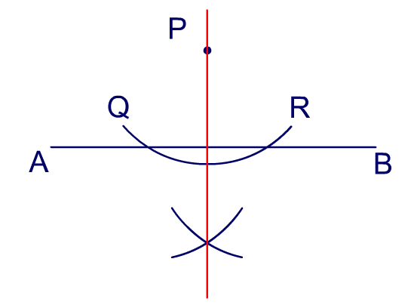
- Construct a perpendicular line from a point above a line

Slide 9
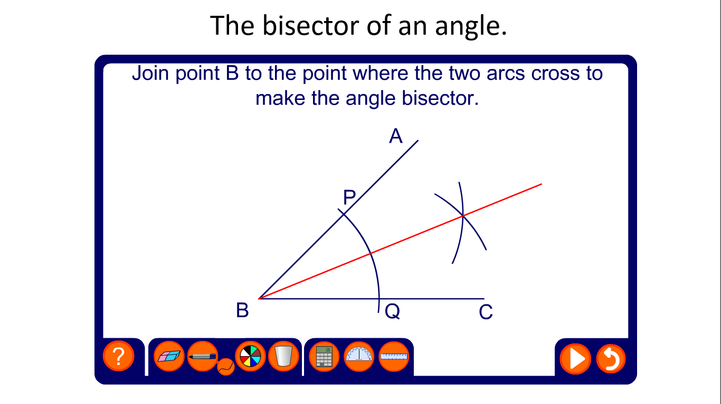
- Angle bisector

