Slide 1
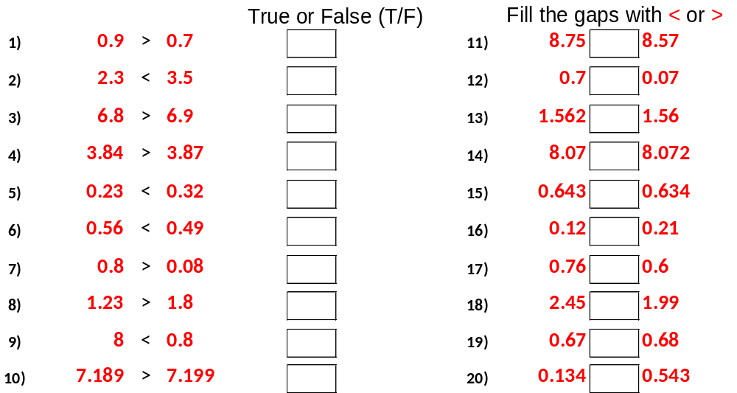

Slide 2
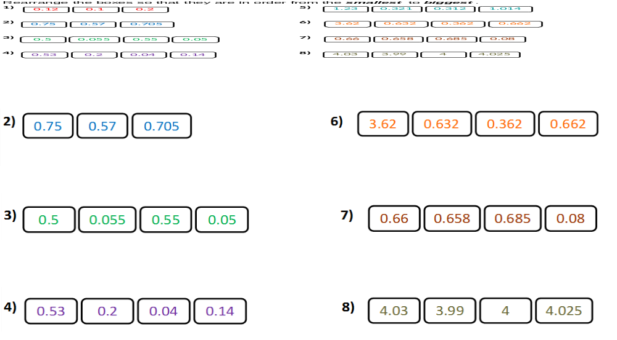

Slide 3
ANSWERS

Slide 4
T
>
T
>
F
>
F
<
T
>
F
<
T
>
F
>
F
<
F
<

Slide 5
0.1, 0.12, 0.2
0.312, 0.321, 1.014, 1.23
0.57, 0.705, 0.75
0.362, 0.632, 0.662 3.62
0.05, 0.055, 0.5, 0.55
0.08, 0.658, 0.66, 0.85
0.04, 0.014, 0.2, 0.53
3.99, 4, 4,025, 4.03

