Slide 1
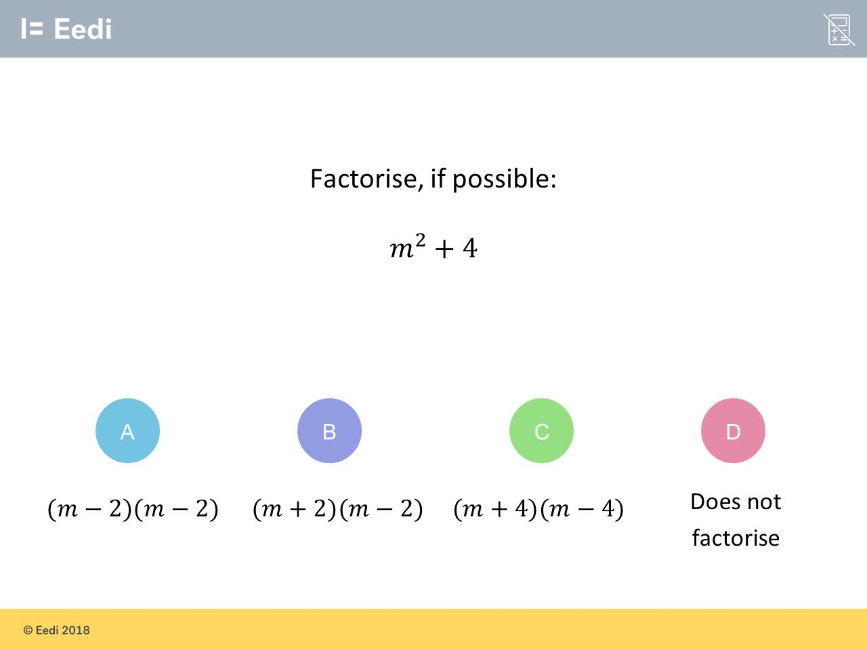
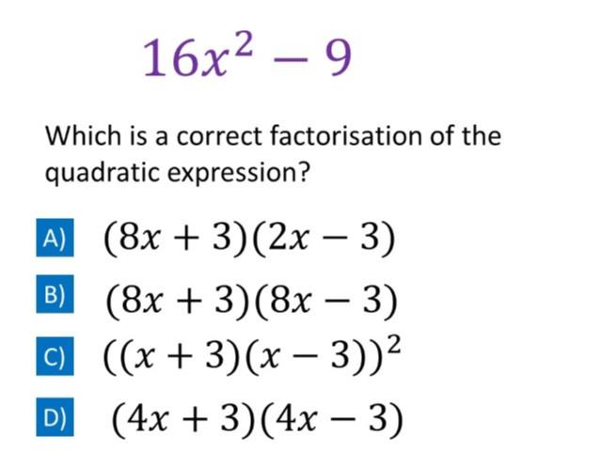
Worst answered question?
Most common wrong answer?

Slide 2
ANSWERS

Slide 3
Worst answered question?

Slide 4
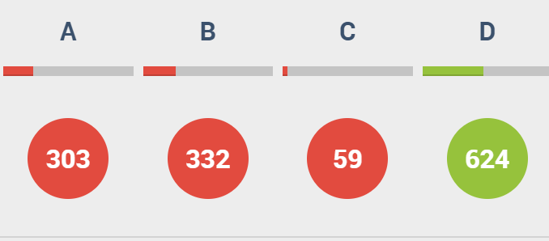
B
The constant would a negative 4.

Slide 5
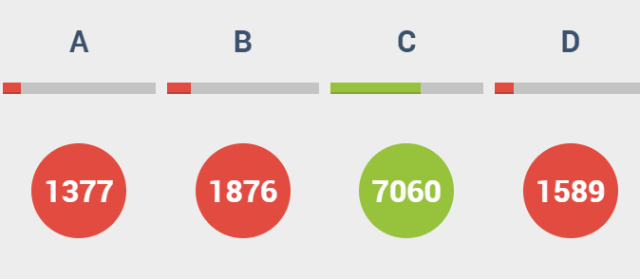
B
The x² term would have a value of 64.

