Slide 1
Forces and Friction
Friction
Chapter 5
(Part 3 of 3)

Slide 2
Friction
Driving Force
Smooth Surface
Friction Force
Driving Force
Rough Surface

Slide 3
Friction
Friction forces will always oppose the direction
of motion.

Slide 4





Friction $=μR$
$μ$ is the coefficient of friction
$R$ is the normal reaction
$$R$$
$$μR$$
Driving Force

Slide 5

Friction $=μR$
The size of the friction force depends on 2 things:
how rough the surface is
the mass of the particle

Slide 6
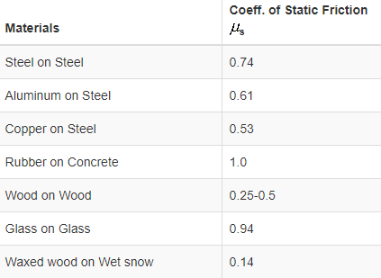


Coefficient of Friction
0 ≤ $μ$ ≤ 1
Martial
$$μ$$

Slide 7

$$F_{max}=μR$$
Friction force will always have
a maximum value.

Slide 8
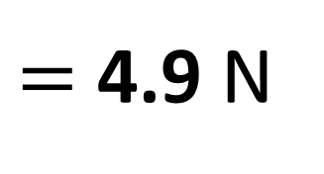

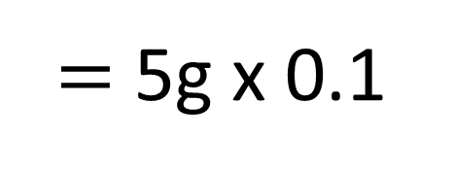

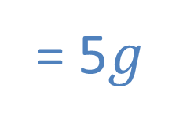


What is the max Friction Force?
$$R$$
= 5$g$
$$μ=0.1$$
5$g$
$$Friction=μR$$
$=$ 5g x 0.1
$=$ 4.9 N

Slide 9
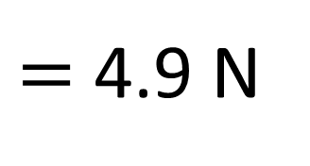

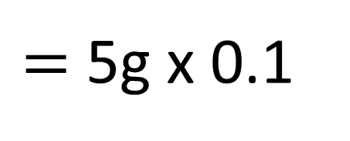

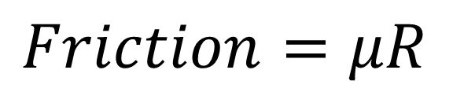
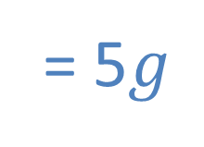

What is the Friction Force?
$$R$$
= 5$g$
3N
$$μ=0.1$$
5$g$
$$Friction=μR$$
Friction Force = 3N
$=$ 5g x 0.1
$=$ 4.9 N

Slide 10


What is the Friction Force?
$$R$$
= 5$g$
4.5N
$$μ=0.1$$
5$g$
$$Friction=μR$$
Friction Force = 4.5N
$=$ 5g x 0.1
$=$ 4.9 N

Slide 11


What is the Friction Force?
$$R$$
= 5$g$
4.9N
$$μ=0.1$$
5$g$
$$Friction=μR$$
Friction Force = 4.9N
$=$ 5g x 0.1
$=$ 4.9 N

Slide 12
What is the Friction Force?
$$R$$
= 5$g$
5N
$$μ=0.1$$
5$g$
$$Friction=μR$$
Friction Force = 4.9N
$=$ 5g x 0.1
$=$ 4.9 N

Slide 13
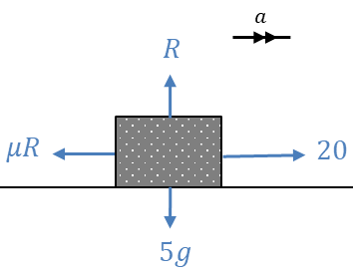




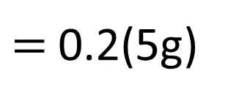


A particle of mass 5kg is pulled along a rough horizontal surface by a horizontal force of magnitude 20N.
The coefficient of friction between the particle and the floor is 0.2. Calculate:
a) the magnitude of frictional force
b) the acceleration of the particle.
a)
$$Friction= μR$$
$=$0.2(5g)
$=9.8N$
b)
$$F=ma$$
$20−μR=5a$
$20−9.8=5a$
$a=2.04 ms^{−2}$

Slide 14


Friction and Inclined Slopes
Remember friction always opposes motion.
$$μR$$
a
m
$$ɵ$$

Slide 15


Friction and Inclined Slopes
Remember friction always opposes motion.
a
m
$$μR$$
$$ɵ$$

Slide 16
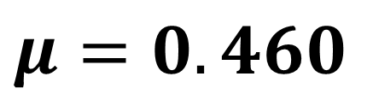

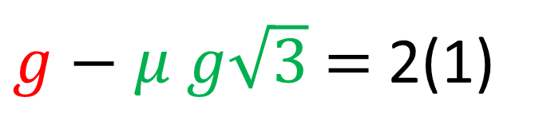




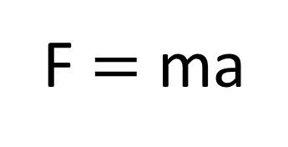
Calculate the coefficient of friction.
F $=$ ma
$$2g\cos{30=g\sqrt{3}}$$
$$μR$$
$g−μ g\sqrt{3}$ $=$ 2(1)
1ms⁻²
2kg
$$μ=0.460$$
$$2g\cos{30}=g\sqrt{3}$$
$$2g\sin{30=g}$$
$$30°$$

