Slide 1
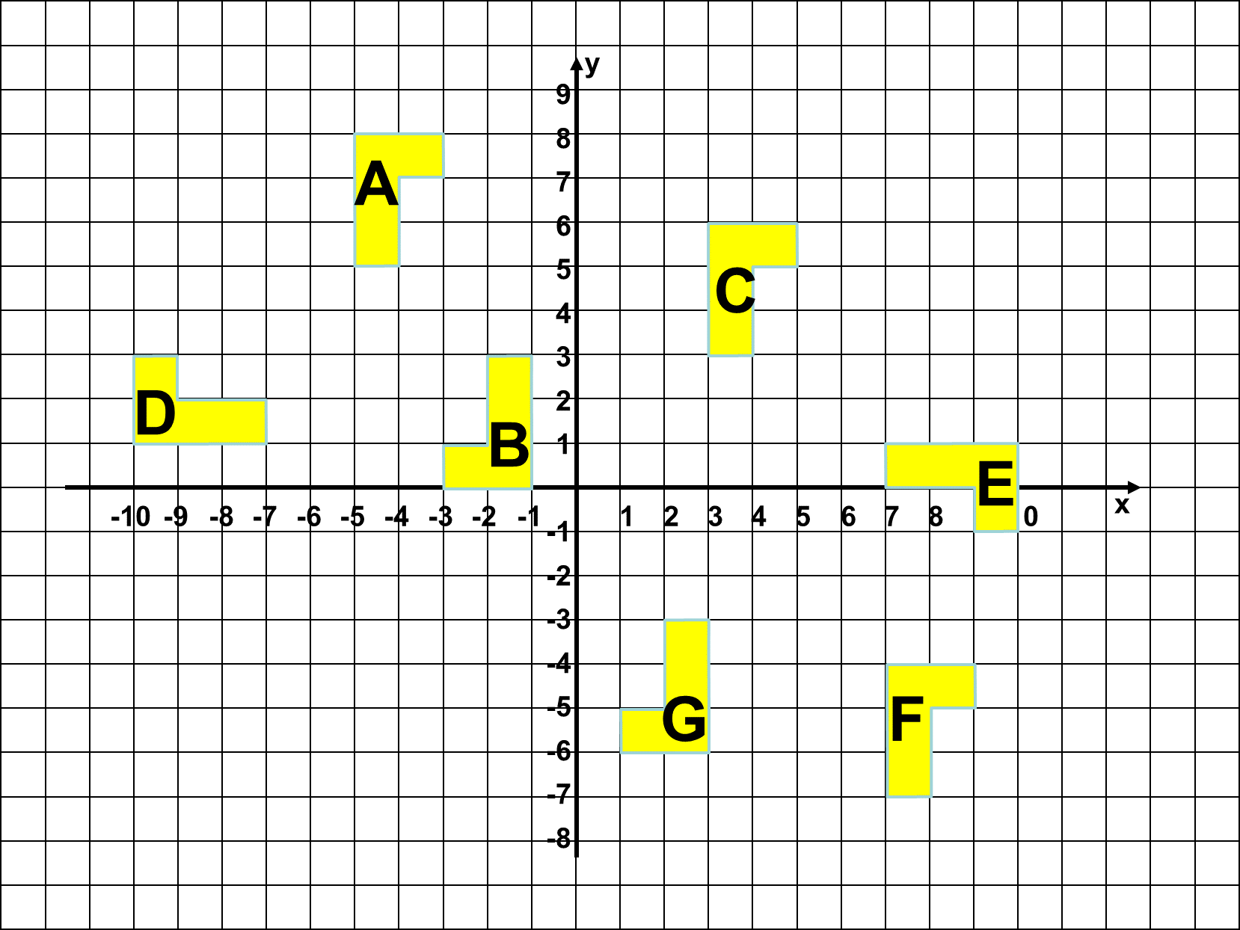

Slide 2
Fully describe the transformations shown on the grid
Rotation | Angle and Direction | Centre of Rotation
A to B
B to C
A to D
C to E
E to D
D to B
C to D
A to E
E to B
B to F
F to G
D to G

Slide 3
ANSWERS

Slide 4
Rotation | Angle and Directions | Centre of Rotation
A to B | 180º | (-3, 4)
B to C | 180º | (1, 3)
A to D | 90º anti clockwise | (-4, 2)
C to E | 90º clockwise | (4, 0)
E to D | 180º | (0, 1)
D to B | 90º anti clockwise | (-5, 5)
C to D | 90º anti clockwise | (-1, -3)
A to E | 90º clockwise | (-1, -3)
E to B | 90º clockwise | (4, 6)
B to F | 180º | (3, -2)
F to G | 180º | (5, -5)
D to G | 90º anti clockwise | (0, 4)

