Slide 1
Binomial Expansion
Coefficients
Chapter 8
(Part 2 of 4)

Slide 2
x is 5 times bigger than y.
Write an equation in terms of x and y.
x = 5y

Slide 3
x is 3 times bigger than 30a.
Write an equation in terms of x and a.
x = 3(30a)
x = 90a

Slide 4


$${4x+3ax^{2}−3ab}^{2}x^{3}$$
What is the coefficient of the x term?
$$4$$

Slide 5

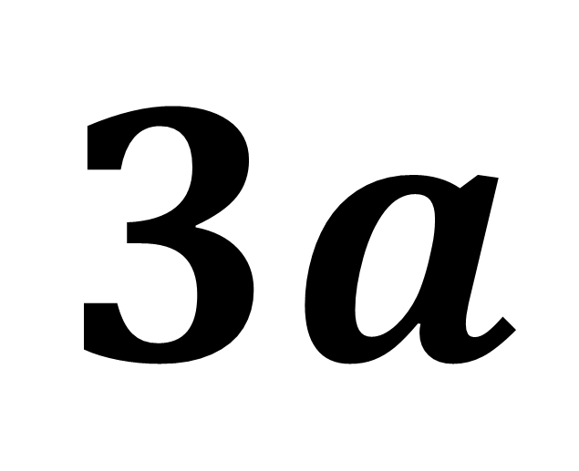
$${4x+3ax^{2}−3ab}^{2}x^{3}$$
What is the coefficient of the $x^{2}$ term?
$$3a$$

Slide 6

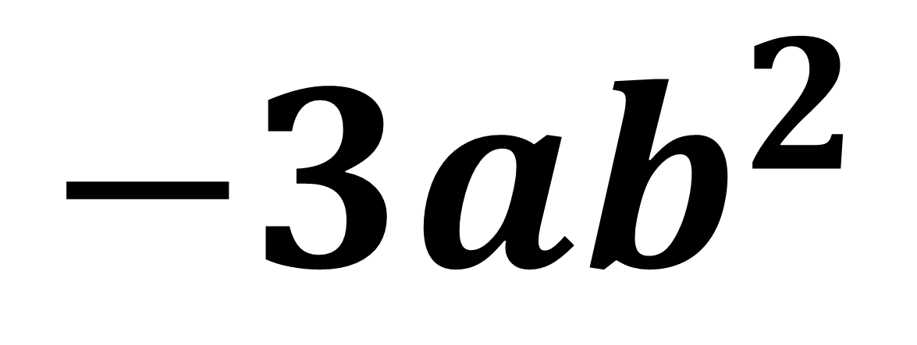
$${4x+3ax^{2}−3ab}^{2}x^{3}$$
What is the coefficient of the $x^{3}$ term?
$${−3ab}^{2}$$

Slide 7
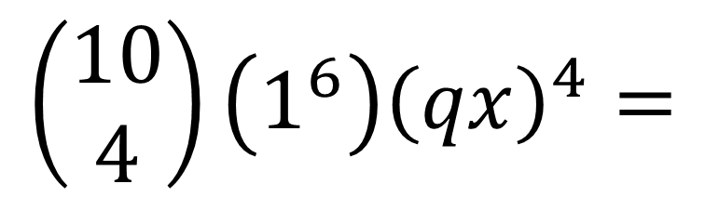
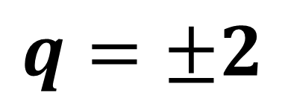
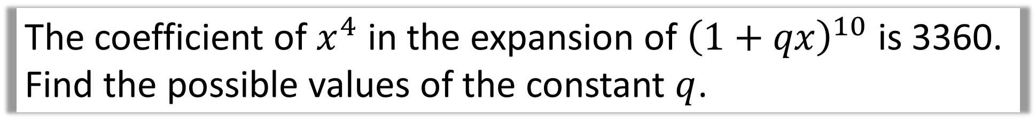
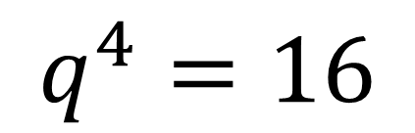
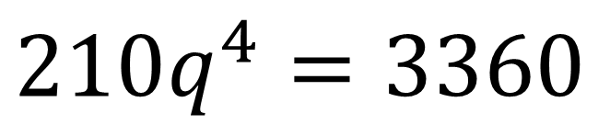
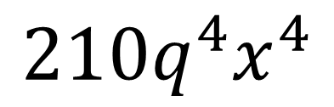
The coefficient of $x^{4}$ in the expansion of ${\left(1+qx\right)}^{10}$ is 3360. Find the possible values of the constant $q$.
$$\left(\begin{matrix}10 \\ 4\end{matrix}\right)\left(1^{6}\right){\left(qx\right)}^{4}=$$
$$210q^{4}x^{4}$$
$$210q^{4}=3360$$
$$q^{4}=16$$
$$q=±2$$

Slide 8
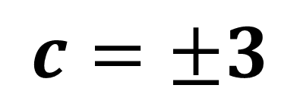
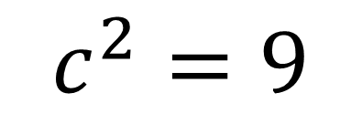
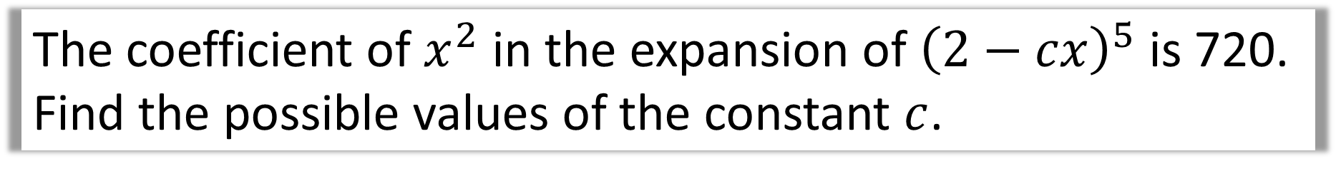
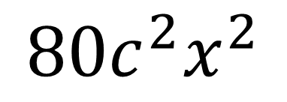
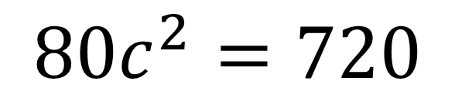
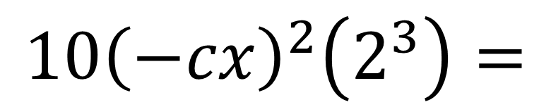
The coefficient of $x^{2}$ in the expansion of ${\left(2−cx\right)}^{5}$ is 720. Find the possible values of the constant $c$.
$$10{\left(−cx\right)}^{2}\left(2^{3}\right)=$$
$${80c}^{2}x^{2}$$
$$80c^{2}=720$$
$$c^{2}=9$$
$$c=±3$$

Slide 9

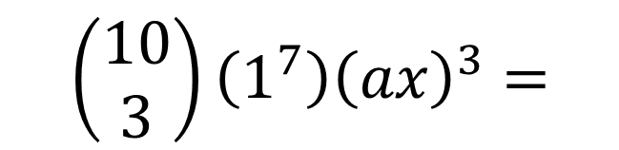
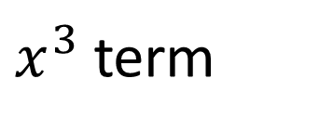


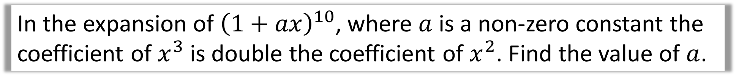

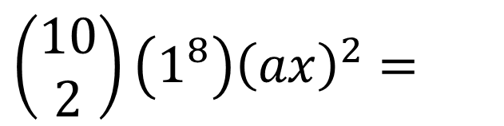
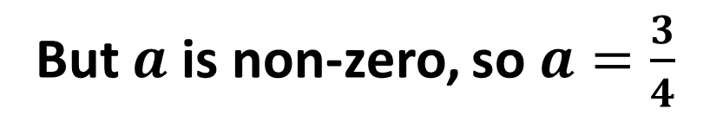
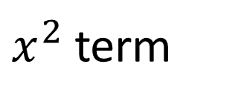
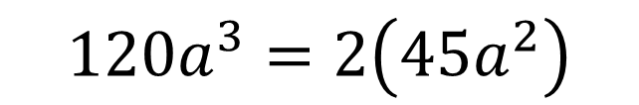
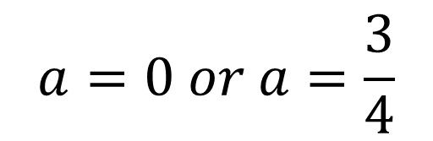

In the expansion of ${\left(1+ax\right)}^{10}$, where $a$ is a non-zero constant the coefficient of $x^{3}$ is double the coefficient of $x^{2}$. Find the value of $a$.
$x^{2}$ term
$$120a^{3}=2\left(45a^{2}\right)$$
$$\left(\begin{matrix}10 \\ 2\end{matrix}\right)\left(1^{8}\right){\left(ax\right)}^{2}=$$
$$120a^{3}=90a^{2}$$
$$45a^{2}x^{2}$$
$$4a^{3}−3a^{2}=0$$
$x^{3}$ term
$$a^{2}\left(4a−3\right)=0$$
$$\left(\begin{matrix}10 \\ 3\end{matrix}\right)\left(1^{7}\right){\left(ax\right)}^{3}=$$
$$a=0 or a=\frac{3}{4}$$
$$120a^{3}x^{3}$$
But $a$ is non-zero, so $a=\frac{3}{4}$

Slide 10
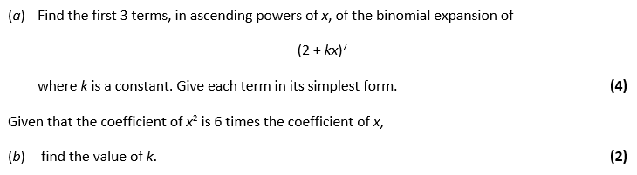
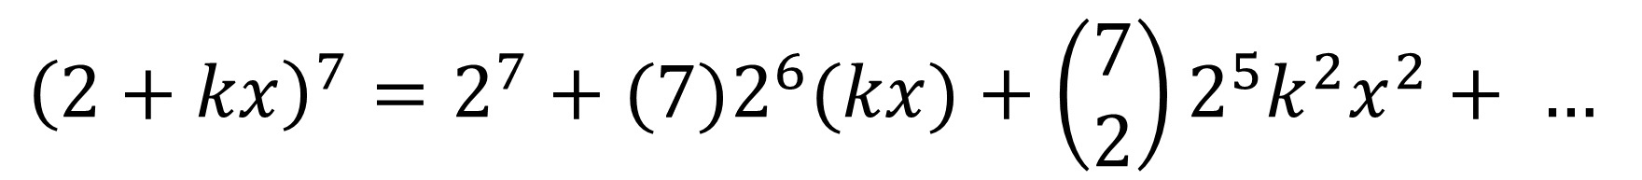
$${{\left(2+kx\right)}^{7}=2}^{7}+(7{)2}^{6}(kx)+\left(\begin{matrix}7 \\ 2\end{matrix}\right){2^{5}k^{2}x}^{2}+ …$$
$${\left(2+kx\right)}^{7}=128+448k+672{k^{2}x}^{2}+ …$$

Slide 11
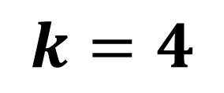
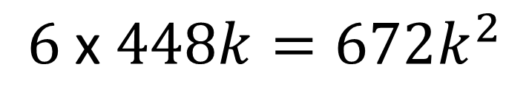
$${\left(2+kx\right)}^{7}=128+448k+672{k^{2}x}^{2}+ …$$
$$6 \text{x} 448k=672k^{2}$$
$$k=4$$

