Slide 1
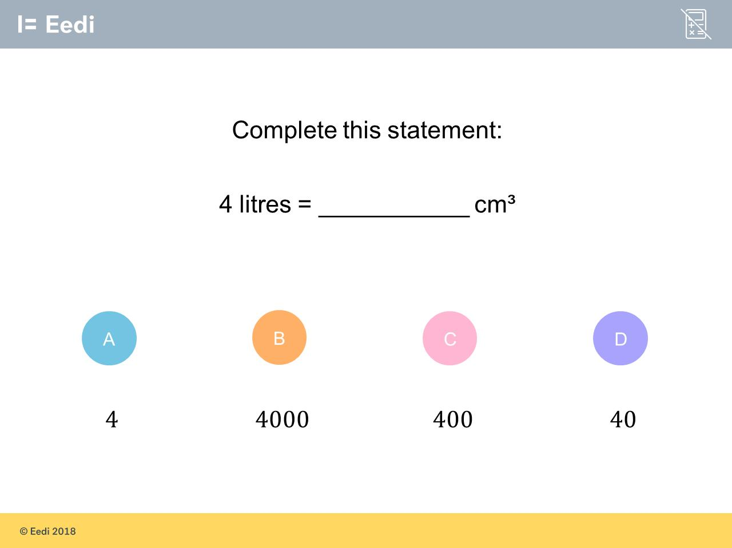
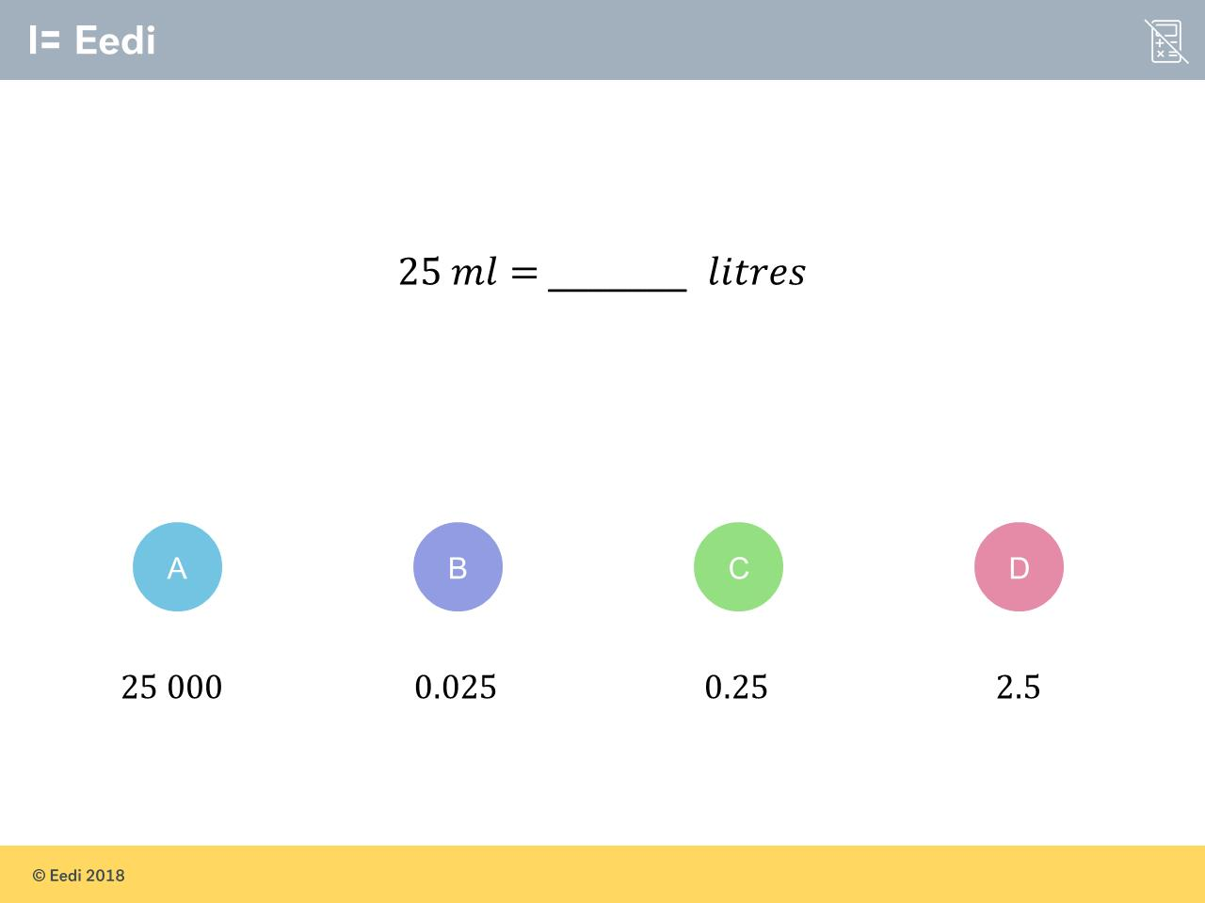
Worst answered question?
Most common wrong answer?

Slide 2
ANSWERS

Slide 3
Worst answered question?

Slide 4
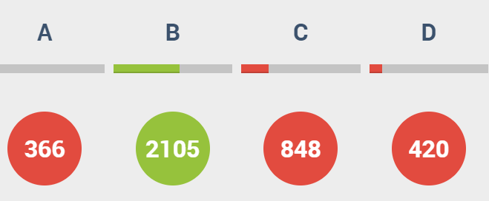
C
They thought there is
1 litre = 100ml

Slide 5
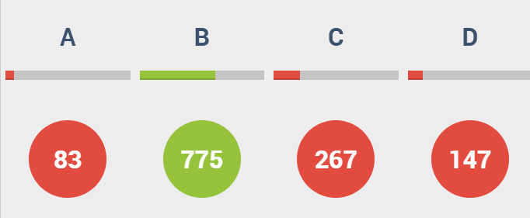
C
They thought there is
1 litre = 100ml

