Slide 1
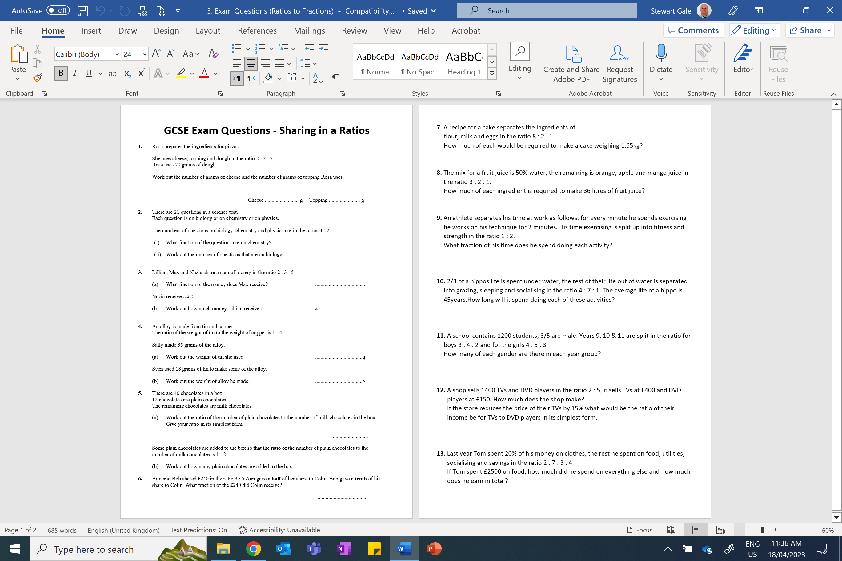

Slide 2
ANSWERS

Slide 3
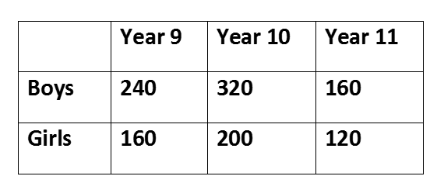
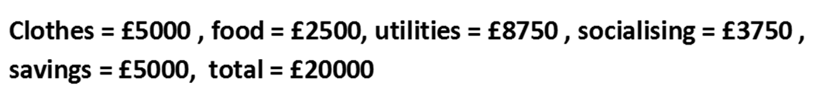








1.2kg : 300g : 150g
18L : 9L : 6L : 3L
$$F\frac{1}{9} S\frac{2}{9} T\frac{2}{3}$$
$$W 30$$
$$G 5$$
$$Sleep 9years 8months$$
$$Socialising 1year 3 months$$
£310,000
68 : 75

