Slide 1
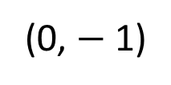
1
2
3
(1,4)
(2,8)
(3,9)
(0,0)
(0,0)
(0,0)
4
(1,5)
5
6
(2,8)
(1,8)
(0,1)
(0,2)
(0, $−$1)

Slide 2
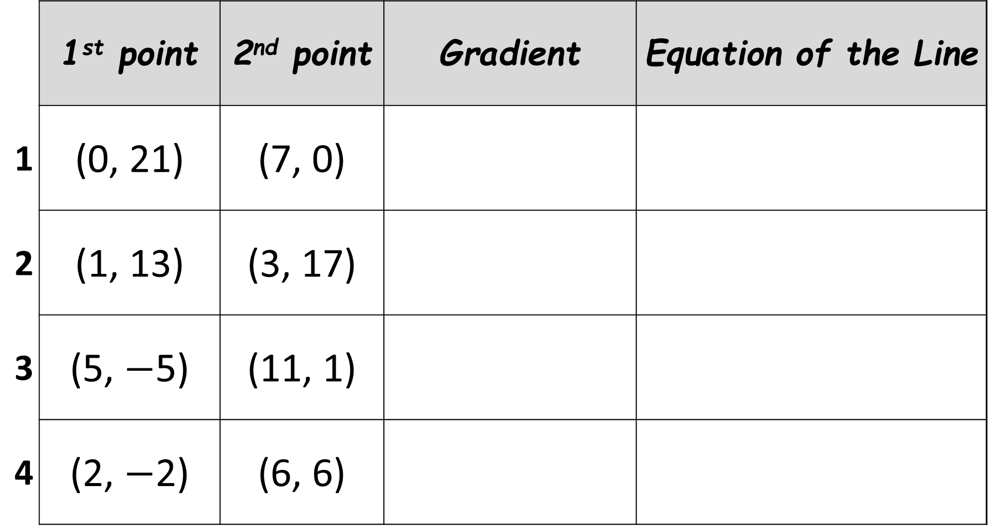
 | 1st point | 2nd point | Gradient | Equation of the Line
1 | (0, 21) | (7, 0)
2 | (1, 13) | (3, 17)
3 | (5, $−$5) | (11, 1)
4 | (2, $−$2) | (6, 6)

Slide 3
ANSWERS

Slide 4






1
(1,4)
2
(2,8)
3
(3,9)
(0,0)
(0,0)
(0,0)
$$y=4x$$
$$y=4x$$
$$y=3x$$
4
(1,5)
5
6
(2,8)
(1,8)
(0,2)
(0,1)
(0,-1)
$$y=4x+1$$
$$y=9x−1$$
$$y=3x+2$$

Slide 5
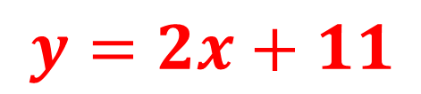
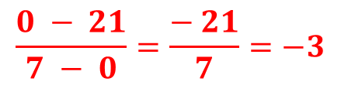
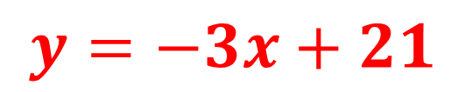
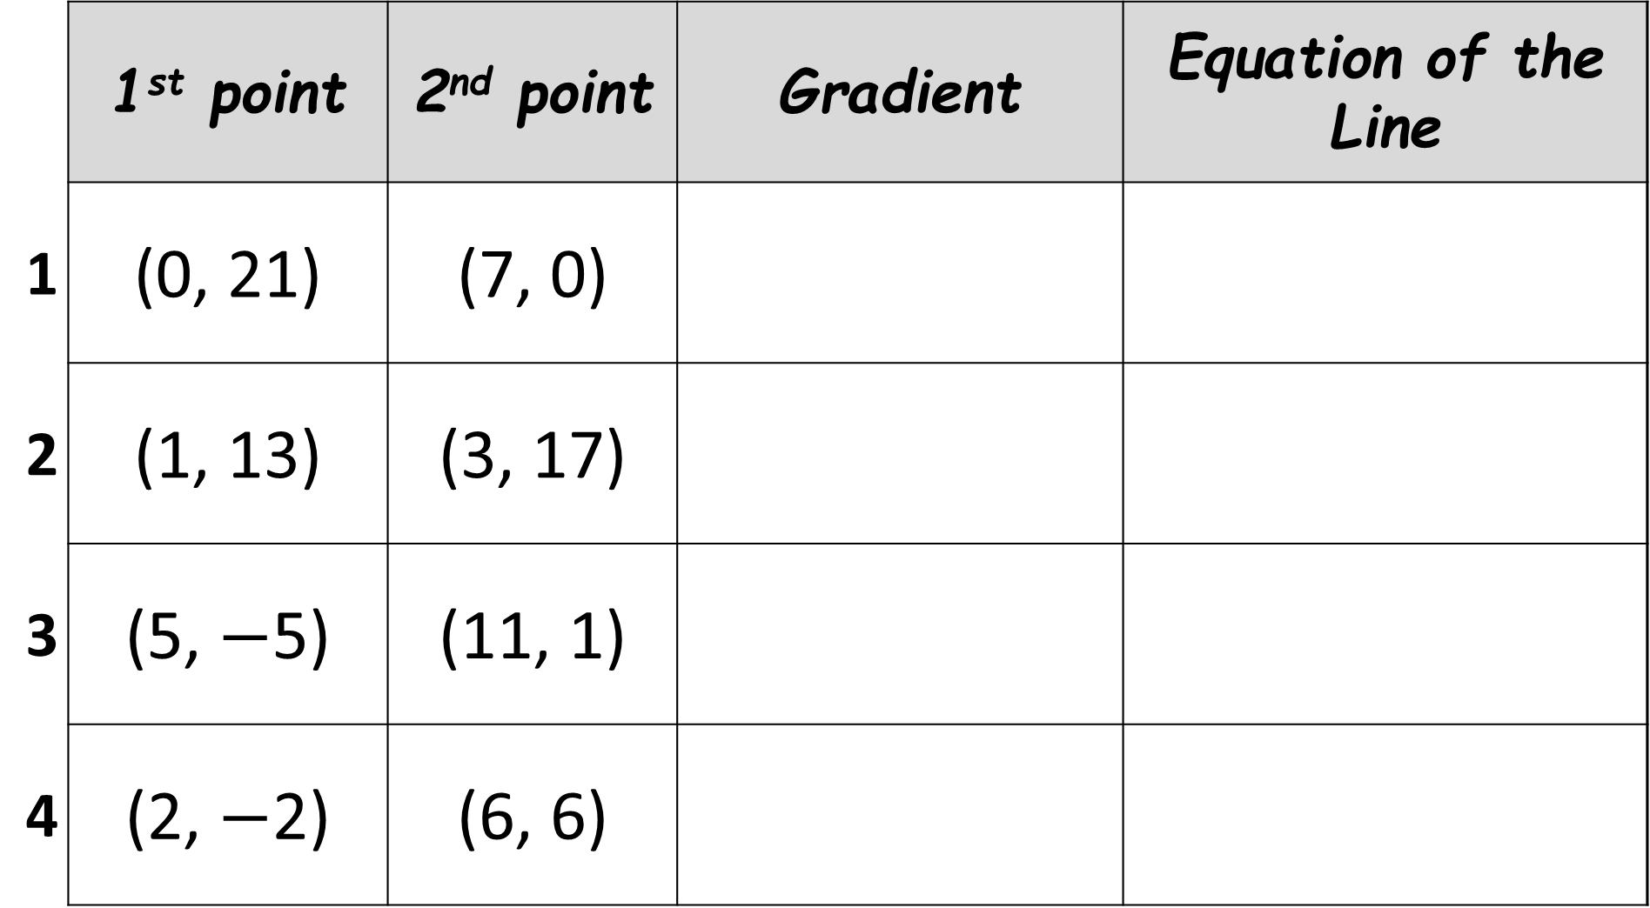
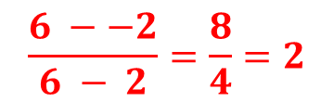
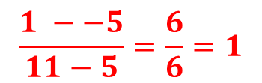
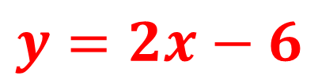
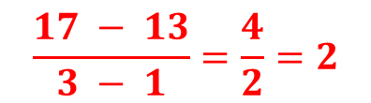
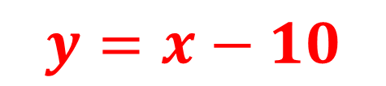
 | 1st point | 2nd point | Gradient | Equation of the Line
1 | (0, 21) | (7, 0)
2 | (1, 13) | (3, 17)
3 | (5, $−$5) | (11, 1)
4 | (2, $−$2) | (6, 6)
$$\frac{0 − 21}{7 − 0}=\frac{− 21}{7}=−3$$
$$y=−3x+21$$
$$\frac{17 − 13}{3 − 1}=\frac{4}{2}=2$$
$y=2x+11$
$$\frac{1 −−5}{11−5}=\frac{6}{6}=1$$
$$y=x−10$$
$$\frac{6 −−2}{6 − 2}=\frac{8}{4}=2$$
$$y=2x−6$$

