Slide 1
Statistical Distributions
Probability Distributions
Chapter 6
(Part 1 of 3)

Slide 2

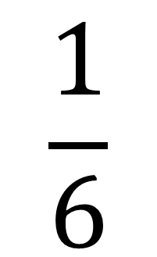

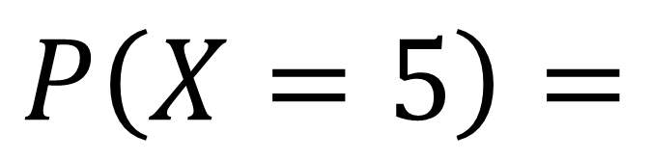
Notation
$$P\left(X=x\right)$$
Probability
Outcome
Required Outcome
$$\frac{1}{6}$$
$P\left(X=5\right)=$

Slide 3
A probability distribution
gives the probability of any
possible outcome of an event.

Slide 4
There are a number of ways you can present a probability distribution.
as a diagram
as a table
as a function

Slide 5
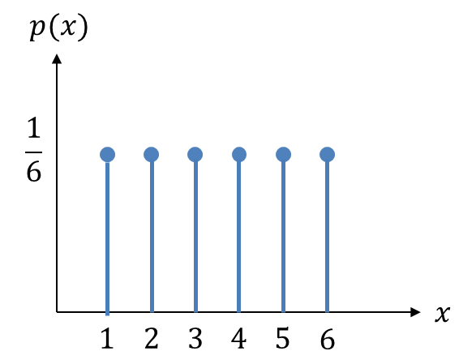

Probability Distribution as a diagram

Slide 6
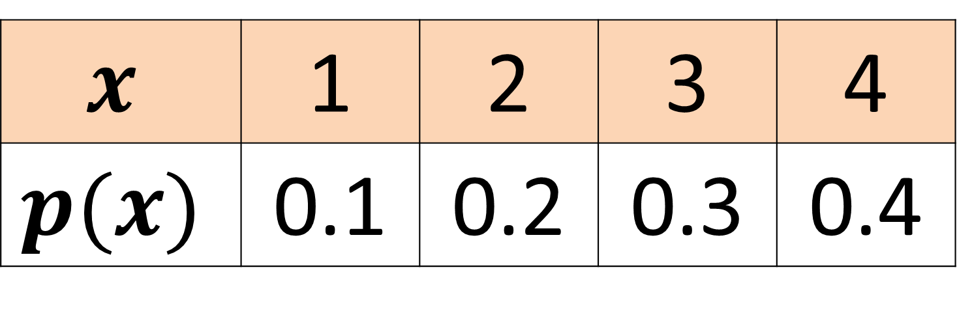
Probability Distribution as a table
$$x$$ | 1 | 2 | 3 | 4
$$p(x)$$ | 0.1 | 0.2 | 0.3 | 0.4

Slide 7
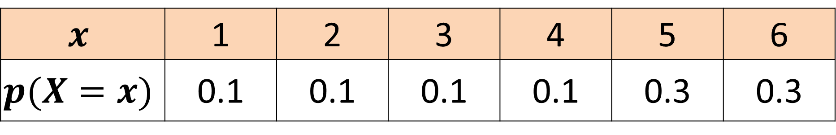
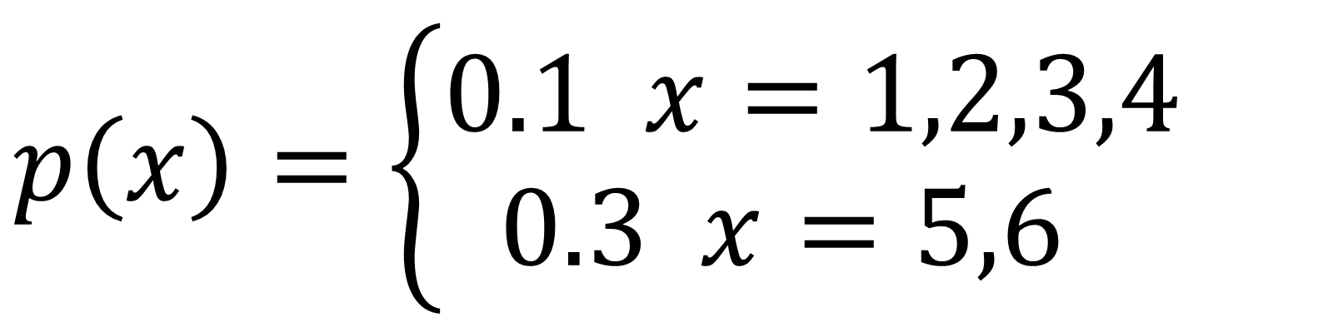
Probability Distribution as a function
$$p\left(x\right)=\left\{\begin{aligned}0.1 x=1,2,3,4 \\ 0.3 x=5,6,3\end{aligned}\right.$$
$$x$$ | 1 | 2 | 3 | 4 | 5 | 6
$$p(X=x)$$ | 0.1 | 0.1 | 0.1 | 0.1 | 0.3 | 0.3

Slide 8
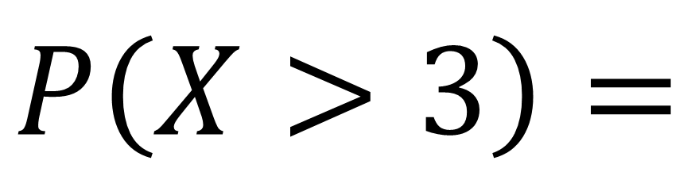
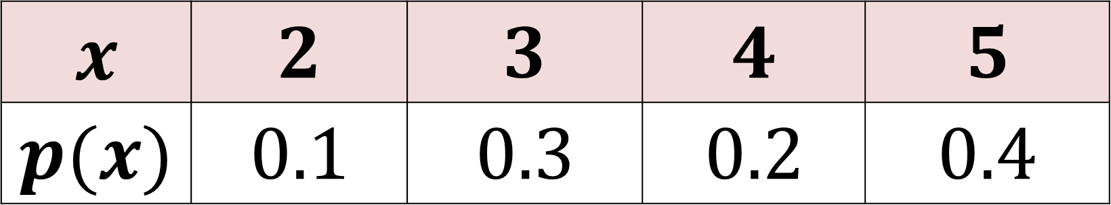

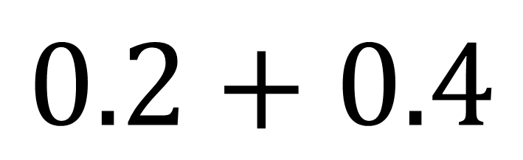
$$x$$ | $$2$$ | $$3$$ | $$4$$ | $$5$$
$$p(x)$$ | $$0.1$$ | $$0.3$$ | $$0.2$$ | $$0.4$$
$$P\left(X>3\right)=$$
$$0.2+0.4$$
$$=0.6$$

Slide 9

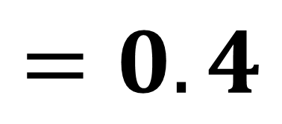
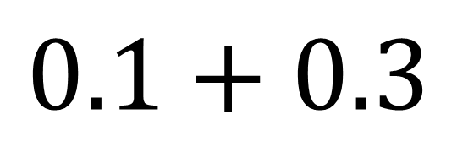
$$x$$ | $$2$$ | $$3$$ | $$4$$ | $$5$$
$$p(x)$$ | $$0.1$$ | $$0.3$$ | $$0.2$$ | $$0.4$$
$$P\left(2≤X<4\right)=$$
$$0.1+0.3$$
$$=0.4$$

Slide 10
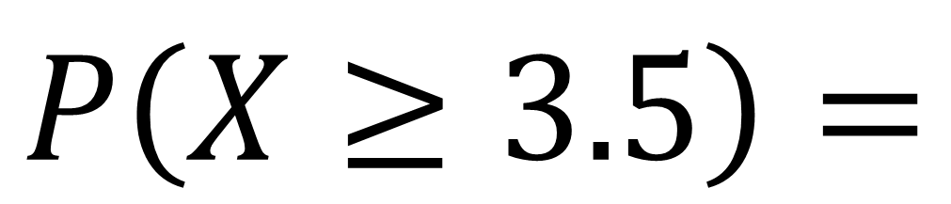
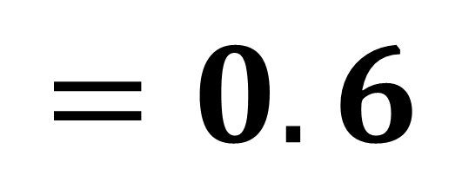
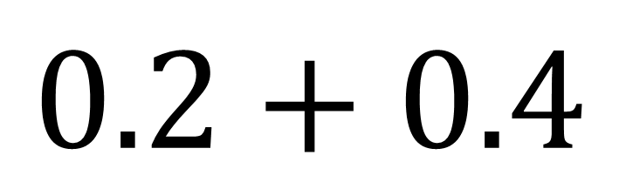
$$x$$ | $$2$$ | $$3$$ | $$4$$ | $$5$$
$$p(x)$$ | $$0.1$$ | $$0.3$$ | $$0.2$$ | $$0.4$$
$$P\left(X≥3.5\right)=$$
$$0.2+0.4$$
$$=0.6$$

Slide 11
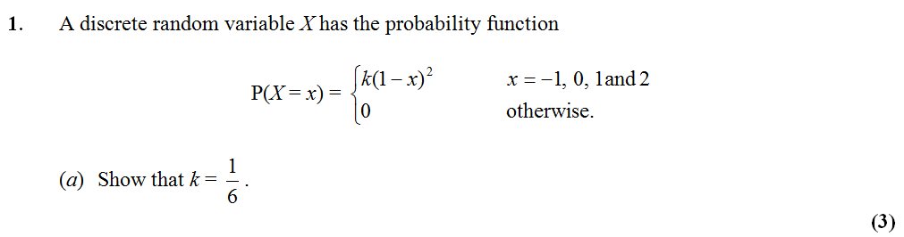

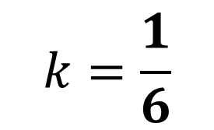







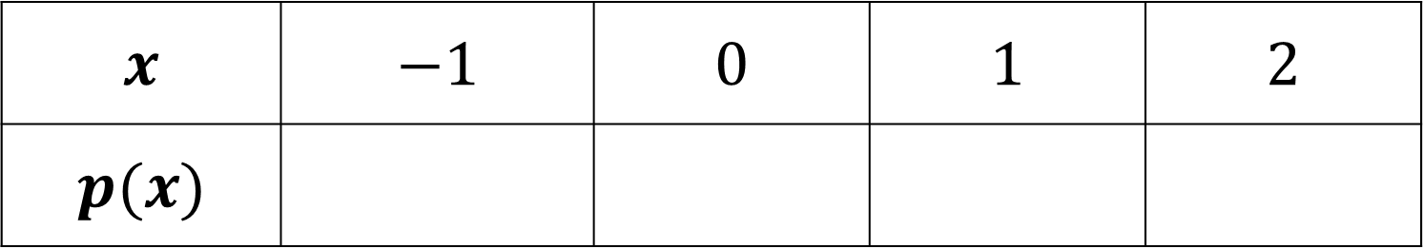

$$x$$ | $$−1$$ | $$0$$ | $$1$$ | $$2$$
$$p(x)$$
$$4k$$
$$k$$
$$0$$
$$k$$
$$k{\left(1−−1\right)}^{2}$$
$$k{\left(1−0\right)}^{2}$$
$$k{\left(1−1\right)}^{2}$$
$$k{\left(1−2\right)}^{2}$$
$$4k+k+0+k=1$$
$$k=\frac{1}{6}$$

