Slide 1
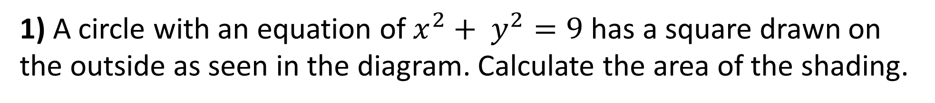
1) A circle with an equation of $x^{2}+ y^{2}=9$ has a square drawn on the outside as seen in the diagram. Calculate the area of the shading.

Slide 2
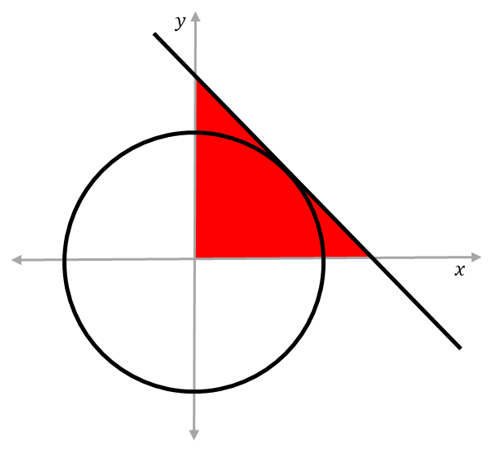
2) The tangent meet the circle at (3,12).
What is the area of the shaded triangle?

Slide 3
3) What is exact area of triangle OAB?
A(2,4)
B(10, 0)
0

Slide 4
4) AB is the tangent to the circle.
What is exact area of triangle OAB?
A(2,8)
B(?, 0)
0

Slide 5
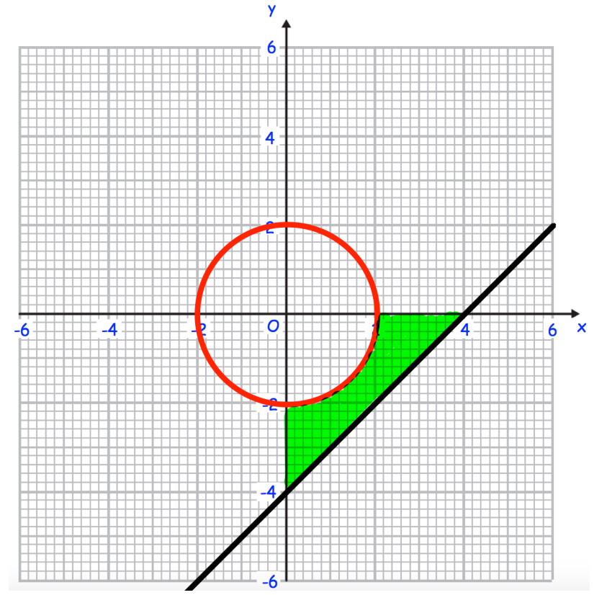
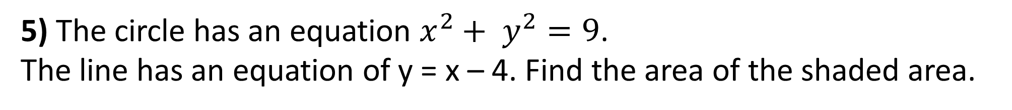
5) The circle has an equation $x^{2}+ y^{2}=9$.
The line has an equation of y = x – 4. Find the area of the shaded area.

Slide 6
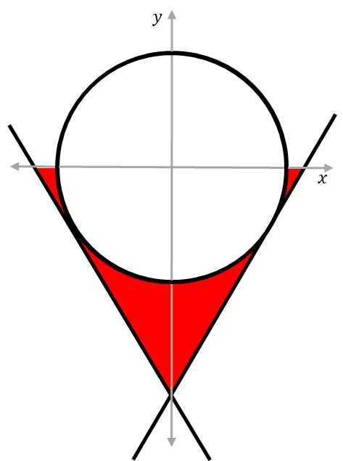
6) One tangent meets the circle at (2,-6), and another meets the circle at (-2,-6) What is the total area of the shaded sections?

Slide 7
ANSWERS

Slide 8
1) A circle with an equation of $x^{2}+ y^{2}=9$ has a square drawn on the outside as seen in the diagram. Calculate the area of the shading.

Slide 9
2) The tangent meet the circle at (3,12).
What is the area of the shaded triangle?

Slide 10
3) What is exact area of triangle OAB?
A(2,4)
B(10, 0)
0

Slide 11
4) AB is the tangent to the circle.
What is exact area of triangle OAB?
A(2,8)
B(?, 0)
0

Slide 12
5) The circle has an equation $x^{2}+ y^{2}=9$.
The line has an equation of y = x – 4. Find the area of the shaded area.

Slide 13
6) One tangent meets the circle at (2,-6), and another meets the circle at (-2,-6) What is the total area of the shaded sections?

