Slide 1
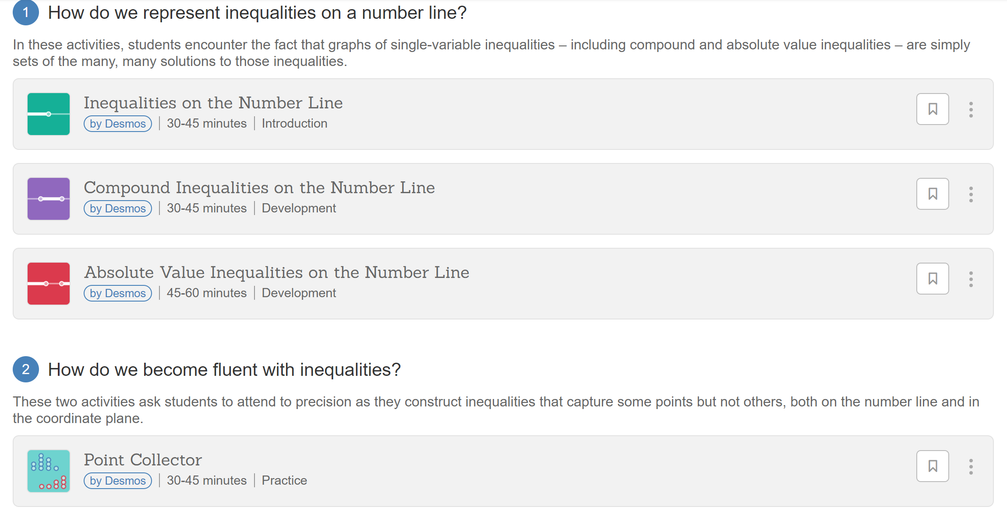
https://teacher.desmos.com/inequalities

