Slide 1
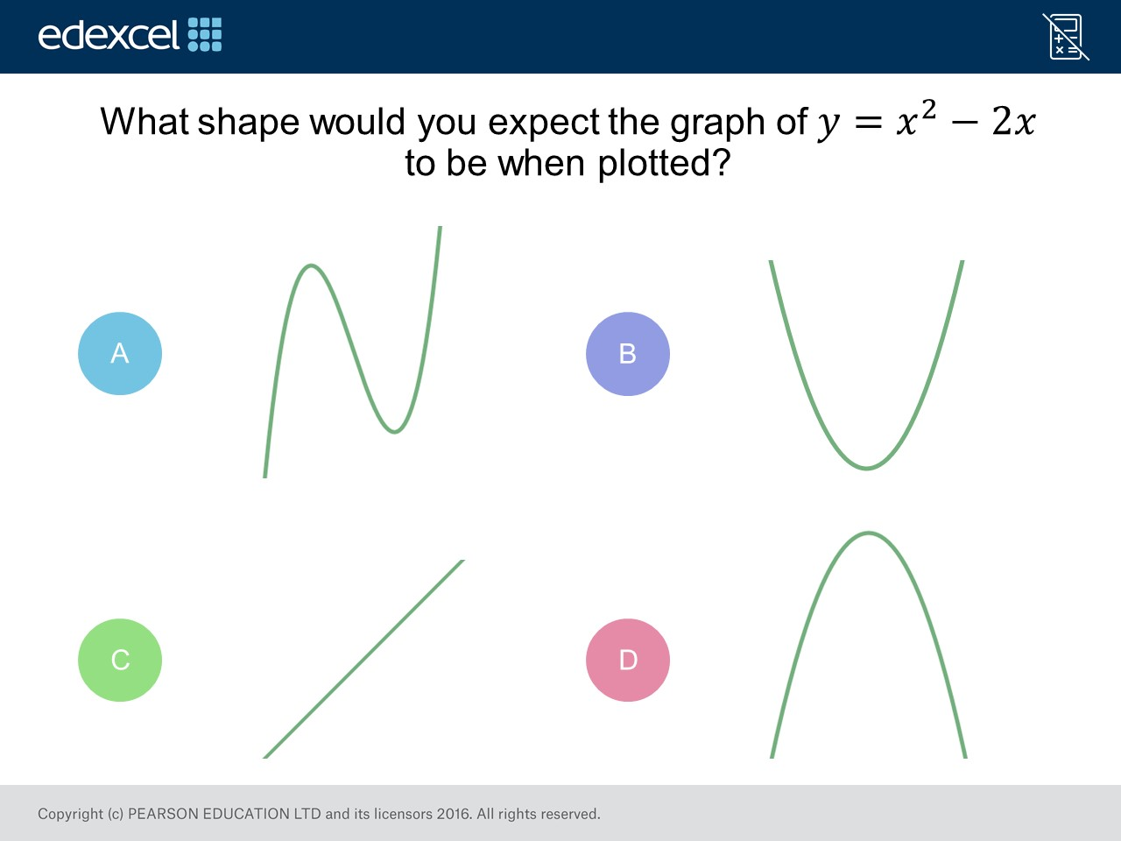
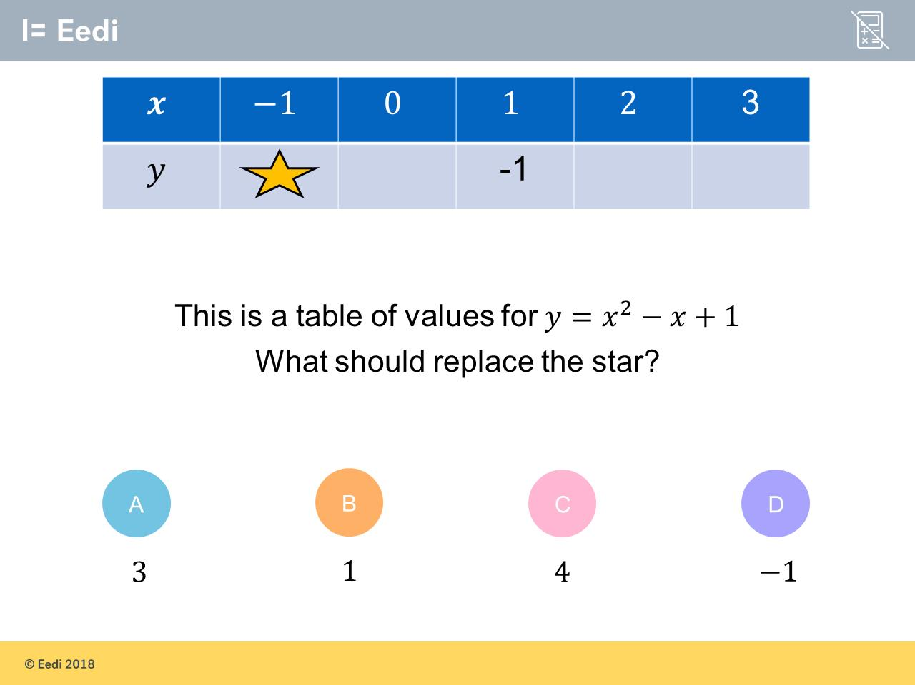
Worst answered question?
Most common wrong answer?

Slide 2
ANSWERS

Slide 3
Worst answered question?

Slide 4
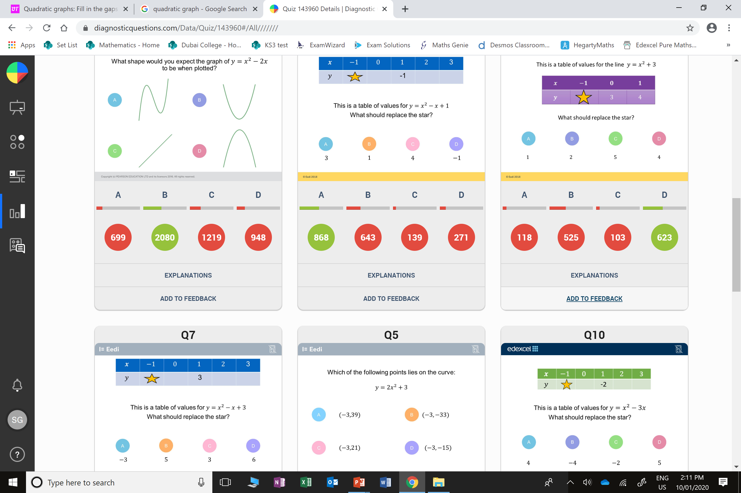
C
They don’t understand the effect of x².

Slide 5
B
They did
1 – 1 + 1
instead of
1 + 1 + 1

