Slide 1
Moments
Introduction
Chapter 4
(Part 1 of 4)

Slide 2
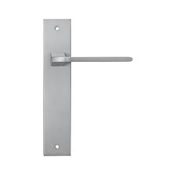
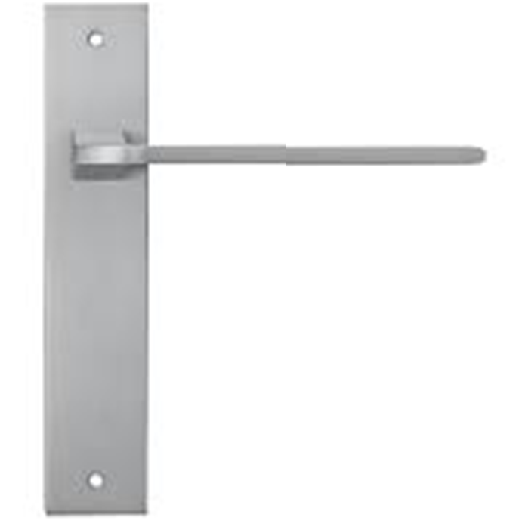
Which is the easier handle to turn?

Slide 3
The ‘moment’ of a force
measures the turning effect

Slide 4
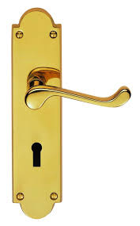
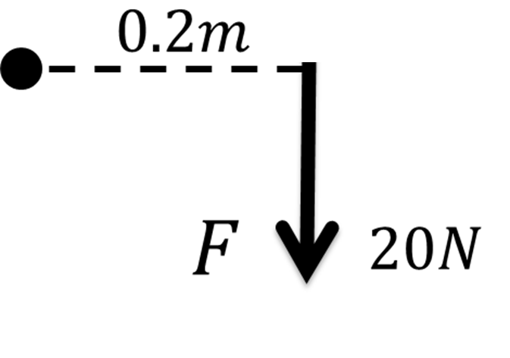
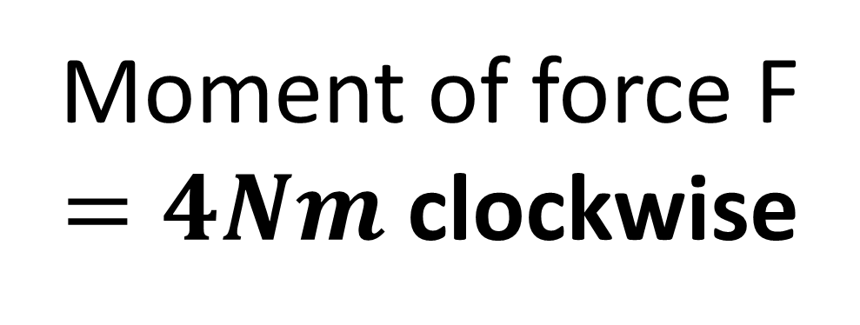

Moment of force F
$=4Nm$ clockwise
$$F$$

Slide 5
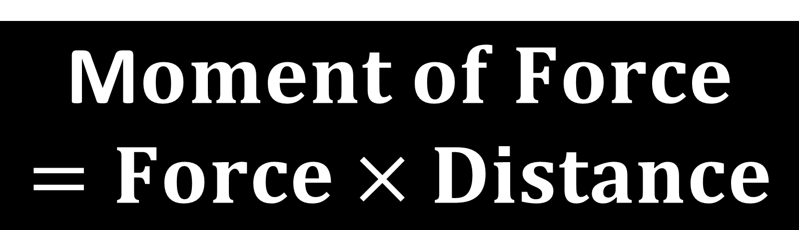
M$oment of Force$
$$=Force×Distance$$
Force must be the perpendicular component

Slide 6
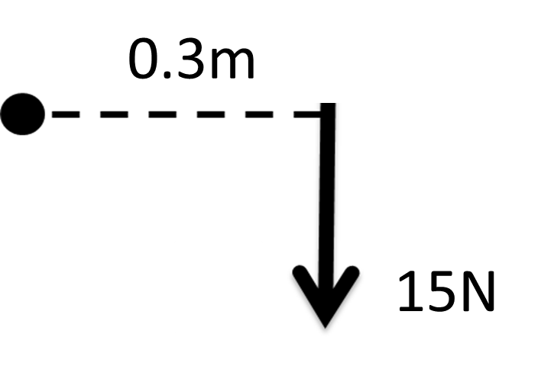
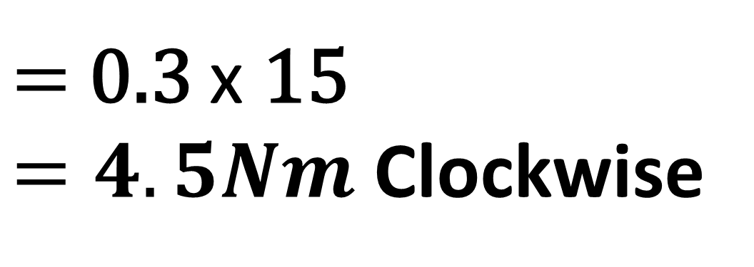
Find the Moments
0.3m
$=$ 0.3 $\text{x}$ 15
$=4.5Nm$ Clockwise
15N

Slide 7
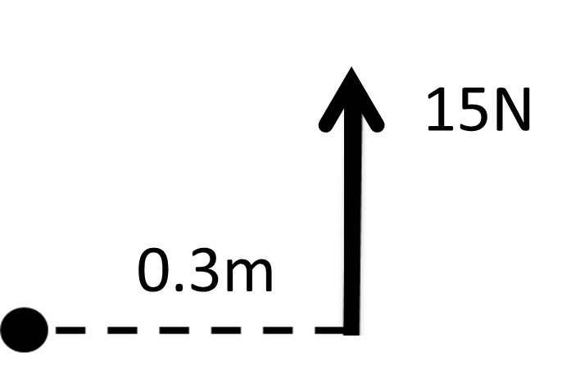
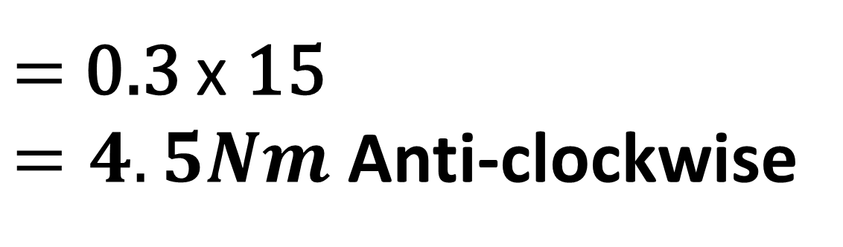
Find the Moments
15N
0.3m
$=$ 0.3 $\text{x}$ 15
$=4.5Nm$ Anti-clockwise

Slide 8
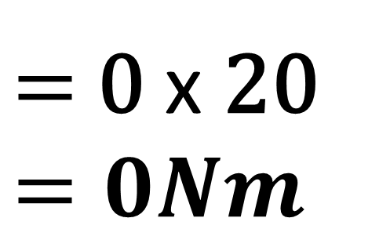
Find the Moments
20N
20N
$=$ 0 $\text{x}$ 20
$$=0Nm$$

Slide 9
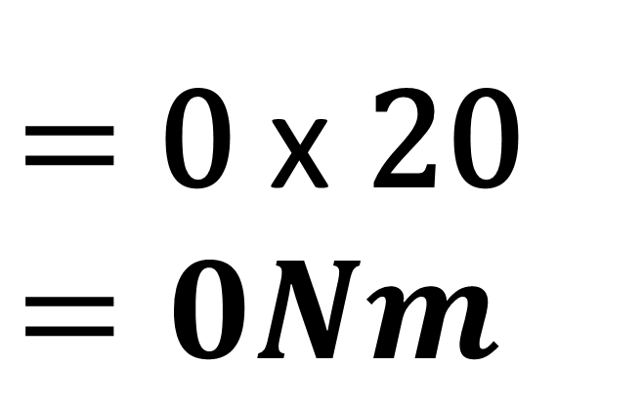
Find the Moments
$=$ 0 $\text{x}$ 20
$$=0Nm$$
20N

Slide 10
Perpendicular Force

Slide 11
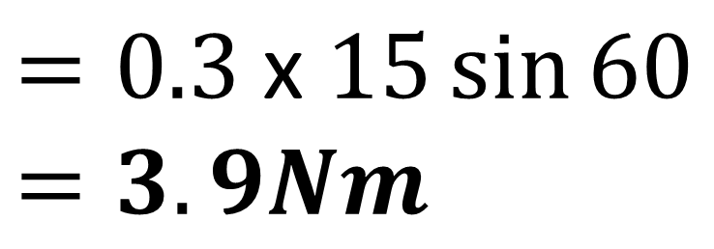
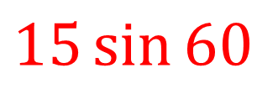
Find the Moments
15N
$$15\sin{60}$$
60°
0.3m
0.3m
$$=0.3 \text{x} 15\sin{60}$$
$$=3.9Nm$$

Slide 12
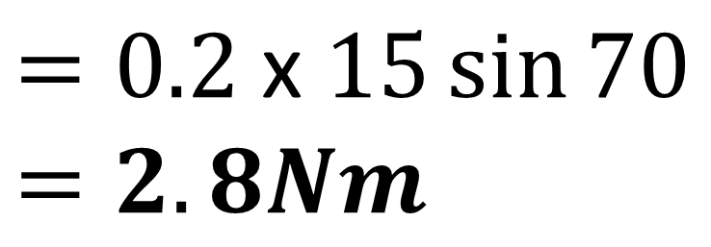
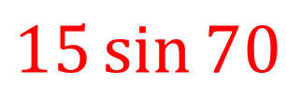
Find the Moments
$$=0.\text{2} \text{x} 15\sin{70}$$
$$=2.8Nm$$
0.2m
70°
0.2 m
15N
$$15\sin{70}$$

Slide 13

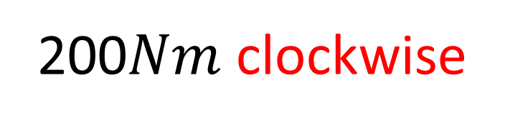

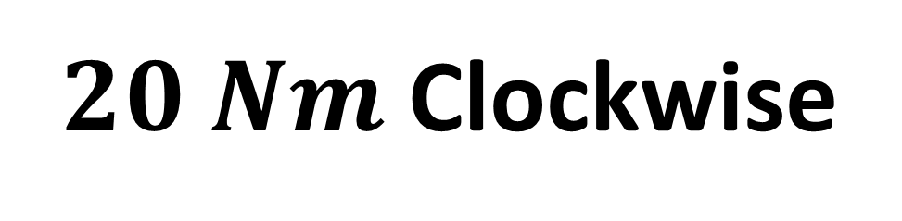



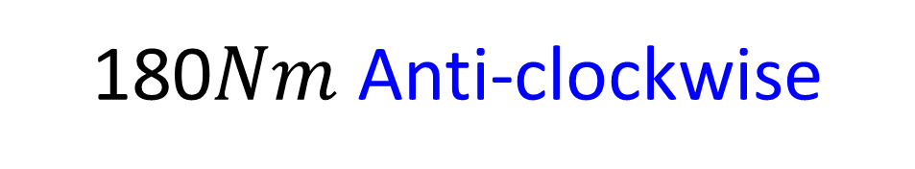
$$F=20N$$
200$Nm$ clockwise
$$10m$$
$$P$$
$$12m$$
$$F=15N$$
180$Nm$ Anti-clockwise
What direction will the rotation be?
$20 Nm$ Clockwise

Slide 14
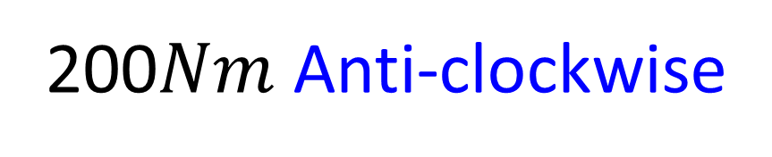






$$F=20N$$
200$Nm$ clockwise
$$10m$$
$$P$$
$$16m$$
$$F=12.5N$$
200$Nm$ Anti-clockwise
What direction will the rotation be?
CW Moments = ACW Moments
Therefore, no rotation.

Slide 15
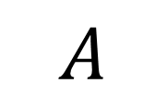
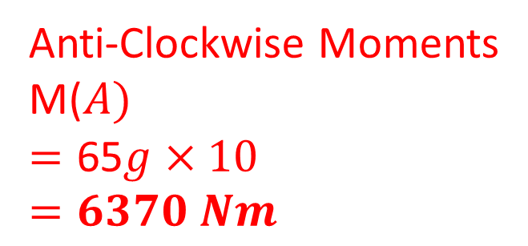

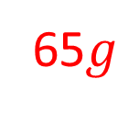
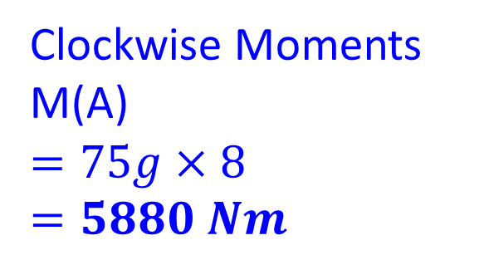
Will the rod rotate clockwise or anti-clockwise
and what is the moments force?
10m
8m
65$g$
$$A$$
$$75g$$
Anti-Clockwise Moments
M($A)$
$$=\text{65}g×10$$
$$=6370 Nm$$
Clockwise Moments
M(A)
$$=75g×8$$
$$=5880 Nm$$
Anti-Clockwise 490 Nm

