Slide 1
Statistical Distributions
Cumulative
Binomial Distribution
Chapter 6
(Part 3 of 3)

Slide 2
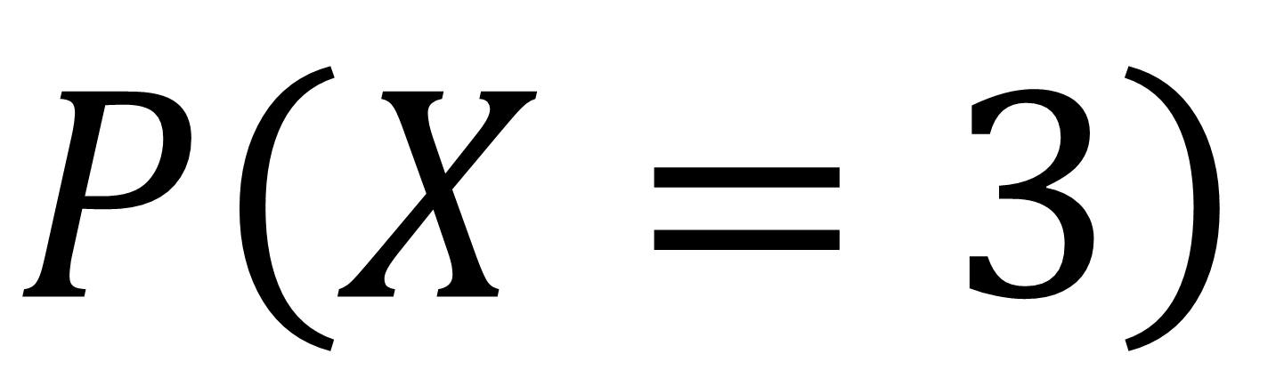
Individual Probability
$P\left(X=3\right)$

Slide 3
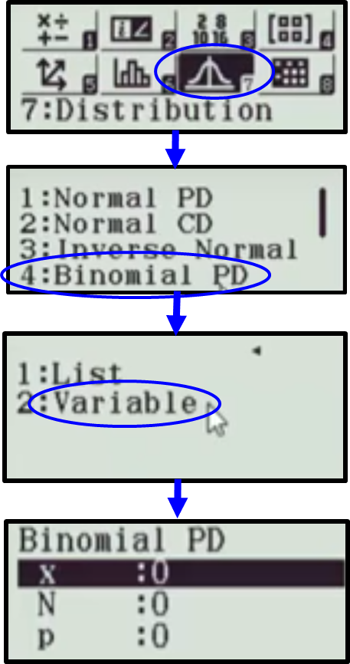
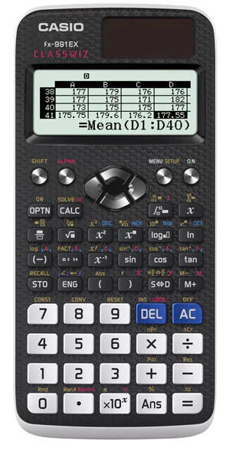
Individual Probabilities

Slide 4









N = 8 P = 0.55
$$P\left(X=0\right)=0.00168$$
$$P\left(X=1\right)=0.0164$$
$$P\left(X=2\right)=0.0703$$
$$P\left(X=3\right)=0.172$$
$$P\left(X=4\right)=0.262$$
$$P\left(X=5\right)=0.257$$
$$P\left(X=6\right)=0.157$$
$$P\left(X=7\right)=0.0548$$
$$P\left(X=8\right)=0.00837$$

Slide 5
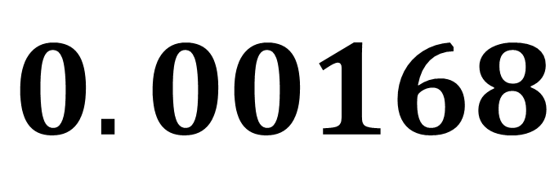
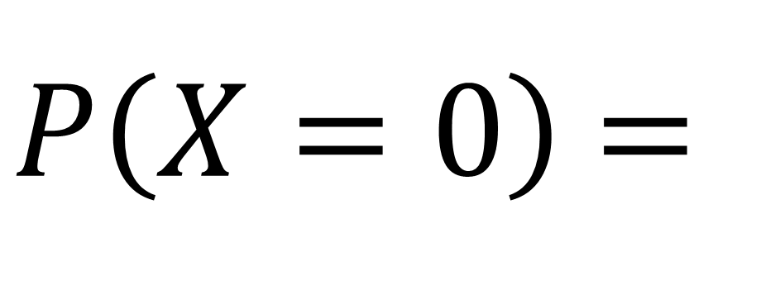
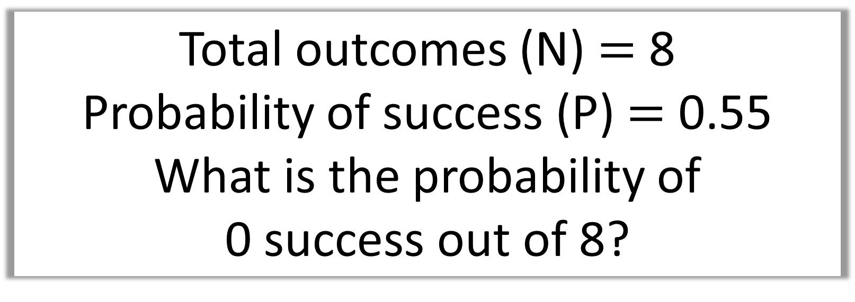
Total outcomes (N) $=$ 8
Probability of success (P) $=$ 0.55
What is the probability of
0 success out of 8?
$P\left(X=0\right)$ =
$$0.00168$$

Slide 6
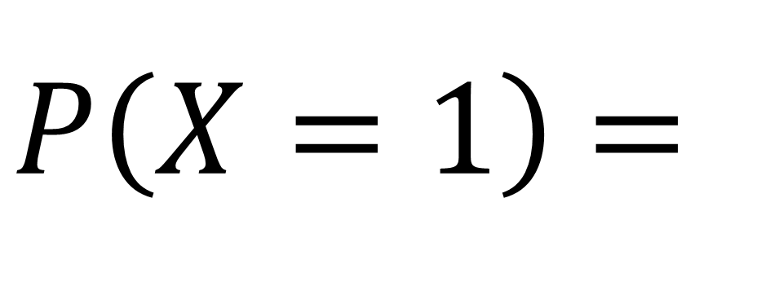
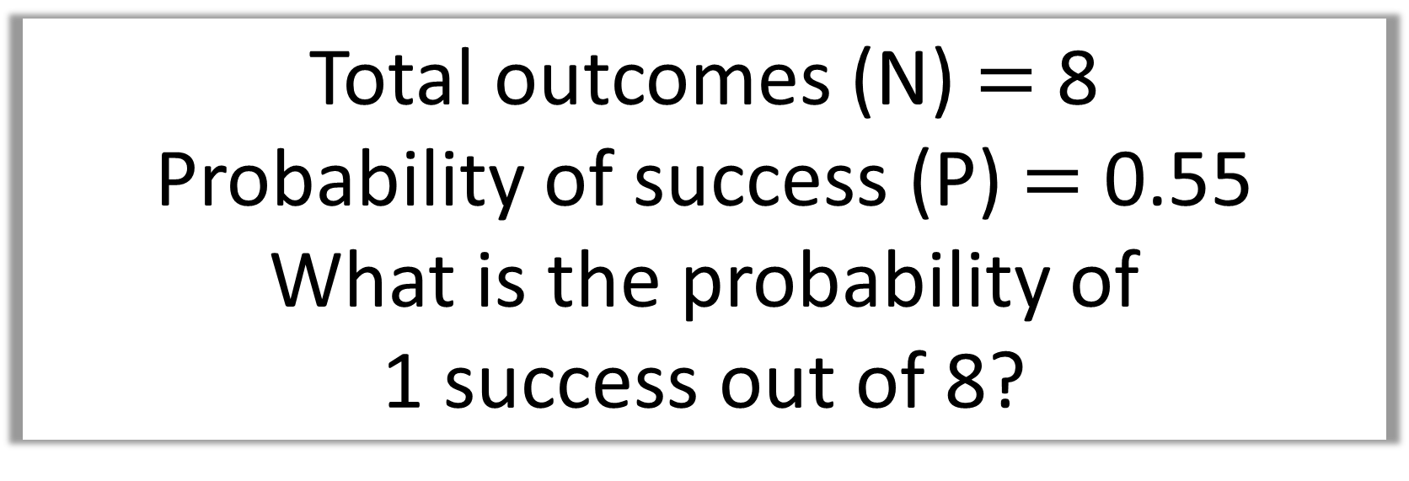
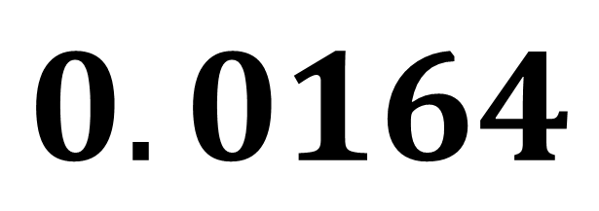
Total outcomes (N) $=$ 8
Probability of success (P) $=$ 0.55
What is the probability of
1 success out of 8?
$P\left(X=1\right)$ =
$$0.0164$$

Slide 7
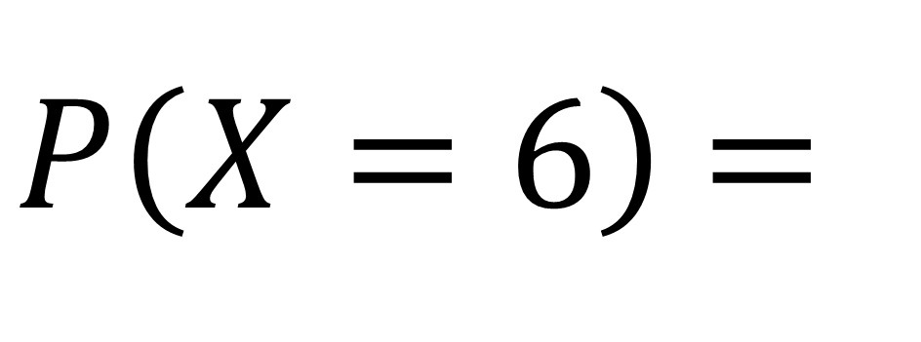
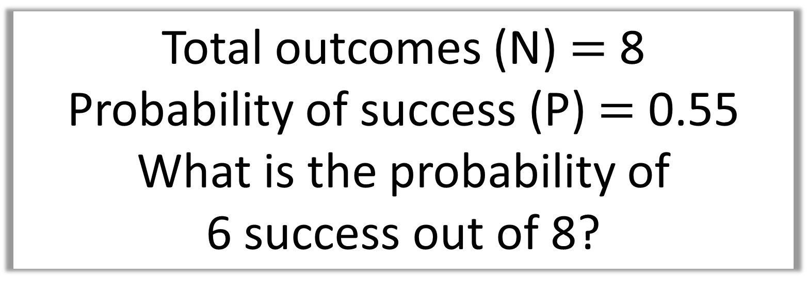
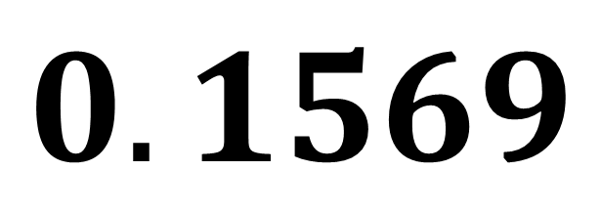
Total outcomes (N) $=$ 8
Probability of success (P) $=$ 0.55
What is the probability of
6 success out of 8?
$P\left(X=6\right)$ =
$$0.1569$$

Slide 8
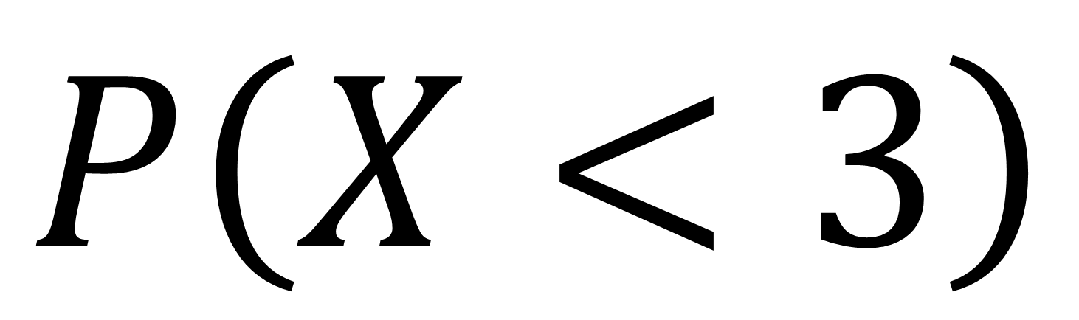
Cumulative Probability
$P\left(X<3\right)$

Slide 9
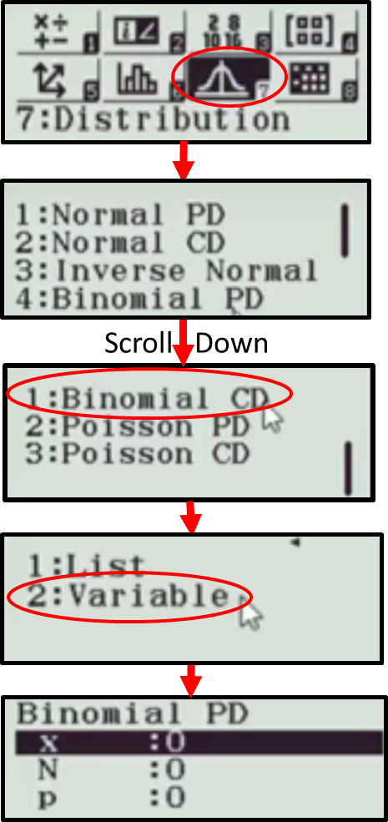
Cumulative Probabilities

Slide 10
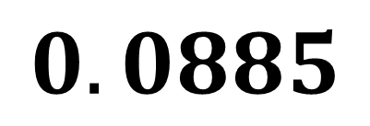
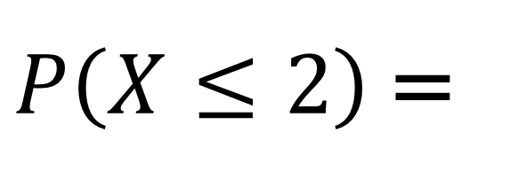
N = 8 P = 0.55
}
$$P\left(X=0\right)=0.00168$$
$$P\left(X=1\right)=0.0164$$
$P\left(X≤2\right)$ =
$$0.0885$$
$$P\left(X=2\right)=0.0703$$
$$P\left(X=3\right)=0.172$$
$$P\left(X=4\right)=0.262$$
$$P\left(X=5\right)=0.257$$
$$P\left(X=6\right)=0.157$$
$$P\left(X=7\right)=0.0548$$
$$P\left(X=8\right)=0.00837$$

Slide 11
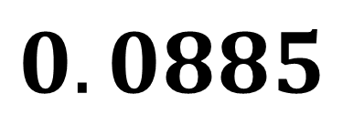
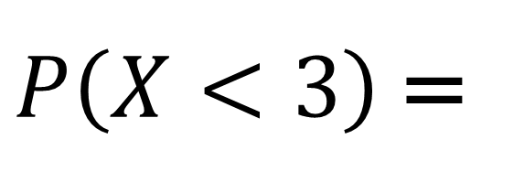
N = 8 P = 0.55
}
$$P\left(X=0\right)=0.00168$$
$$P\left(X=1\right)=0.0164$$
$P\left(X<3\right)$ =
$$0.0885$$
$$P\left(X=2\right)=0.0703$$
$$P\left(X=3\right)=0.172$$
$$P\left(X=4\right)=0.262$$
$$P\left(X=5\right)=0.257$$
$$P\left(X=6\right)=0.157$$
$$P\left(X=7\right)=0.0548$$
$$P\left(X=8\right)=0.00837$$

Slide 12
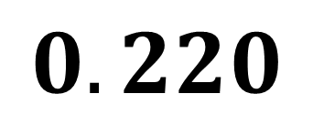
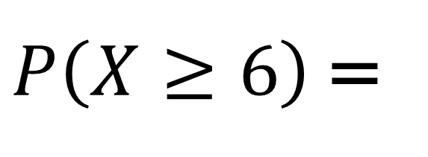

N = 8 P = 0.55
$$P\left(X=0\right)=0.00168$$
$$P\left(X=1\right)=0.00164$$
$$P\left(X=2\right)=0.0703$$
$$P\left(X=3\right)=0.172$$
$$P\left(X=4\right)=0.262$$
$$P\left(X=5\right)=0.257$$
}
$$P\left(X=6\right)=0.157$$
$$P\left(X=7\right)=0.0548$$
$P\left(X≥6\right)$ =
$$0.220$$
$$P\left(X=8\right)=0.00837$$

Slide 13
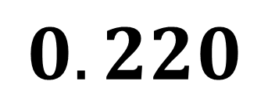
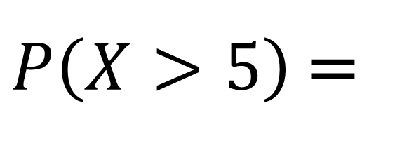
N = 8 P = 0.55
$$P\left(X=0\right)=0.00168$$
$$P\left(X=1\right)=0.00164$$
$$P\left(X=2\right)=0.0703$$
$$P\left(X=3\right)=0.172$$
$$P\left(X=4\right)=0.262$$
$$P\left(X=5\right)=0.257$$
}
$$P\left(X=6\right)=0.157$$
$$P\left(X=7\right)=0.0548$$
$P\left(X>5\right)$ =
$$0.220$$
$$P\left(X=8\right)=0.00837$$

Slide 14
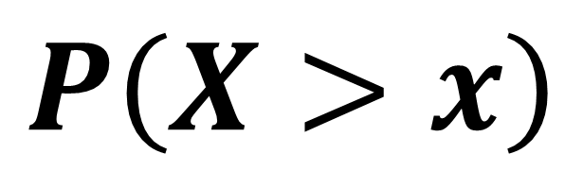
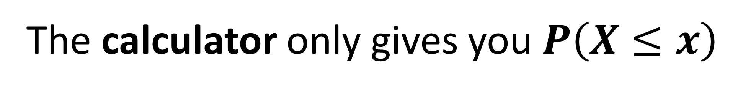
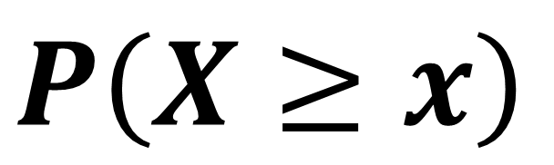
Warning!
The calculator only gives you $P\left(X≤x\right)$
So watch out for questions that ask…
$P\left(X>x\right)$
$P\left(X≥x\right)$

Slide 15

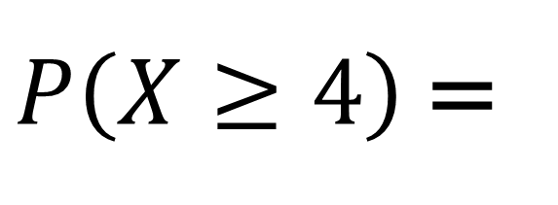
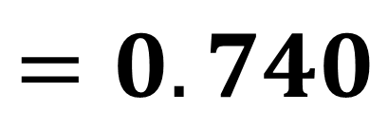


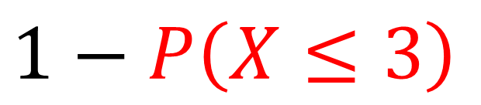



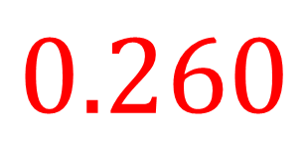



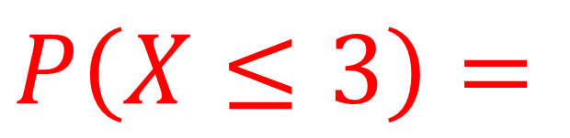
N = 8 P = 0.55
}
$$P\left(X=0\right)=0.00168$$
$$P\left(X=1\right)=0.00164$$
$P\left(X≤3\right)=$
$$0.260$$
$$P\left(X=2\right)=0.0703$$
}
$$P\left(X=3\right)=0.172$$
$$P\left(X=4\right)=0.262$$
$$P\left(X=5\right)=0.257$$
$$P\left(X=6\right)=0.157$$
$P\left(X≥4\right)$ =
$1−P\left(X≤3\right)$
$$P\left(X=7\right)=0.0548$$
$$=0.740$$
$$P\left(X=8\right)=0.00837$$

Slide 16
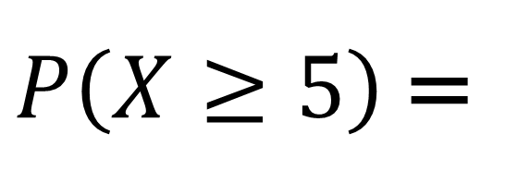
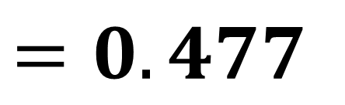
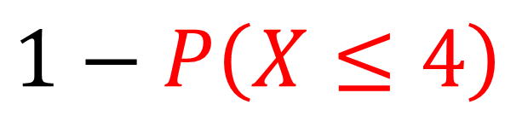
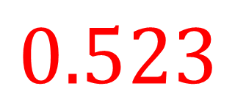
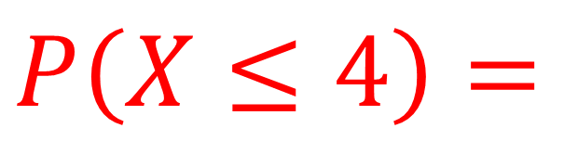
}
N = 8 P = 0.55
$$P\left(X=0\right)=0.00168$$
$$P\left(X=1\right)=0.00164$$
$P\left(X≤4\right)=$
$$0.523$$
$$P\left(X=2\right)=0.0703$$
$$P\left(X=3\right)=0.172$$
$$P\left(X=4\right)=0.262$$
}
$$P\left(X=5\right)=0.257$$
$$P\left(X=6\right)=0.157$$
$P\left(X≥5\right)$ =
$1−P\left(X≤4\right)$
$$P\left(X=7\right)=0.0548$$
$$=0.477$$
$$P\left(X=8\right)=0.00837$$

Slide 17
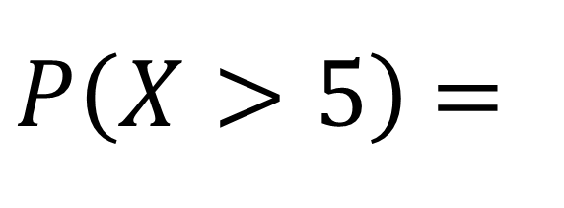
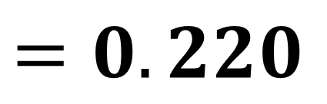
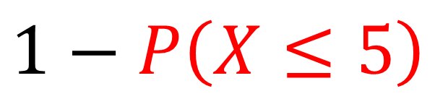
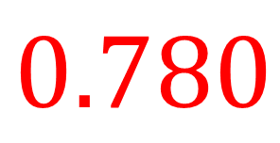
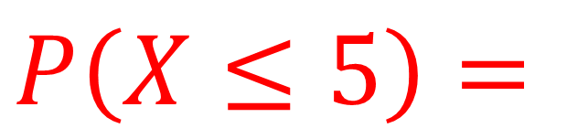
}
N = 8 P = 0.55
$$P\left(X=0\right)=0.00168$$
$$P\left(X=1\right)=0.00164$$
$$P\left(X=2\right)=0.0703$$
$P\left(X≤5\right)=$
$$0.780$$
$$P\left(X=3\right)=0.172$$
$$P\left(X=4\right)=0.262$$
$$P\left(X=5\right)=0.257$$
}
$$P\left(X=6\right)=0.157$$
$P\left(X>5\right)$ =
$1−P\left(X≤5\right)$
$$P\left(X=7\right)=0.0548$$
$$P\left(X=8\right)=0.00837$$
$$=0.220$$

Slide 18
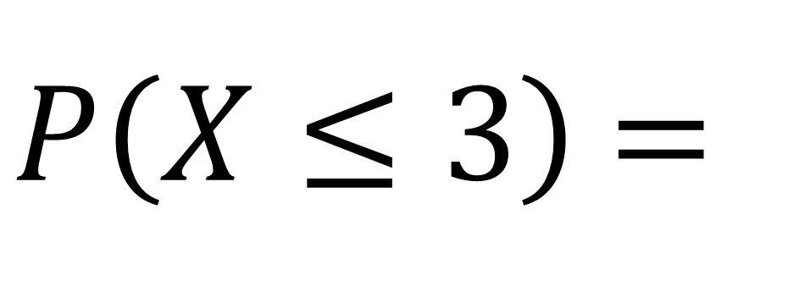
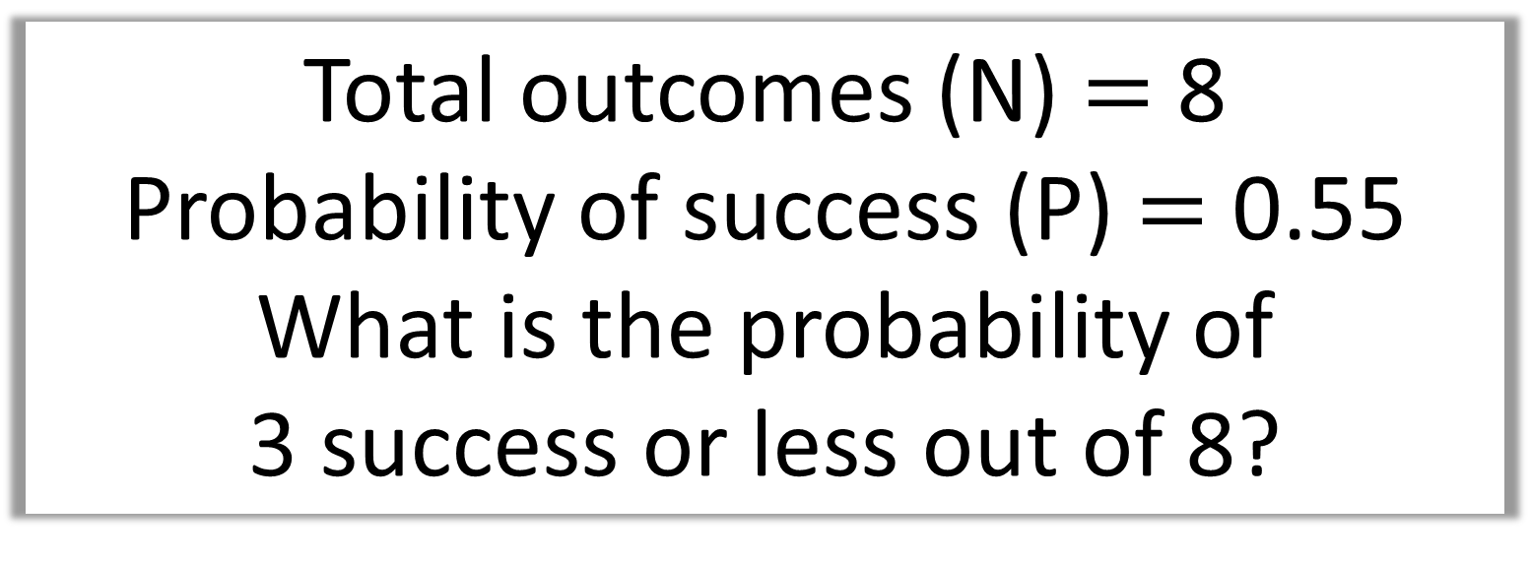
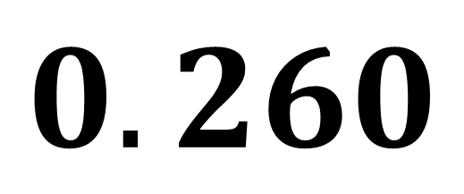
Total outcomes (N) $=$ 8
Probability of success (P) $=$ 0.55
What is the probability of
3 success or less out of 8?
$P\left(X≤3\right)$ =
$$0.260$$

Slide 19
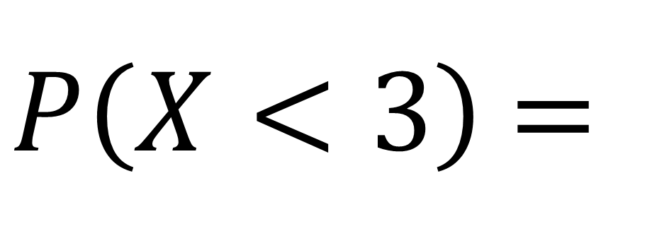
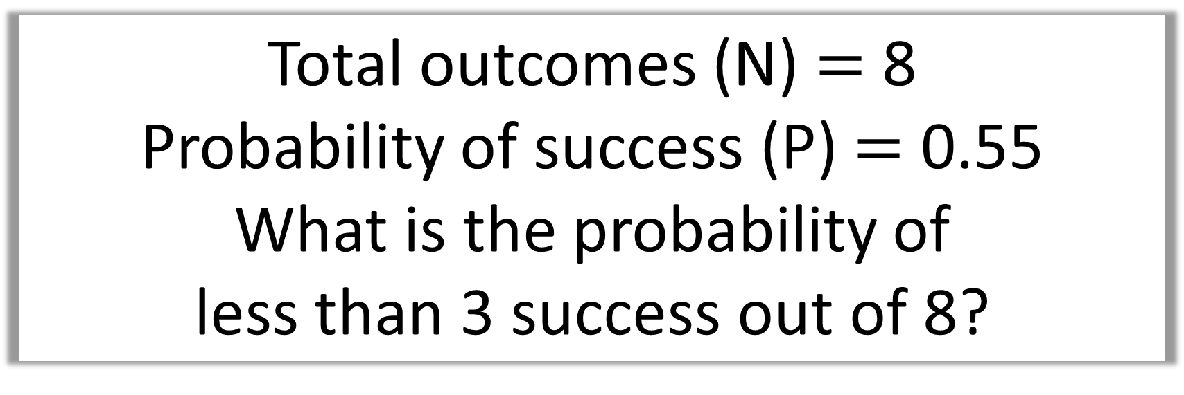
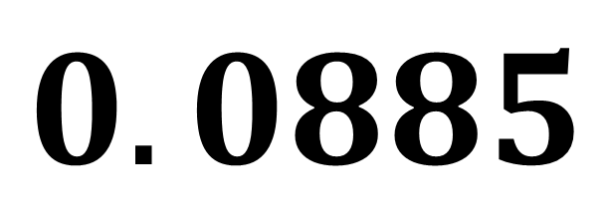
Total outcomes (N) $=$ 8
Probability of success (P) $=$ 0.55
What is the probability of
less than 3 success out of 8?
$P\left(X<3\right)$ =
$$0.0885$$

Slide 20
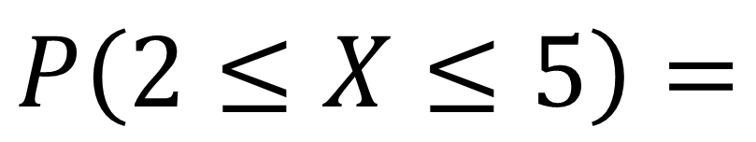
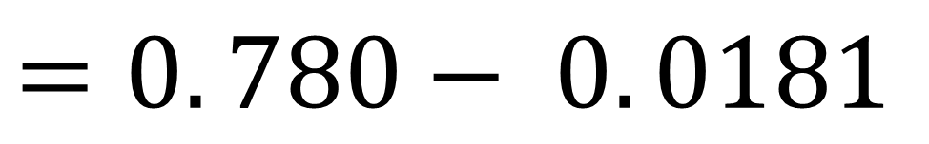

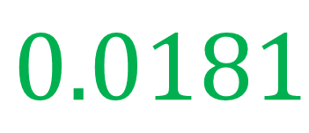

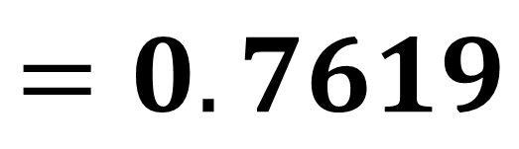
N = 8 P = 0.55
}
$$P\left(X=0\right)=0.00168$$
$P\left(X≤1\right)=$
$$0.0181$$
$$P\left(X=1\right)=0.00164$$
}
$$P\left(X=2\right)=0.0703$$
$$P\left(X=3\right)=0.172$$
$$P\left(2≤X≤5\right)=$$
$$P\left(X=4\right)=0.262$$
$$P\left(X=5\right)=0.257$$
$$=P\left(X≤5\right)−P\left(X≤1\right)$$
$$P\left(X=6\right)=0.157$$
$$=0. 780− 0. 0181$$
$$P\left(X=7\right)=0.0548$$
$$=0.7619$$
$$P\left(X=8\right)=0.00837$$

Slide 21





N = 8 P = 0.55
}
$$P\left(X=0\right)=0.00168$$
$P\left(X≤1\right)=$
$$0.0181$$
$$P\left(X=1\right)=0.00164$$
}
$$P\left(X=2\right)=0.0703$$
$P\left(2≤X<5\right)=$
$$P\left(X=3\right)=0.172$$
$$P\left(X=4\right)=0.262$$
$$=P\left(X≤4\right)−P\left(X≤1\right)$$
$$P\left(X=5\right)=0.257$$
$$P\left(X=6\right)=0.157$$
$$=0.523− 0. 0181$$
$$P\left(X=7\right)=0.0548$$
$$=0.5049$$
$$P\left(X=8\right)=0.00837$$

Slide 22




Total outcomes (N) $=$ 8
Probability of success (P) $=$ 0.55
$P\left(2≤X≤7\right)$?
$$P\left(2≤X≤7\right)=$$
$$=P\left(X≤7\right)−P\left(X≤1\right)$$
$$=0.992−0.0181=0.974$$

Slide 23



Total outcomes (N) $=$ 8
Probability of success (P) $=$ 0.55
$P(2≤X<4)$?
$$P\left(2≤X<4\right)=$$
$$=P\left(X≤3\right)−P\left(X≤1\right)$$
$$=0.260 −0.0181=0.242$$

Slide 24



The random variable $X\sim B(20,0.4)$.
Find:
i) $P\left(X=7\right)$
ii) $P\left(X≤7\right)$
iii) $P\left(4≤X≤5\right)$
iv) $P\left(X≥15\right)$
0.166
0.1255 – 0.0160 = 0.1095
i)
iii)
$$0.4159$$
$$1−P\left(X≤14\right)$$
$$=1 −0.998=0.002$$
ii)
iv)

