Slide 1
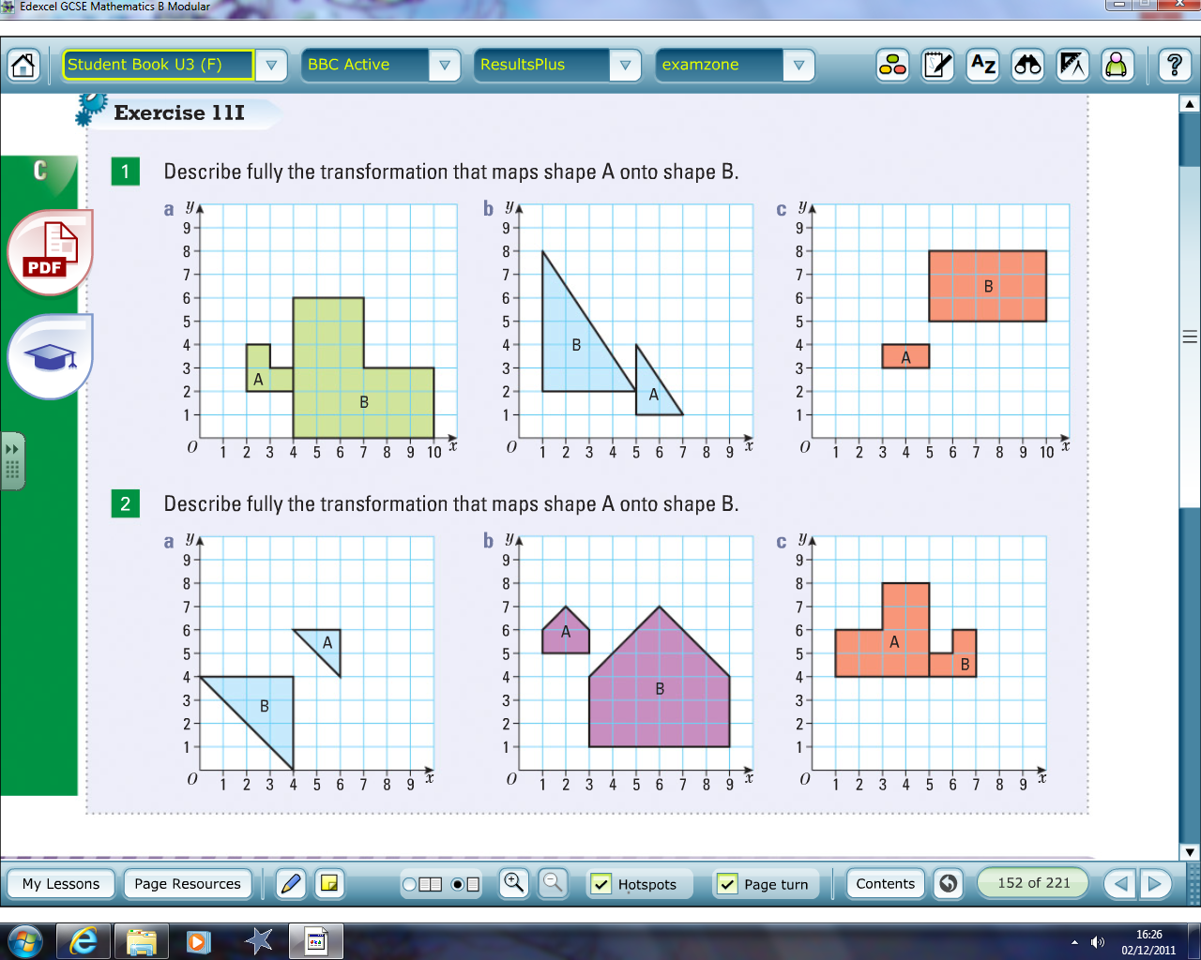
Find the centre of enlargement and scale factor for A to B and B to A.
1)
B
2)

Slide 2
ANSWERS

Slide 3
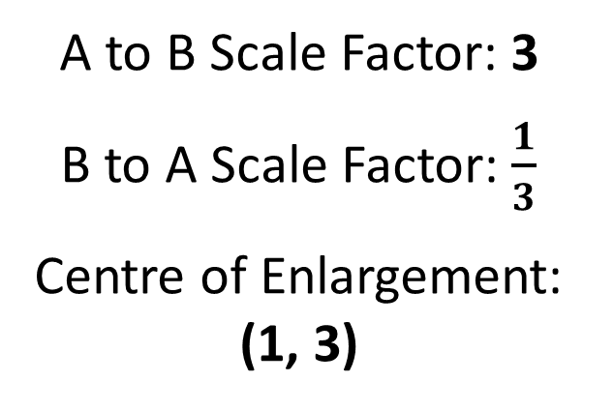
A to B Scale Factor: 3
B to A Scale Factor: $\frac{1}{3}$
Centre of Enlargement: (1, 3)

Slide 4
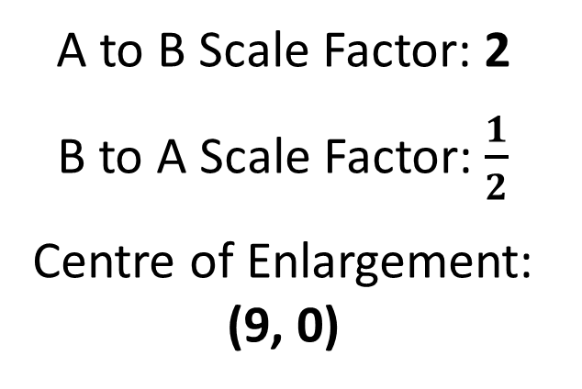
A to B Scale Factor: 2
B to A Scale Factor: $\frac{1}{2}$
Centre of Enlargement: (9, 0)

Slide 5
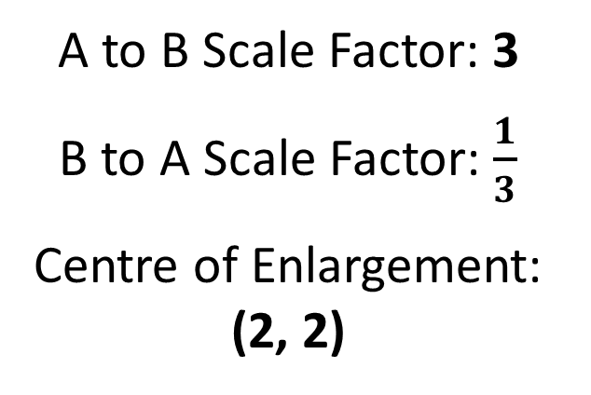
B
A to B Scale Factor: 3
B to A Scale Factor: $\frac{1}{3}$
Centre of Enlargement: (2, 2)

Slide 6
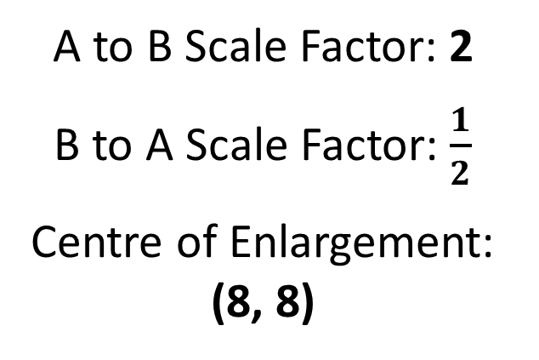
A to B Scale Factor: 2
B to A Scale Factor: $\frac{1}{2}$
Centre of Enlargement: (8, 8)

Slide 7
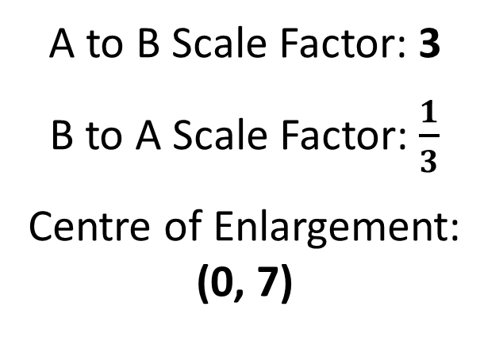
A to B Scale Factor: 3
B to A Scale Factor: $\frac{1}{3}$
Centre of Enlargement: (0, 7)

Slide 8
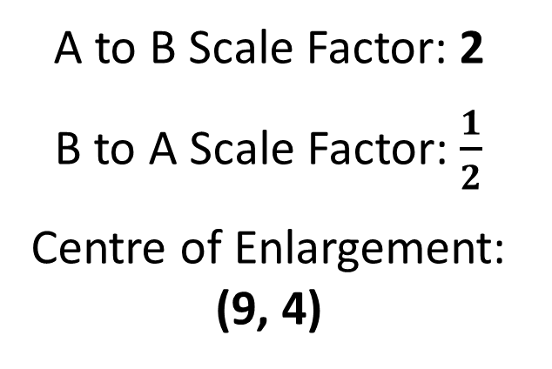
A to B Scale Factor: 2
B to A Scale Factor: $\frac{1}{2}$
Centre of Enlargement: (9, 4)

