Slide 1
FM: Graphs with up to 3 Domains

Slide 2
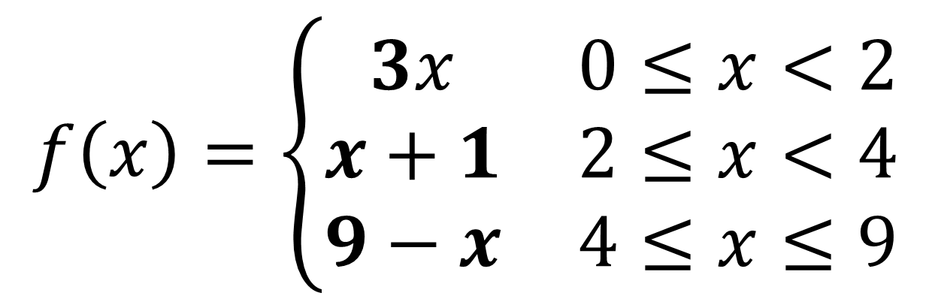
A graph with up to 3 domains can be called a
Piecewise Function.
$$f\left(x\right)=\left\{\begin{matrix}3x & 0≤x<2 \\ x+1 & 2≤x<4 \\ 9−x & 4≤x≤9\end{matrix}\right.$$

Slide 3
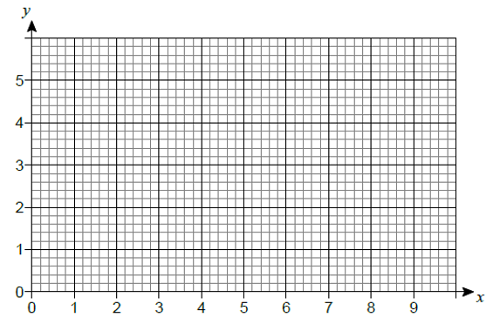

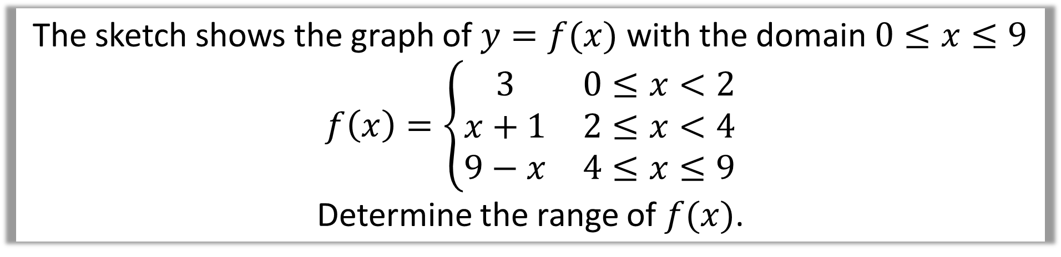


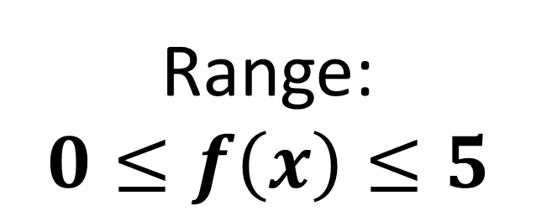
The sketch shows the graph of $y=f(x)$ with the domain $0≤x≤9$
$$f\left(x\right)=\left\{\begin{matrix}3 & 0≤x<2 \\ x+1 & 2≤x<4 \\ 9−x & 4≤x≤9\end{matrix}\right.$$
Determine the range of $f(x)$.
$3$ $0≤x<2$
$x+1 2≤x<4$
$9−x 4≤x≤9$
Range:
$$0≤f\left(x\right)≤5$$

Slide 4
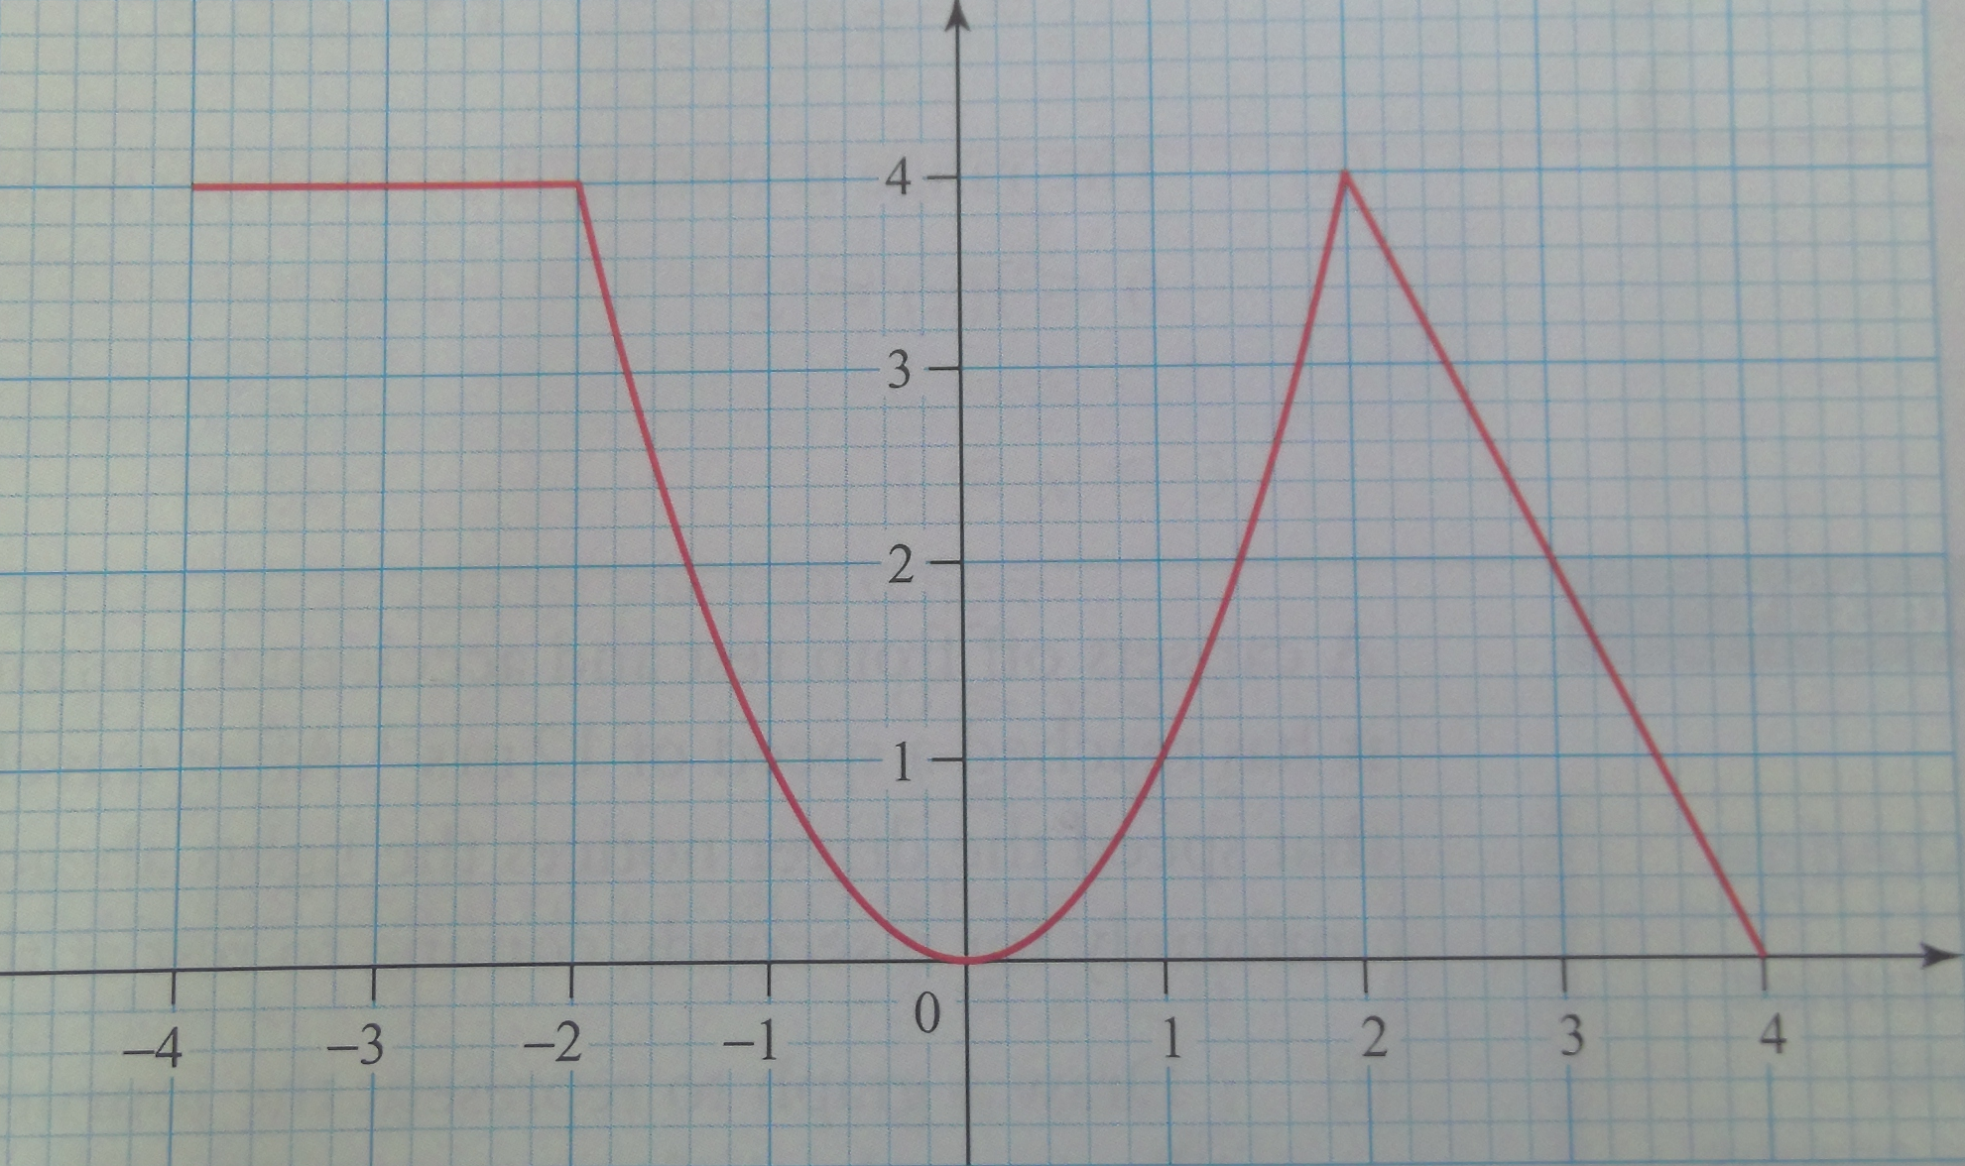
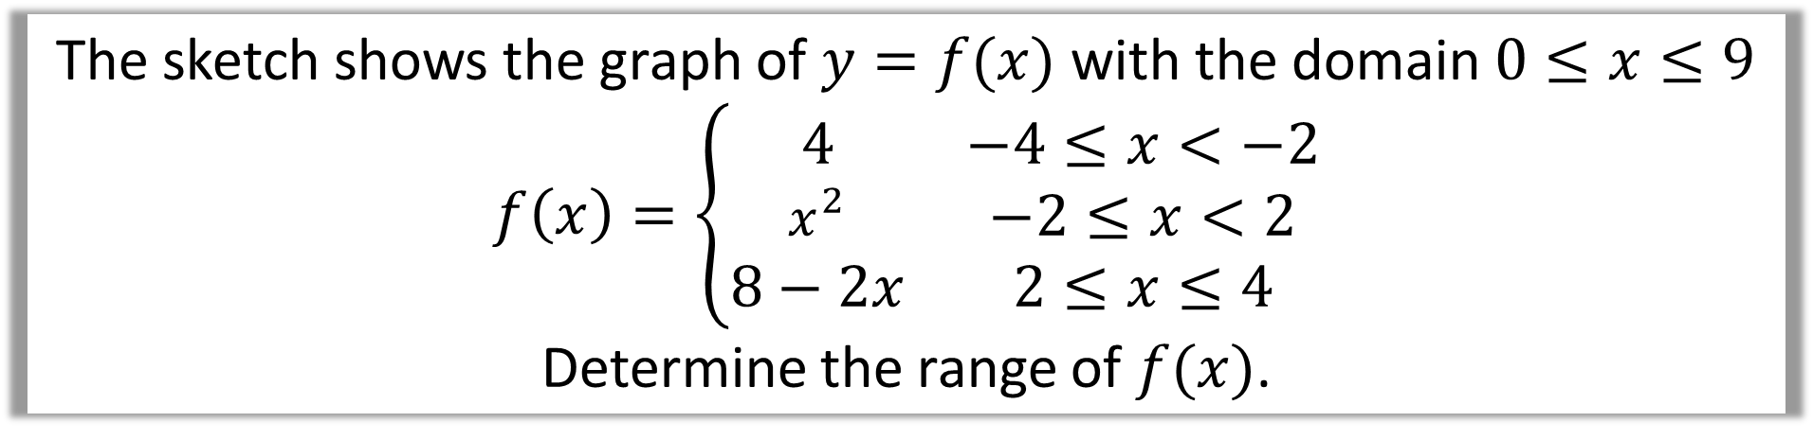
The sketch shows the graph of $y=f(x)$ with the domain $0≤x≤9$
$$f\left(x\right)=\left\{\begin{matrix}4 & −4≤x<−2 \\ x^{2} & −2≤x<2 \\ 8−2x & 2≤x≤4\end{matrix}\right.$$
Determine the range of $f(x)$.

Slide 5

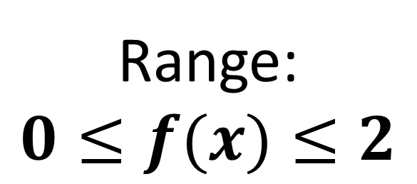
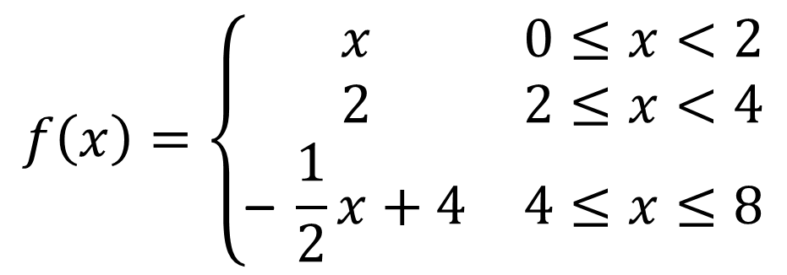
Here is a graph of $y=f\left(x\right)$
Define f (x) stating clearly the domain for each part
and state the range of f (x)
$$f\left(x\right)=\left\{\begin{matrix}x & 0≤x<2 \\ 2 & 2≤x<4 \\ \text{– }\frac{1}{2}x+4 & 4≤x≤8\end{matrix}\right.$$
Range:
$$0≤f(x)≤2$$

