Slide 1
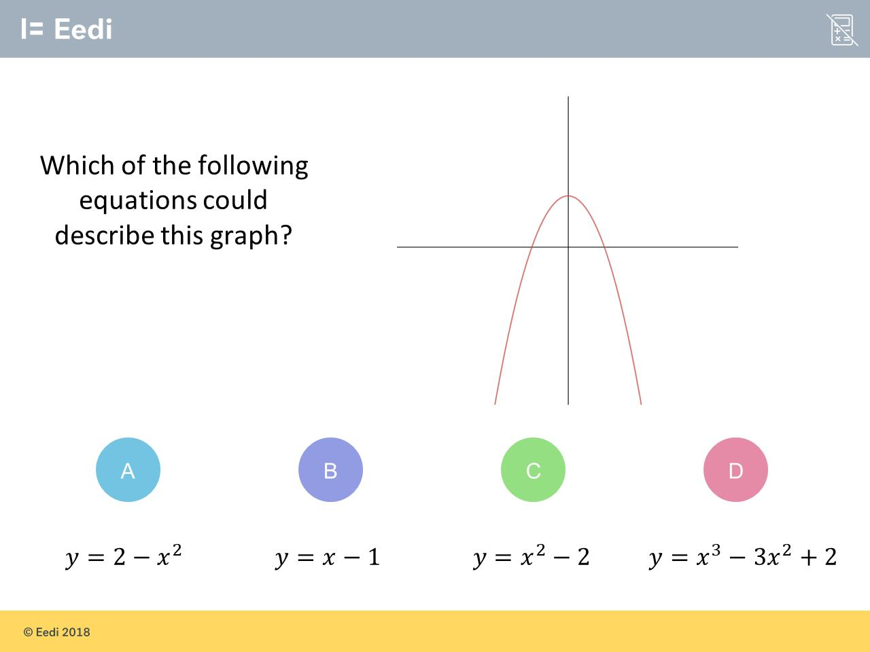
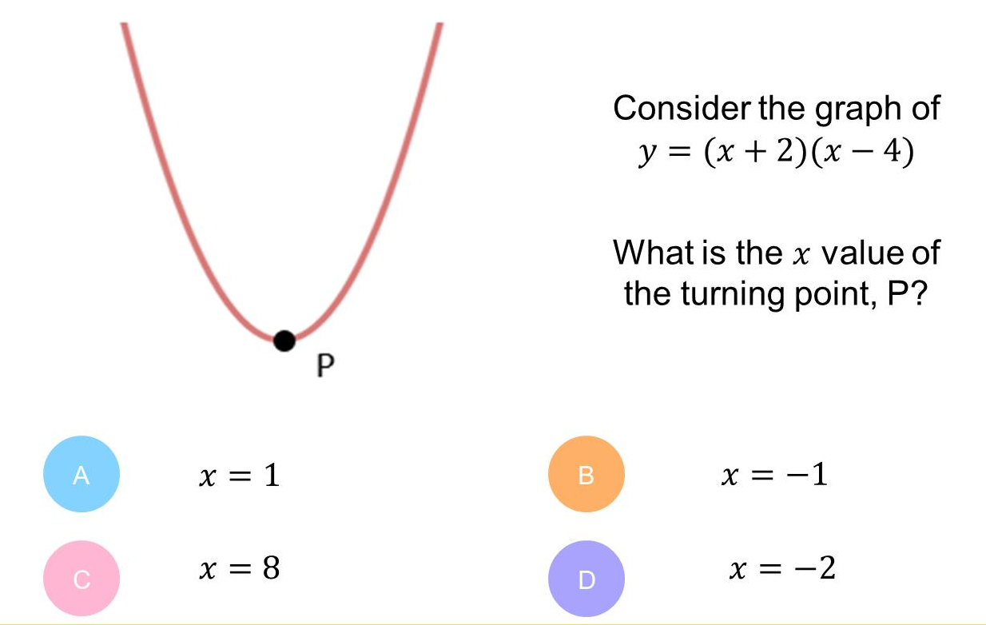
Worst answered question?
Most common wrong answer?

Slide 2
ANSWERS

Slide 3
Worst answered question?

Slide 4
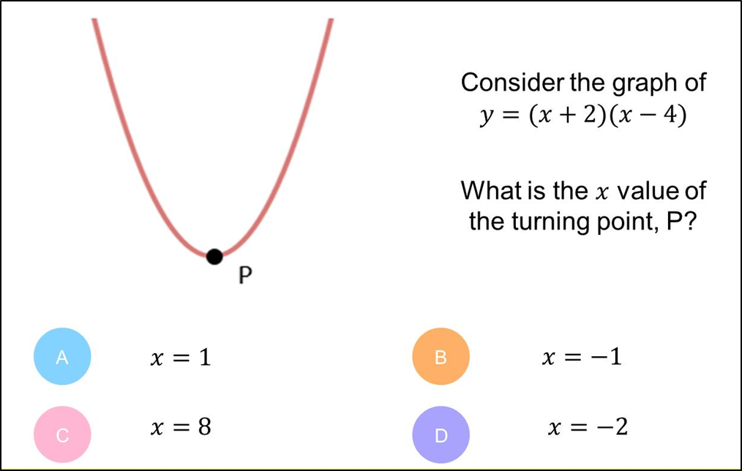
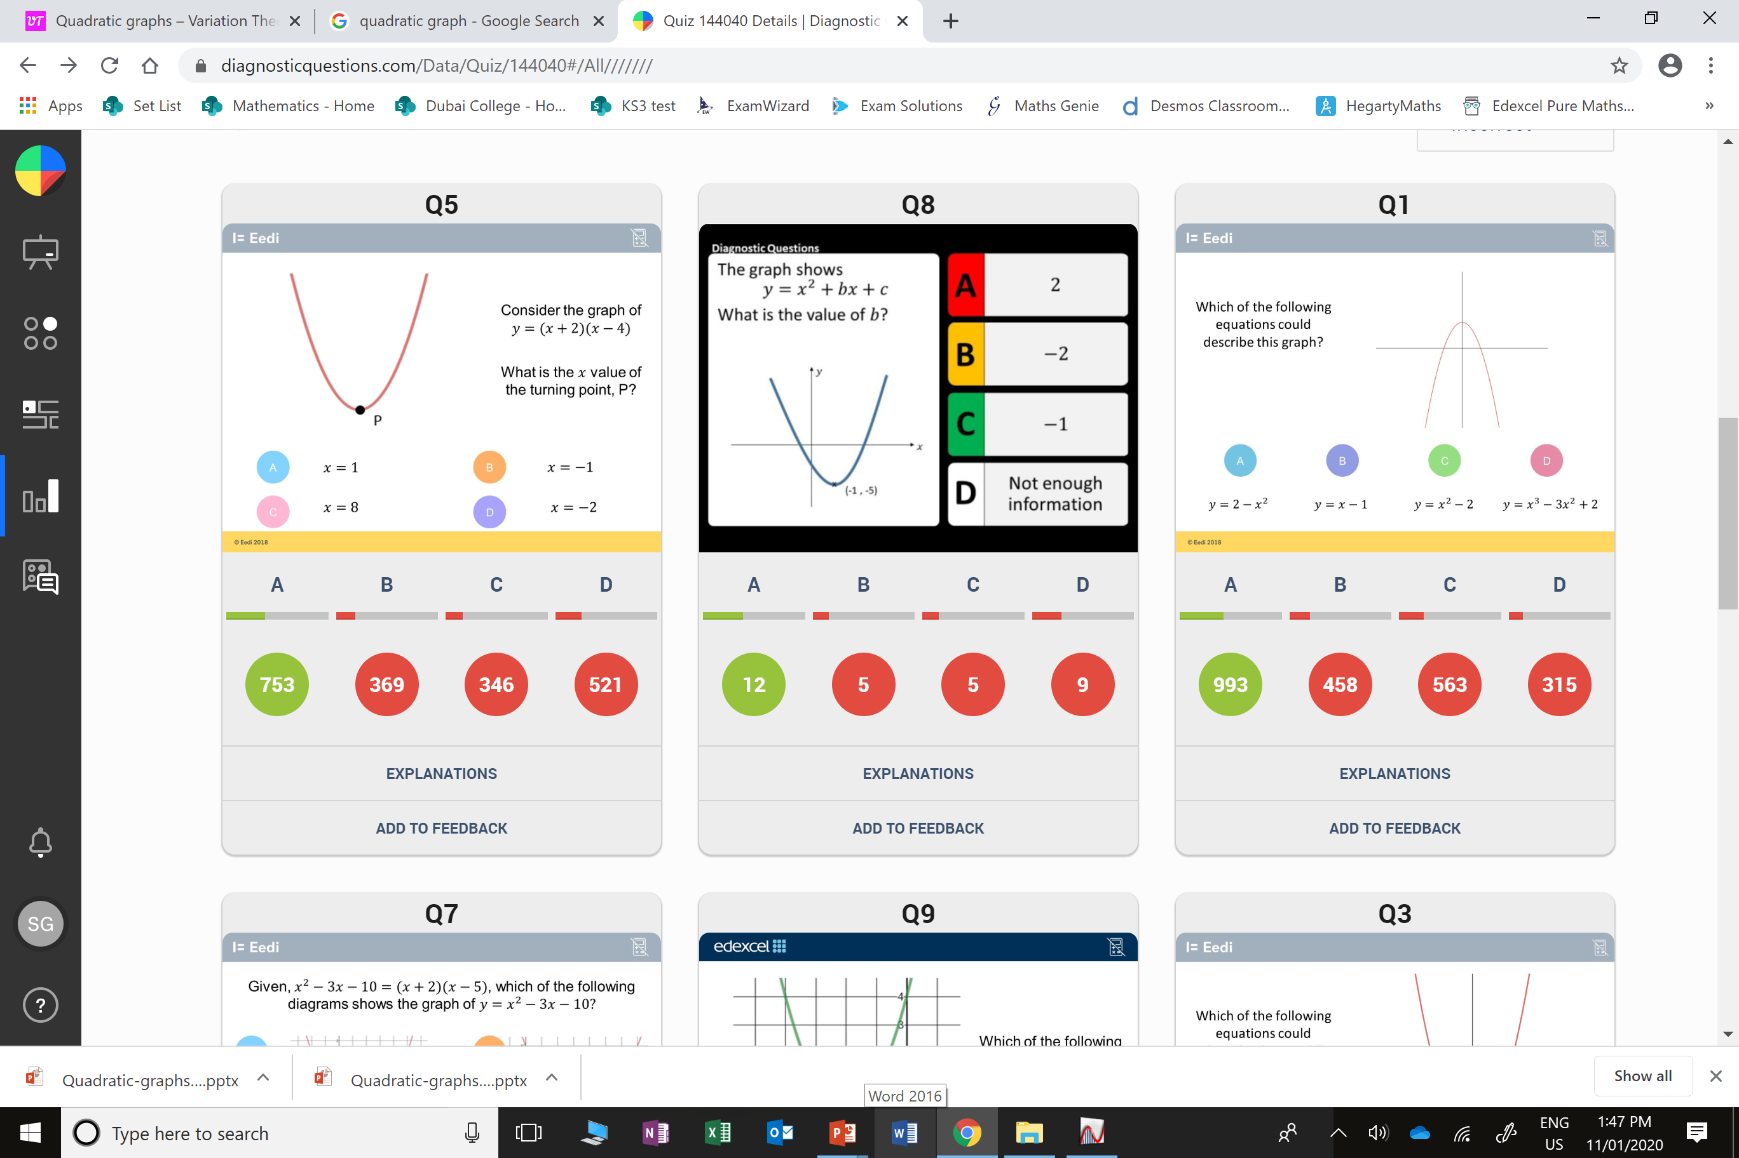
D
The student used one of the solutions as the x turning point.

Slide 5
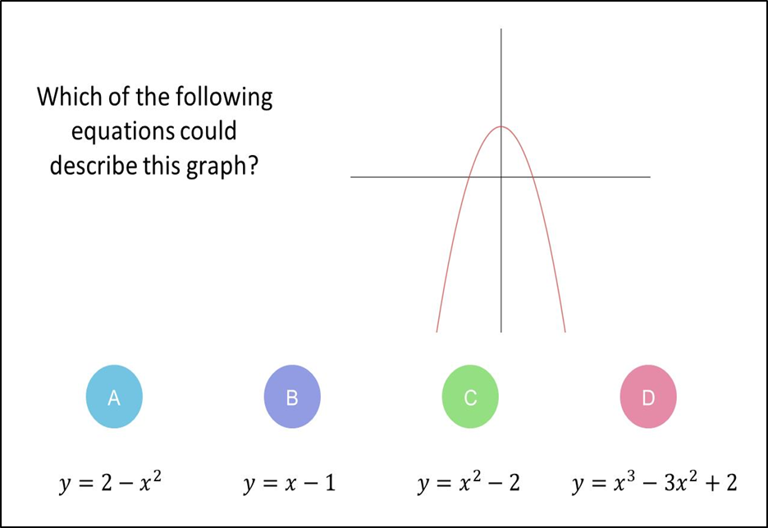
C
They forgot to that is needs to be negative x² for
a sad graph.

