Slide 1
LO: Calculating
with Indices

Slide 2
Indices are more commonly know as…
Powers

Slide 3
Index
Value
5³
Base Value

Slide 4
Write as a single power?
5 × 5 × 5 =
5³

Slide 5
Write as a single power?
6 × 6 × 6 × 6 × 6 =
6⁵

Slide 6
Write as a single power?
3 × 3 × 3 × 3 × 3 × 3 × 3 × 3 =
3⁸

Slide 7
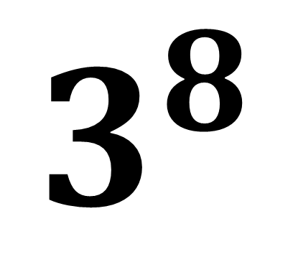
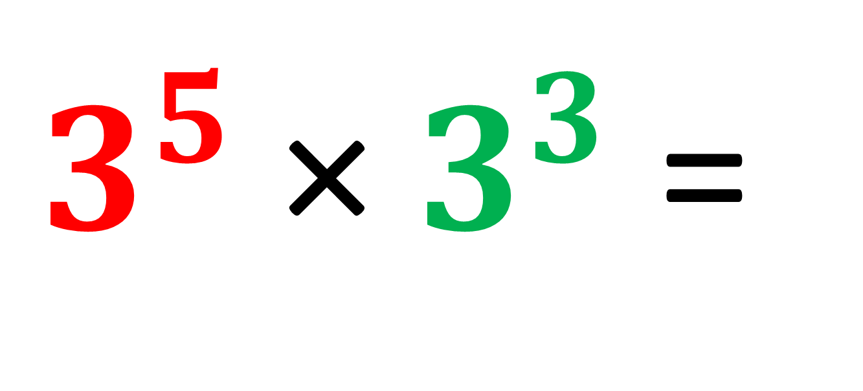
Write as a single power?
$3^{5}$ × $3^{3}$ =
$$3^{8}$$

Slide 8
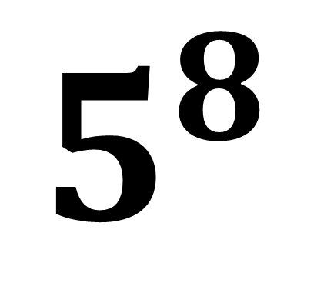
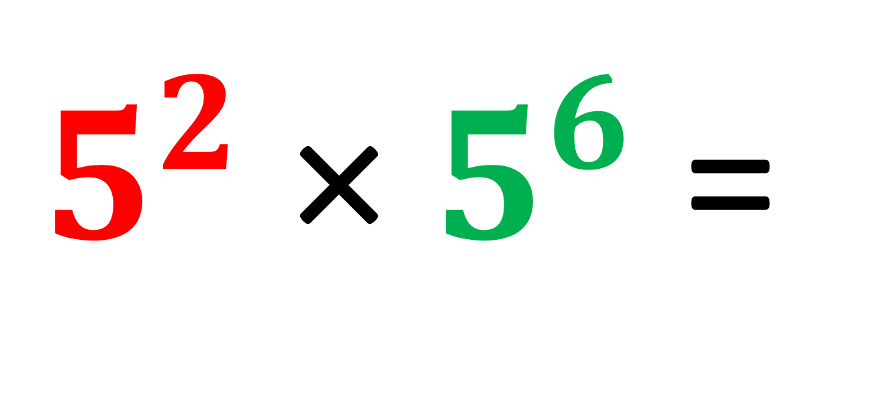
Write as a single power?
$5^{2}$ × $5^{6}$ =
$$5^{8}$$

Slide 9
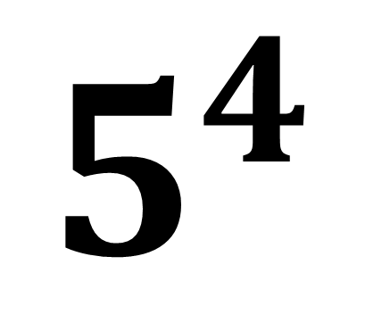
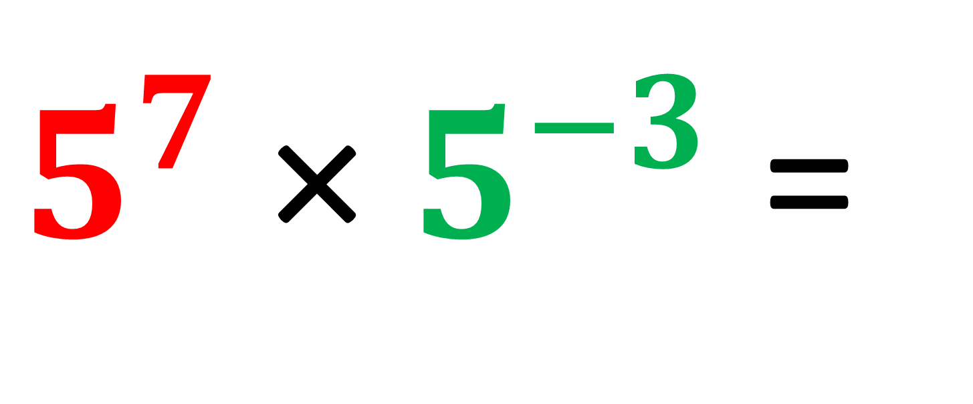
Write as a single power?
$5^{7}$ × $5^{−3}$ =
$$5^{4}$$

Slide 10
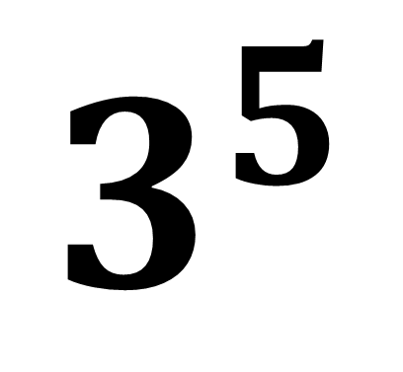
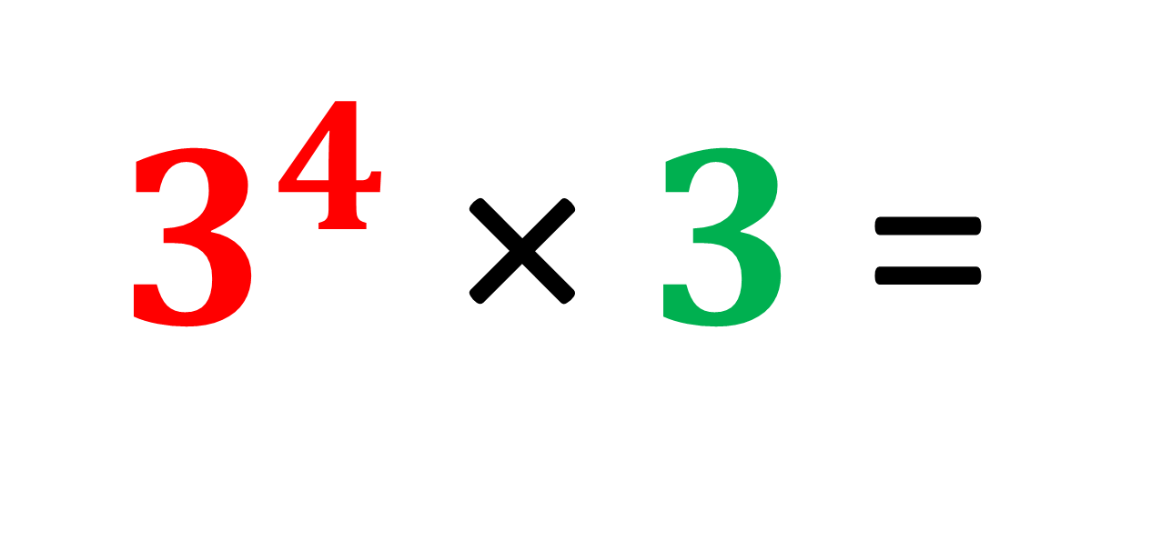
Write as a single power?
$3^{4}$ × $3$ =
$$3^{5}$$

Slide 11
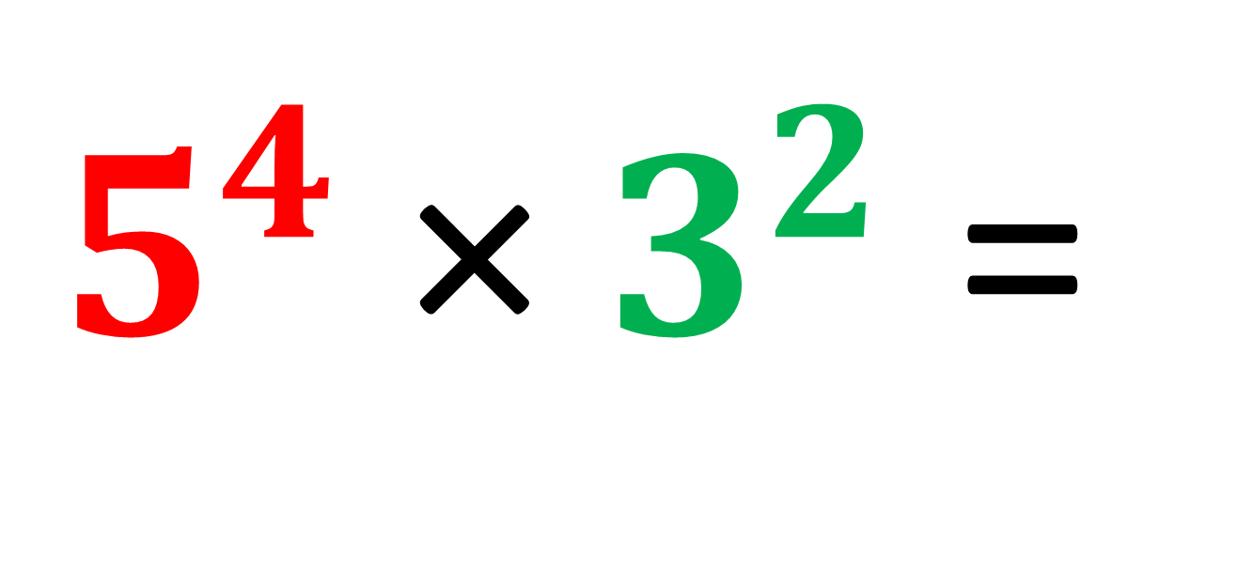
Write as a single power?
Cannot be written as a single power
because they have different base values.
$5^{4}$ × $3^{2}$ =

Slide 12
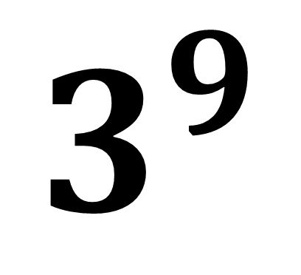
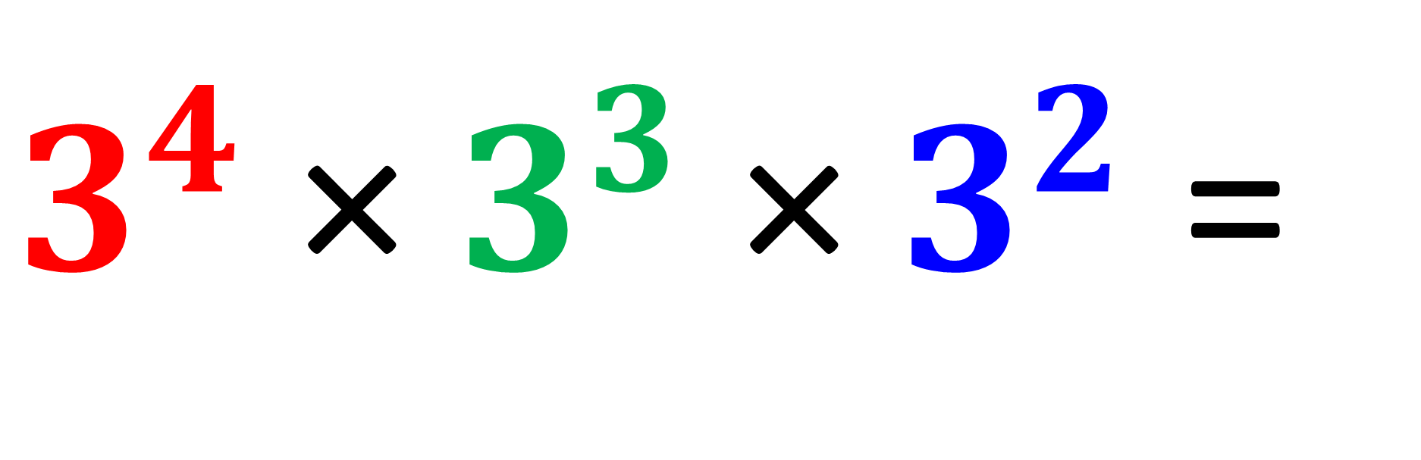
Write as a single power?
$3^{4}$ × $3^{3}$ × $3^{2}$ =
$$3^{9}$$

Slide 13
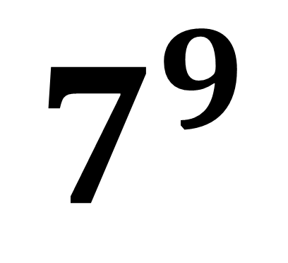
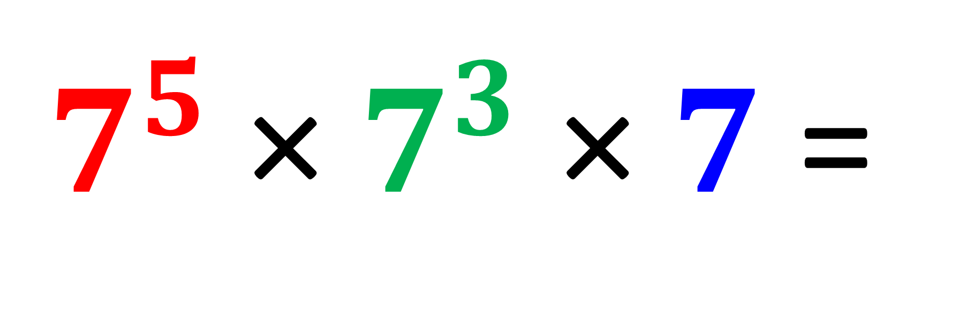
Write as a single power?
$7^{5}$ × $7^{3}$ × $7$ =
$$7^{9}$$

Slide 14
Write as a single power?
(5³)² =
5³ x 5³ =
5⁶

Slide 15
Write as a single power?
(5⁴)⁵ =
5²⁰

Slide 16
Write as a single power?
(3²)⁵ =
3¹⁰

Slide 17
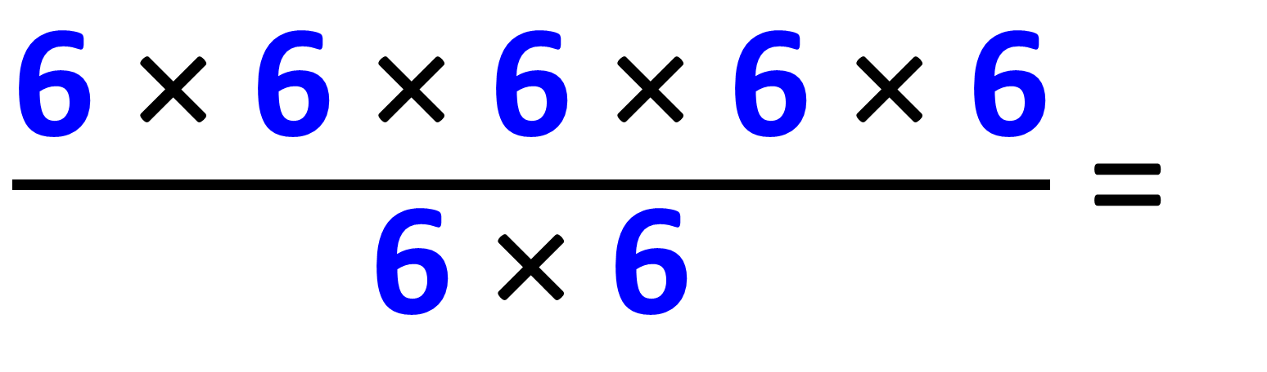
Write as a single power?
$\frac{\text{6}\text{ × }\text{6}\text{ × }\text{6}\text{ × }\text{6}\text{ × }\text{6}}{\text{6}\text{ × }\text{6}}$ =
6³

Slide 18
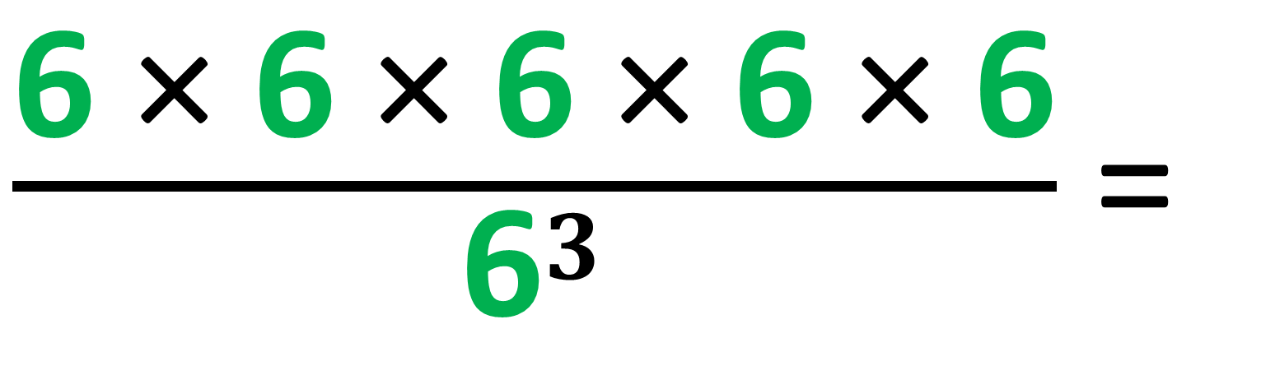
Write as a single power?
$\frac{\text{6}\text{ × }\text{6}\text{ × }\text{6}\text{ × }\text{6}\text{ × }\text{6}}{{\text{6}}^{3}}$ =
6²

Slide 19
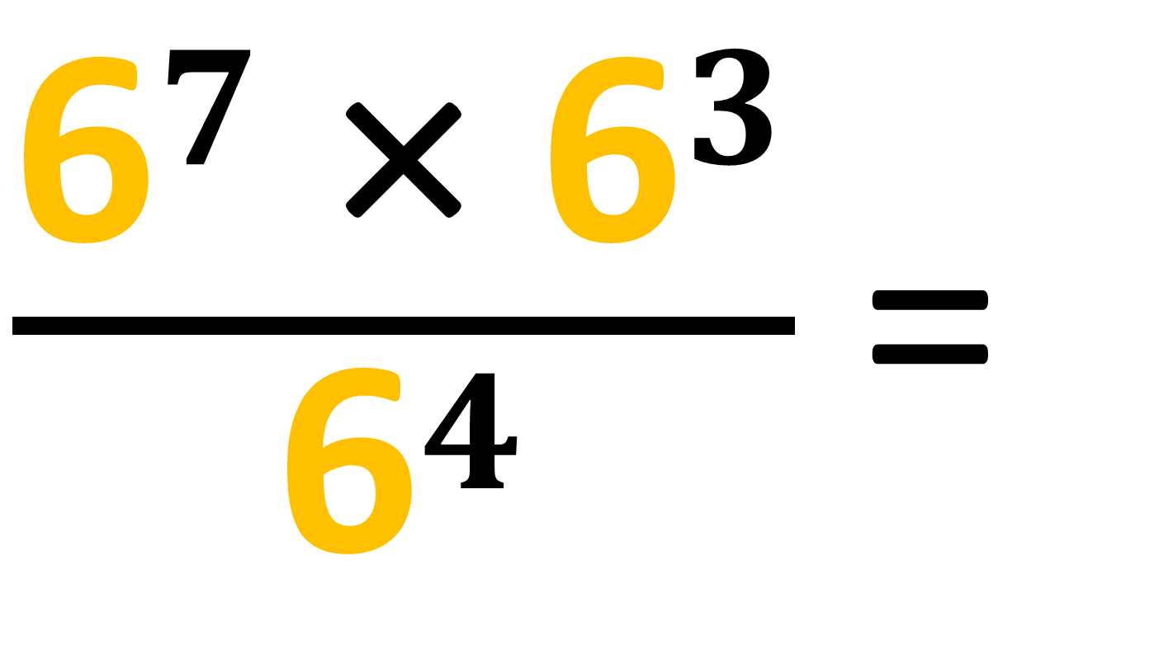
Write as a single power?
$\frac{{\text{6}}^{7}\text{ ×} {\text{6}}^{3}}{{\text{6}}^{4}}$ =
6⁶

Slide 20
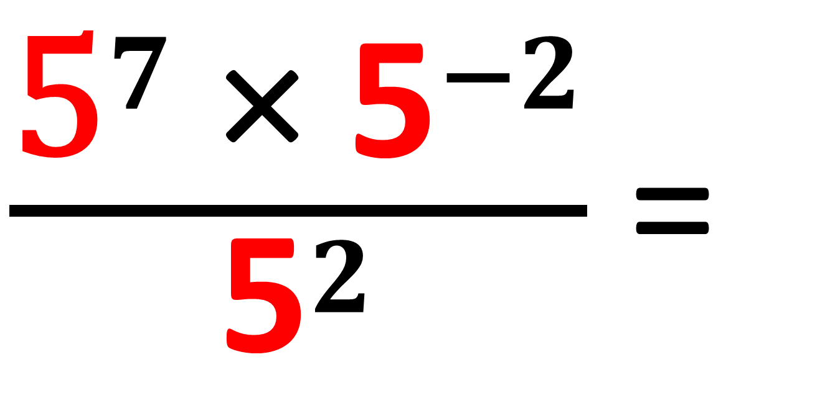
Write as a single power?
$\frac{{\text{5}}^{7}\text{ ×} {\text{5}}^{−2}}{{\text{5}}^{2}}$ =
5³

Slide 21
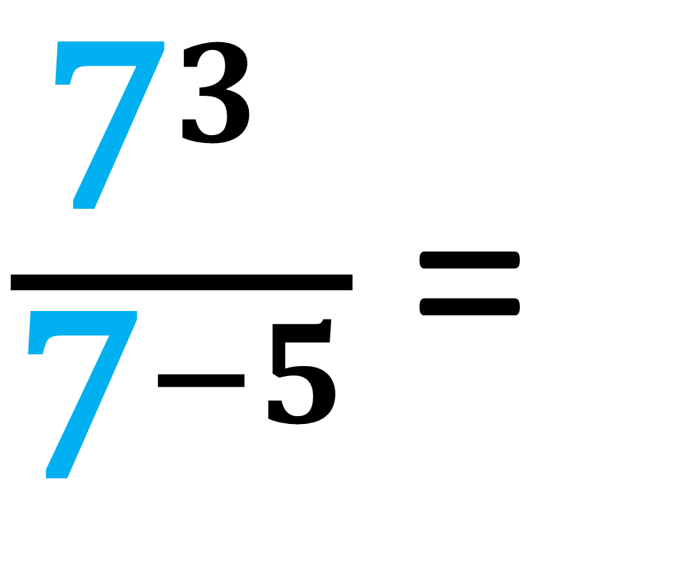
Write as a single power?
$\frac{{\text{7}}^{3} }{{\text{7}}^{−5}}$ =
7⁸

Slide 22
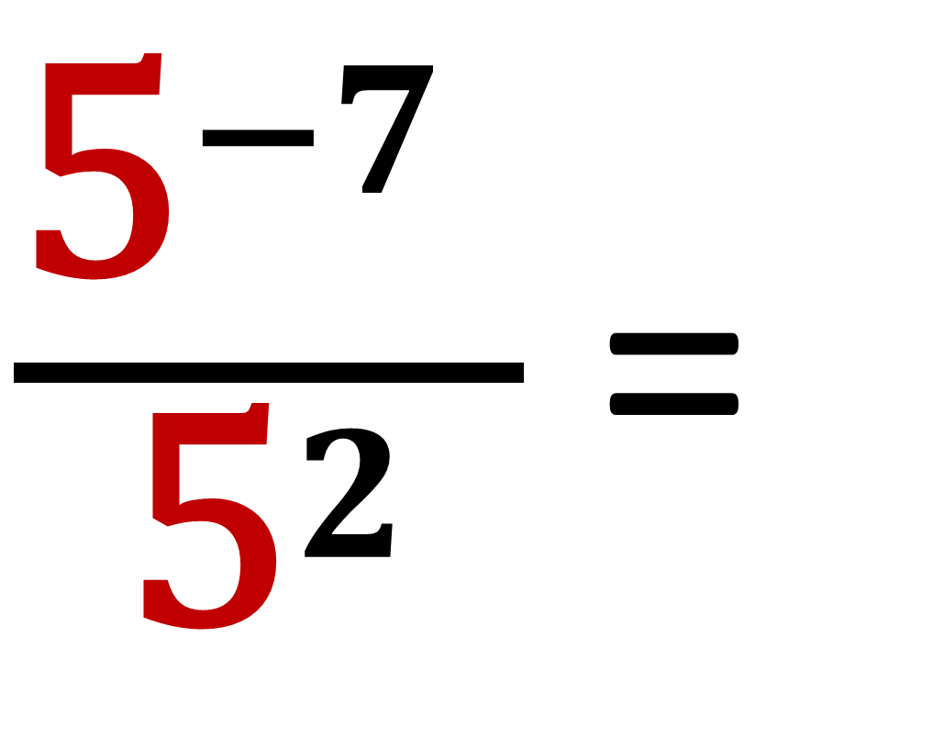
Write as a single power?
$\frac{{\text{5}}^{−7} }{{\text{5}}^{2}}$ =
5⁻⁹

Slide 23
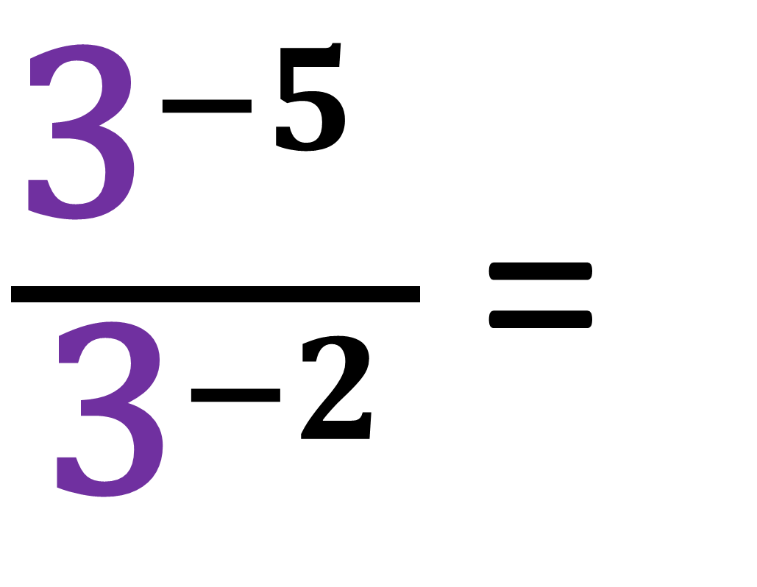
Write as a single power?
$\frac{{\text{3}}^{−5} }{{\text{3}}^{−2}}$ =
3⁻³

Slide 24
If you have the same base value.
Multiply Indices by adding
Divide Indices by subtracting
Power to a Power by multiplying

