Slide 1
LO: Capacity

Slide 2
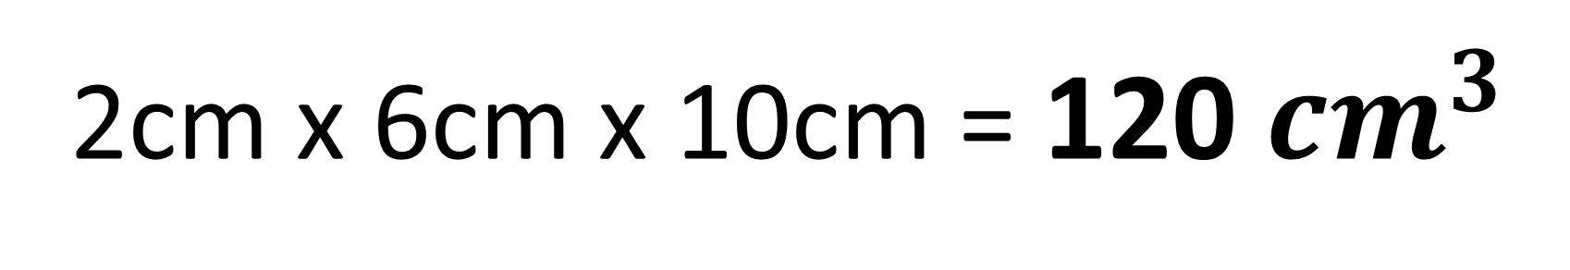
What is the volume?
2cm
10cm
6cm
2cm x 6cm x 10cm = 120 ${cm}^{3}$

Slide 3
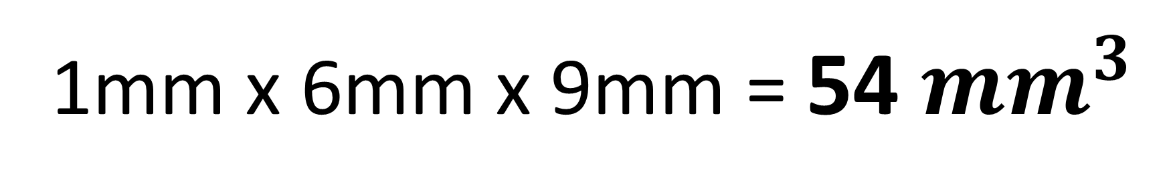
What is the volume?
6mm
9mm
1mm
1mm x 6mm x 9mm = 54 ${mm}^{3}$

Slide 4
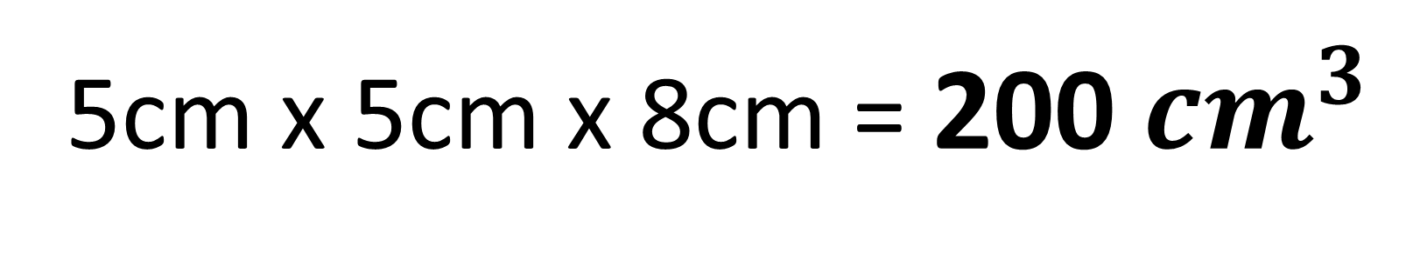
What is the volume?
5cm
80mm
5cm
5cm x 5cm x 8cm = 200 ${cm}^{3}$

Slide 5
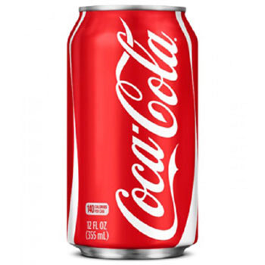
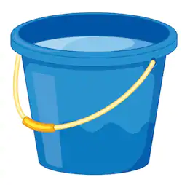
What is meant by capacity?
Capacity is the amount of liquid that can be contained by
a 3D Shape.

Slide 6
What units are used to measure capacity?
Litres, millilitres, gallons, pints……

Slide 7
Can you name items that have a capacity?

Slide 8
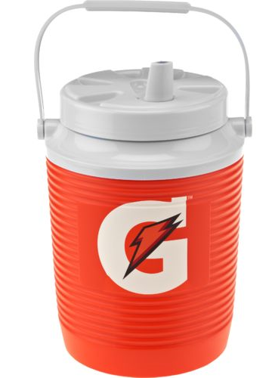
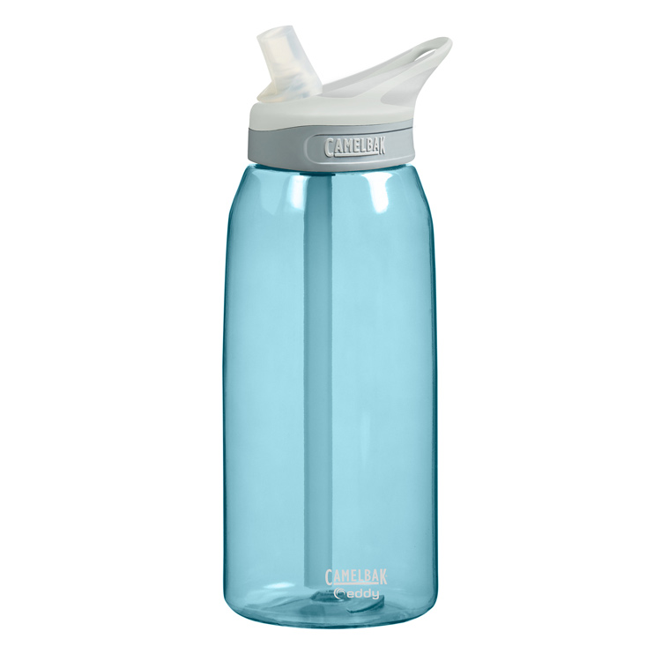
300ml
1 litre = 1000ml
1 gallon = 3.78541 litres

Slide 9
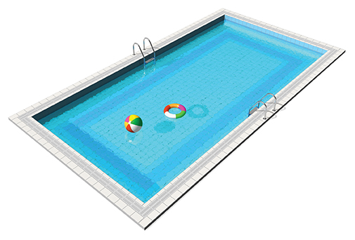
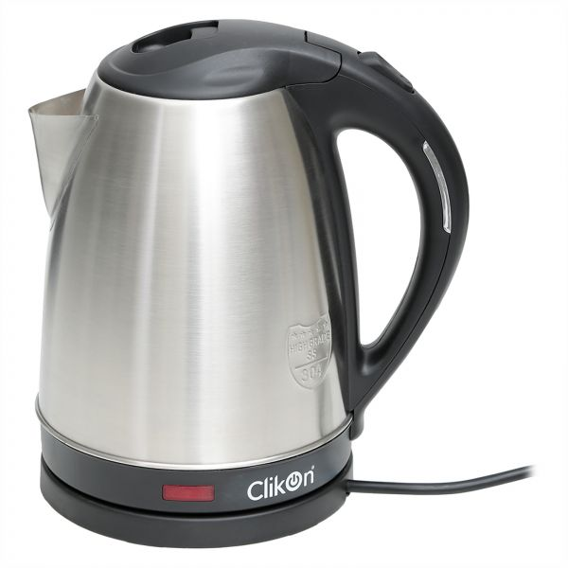
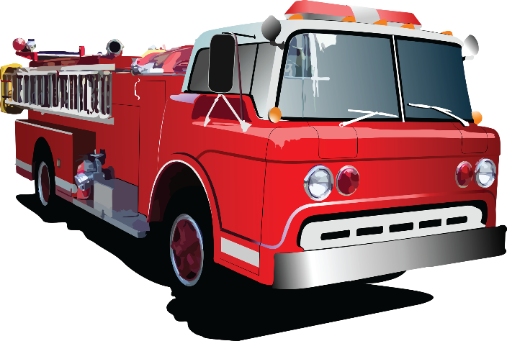
Estimate the capacity of the following items.
Kitchen Kettle
Fire Engine
Olympic
Swimming Pool
1.8 litres
3,785 litres
(1,000 gallons)
2,500,000 litres
(660,430 gallons)

Slide 10
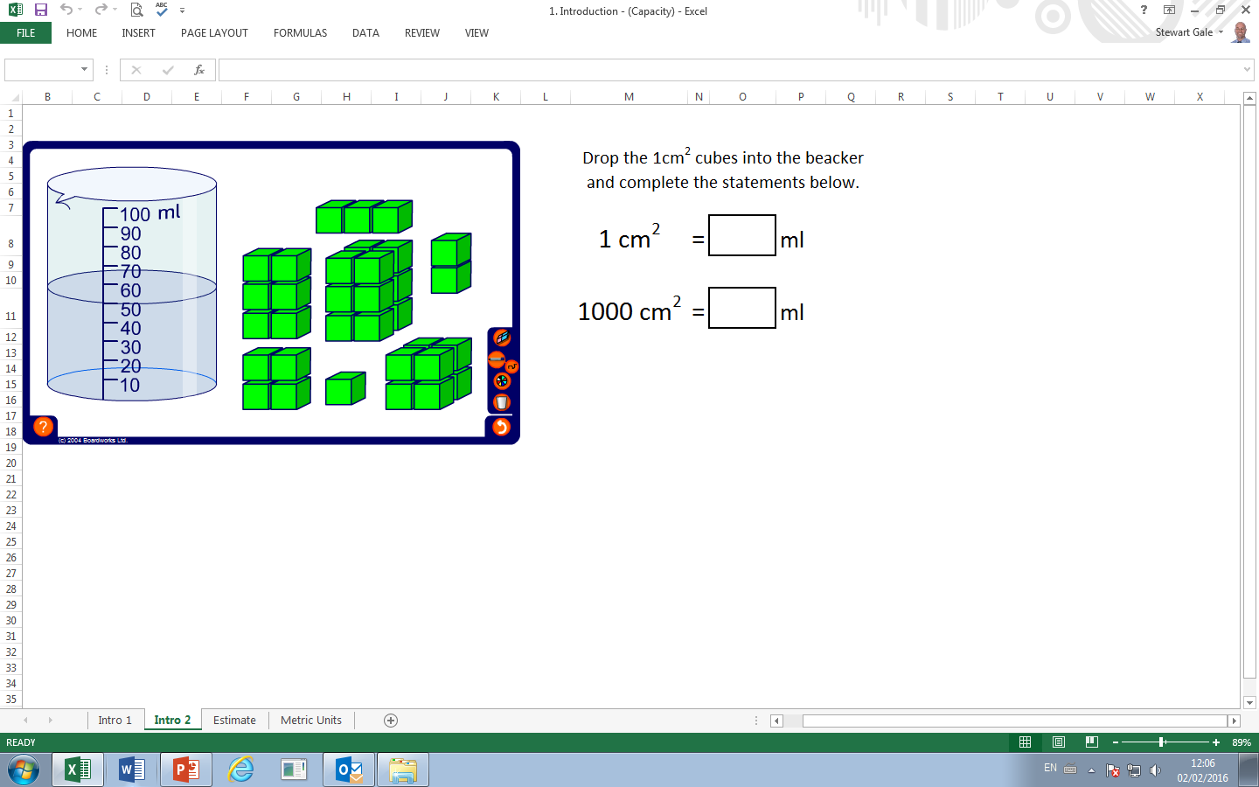
What will the water level rise to if
you put the 1cm³ cube in the beaker?
51 ml
because
1 cm³ = 1 ml

Slide 11
You need to remember:
1 cm³ | = | 1ml
1000 ml | = | 1 litre

Slide 12
Also remember:
1 cl = 1 centilitre
1 cl = 10 ml

Slide 13
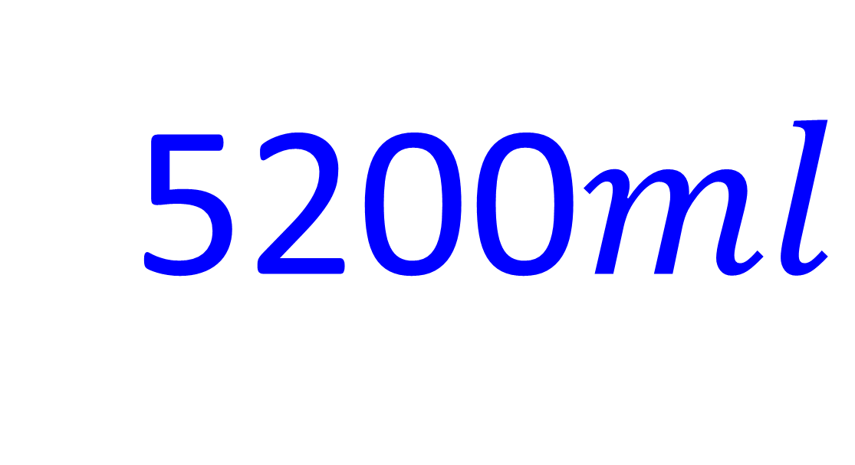
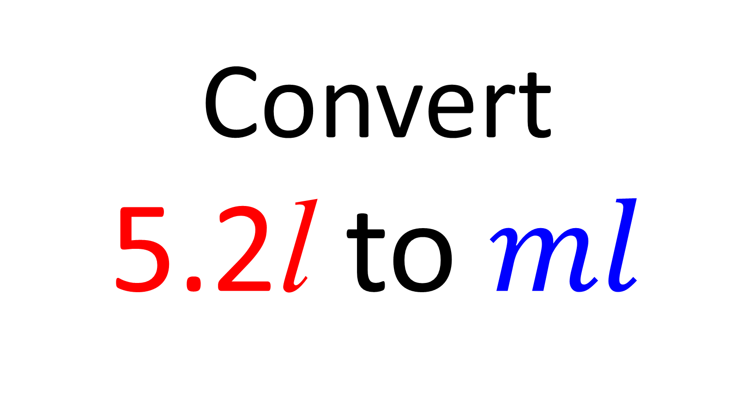
Convert
5.2l to $ml$
5200$ml$

Slide 14
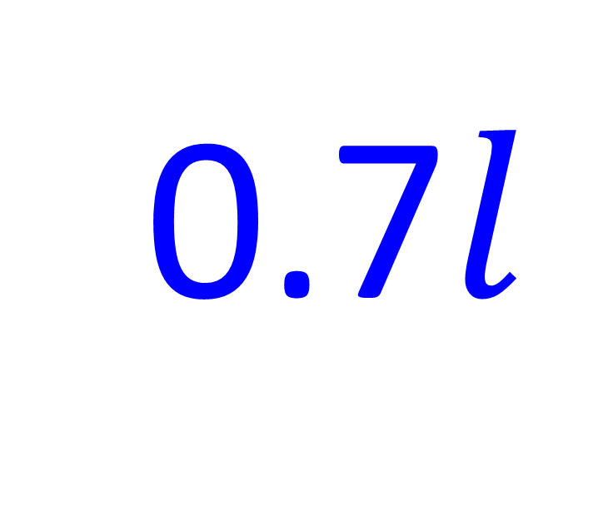
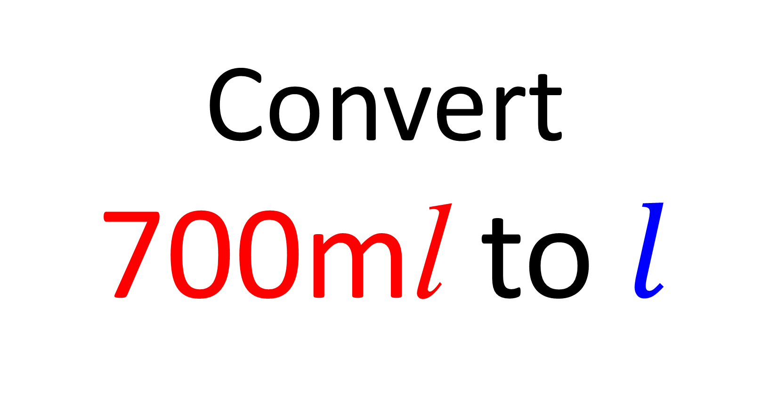
Convert
700ml to $l$
0.7$l$

Slide 15
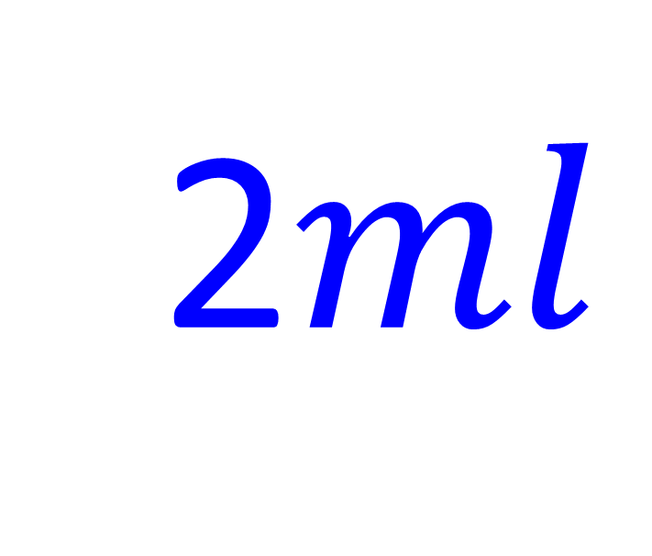
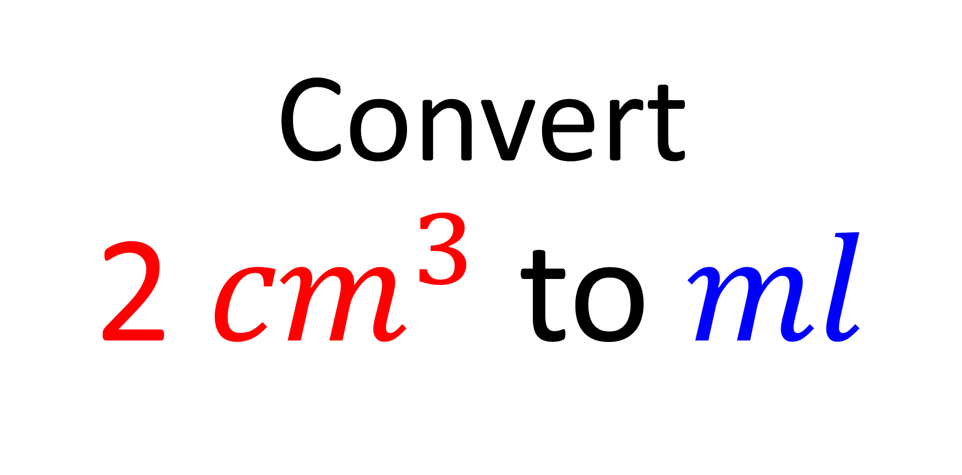
Convert
2${ cm}^{3}$ to $ml$
2$ml$

Slide 16
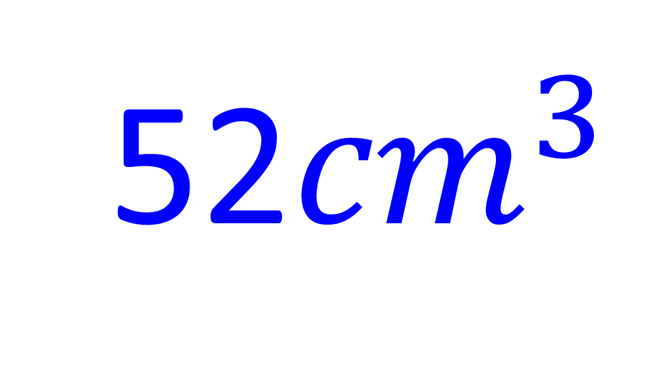
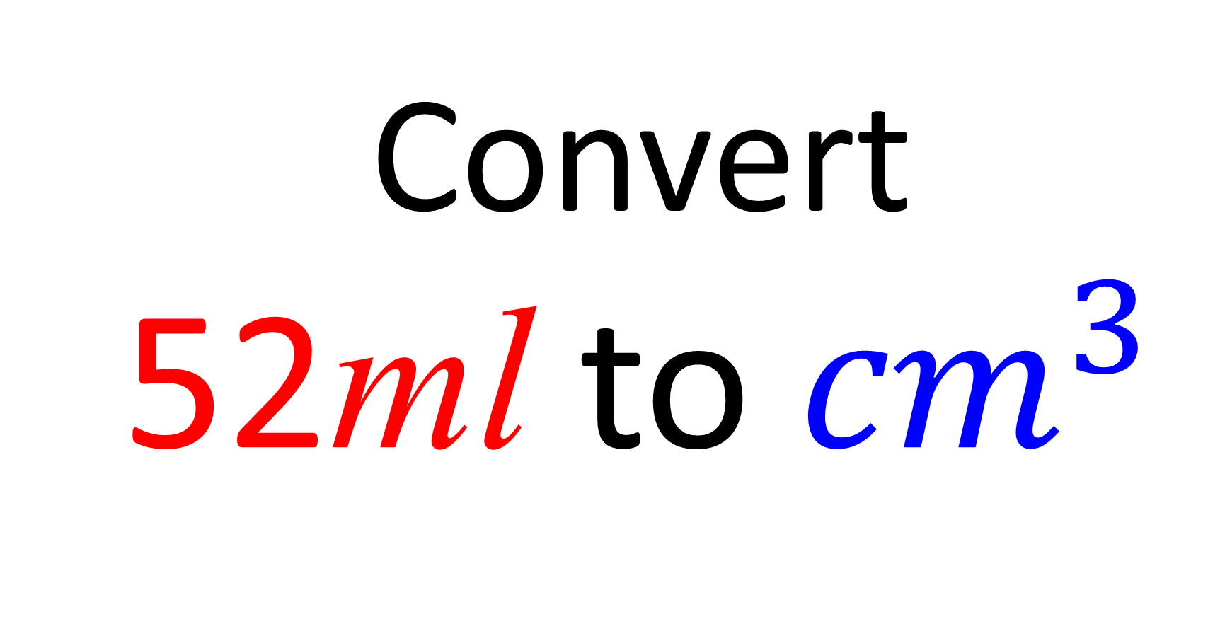
Convert
52ml to ${cm}^{3}$
52${cm}^{3}$

Slide 17
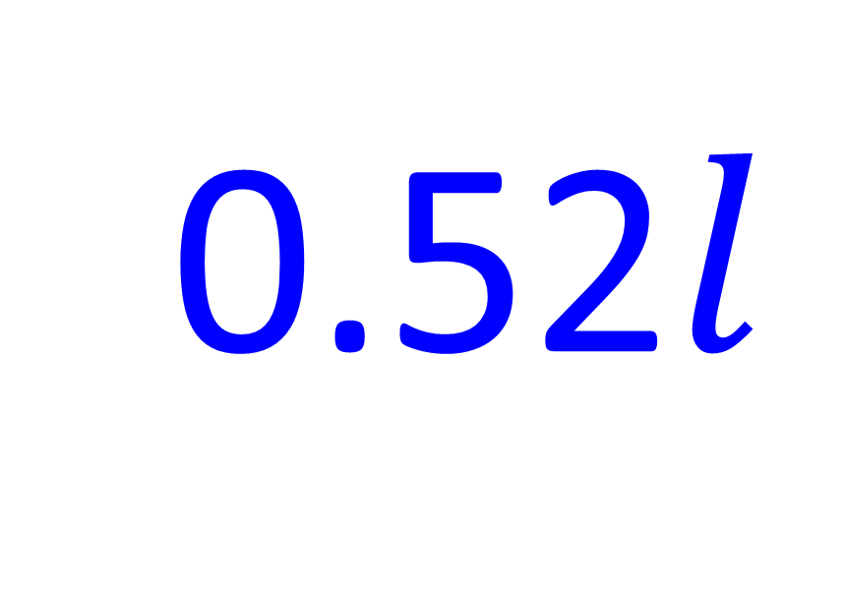
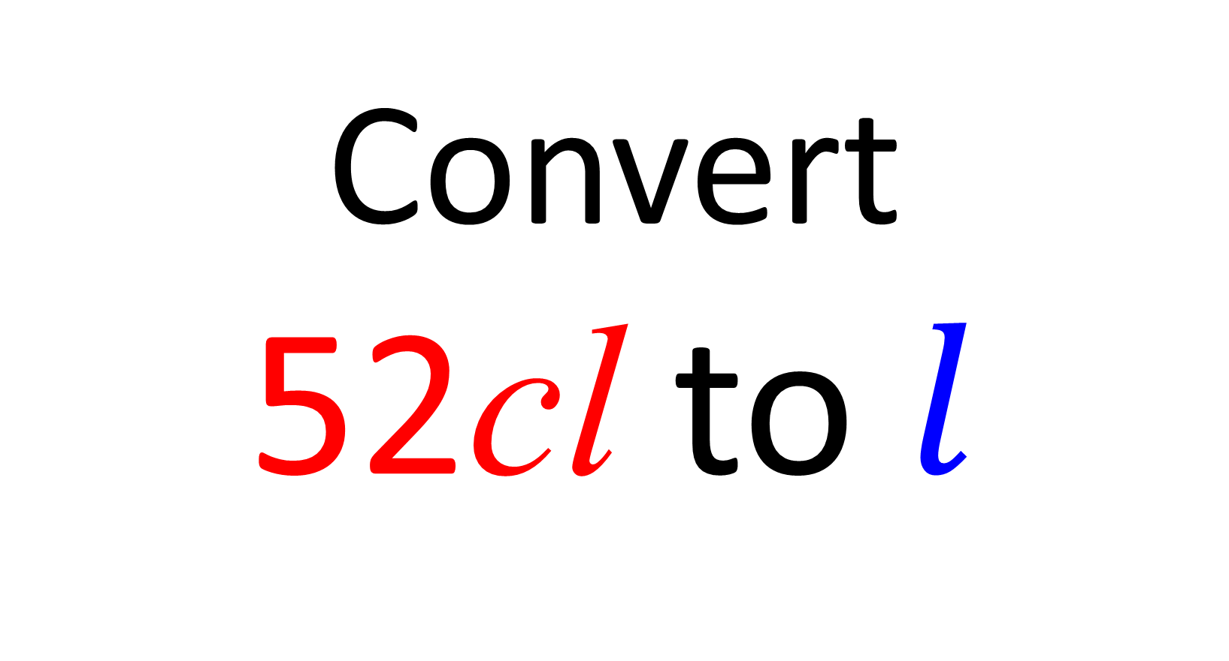
Convert
52cl to $l$
0.52$l$

Slide 18
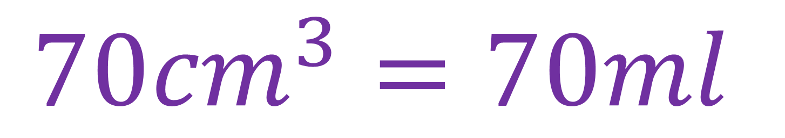
Find the capacity in ml
2cm
7cm
5cm
$$70{cm}^{3}=70ml$$

Slide 19
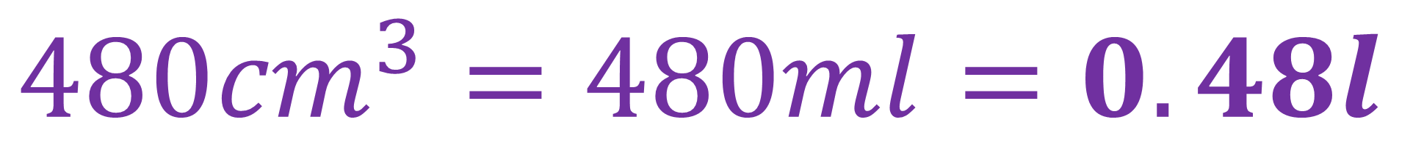
Find the capacity in litres
6cm
10cm
8cm
$$480{cm}^{3}=480ml=0.48l$$

Slide 20
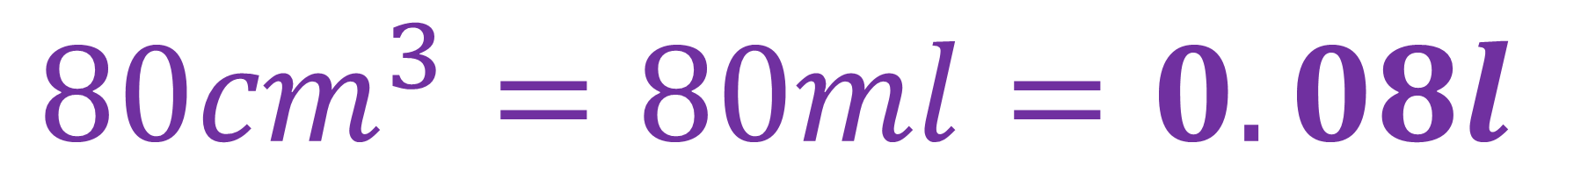
Find the capacity in litres
2cm
0.1m
4cm
$$80{cm}^{3}=80ml=0.08l$$

