Slide 1
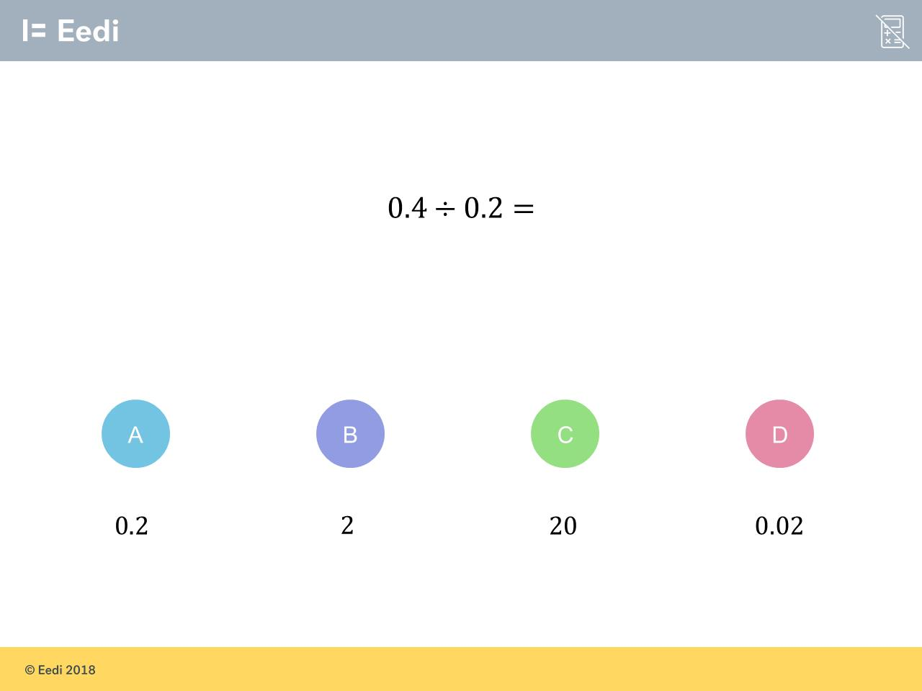
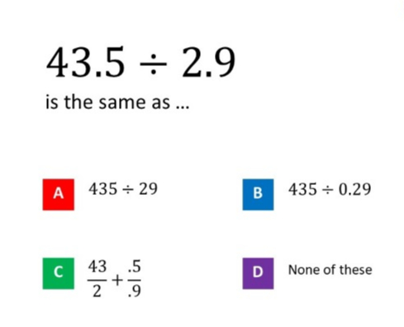
Worst answered question?
Most common wrong answer?

Slide 2
ANSWERS

Slide 3
Worst answered question?

Slide 4
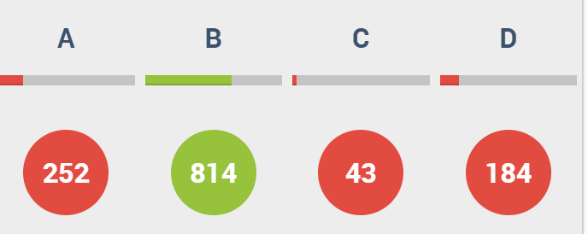
A
They did 0.4 ÷ 2

Slide 5
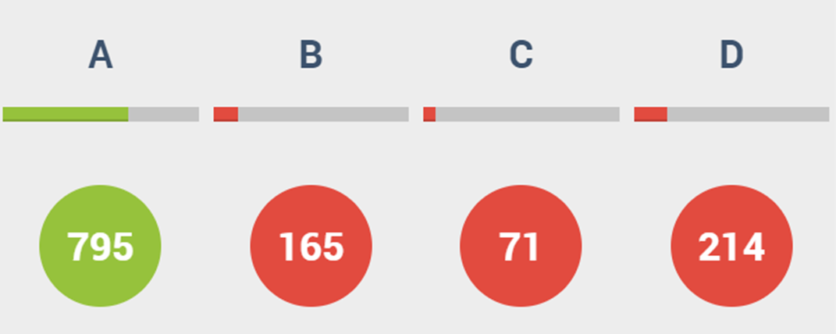
D
They did not know how to look for equivalents.

