Slide 1
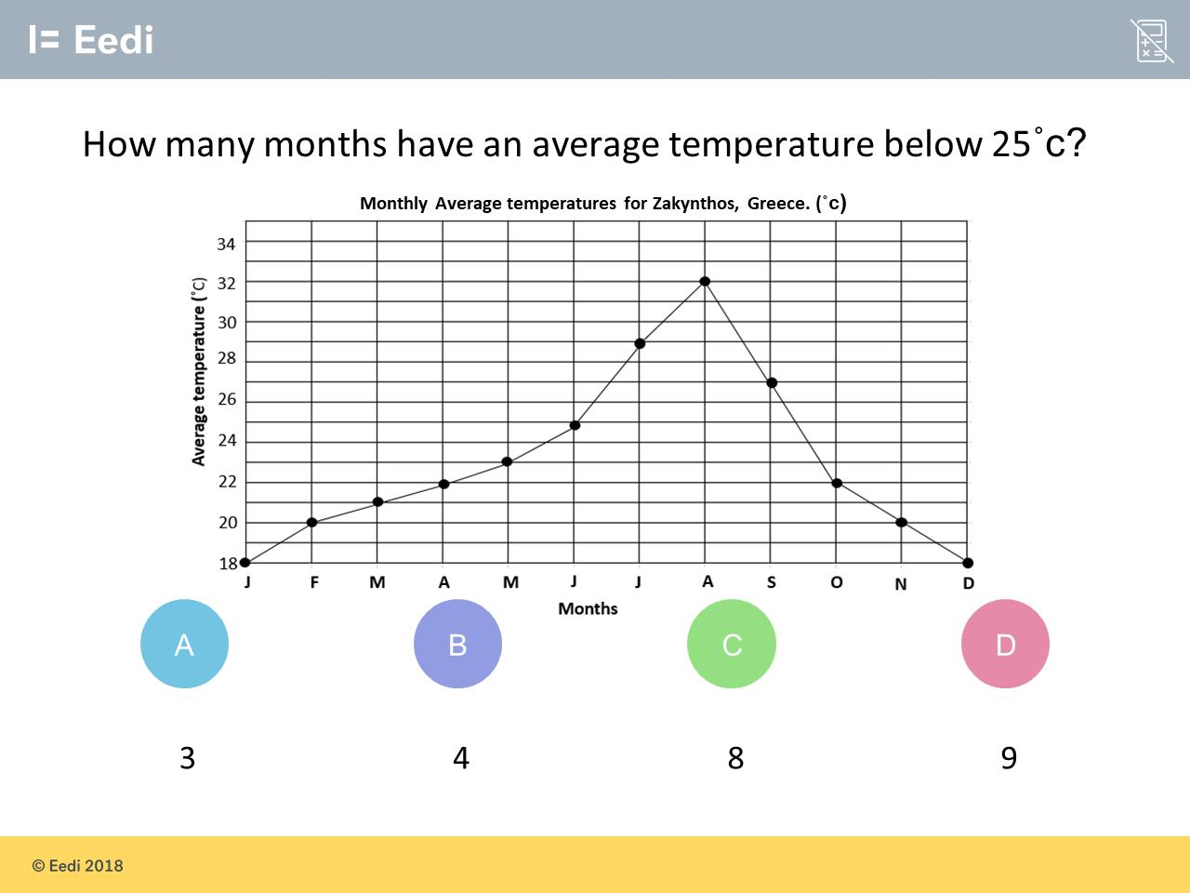
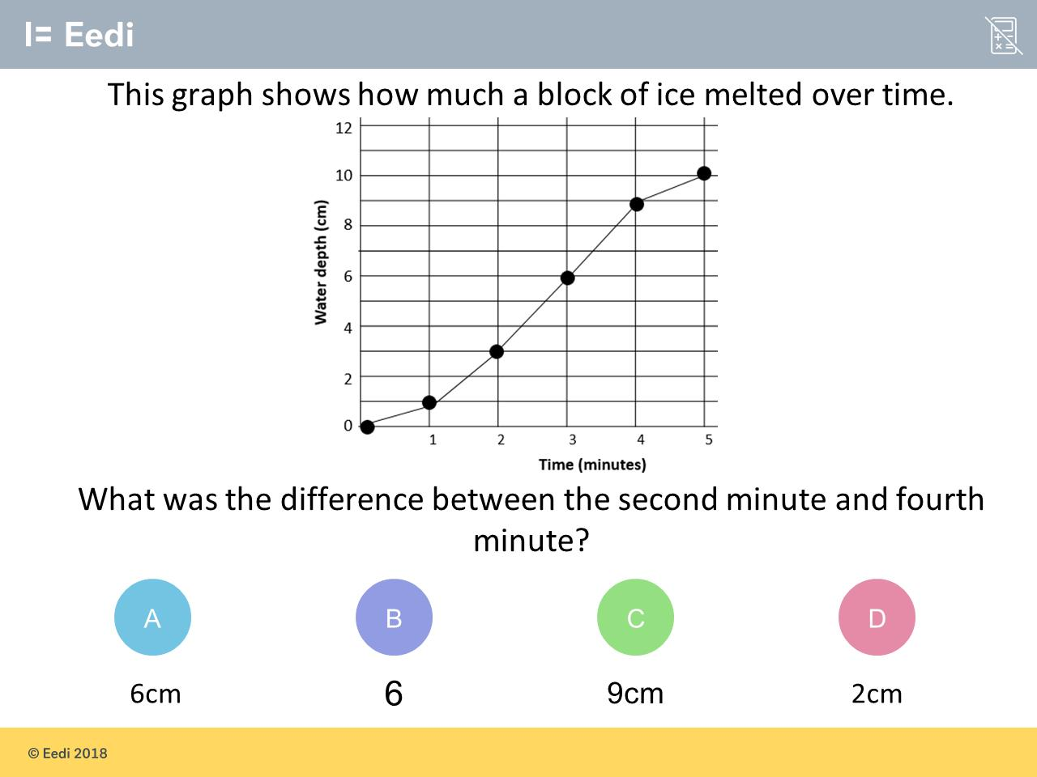
Worst answered question?
Most common wrong answer?

Slide 2
ANSWERS

Slide 3
Worst answered question?

Slide 4
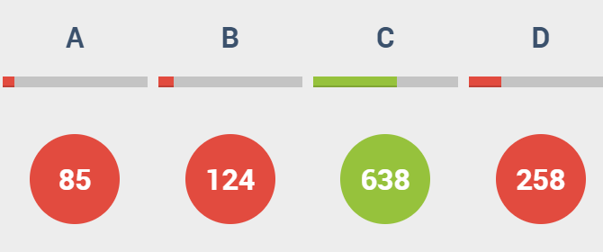
D
The student have included June.

Slide 5
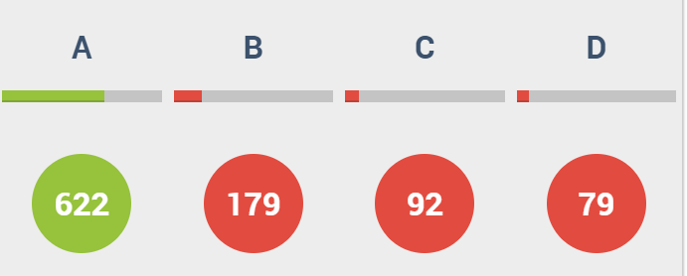
B
The student has not included units.

