Slide 1
Say what you see!

Slide 2

q t
Cutie Pie
Notes:
Cutie Pie

Slide 3

Apple Pie
Notes:
Apple Pie

Slide 4
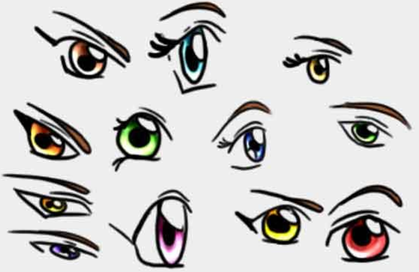

I Spy
Notes:
I Spy

Slide 5

‘n
Pineapple
Notes:
Pineapple

Slide 6
πR
πR
πR
πR
Pi R Squared

Slide 7

th
Python

Slide 8

Pioneer

Slide 9

Hi
Meat Pie

