Slide 1

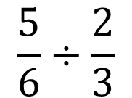
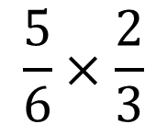

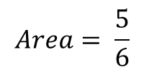
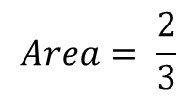
1) Calculate and simplify your answer if possible.
2) Calculate and simplify your answer if possible.
$$\frac{5}{6}×\frac{2}{3}$$
$$\frac{5}{6}÷\frac{2}{3}$$
3) Calculate the area of the rectangle. Simplify your answer if possible.
4) How much bigger is the area of the big rectangle compared to the area of the smaller rectangle?
$$\frac{2}{3}$$
$$Area= \frac{5}{6}$$
$$Area= \frac{2}{3}$$
$$\frac{5}{6}$$

Slide 2

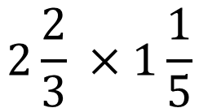

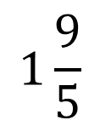
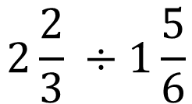

5) Calculate and simplify your answer if possible.
6) Calculate and simplify your answer if possible.
$$2\frac{2}{3} ×1\frac{1}{5}$$
$$2\frac{2}{3} ÷1\frac{5}{6}$$
7) Calculate the area of the rectangle. Simplify your answer if possible.
8) Which fraction is the biggest and why?
$$2\frac{2}{3}$$
$$1\frac{9}{5}$$
or
$$1\frac{1}{5}$$
2$\frac{5}{6}$

Slide 3
ANSWERS

Slide 4
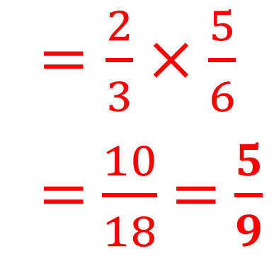
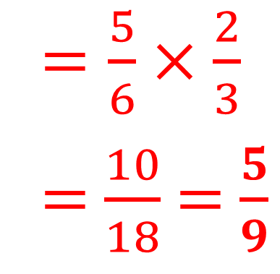
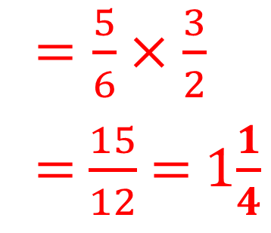
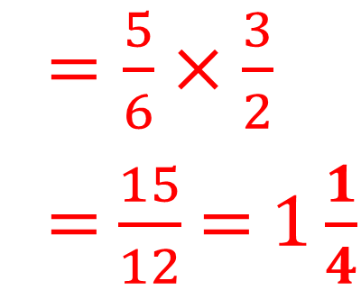
1) Calculate and simplify your answer if possible.
2) Calculate and simplify your answer if possible.
$$\frac{5}{6}×\frac{2}{3}$$
$$\frac{5}{6}÷\frac{2}{3}$$
$=\frac{5}{6}×\frac{2}{3}$
= $\frac{10}{18}$ = $\frac{5}{9}$
$=\frac{5}{6}×\frac{3}{2}$
= $\frac{15}{12}$ = $1\frac{1}{4}$
3) Calculate the area of the rectangle. Simplify your answer if possible.
4) How much bigger is the area of the big rectangle compared to the area of the smaller rectangle?
$=\frac{2}{3}×\frac{5}{6}$
= $\frac{10}{18}$ = $\frac{5}{9}$
$$\frac{2}{3}$$
$=\frac{5}{6}×\frac{3}{2}$
= $\frac{15}{12}$ = 1$\frac{1}{4}$
$$Area= \frac{5}{6}$$
$$Area= \frac{2}{3}$$
$$\frac{5}{6}$$

Slide 5
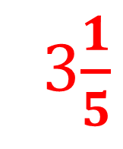
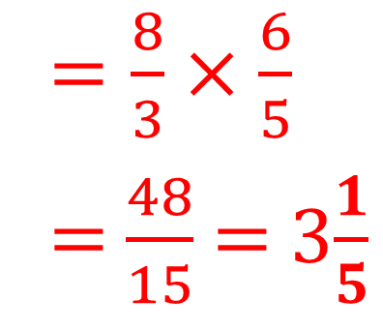
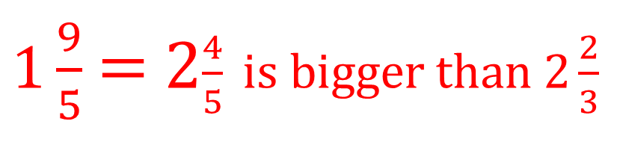
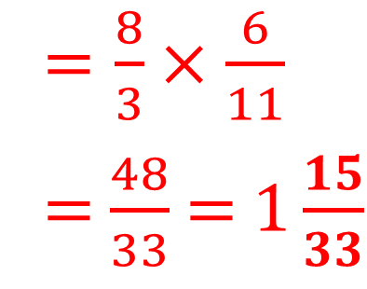
5) Calculate and simplify your answer if possible.
6) Calculate and simplify your answer if possible.
$$2\frac{2}{3} ×1\frac{1}{5}$$
$$2\frac{2}{3} ÷1\frac{5}{6}$$
$=\frac{8}{3}×\frac{6}{5}$
= $\frac{48}{15}$ = 3$\frac{1}{5}$
$=\frac{8}{3}×\frac{6}{11}$
= $\frac{48}{33}$ = $1\frac{15}{33}$
7) Calculate the area of the rectangle. Simplify your answer if possible.
8) Which fraction is the biggest and why?
$$2\frac{2}{3}$$
$$1\frac{9}{5}$$
or
$$1\frac{1}{5}$$
3$\frac{1}{5}$
2$\frac{5}{6}$
$1\frac{9}{5}$ = 2$\frac{4}{5} is bigger than 2\frac{2}{3}$

