Slide 1
LO: Sequences and Limiting Values

Slide 2
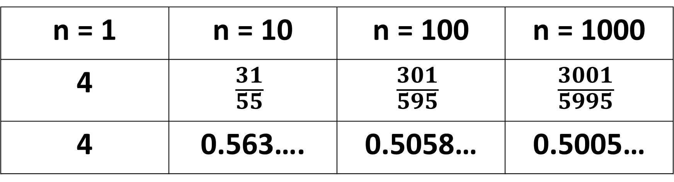
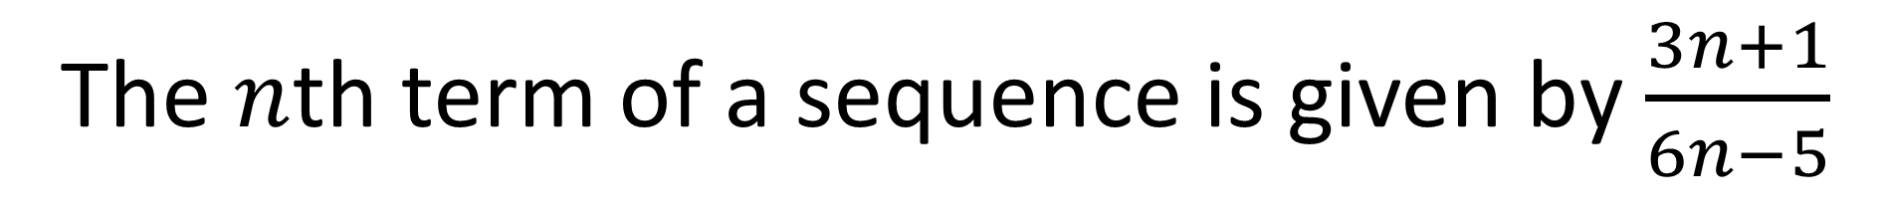
The $n$th term of a sequence is given by $\frac{3n+1}{6n−5}$
Write down the first, tenth, hundredth and one thousandth terms of the sequence.
n = 1 | n = 10 | n = 100 | n = 1000
4 | $$\frac{31}{55}$$ | $$\frac{301}{595}$$ | $$\frac{3001}{5995}$$
4 | 0.563…. | 0.5058… | 0.5005…

Slide 3
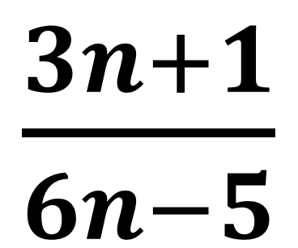
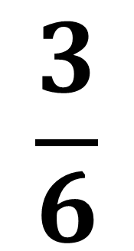
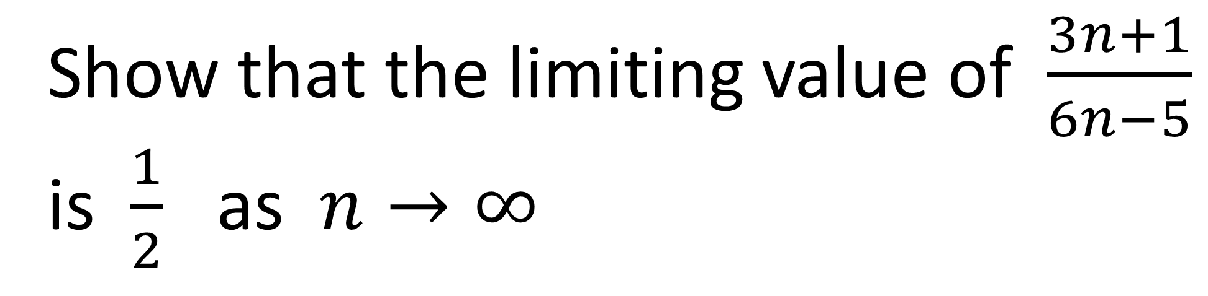
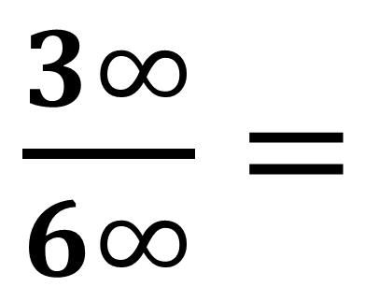


Show that the limiting value of $\frac{3n+1}{6n−5}$
is $\frac{1}{2}$ as $n→∞$
$$\frac{3}{6}$$
$\frac{3n+1}{6n−5}$
$\frac{3∞}{6∞}=$
as $n→∞$ 3n + 1 becomes 3n
as $n→∞$ 6n – 5 becomes 5n

Slide 4

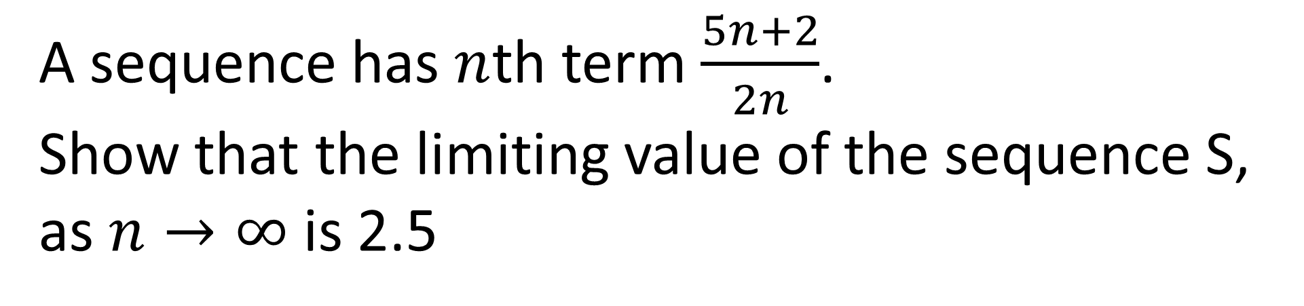
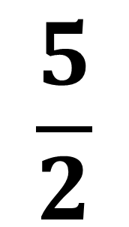
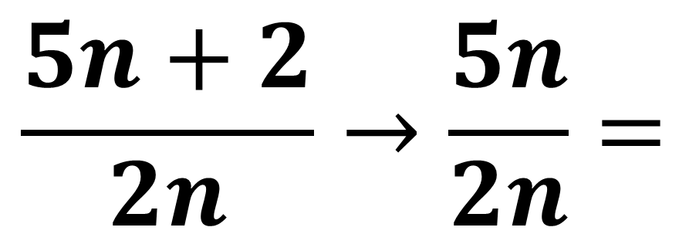
A sequence has $n$th term $\frac{5n+2}{2n}$.
Show that the limiting value of the sequence S,
as $n→∞$ is 2.5
As $n$ becomes large
$$\frac{5n+2}{2n}→\frac{5n}{2n}=$$
$$\frac{5}{2}$$

Slide 5
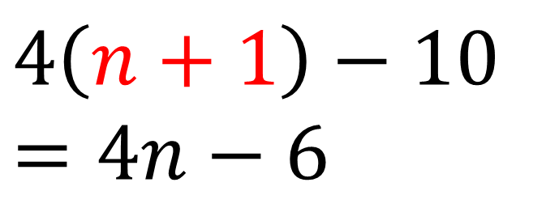
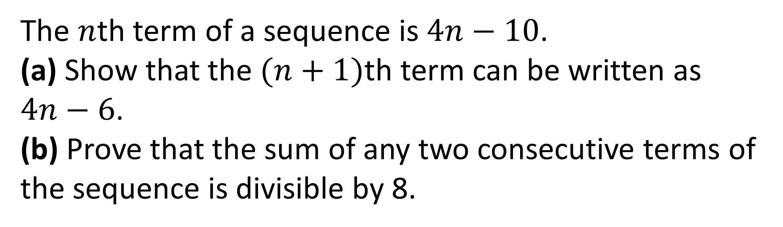
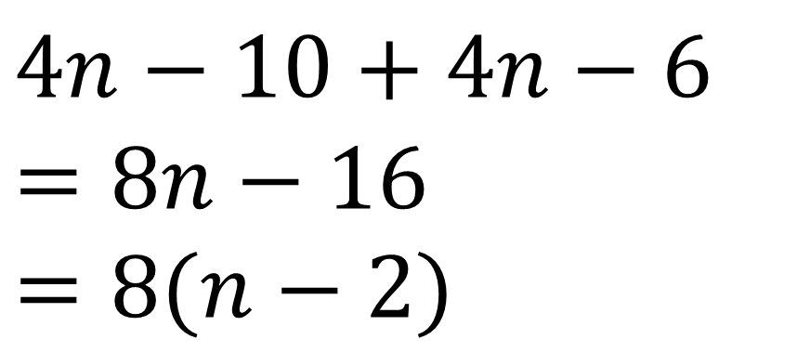
The $n$th term of a sequence is $4n−10$.
(a) Show that the $(n+1)$th term can be written as $4n−6$.
(b) Prove that the sum of any two consecutive terms of the sequence is divisible by 8.
$$4\left(n+1\right)−10$$
$$=4n−6$$
$$4n−10+4n−6$$
$$=8n−16$$
$$=8(n−2)$$

Slide 6
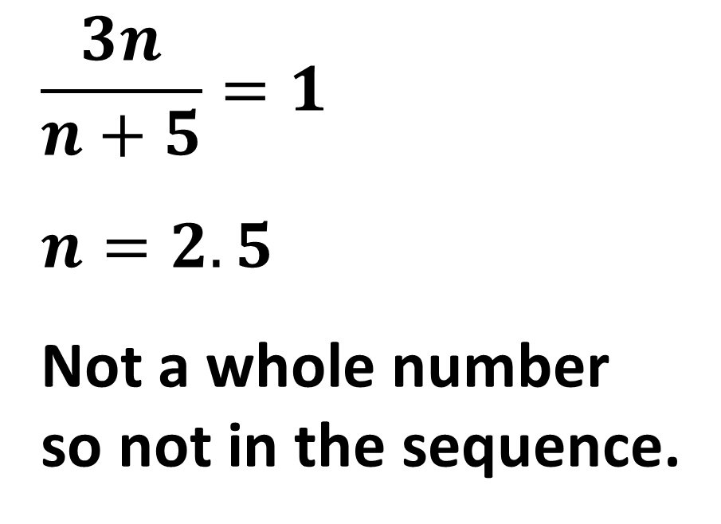

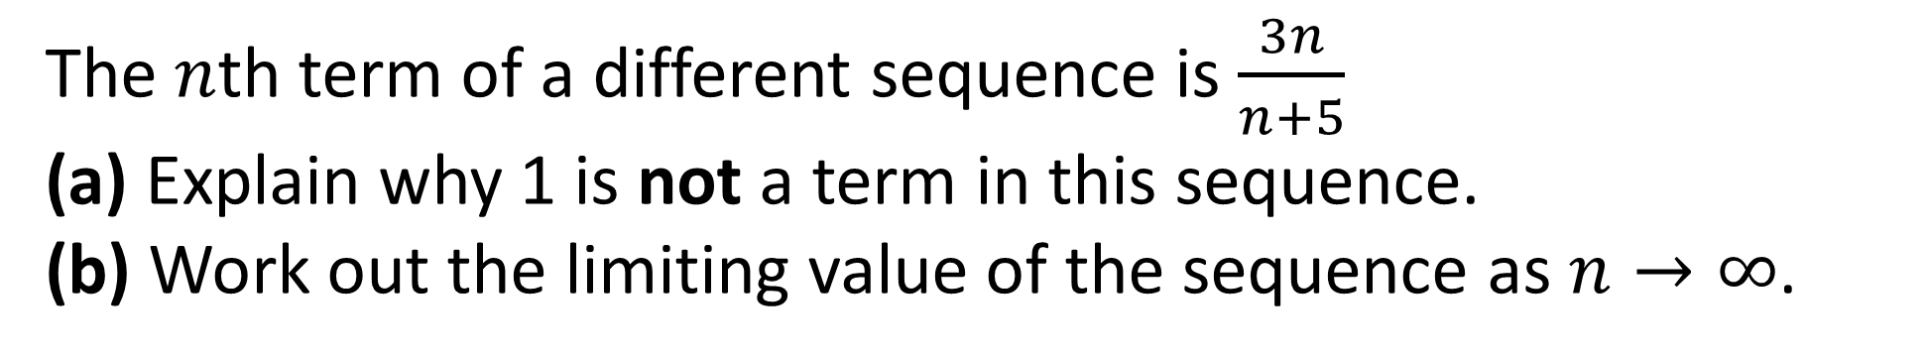
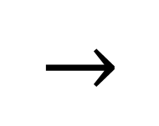
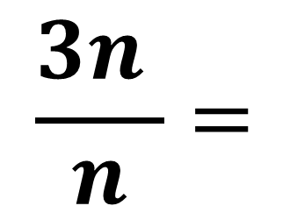
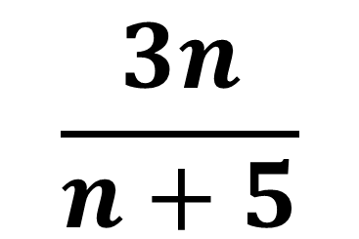
The $n$th term of a different sequence is $\frac{3n}{n+5}$
(a) Explain why 1 is not a term in this sequence.
(b) Work out the limiting value of the sequence as $n→∞$.
$$\frac{3n}{n+5}=1$$
$n=2.5$
Not a whole number
so not in the sequence.
As $n$ becomes large
$$\frac{3n}{n+5}$$
$$\frac{3n }{n}=$$
$$→$$
3

Slide 7
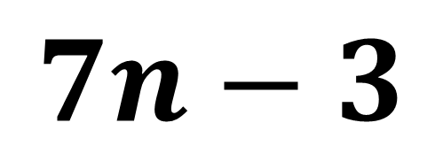
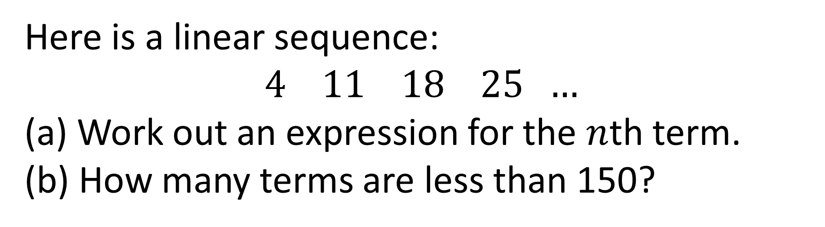
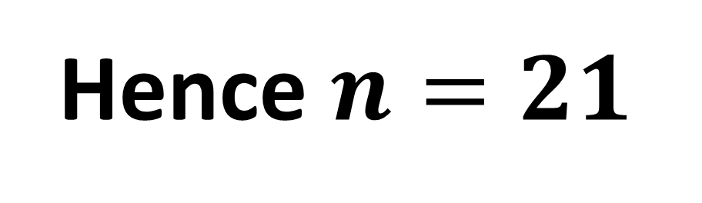
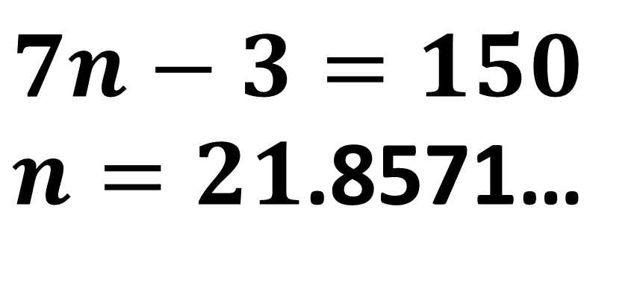
Here is a linear sequence:
$$4 11 18 25 …$$
(a) Work out an expression for the $n$th term.
(b) How many terms are less than 150?
$$7n−3$$
$$7n−3=150$$
$n=21$.8571…
Hence $n=21$

Slide 8
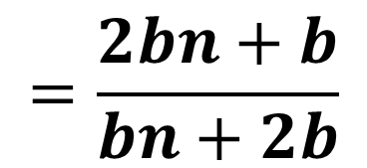
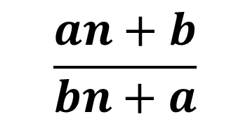
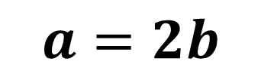
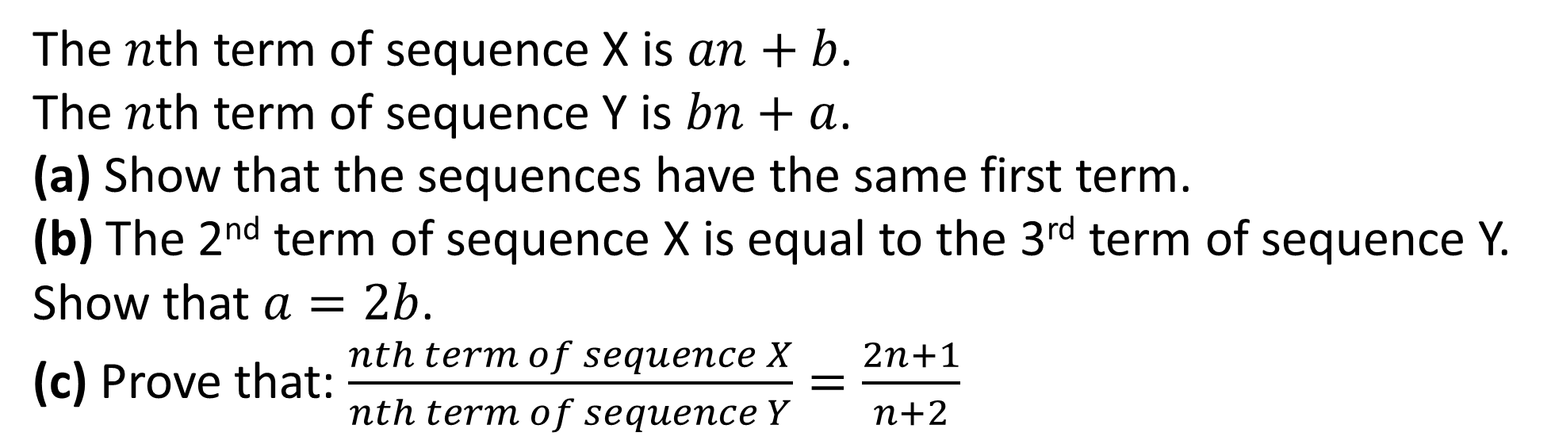
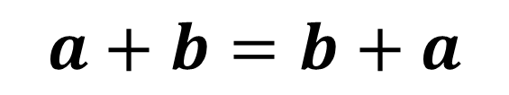
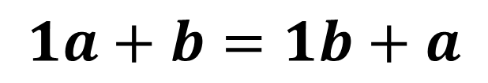
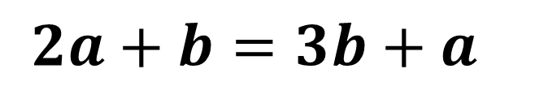
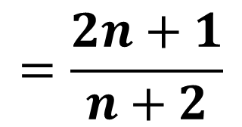
The $n$th term of sequence X is $an+b$.
The $n$th term of sequence Y is $bn+a$.
(a) Show that the sequences have the same first term.
(b) The 2nd term of sequence X is equal to the 3rd term of sequence Y. Show that $a=2b$.
(c) Prove that: $\frac{nth term of sequence X}{nth term of sequence Y}=\frac{2n+1}{n+2}$
$$\frac{an+b}{bn+a}$$
$$1a+b=1b+a$$
$$2a+b=3b+a$$
$$=\frac{2bn+b}{bn+2b}$$
$$a+b=b+a$$
$$a=2b$$
$$=\frac{2n+1}{n+2}$$

Slide 9
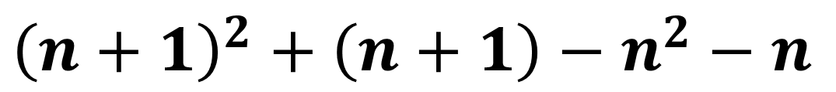
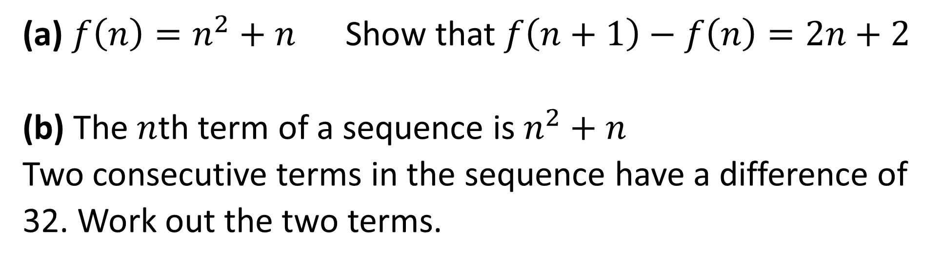
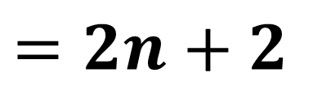
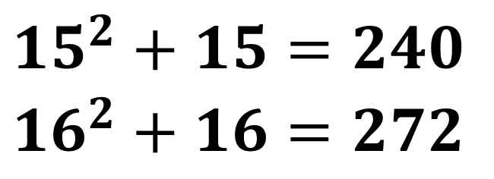
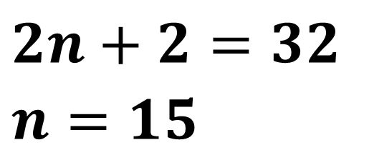
On provided sheet.
(a) $f\left(n\right)=n^{2}+n$ Show that $f\left(n+1\right)−f\left(n\right)=2n+2$
(b) The $n$th term of a sequence is $n^{2}+n$
Two consecutive terms in the sequence have a difference of 32. Work out the two terms.
$$2n+2=32$$
$$n=15$$
$${\left(n+1\right)}^{2}+\left(n+1\right)−n^{2}−n$$
$$=2n+2$$
$${15}^{2}+15=240$$
$${16}^{2}+16=272$$

Slide 10

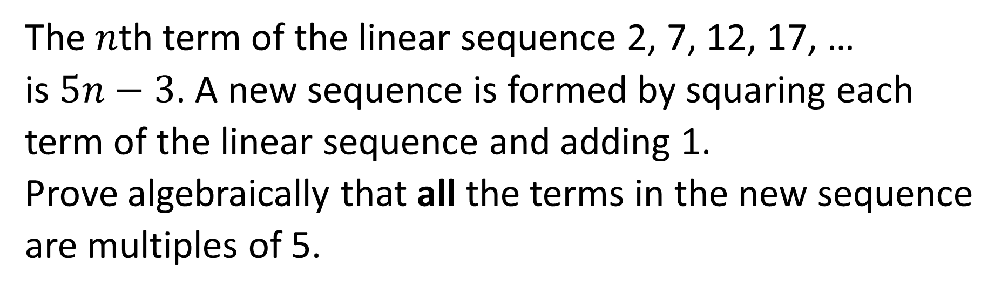
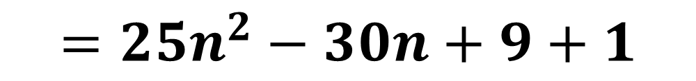


On provided sheet.
The $n$th term of the linear sequence 2, 7, 12, 17, …
is $5n−3$. A new sequence is formed by squaring each term of the linear sequence and adding 1.
Prove algebraically that all the terms in the new sequence are multiples of 5.
$${\left(5n−3\right)}^{2}+1$$
$$=25n^{2}−30n+9+1$$
$$=25n^{2}−30n+10$$
$$=5(5n^{2}−6n+2)$$

