Slide 1
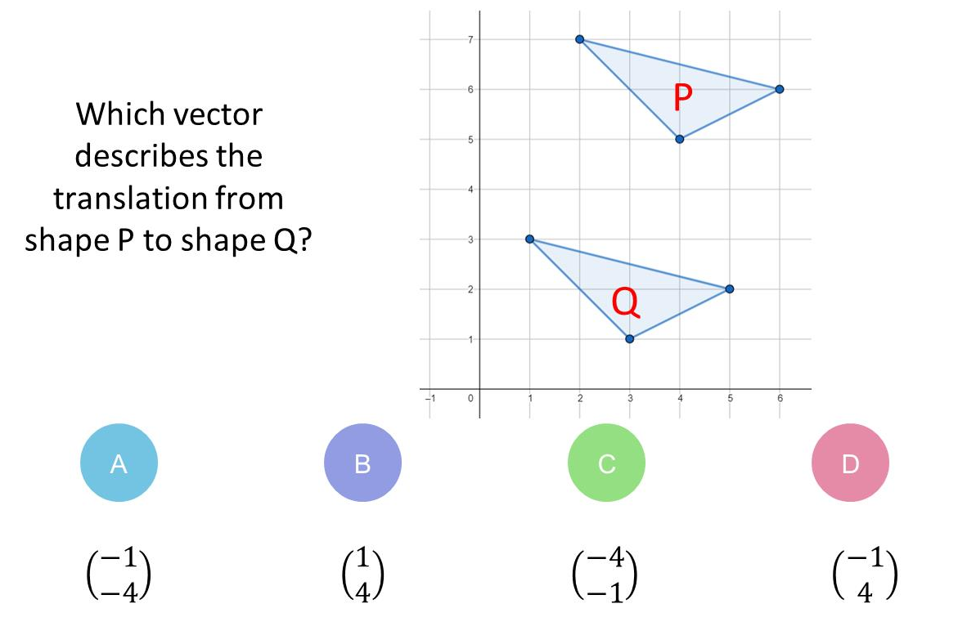
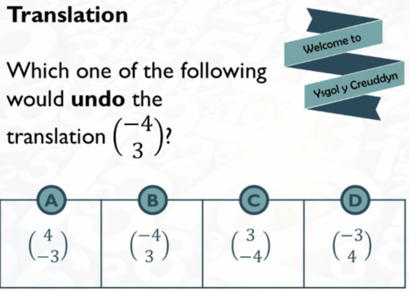
Which question had the lowest percentage of
correct answers?
For each question, what was the most common
wrong answer?

Slide 2
ANSWERS

Slide 3
Which question had the lowest percentage of
correct answers?

Slide 4
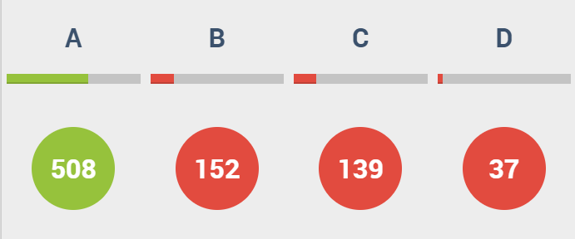
B
Student did
Q to P

Slide 5
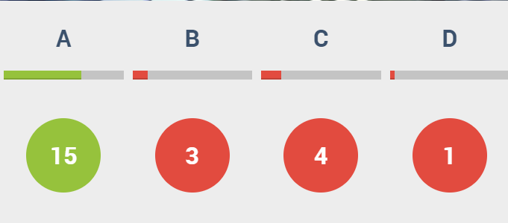
C
Students just swapped numbers.

