Slide 1
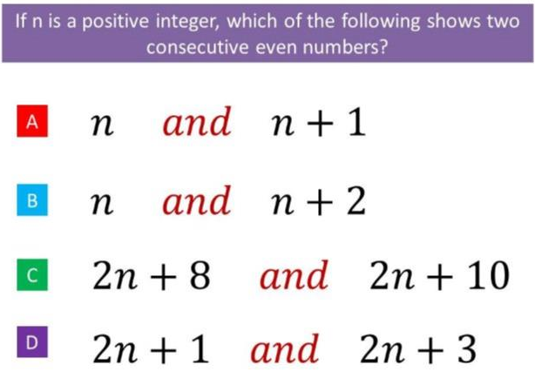
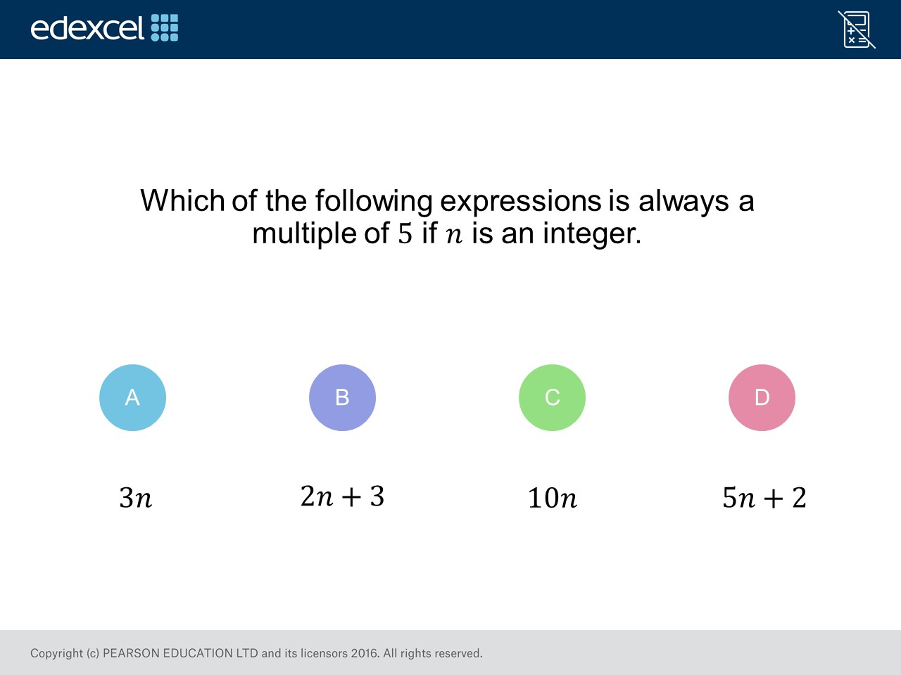
Worst answered question?
Most common wrong answer?

Slide 2
ANSWERS

Slide 3
Worst answered question?

Slide 4
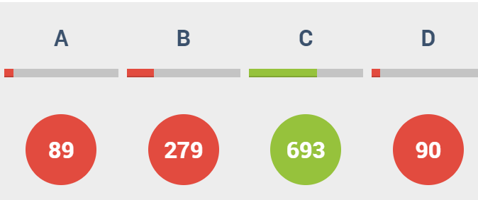
B
n could be an odd number.

Slide 5

B
They thought
2 + 3 = 5 therefore it is a multiple of 5.

