Slide 1
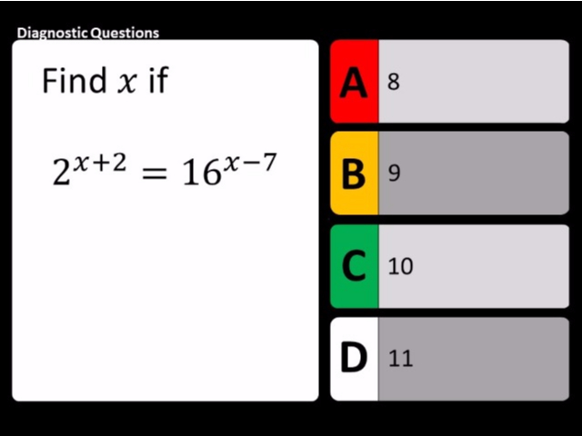
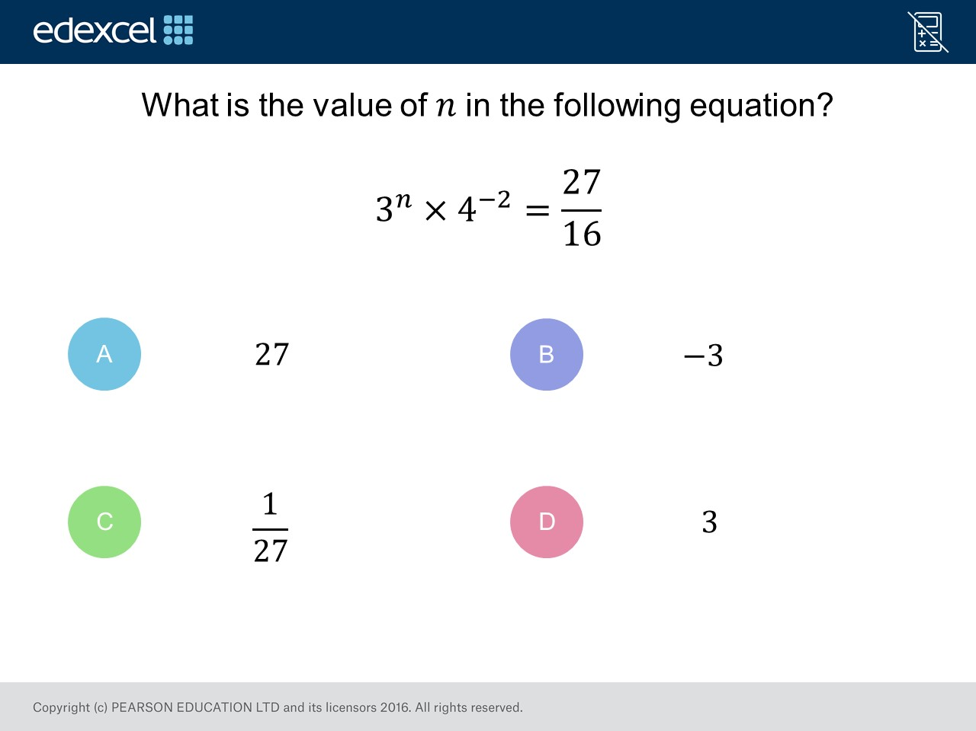
Worst answered question?
Most common wrong answer?

Slide 2
ANSWERS

Slide 3
Worst answered question?

Slide 4
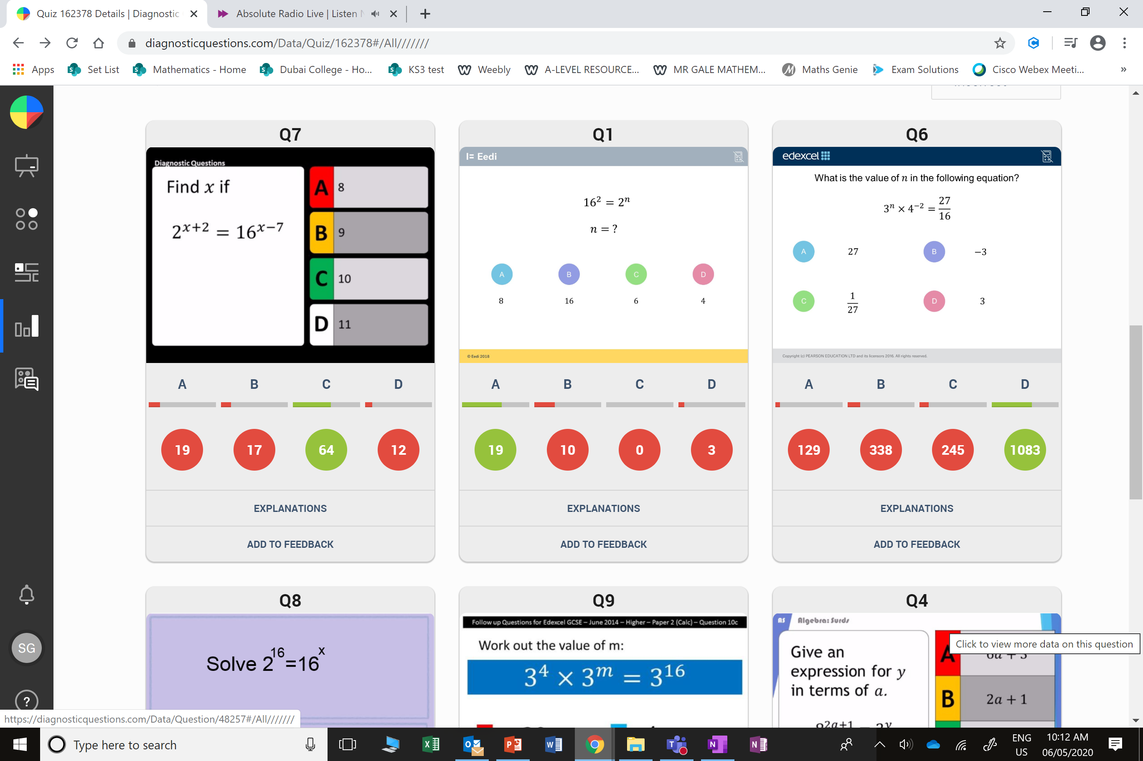
B
They used a negative, as they did not recognized the 27 is on top of the fraction.

Slide 5
A
They guessed!

