Slide 1
Straight Line Graphs
Parallel and Perpendicular
Chapter 5
(Part 3 of 4)

Slide 2
What can you say about
the gradients when
two lines are parallel?
The gradients are equal

Slide 3
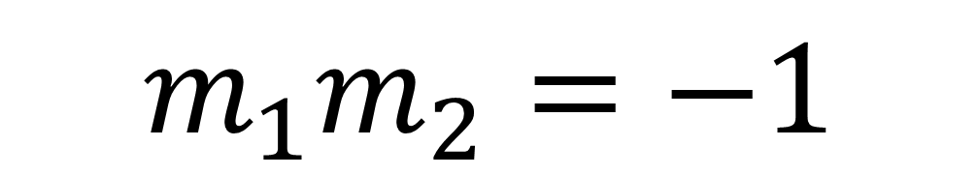

What can you say about
the gradients when
two lines are perpendicular?
The product is $−1$
$$m_{1}m_{2}=−1$$

Slide 4

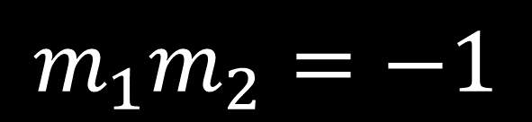





$$m_{1}m_{2}=−1$$
One is the negative reciprocal of the other.
Gradient | Gradient of Perpendicular Line
$$−3$$ | $$\frac{1}{3}$$
$$\frac{1}{4}$$
$$5$$ | $$−\frac{1}{5}$$
$$−\frac{2}{7}$$ | $$\frac{7}{2}$$
$$\frac{7}{5}$$ | $$−\frac{5}{7}$$
$$\frac{1}{3}$$
$$−4$$
$$−\frac{1}{5}$$
$$\frac{7}{2}$$
$$−\frac{5}{7}$$

Slide 5
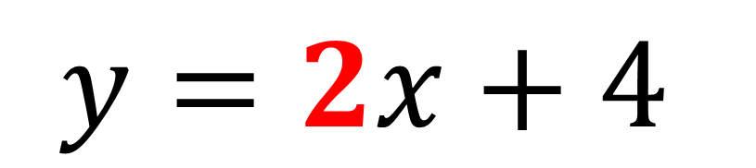

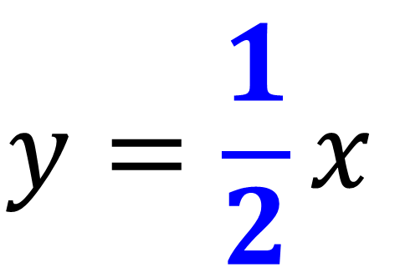
Are the following lines parallel, perpendicular, or neither?
$$y=\frac{1}{2}x$$
$$2x−y+4=0$$
$$y=\frac{1}{2}x$$
$$y=2x+4$$
Neither

Slide 6
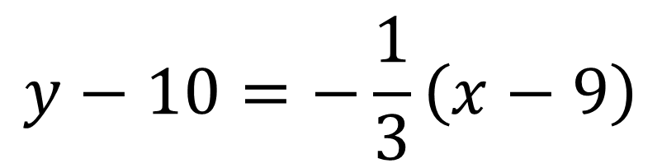
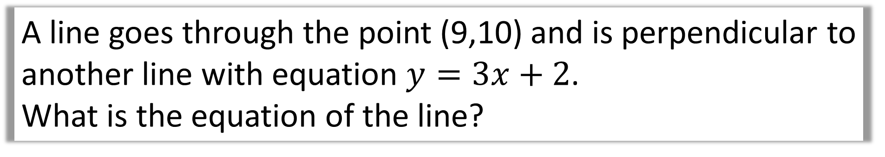
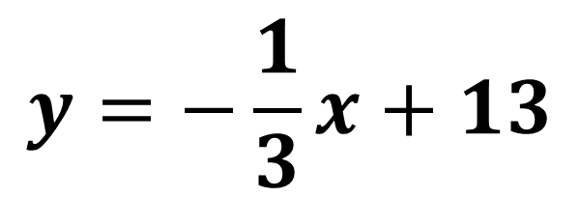
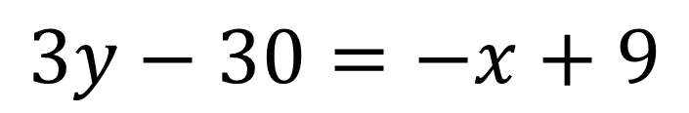
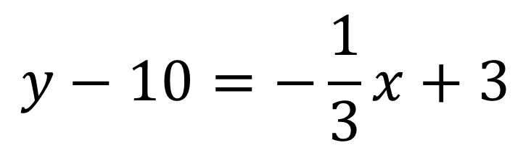
A line goes through the point (9,10) and is perpendicular to another line with equation $y=3x+2$.
What is the equation of the line?
$$y−10=−\frac{1}{3}\left(x−9\right)$$
$$y=−\frac{1}{3}x+13$$
$$y−10=−\frac{1}{3}x+3$$
$$3y−30=−x+9$$

Slide 7
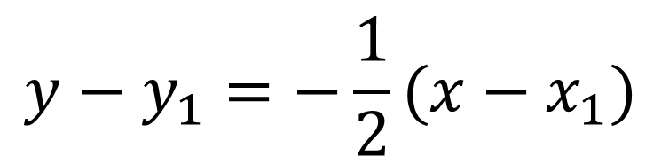
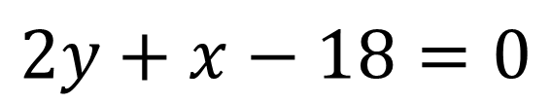
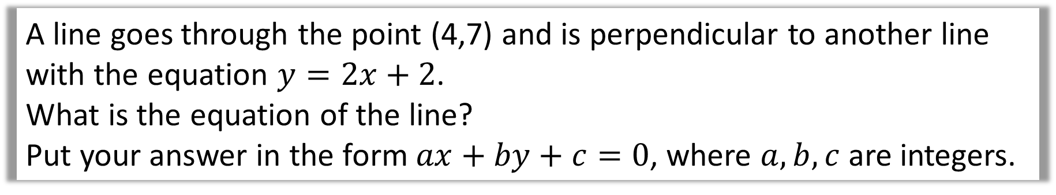
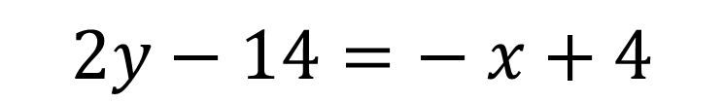
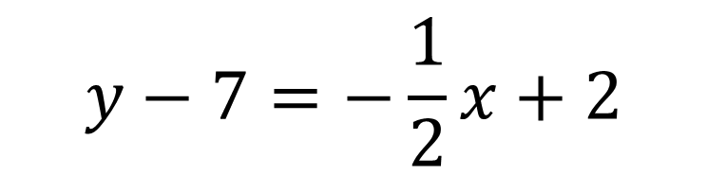
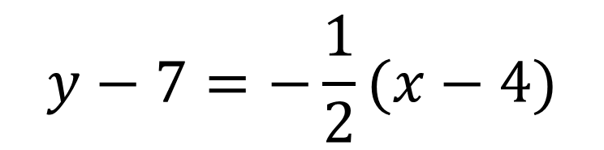
A line goes through the point (4,7) and is perpendicular to another line
with the equation $y=2x+2$.
What is the equation of the line?
Put your answer in the form $ax+by+c=0$, where $a,b,c$ are integers.
$$y−y_{1}=−\frac{1}{2}(x−x_{1})$$
$$2y−14=− x+4$$
$$y−7=−\frac{1}{2}(x−4)$$
$$2y+x−18=0$$
$$y−7=−\frac{1}{2}x+2$$

Slide 8


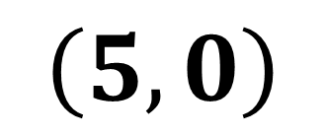
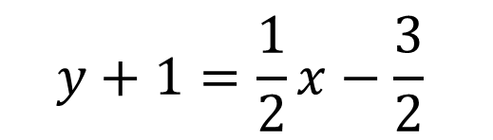

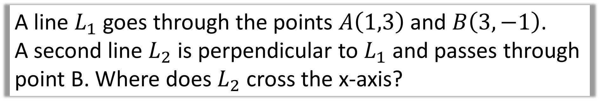
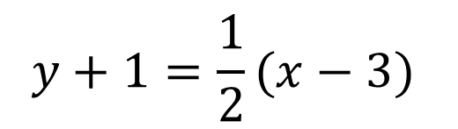
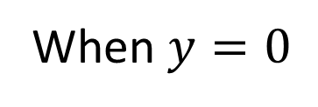
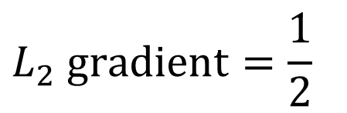
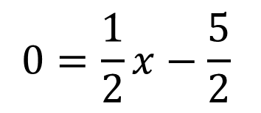
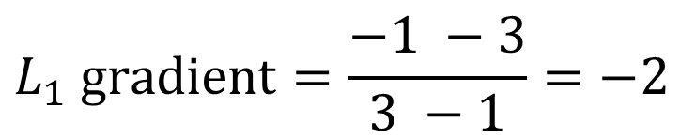
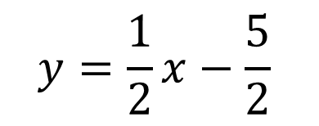
A line $L_{1}$ goes through the points $A\left(1,3\right)$ and $B\left(3,−1\right)$.
A second line $L_{2}$ is perpendicular to $L_{1}$ and passes through point B. Where does $L_{2}$ cross the x-axis?
$$y+1=\frac{1}{2}(x−3)$$
$$L_{1} gradient=\frac{−1 −3}{3 −1}=−2$$
When $y=0$
$$0=\frac{1}{2}x−\frac{5}{2}$$
$$y+1=\frac{1}{2}x−\frac{3}{2}$$
$$L_{2} gradient=\frac{1}{2}$$
$$0=x−5$$
$$2y+2=x−3$$
$$x=5$$
$$y=\frac{1}{2}x−\frac{5}{2}$$
$$\left(5,0\right)$$

Slide 9
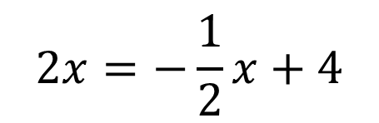

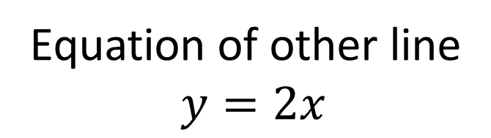
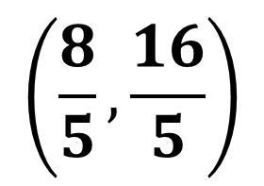
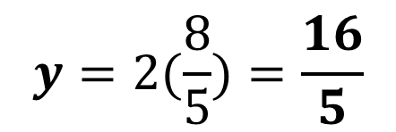

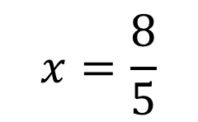
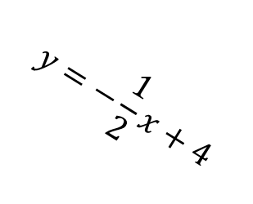



From the graph below determine the co-ordinate of point A.
$$y$$
$$A$$
$$y=−\frac{1}{2}x+4$$
$$x$$
$$2x=−\frac{1}{2}x+4$$
Equation of other line
$$y=2x$$
$$y=2(\frac{8}{5})=\frac{16}{5}$$
$$4x=−x+8$$
$$5x=8$$
$$\left(\frac{8}{5},\frac{16}{5}\right)$$
$$x=\frac{8}{5}$$

